Slide 1
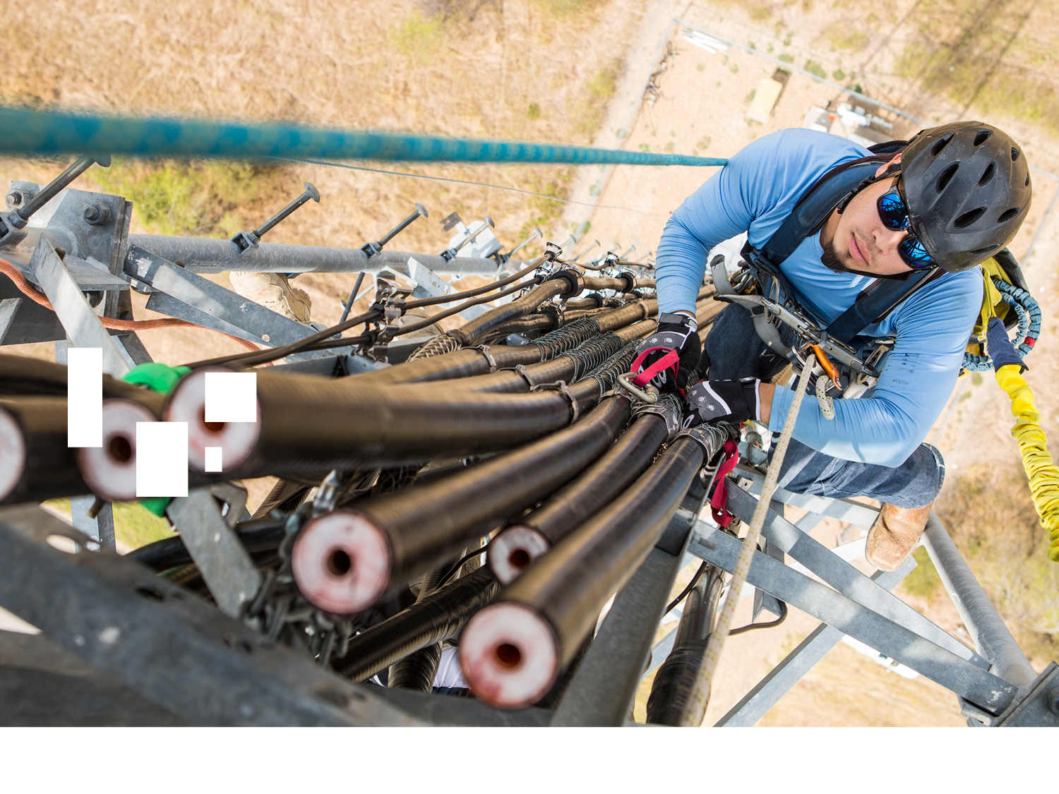


2019 Construction Safety Week
A Construction Insurance Industry Perspective for the Craft Professional
Willis Towers Watson – Construction Practice
4-30-19

Slide 2


Working in Construction can be Dangerous
2017 Bureau of Labor Statistics for the Construction Industry
971
366
37%
Construction Industry Fatalities during 2017
Were work-related fatal falls to a lower level
Fatal Falls from a height of 15 feet or less
19
Cost per week
for serious,
non-fatal injuries
in the construction industry
Trench related fatalities 2017
OSHA’s 2019 National Emphasis Program REDUCE
$1B
97%
100%
of workers have at least one significant workplace fatigue risk factor, 80% have 2 or more.
Number of Construction Workers who should go home everyday

Slide 3




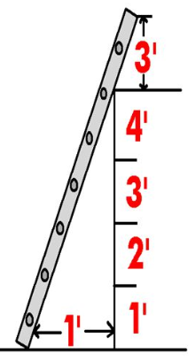
Falls to a Lower Level
What You can Do
Report floor openings and unsecured “HOLE” covers to your supervisor
Report Guardrails that don’t look safe to your supervisor
Know who your Fall protection competent person is
Inspect your personal fall protection equipment frequently
Keep both hands free when climbing ladders
Know how to identify a safe anchorage point
Retractable lanyards may not prevent swing falls
When working above 6 feet use fall protection

Slide 4



Slips, Trips and Falls on Walking Surfaces
What You can Do
Make sure the access path to the project are marked and clear of fall hazards
Wear ankle high work boots with non-slip tread
Keep walk paths clean and free of debris, materials, and water
If you wear bi-focals you are 40% more likely to trip and fall
Treat and clean-up all spills very quickly
Empty trash containers when ¾ from the top
Make sure your work area has brooms and shovels for clean-up
Make sure any tripping hazards are eliminated or clearly marked

Slide 5




Overexertion from Pushing, Pulling, Lifting, and Carrying
What You can Do
Avoid lifting and carrying by using mechanical aids
Lift comfortably with or without a straight back
Carry materials close to your body
Keep work at waist level in the power zone between knuckle and shoulder height
Do warm-up exercises in the morning and after breaks
Keep walkways clear so a trip while carrying will not end up being a strain.
Don’t put tools and materials on the floor level that will have to be moved later. Keep objects between knuckle and shoulder height
When lifting while turning, move your feet and don’t just twist your waist

Slide 6

Vehicle Accidents
What You can Do
Inspect your vehicle daily for lights, tire condition, leaks, warning lights, mirrors, and window cleanliness
Wear you seat belt whenever your vehicle moves
Maintain safe following distance between you and the vehicle ahead, double the distance in bad weather
Use your horn, lights, and signals to let others know your intentions early
Avoid distractions like cell phone, eating, reading maps, laptop use, and road rage
Look Left, Right, then Left before going through any intersection
When parking always back so you are ready to safely leave quickly if needed
Tap your horn to get eye contact with pedestrians

Slide 7

Trenching and Excavation
What can You Do?
Make sure you can safely get into and out of the trench
Make sure underground utilities are located and marked
Know who your competent person is
Report unstable or any changes in soil condition to your supervisor.
If the excavation is more than 4 feet don’t go in it without protection
Make sure all workers are accounted for before machine work begins
Make sure the daily trench inspection checklist has been completed and you have looked at it
Make sure you have the right Trench protection

Slide 8
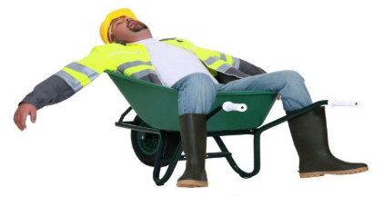
Fatigue
What You can Do
Ride sharing will reduce your driving fatigue, and commuter stress. It will increase your fuel economy
Understand your sleep, rest, and recovery needs
Go to the doctor if you have a health condition that affects your sleep
Drink plenty of fluids. Dehydration increases fatigue
Look out for signs of fatigue in other people you work with
Fatigue and drowsiness increase after a big lunch or breakfast
Use the right tool for the job. The wrong tool will increase your fatigue
Reduce fatigue by taking all your breaks and when necessary

Slide 9
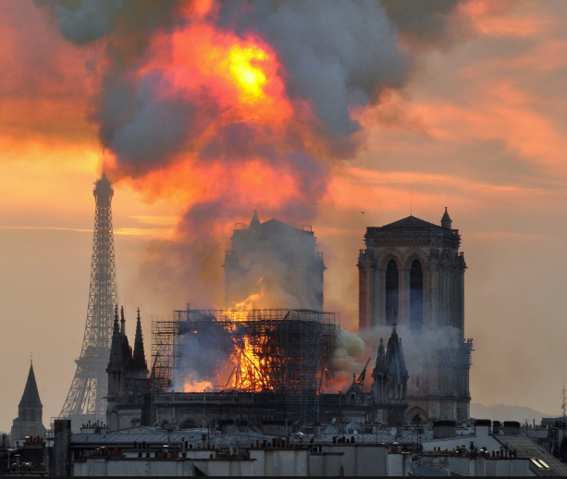
Fire During Construction
What You can Do
Make your supervisor is aware of any suspicious activity by vandals overnight
Remove trash and materials from your work area frequently
Have a Fire extinguisher and know how to use it.
Know and understand the project emergency plan
Know the safety rules for flammable liquid storage and transportation
Know how to get off of the project and where to assemble
When welding or cutting make sure there is a hot work permit completed
Smoking only in designated areas

Slide 10

Water Damage During Construction
What You can Do
Cover up and protect sensitive materials (drywall and electrical components) from water damage
Have a spill response cart available in your work area
Keep materials and equipment on carts, pallets, or wood stringers to protect from standing water.
Have sprinkler head quick stop on the spill response cart
Know who to contact if water starts leaking suddenly. Know who your spill response team is
Know where the water supply shutoff is for each floor
All drains (floor and sink) in the work area are functional and clean
Assume plumbing fixtures and pipe are live and pressurized with water

Slide 11
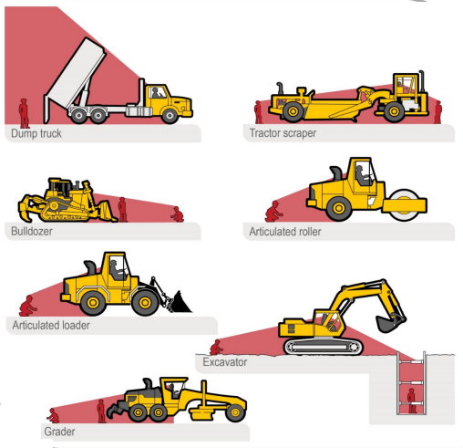

Runover and Backover
Make sure back-up alarms are working
What you Can Do
Only designated people should be around moving equipment and trucks
Understand heavy equipment blind spots
Always use a spotter when backing heavy equipment and trucks
Worker foot traffic should be outside of equipment routes
Watch out for others in harms way
Wear High Visibility reflective work wear

Slide 12
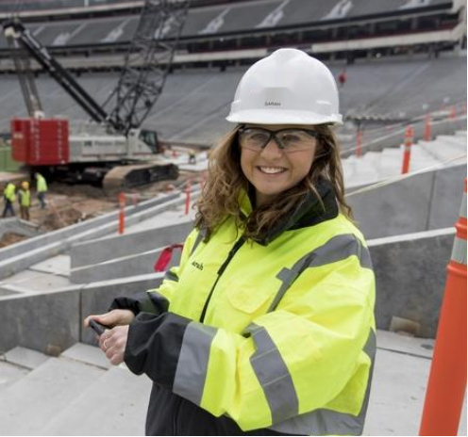
Improve Yourself
What can You Do
Learn how to see upcoming risks when reading a schedule
Become a Competent Person
Do a safety presentation for your work group
Learn another language and do research on other cultures than your own. Diversity = a safer project
Learn how to have tough conversations with your leadership on safety issues/improvements that need to change
Get a construction safety certification
Dress like a safety minded craft professional
Communication is the key to Safe Work.
Study, practice, and learn how to communicate more effectively

Slide 13
Thank You!

