Slide 1
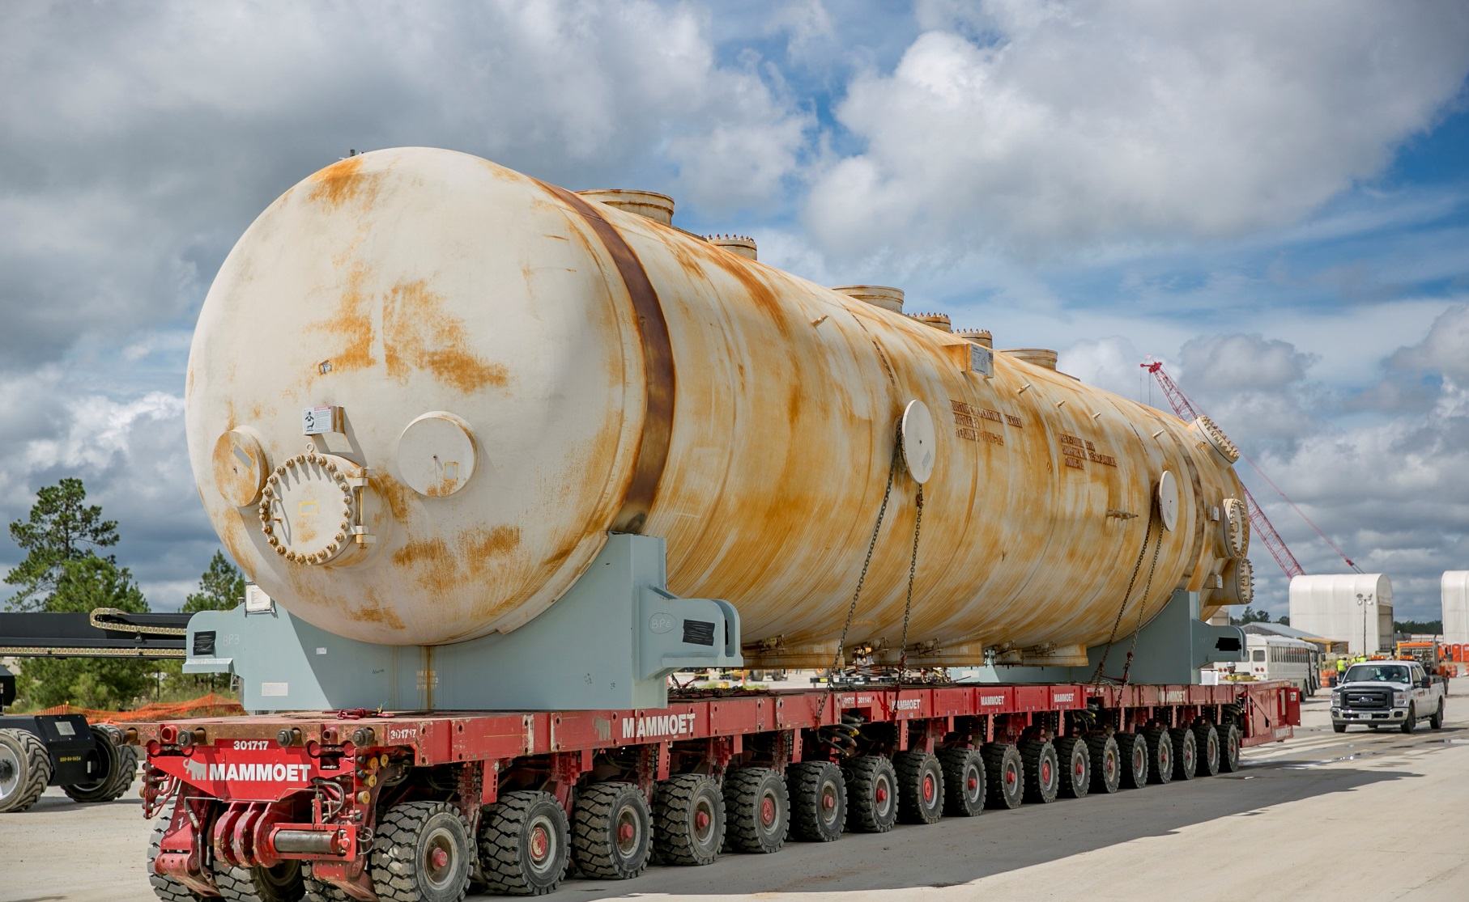
Health and Safety Hazards in Construction: Recognition, Control and Free Resources from CPWR
OH&S Webinar, June 20, 2018
Bruce Lippy, Ph.D., CIH, CSP, FAIHA
Director of Safety Research

Slide 2

CPWR is a nonprofit established by North America’s Building Trades Unions
Research, training and service to improve safety and health in construction industry
National consortium with over 50 organizations
http://www.cpwr.com

Slide 3
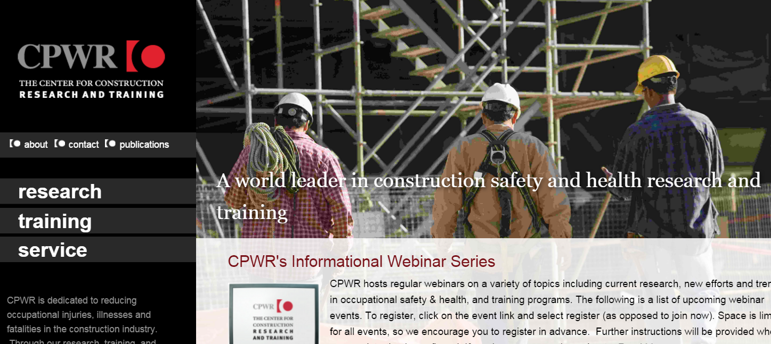
CPWR is funded by NIOSH, NIEHS and DOE
My comments are my own and don’t reflect policies or positions of NIOSH, NIEHS or DOE

Slide 4
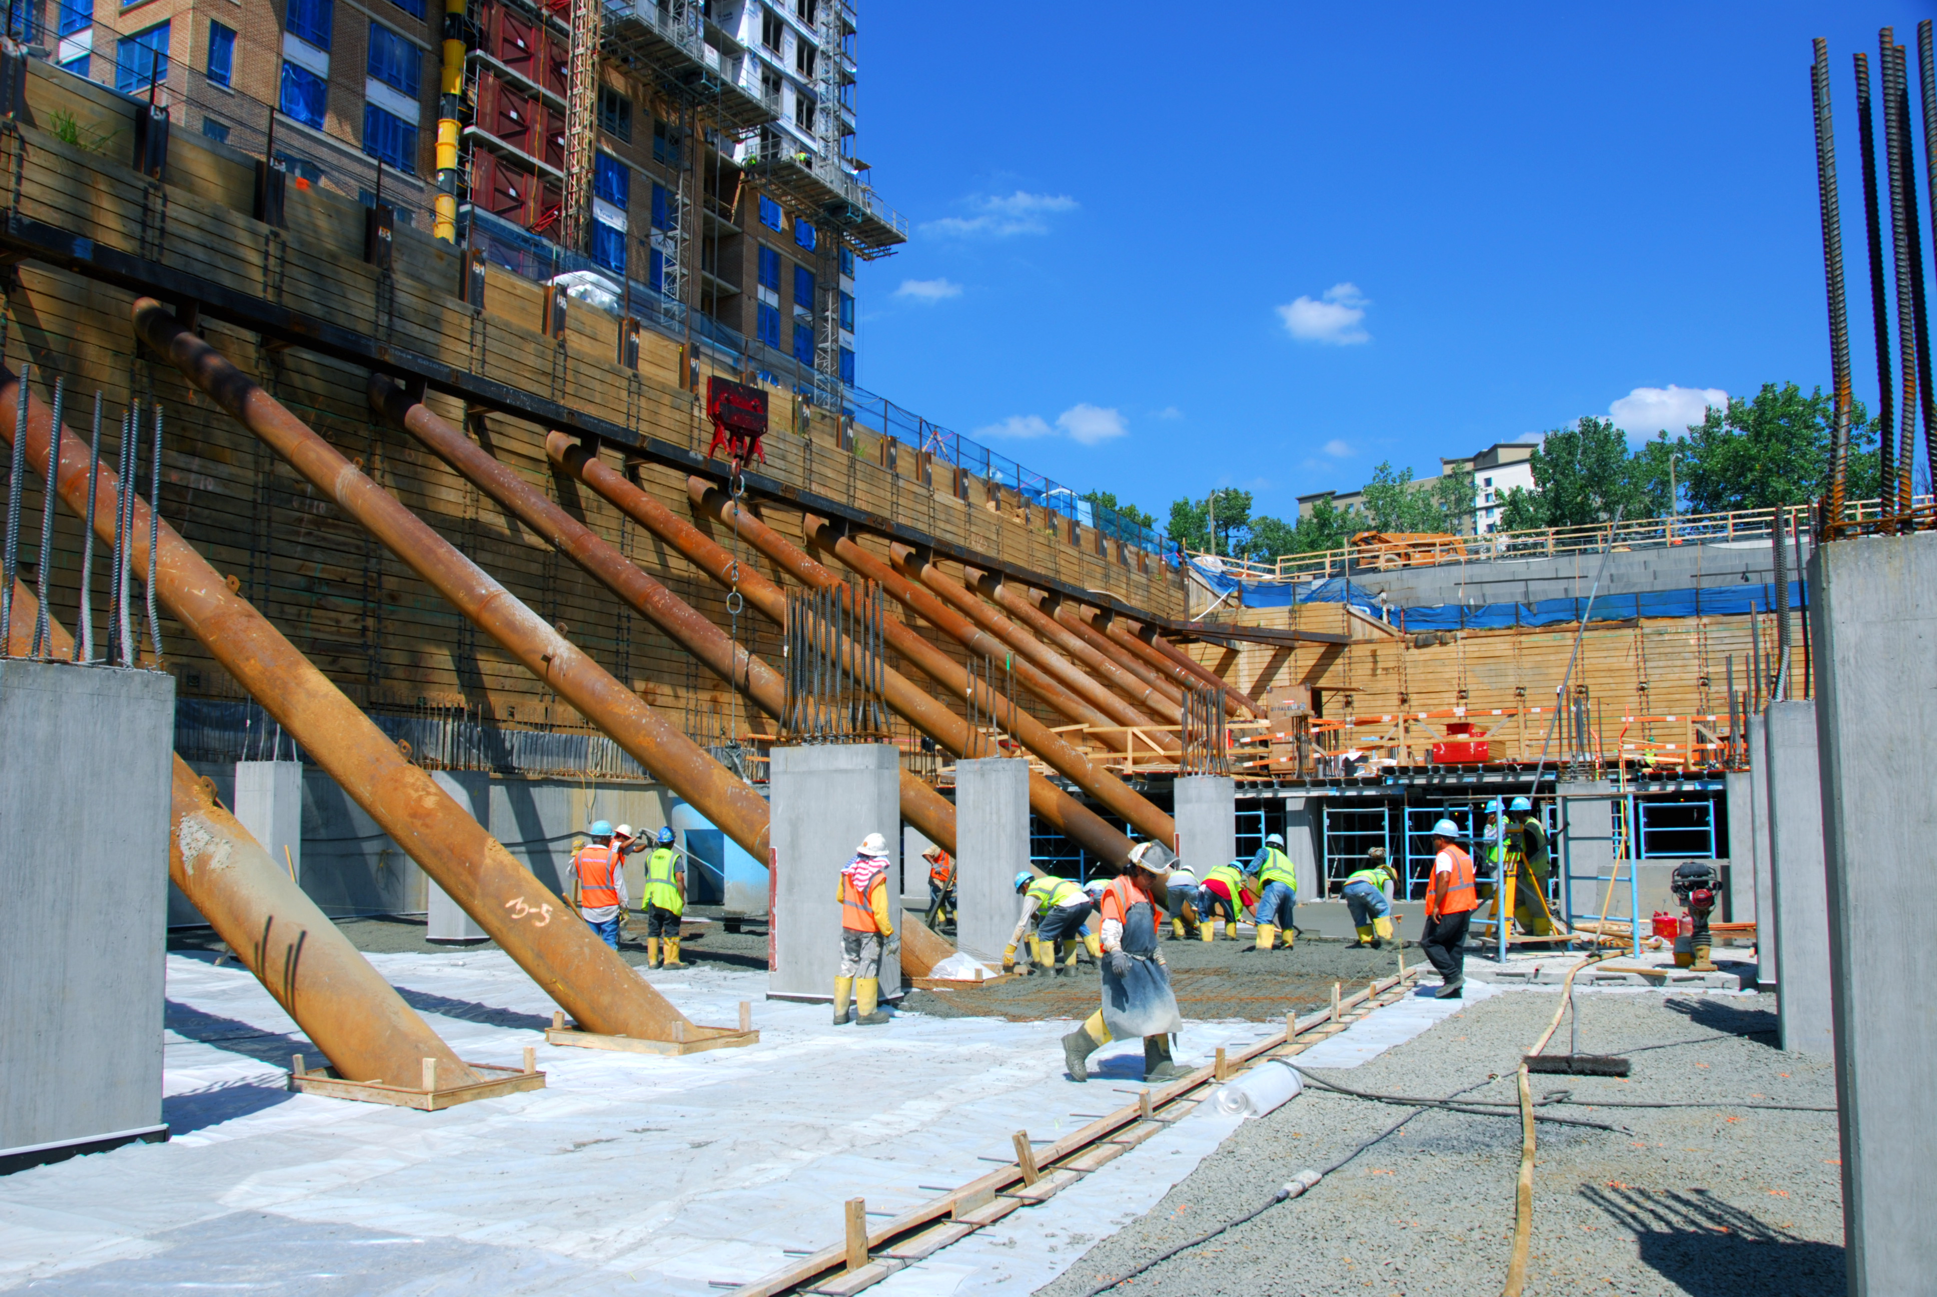
Construction is different
Decentralized and fragmented with mixed crafts
Highly cyclical
No fixed worksites
Changing environmental conditions
Extended hours in good weather
Travelers
Photo courtesy Miller and Long Co., Inc.

Slide 5
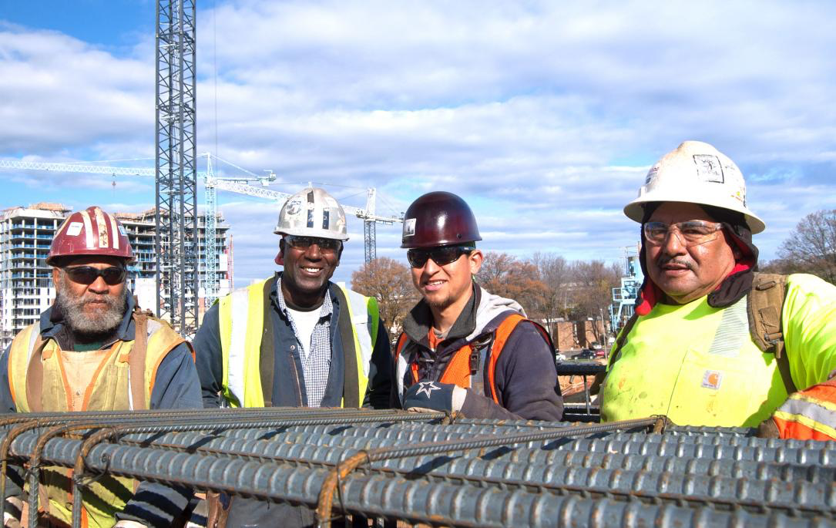
Construction is dominated by small employers and a diverse workforce
90% have <20 employees
About 80% have <10 employees
30% of workers are Hispanic
14% are employed by temp agencies
Sources: U.S Census Bureau; CPWR Construction Chart Book 5th Edition; CPWR 2nd Quarter 2015 Quarterly Data Report

Slide 6
Topics we will cover:
Fatality and injury data for the construction industry
Major hazards on construction sites
Managing and controlling construction hazards
Taking advantage of free CPWR resources

Slide 7
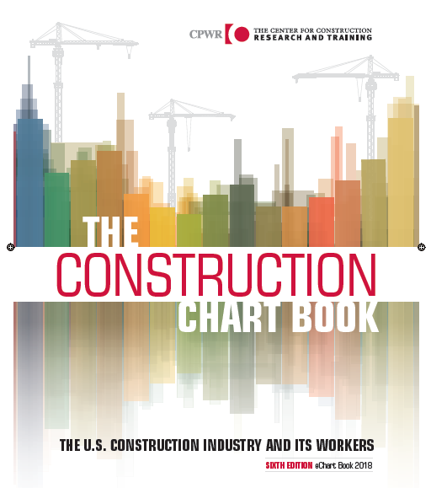
Overview of fatalities and injuries in construction
Topic One

Slide 8
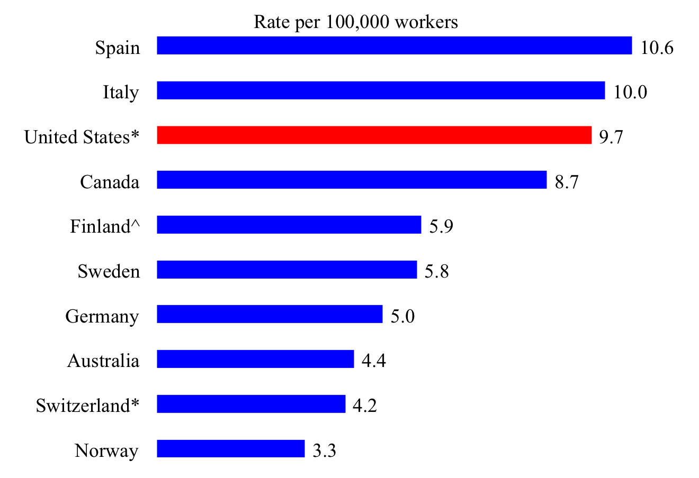
Rate of deaths from injuries in construction, selected countries, 2008
ILO Data

Slide 9
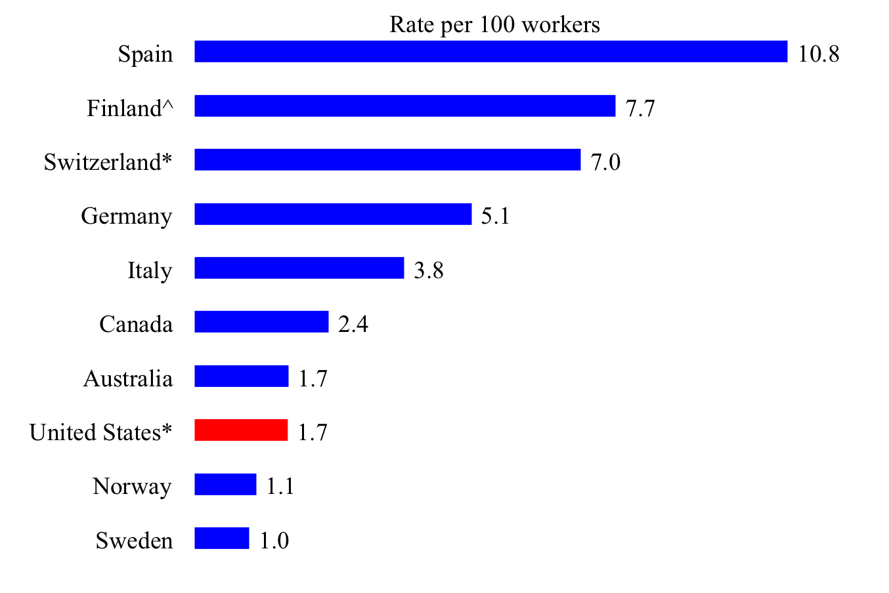
Rate of nonfatal injuries in construction, 2008. Why is the U.S. so low?
ILO Data

Slide 10
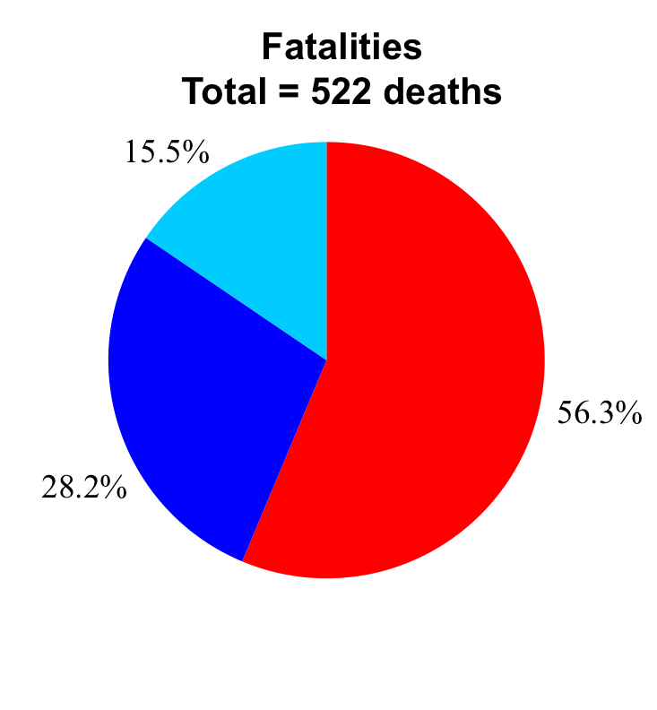
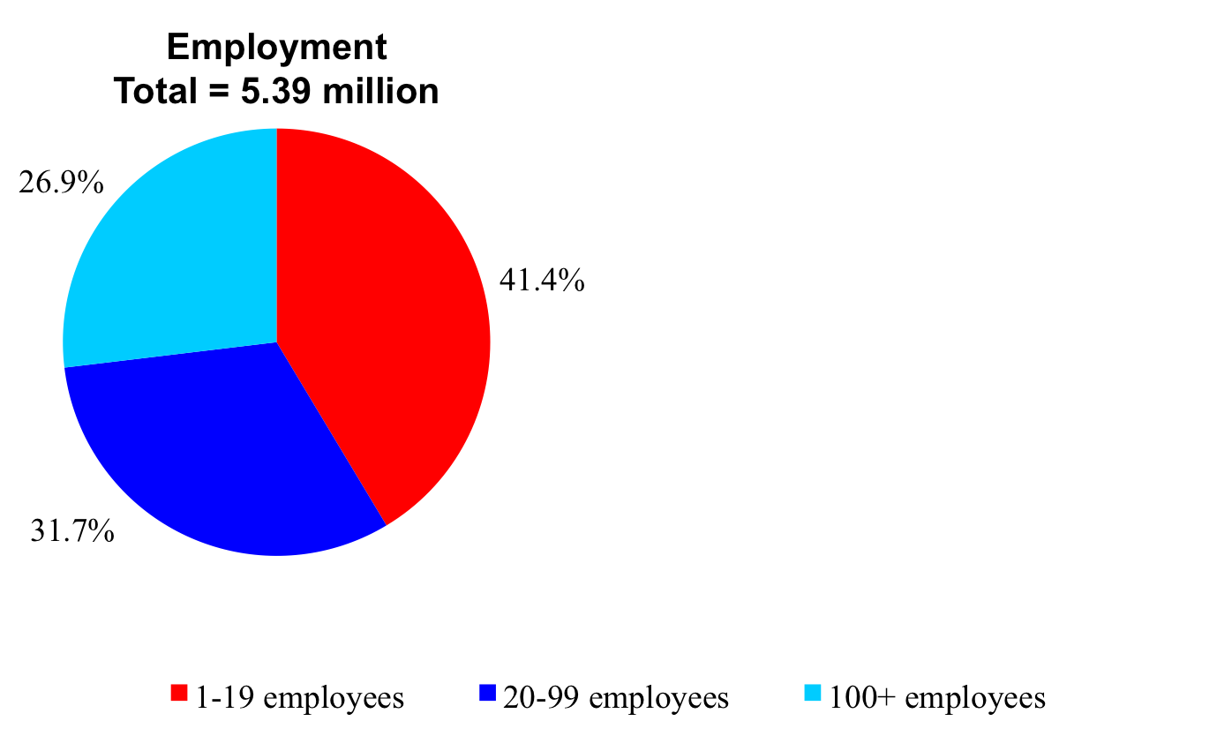
Distribution of construction employment and work-related deaths from injuries, by establishment size, 2010. What is this saying?

Slide 11
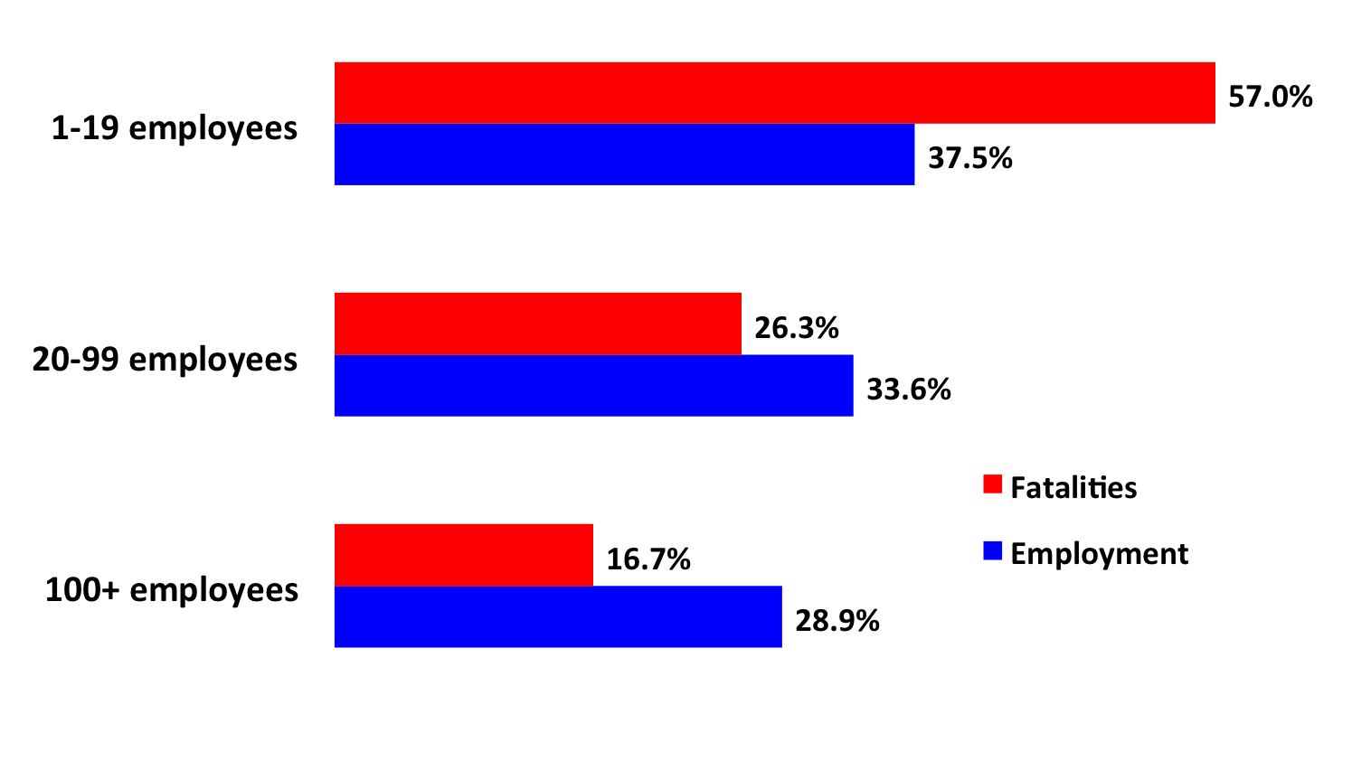
Small firms represent a disproportionate percentage of construction fatalities (2015)
CPWR The Chart Book 2018

Slide 12
Distribution of fatal injuries in construction, by event, 2011-2013 total
Source: U.S. Bureau of Labor Statistics, 2011-2013 Census of Fatal Occupational Injuries. Numbers are from the online CFOI database.

Slide 13
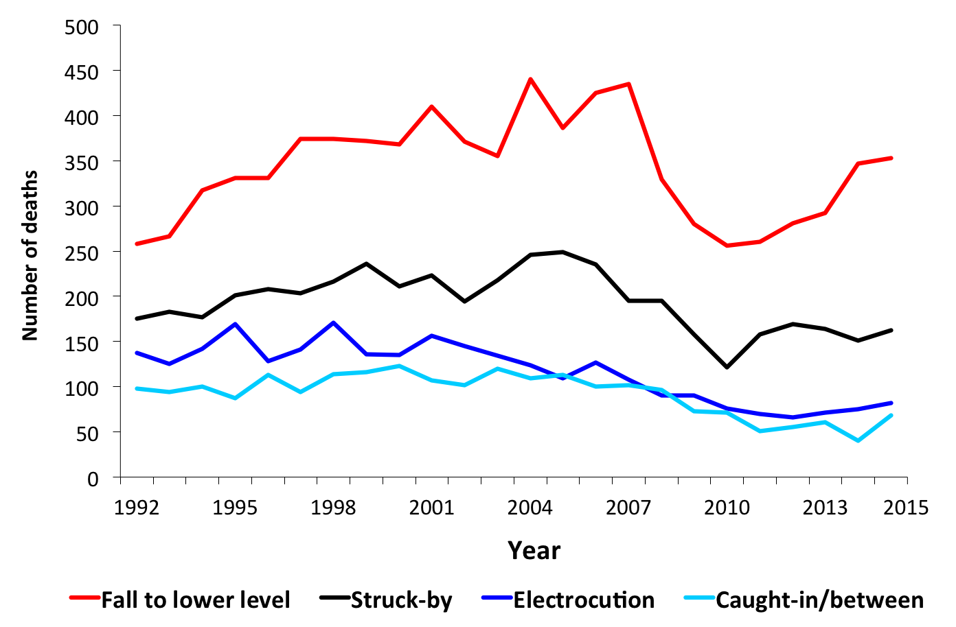
Leading causes of work-related deaths, construction, 1992-2015

Slide 14
Understanding the pattern of construction employment in the US is critical for interpreting S&H data, (BLS data 2003-2016)
Source: U.S. Bureau of Labor Statistics, 2003-2016 Current Population Survey. Calculations by the authors.

Slide 15
See any pattern in fatalities? (BLS)
Note: In 2011, the CFOI switched to OIICS version 2.01 which categorizes slips, trips, and falls together. In previous years, slips and trips were categorized elsewhere.
* Other fatalities are fatalities from all causes except falls.
Source: U.S. Bureau of Labor Statistics, 2003-2015 Census of Fatal Occupational Injuries. Numbers were from the online CFOI database.
Notes:
15

Slide 16
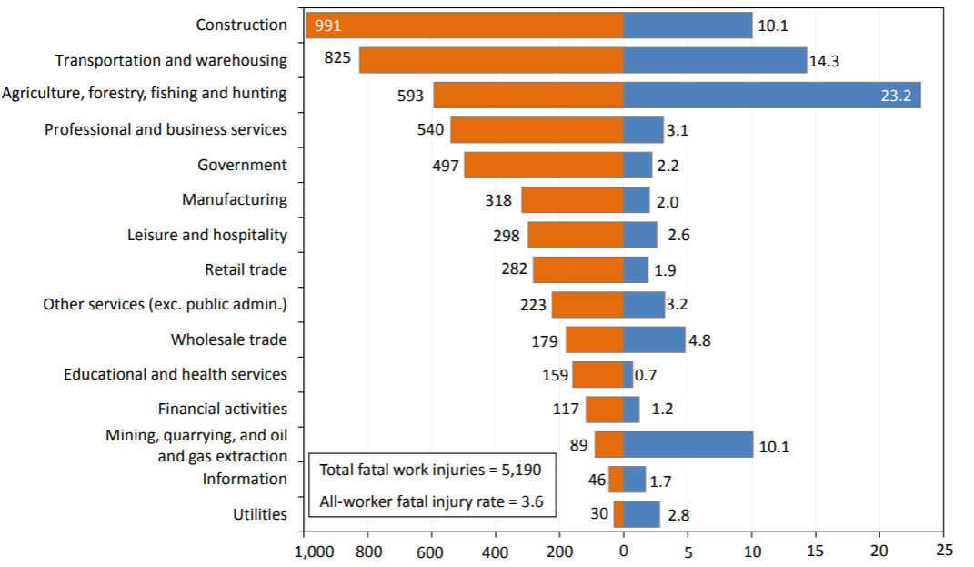
Construction had the most fatalities in 2016, although not the highest rate
Number of fatal work injuries
Fatal work injury rate (per 100,000 full-time equivalent workers)
U.S. BLS, Current Population Survey, Census of Fatal Occupational Injuries, 2017.

Slide 17
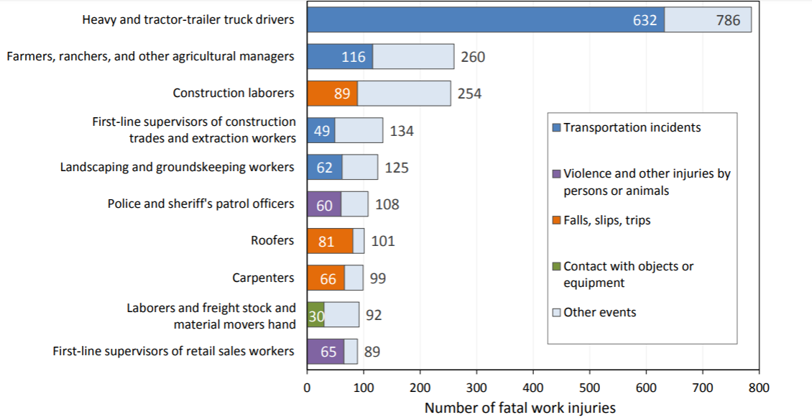
The 10 occupations with highest fatal injury counts accounted for 39% of all fatal injuries in 2016
U.S. BLS, Current Population Survey, Census of Fatal Occupational Injuries, 2017.

Slide 18
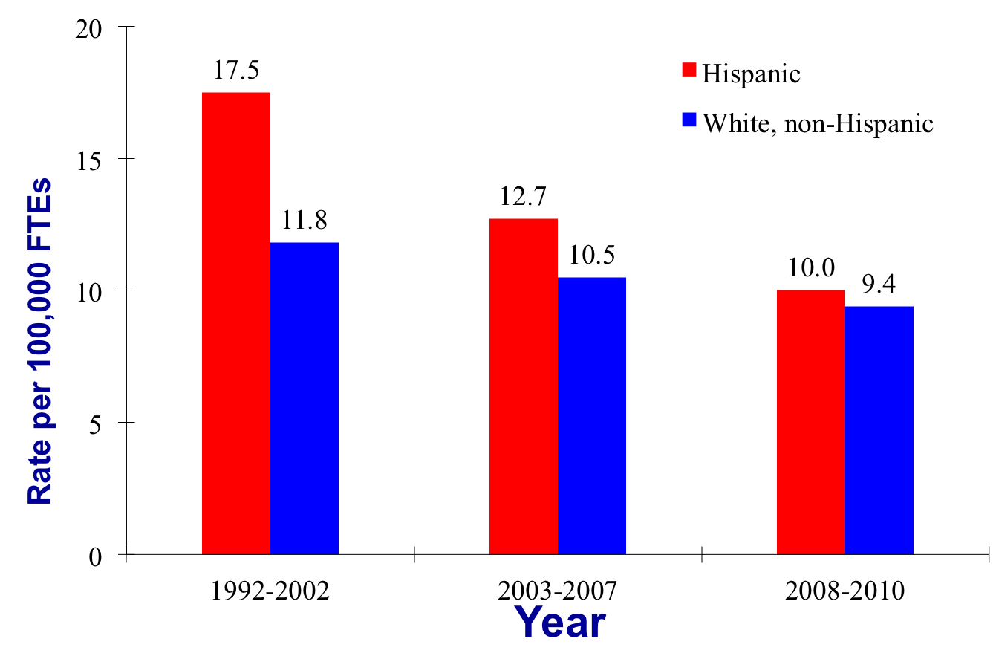
Rate of fatalities in construction has gone down dramatically for Hispanic workers (1992-2010)

Slide 19
Except for the recent rate of fatal falls to a lower level
(2011-2015, BLS)
Source: Numbers were obtained from the BLS through special requests. Numbers of FTEs were estimated using the Current Population Survey. Calculations by the authors. The views expressed here do not necessarily reflect the views of the BLS.

Slide 20
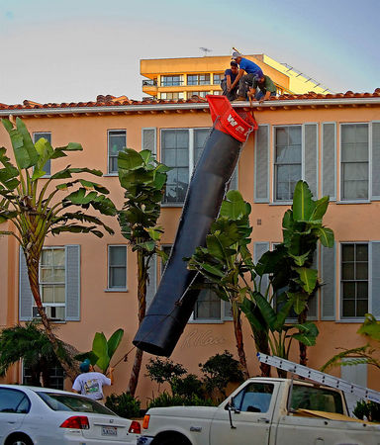
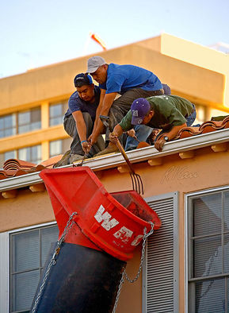
Latino crew at the leading edge
Photos courtesy of Robert Carr

Slide 21
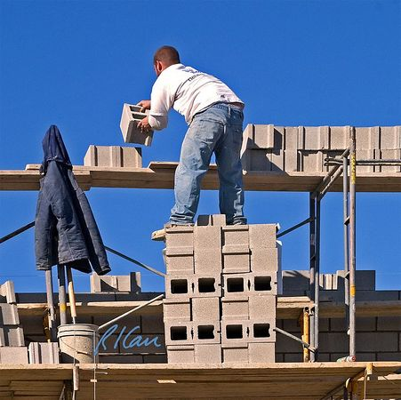
Major Hazards on Construction Jobs
Topic Two

Slide 22
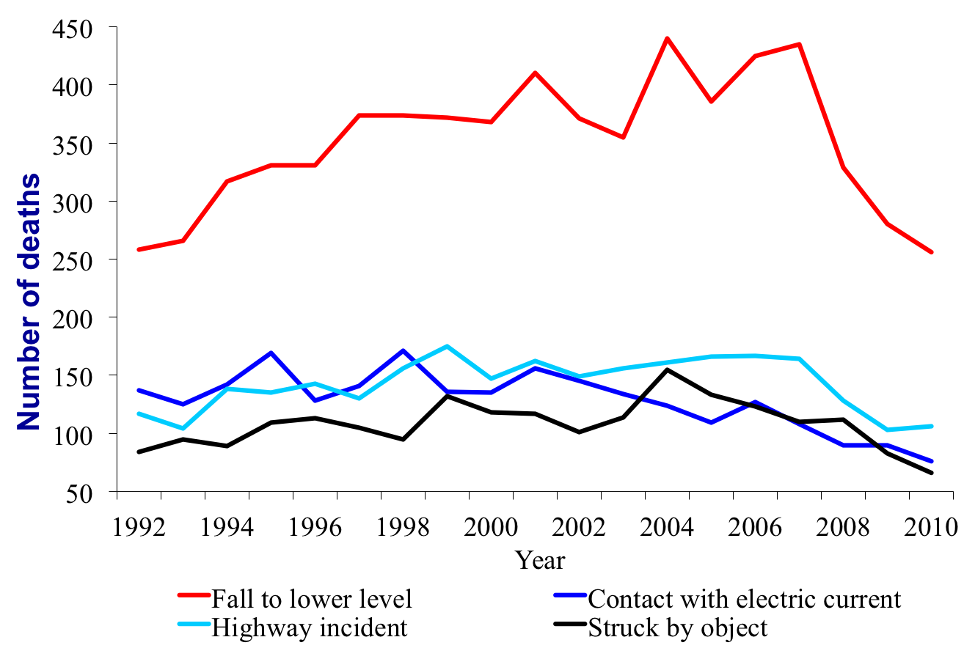
Leading causes of work-related deaths, construction, 1992-2010

Slide 23
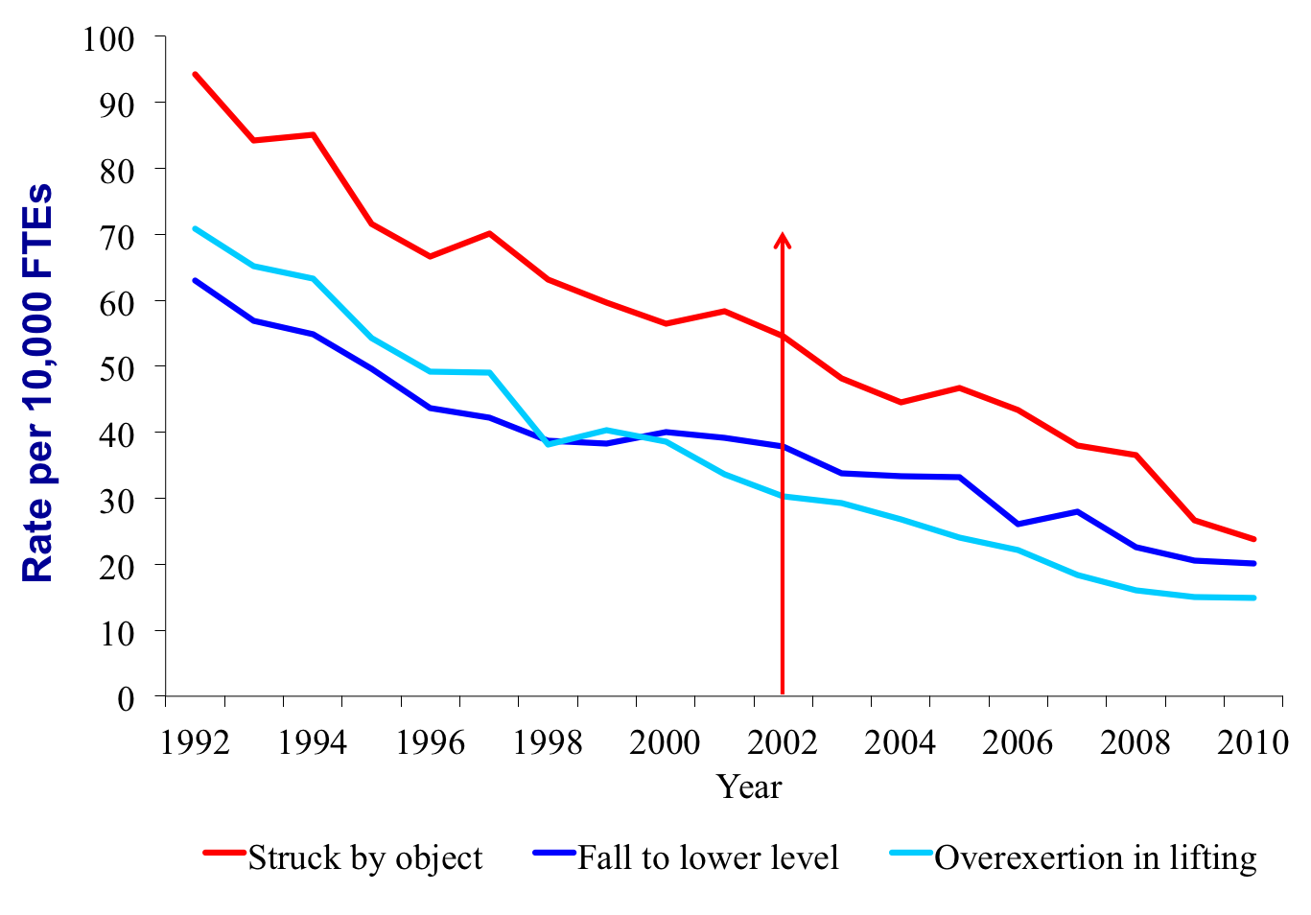
Rate of leading causes of nonfatal injuries resulting in days away from work in construction, 1992-2010 (Private wage-and-salary workers)
OSHA revised requirements

Slide 24
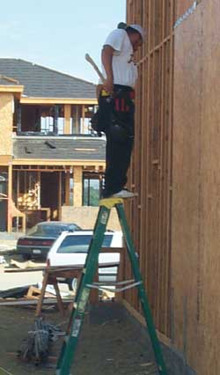
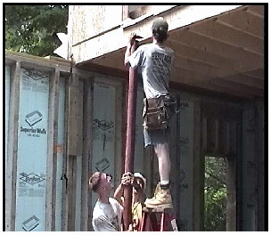
Falls

Slide 25
Fatal falls, slips, trips in construction, by height of fall, 2011-2013 total
Note: 133 deaths without height information were excluded.
Source: These numbers were calculated by the authors with restricted access to BLS CFOI microdata. The views expressed here do not necessarily reflect the views of the BLS.

Slide 26
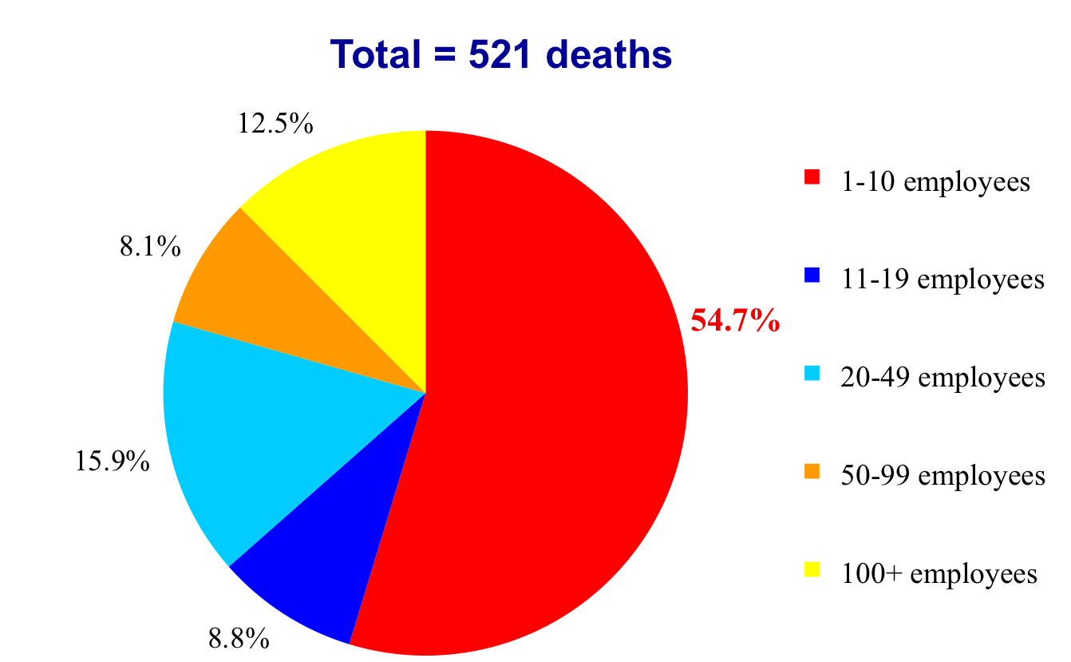
Distribution of fatalities from falls in construction, by establishment size, 2008-2010 total

Slide 27
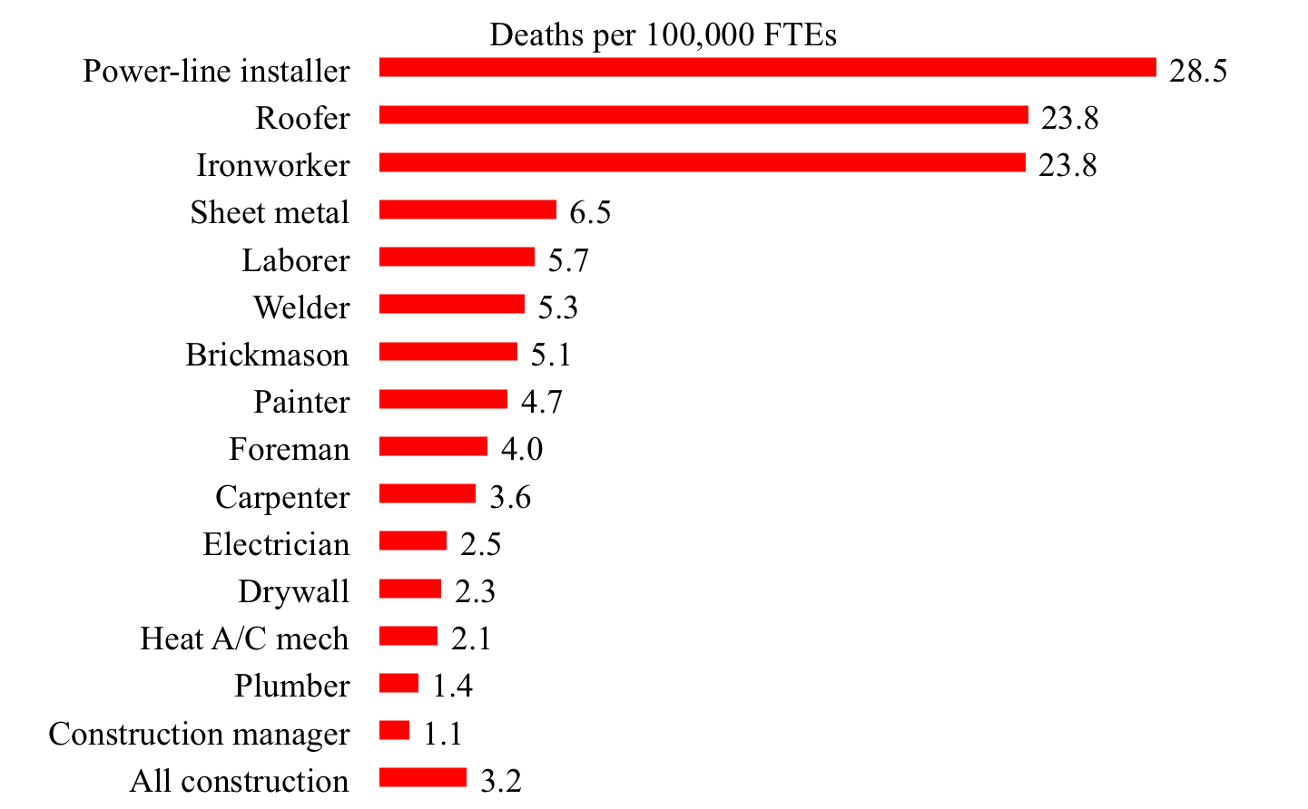
Rate of fatalities from falls, selected construction occupations, 2008-2010 average (All employment)
This research was conducted with restricted access to Bureau of Labor Statistics (BLS) data. The views expressed here do not necessarily reflect the views of the BLS.

Slide 28
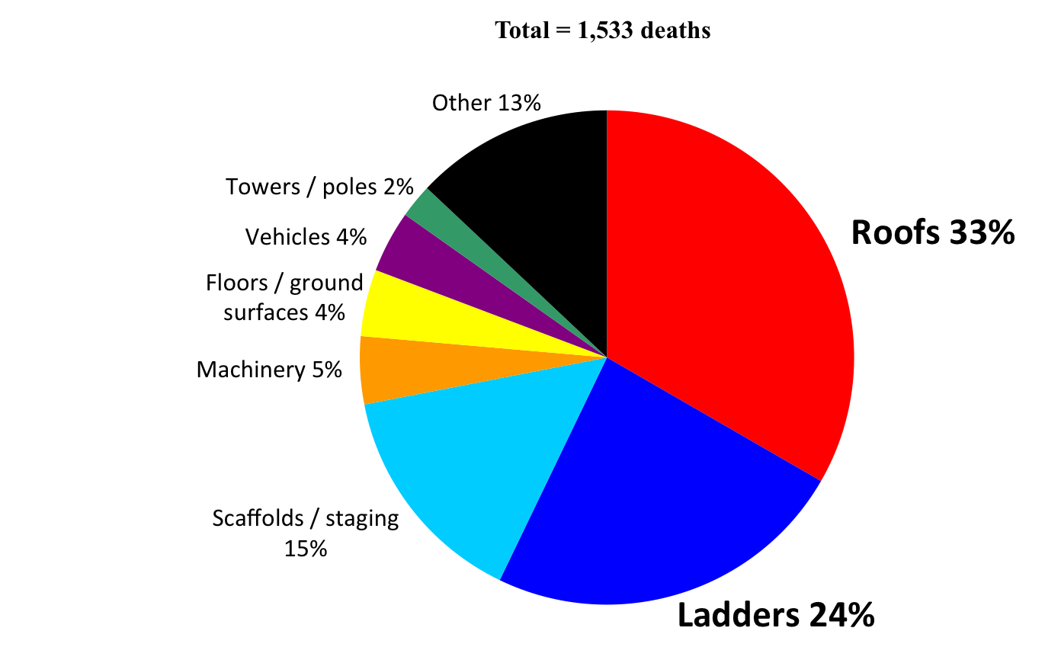
Over half of fatal falls to a lower level in construction were from roofs and ladders, 2011-2015 (BLS)
Source: Numbers were obtained from the BLS through special requests. Calculations by the authors.

Slide 29
Number of fatal falls to a lower level, selected construction subsectors, 2011-2015
Source: Numbers were obtained from the BLS through special requests. Calculations by the authors. The views expressed here do not necessarily reflect the views of the BLS.

Slide 30
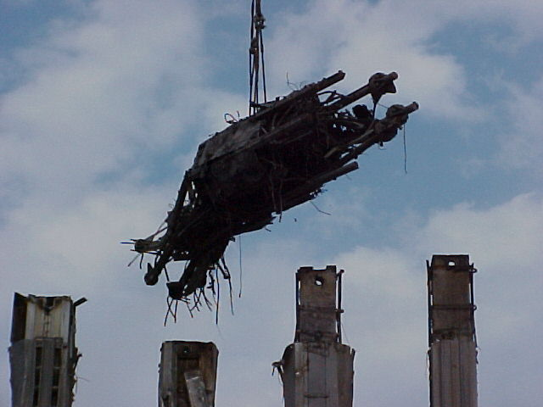
What are “struck-by” hazards?

Slide 31
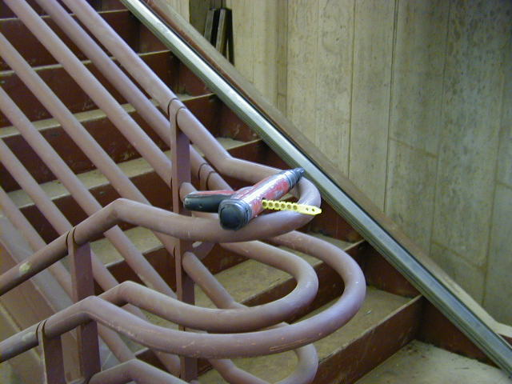
Powder-actuated hand tools
What are the hazards?
37,000 people go to emergency rooms from nail gun injuries every year
The hazards are similar to those of firearms
Sequential-trip triggers could prevent 65 percent of injuries
What is wrong with this picture?
Photo courtesy Laborers-AGC

Slide 32
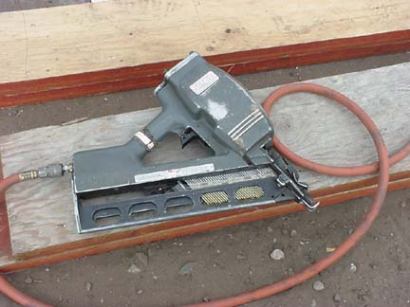
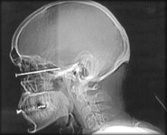
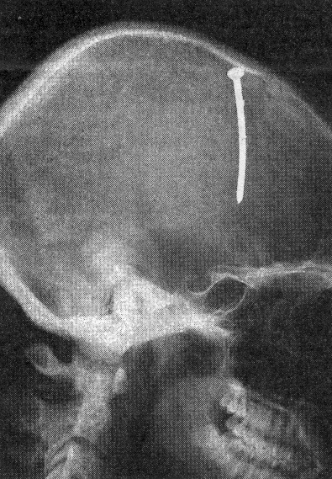
Pneumatic nailers have been made safer
Penetration checks must be made
All proper PPE must be worn

Slide 33
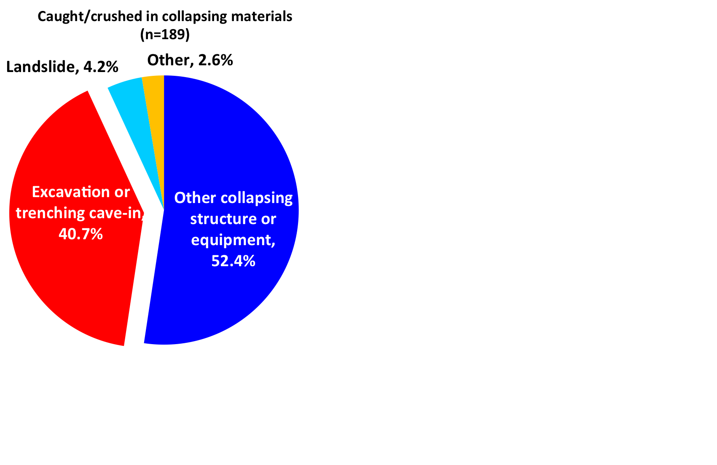
Trenching cave-ins represent 40% of caught-in/between fatalities
(2011-2015)
Notes:
33

Slide 34
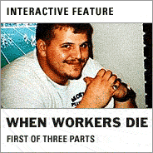
Dedicated to Patrick Walters
One of over 50 workers who needlessly die in trenching and excavation each year

Slide 35
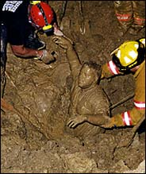
What do we know about the 542 “Patricks” who died in excavations from 1992 to 2001?
Average age was 38
Nearly half of their companies had less than 10 employees
Nearly all were employed by private companies
Cave-ins accounted for 76% of the deaths
Recovery of Patrick Walters’ body

Slide 36
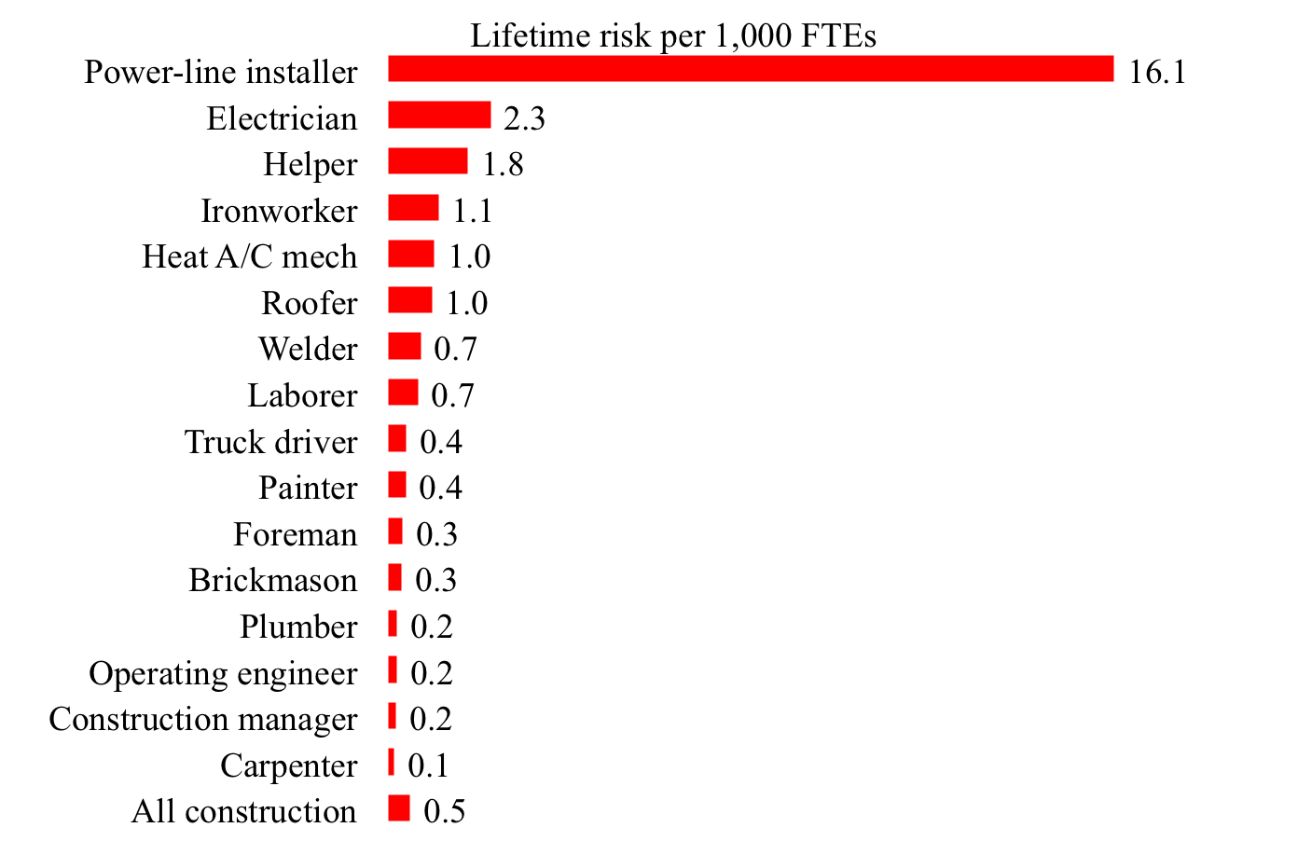
Lifetime risk of electrocution deaths in construction, selected construction occupations (All employment)
This research was conducted with restricted access to Bureau of Labor Statistics (BLS) data. The views expressed here do not necessarily reflect the views of the BLS.

Slide 37
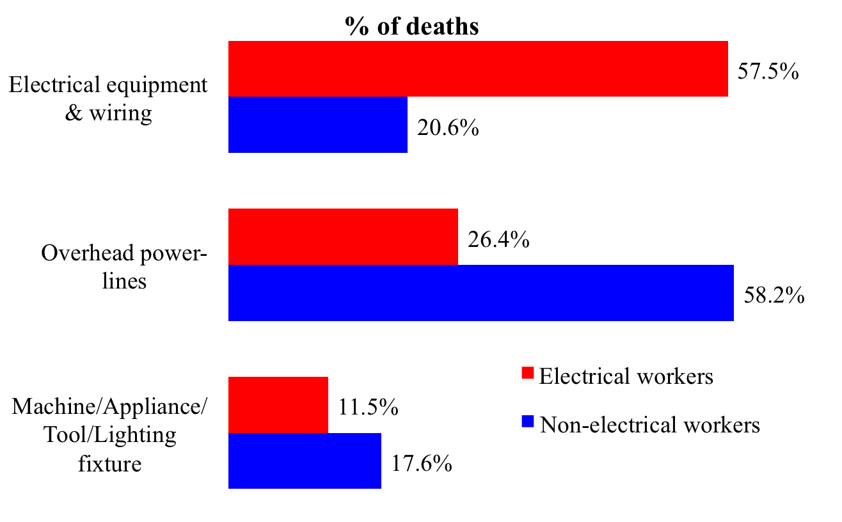
Major causes of electrocution deaths in construction, electrical workers vs. non-electrical workers, 2008-2010 total (All employment)

Slide 38
Managing and Controlling Hazards on Construction Jobs
Topic Three

Slide 39
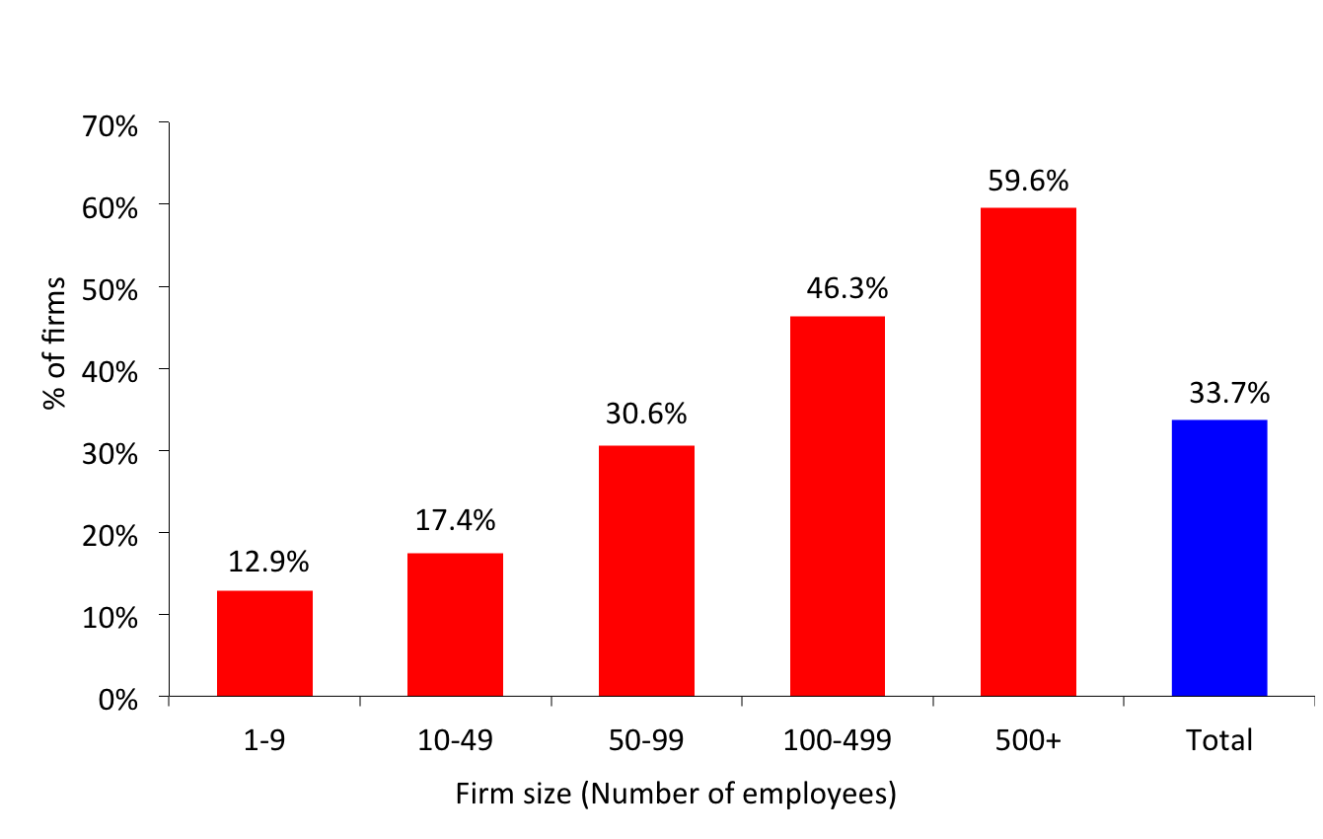
Prevention through Design (PtD) promotes safety, but is not used much by smaller firms (average of 2012 and 2015)
Source: Dodge Data & Analytics, 2012 and 2015 Construction Safety Management Survey. Calculations by the authors.
Notes:
39

Slide 40
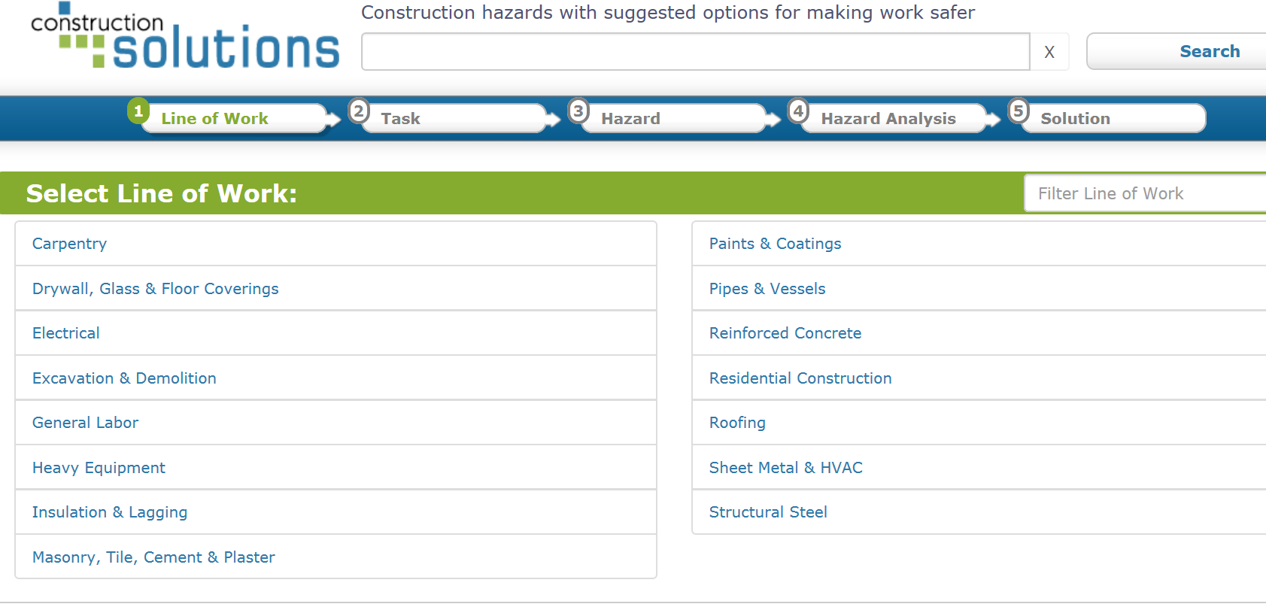
CPWR’s Construction Solutions allows you to select a line of work and specific tasks to learn the hazards
www.cpwrconstructionsolutions.org

Slide 41
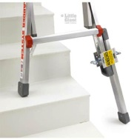
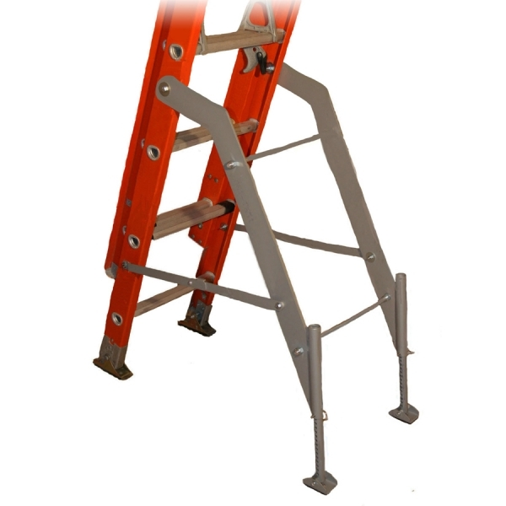
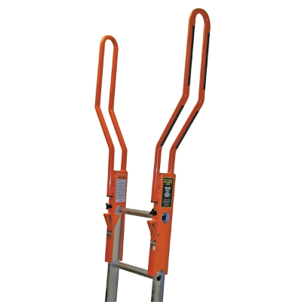
Controls are listed for each hazard
Like stabilizers and extenders for ladders

Slide 42
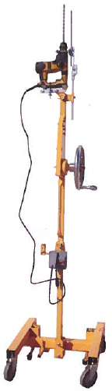
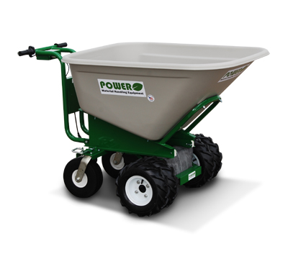
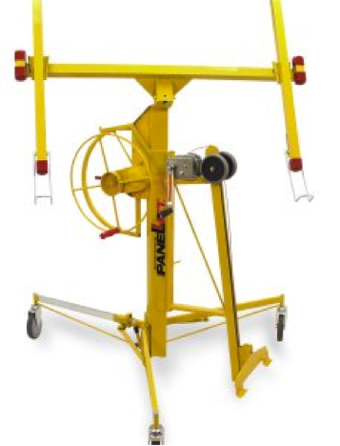
The hierarchy of controls needs to be considered
Electric wheelbarrow
Drywall lift
Overhead drill

Slide 43
Here is why PPE is at the bottom
NIOSH FACE reports, fatal falls in construction, by Personal Fall Arrest System (PFAS) status, 1982-2014
Source: Dong XS, Largay JA, Choi SD, Wang X, Cain CT, Romano N. 2017. Accident Analysis & Prevention, 102:136-143.

Slide 44
Frequency of general safety and health training, average of 2012 and 2015
Source: Dodge Data & Analytics, 2012 and 2015 Construction Safety Management Survey. Calculations by the authors.

Slide 45
Taking advantage of free CPWR resources
Topic Four
http://www.cpwr.com

Slide 46
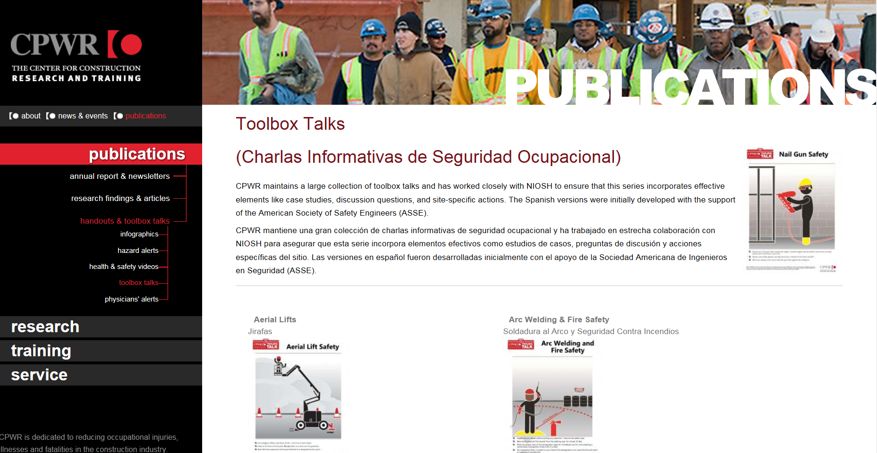
We worked with NIOSH to publish a series of toolbox talks
(in English and Spanish)

Slide 47
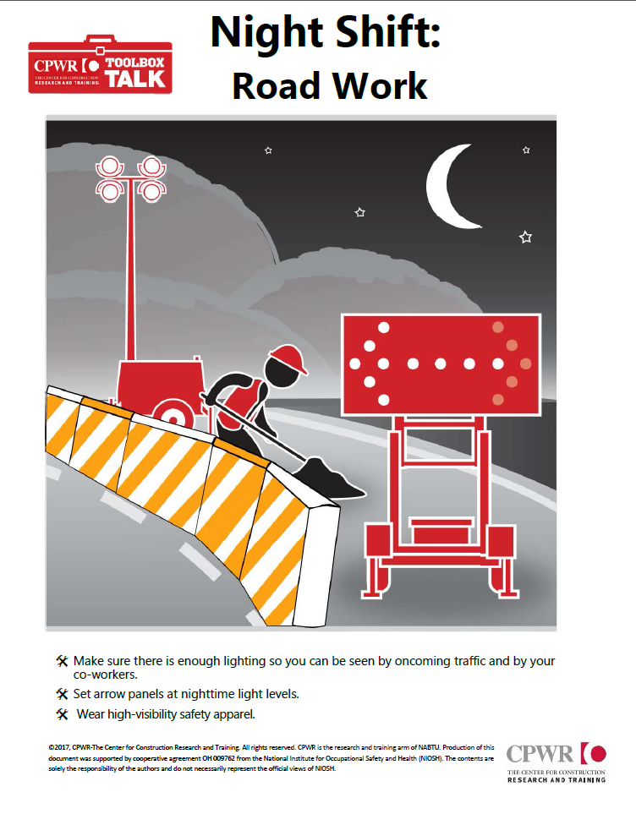
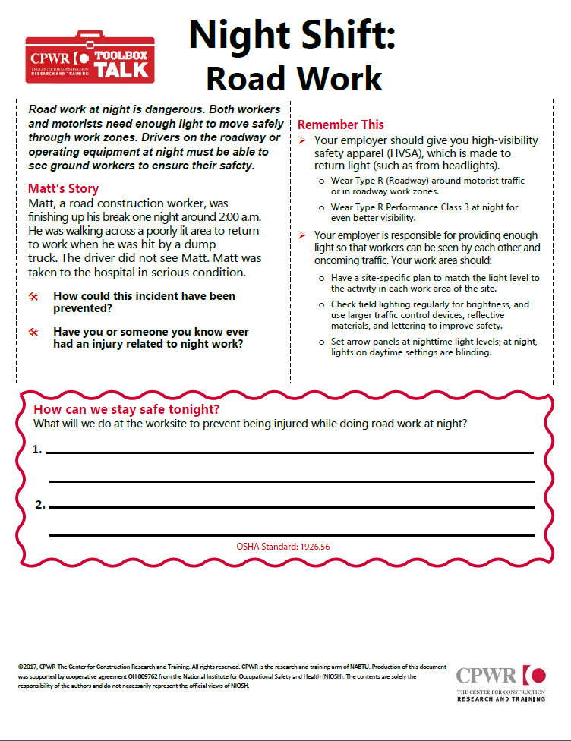
Our toolbox talks feature case studies and graphics

Slide 48
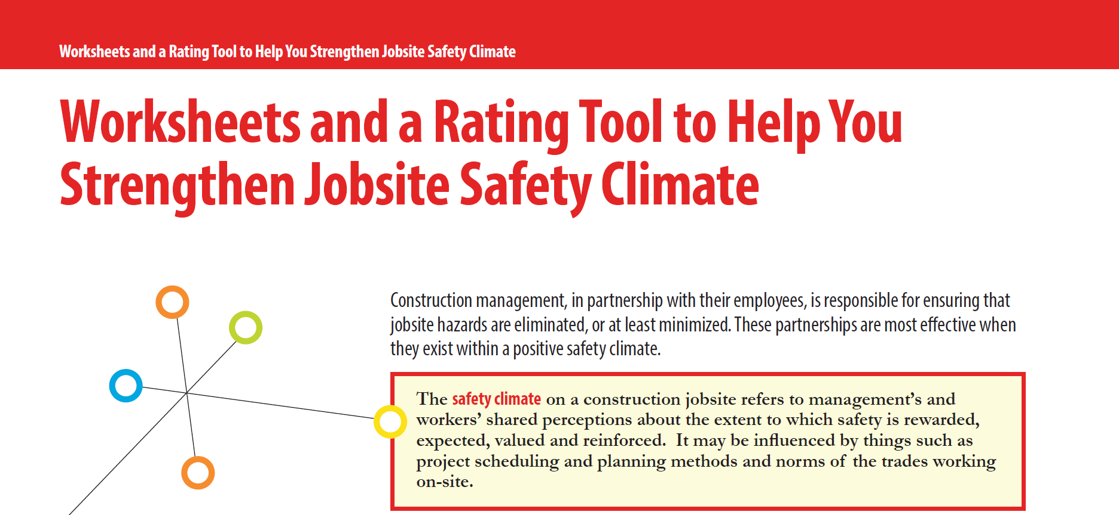
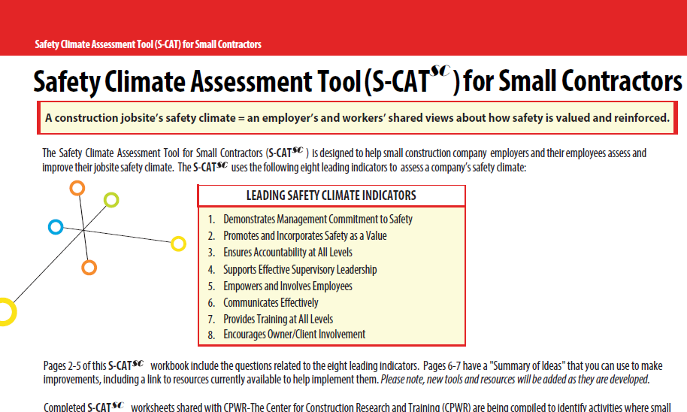
Our safety climate tools are widely used

Slide 49
Both versions focus on 8 leading indicators and have their own activities and ideas
Demonstrating Management Commitment
Aligning and Integrating Safety as a Value
Ensuring Accountability at All Levels
Improving Supervisory Leadership
Empowering and Involving Workers
Improving Communication
Training at All Levels
Encouraging Owner/Client Involvement

Slide 50
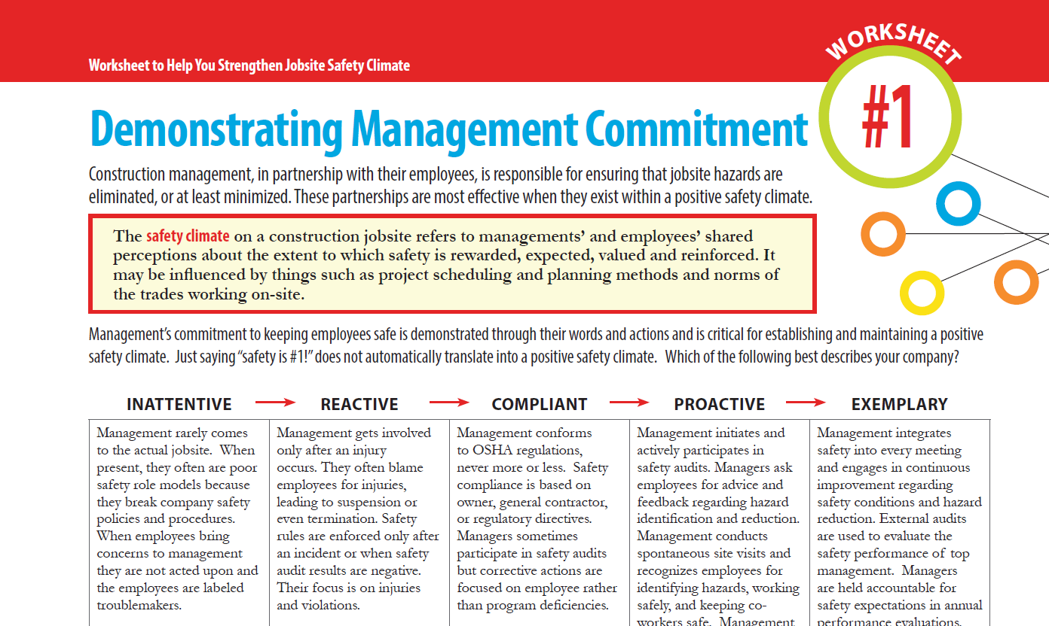
Our Safety Climate Workbook contains worksheets that allow you to rate your program from inattentive to exemplary
“Management rarely comes to the actual jobsite.”
“Management integrates safety into every meeting...”

Slide 51
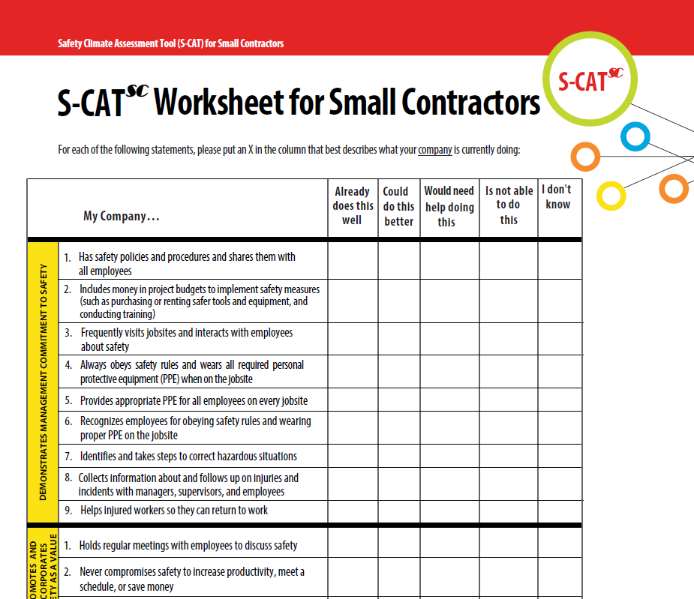
The Small Contractor version allows you to quickly assess on paper or online your company’s activities and where you need help

Slide 52
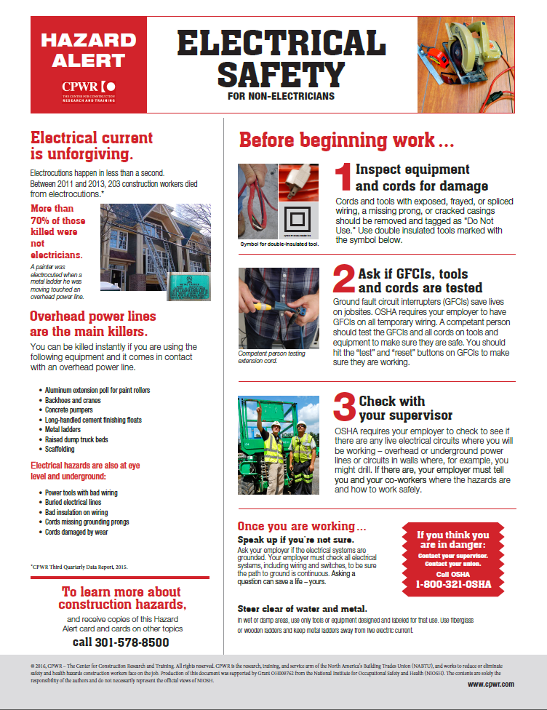

Our Hazard Alerts are in paper and digital form in English &
Spanish

Slide 53

Our electronic Library of Construction Occupational Safety and Health (eLCOSH.org) is focused on practitioners and trainers

Slide 54


eLCOSH has over a thousand images for your use

Slide 55

We maintain an inventory that currently contains 580 commercial construction nanomaterials
www.nano.elcosh.org

Slide 56




  Check out our other online resources & new safety and health network
www.stopconstructionfalls.com
www.choosehandsafety.org
  www.elcosh.org
SafeConstructionNetwork.org

Slide 57

Our silica resources help contractors comply (www.silica-safe.org)

Slide 58


We have lots of silica resources in English and Spanish at www.cpwr.com

Slide 59
Questions?
Bruce Lippy blippy@cpwr.com
301-495-8527

