Slide 1
PORTABLE GENERATOR SAFETY
2-hr Generator Safety Awareness

Slide 2
Topics We Will Cover
Portable Generator Modes and Types
Hazards Associated with Portable Generators
Shocks and Electrocution
Carbon Monoxide
Fire Hazards
Noise and Vibration
Sizing an Emergency Generator
2

Slide 3
TEST YOURSELF
Name one of the most valuable things you can do to understand safe and proper use (and maintenance) of your generator.
Under what conditions would you use (a) an independent portable generator system and (b) an integrated portable generator system?
Assume you will use a portable generator to power a building or residence during a power failure. Before turning the generator on, what very important thing should you do first?
Why is a double-pole, double-throw transfer switch so important for safety?
When using extension cords with a generator, what is a common cause of a spark or fire hazard?
With portable generators, explain why carbon monoxide poisoning is a hazard.
Name two symptoms of carbon monoxide poisoning.
List five items in a home or residence a portable generator should be able to power.
3
Notes:
NOTE: There are many “right” answers to these questions. Many of them are written ambiguously to really cause a person to think hard about what they know or don’t know about these topics.

Slide 4
Objectives
EXPOSURE
Be exposed to topics associated with portable generator hazards such as proper setup, use of cords, proper grounding, water hazards, fire hazards, dangers from hot engines, fuel storage, noise, and vibration.
KNOWLEDGE
Identify independent and integrated portable generator systems.
Understand the purpose and design of a double-pole, double-throw transfer switch.
Understand the cause of carbon monoxide poisoning and its symptoms.
SKILLS
Be able to identify and prioritize power requirements for emergency generator use.
Complete a power calculation worksheet.
Be aware of the need for proper setup with regards to shocks and electrocution.
Contribute to a culture of safe generator practices.
ATTITUDES
4

Slide 5
PORTABLE GENERATOR SAFETY
This presentation discusses specific hazards inherent with the use of generators and also provides helpful information to ensure that workers and others using such equipment remain safe.
5

Slide 6
6
Notes:
Click image to play video.

Slide 7
Safety Notes
If you plan on using an emergency generator, it is essential that you take precautions for your safety and for the safety of utility employees working to restore power.
Before starting your generator, carefully read, understand, and follow the manufacturer’s instructions.
7

Slide 8
Key Points of Generator Safety
All electrical connections must comply with the National Electric Code.
Do not overload generator with too many appliances.
After losing main power, turn off main breaker or pull main fuse block.
Generators that are directly connected to existing wiring systems must use a double-pole, double-throw (DPDT) transfer switch.
Generator must be properly grounded according to manufacturer recommendations.
You may be liable for damage or injury to people and property that may result from an improperly installed or operated emergency generator.
8

Slide 9
Generator Types
Engine-driven generators
Pto-driven generators
Available as portable or stationary units, generators come in many sizes and configurations.
9
Notes:
Factors such as availability, storage, volatility and safety should be considered for each fuel type. In general, smaller units (less than 7,000 watts) tend to be gasoline powered, while the larger units usually run on diesel fuel, liquid propane or natural gas.
Power take-off (PTO) generators use an attachment on farm tractors or construction equipment such as bulldozers and front-end loaders.

Slide 10
Generator Modes
The two safe modes for supplying power from an emergency generator are:
Independent portable operation
Integrated system operation
Typical Portable Generator
10

Slide 11
Generator Modes: Independent Portable Operation
A generator that operates as an independent, stand-alone unit NOT connected to any existing wiring system.
Cords plugged into the generator delivering power to selected electrical equipment and appliances.
Useful when temporary or remote power is needed.
Commonly used during cleanup and recovery efforts following disasters such as hurricanes, tornadoes, etc.
11

Slide 12
Generator Modes: Independent Portable Operation
An emergency generator that is connected to an existing wiring system of a home or business.
This system uses a double-pole, double-throw (DPDT) “transfer switch” to safely isolate the generator from the utility power lines.
12

Slide 13
Transfer Switch Explained
The DPDT transfer switch has three positions:
Utility power on, Generator power off;
Both off; and
Generator power on, Utility power off.
13

Slide 14
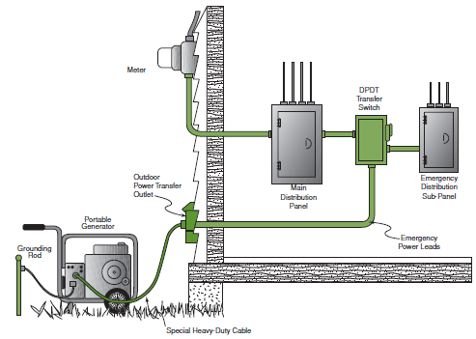
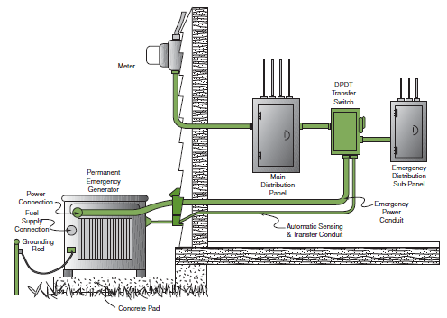
Generator Modes: Integrated System Generators
Portable
Permanent
Note the DPDT transfer switch has been installed between the main panel box and a separate emergency sub-panel box.
14
Notes:
An integrated system must use a DPDT transfer switch.
PORTABLE: Here, a special heavy-duty cable from the generator is plugged into a specially designed outdoor power transfer outlet. (Note: this is different from a typical outdoor electrical outlet found on most homes.) This outlet feeds the DPDT transfer switch which, in turn, connects power to selected circuits in the emergency sub-panel box.
PERMANENT: Shown above is a permanent outdoor generator installation, with the unit housed inside a weather-resistant, protective enclosure. The DPDT transfer switch has been installed between the main panel box and a separate emergency sub-panel box used to redirect generator power to selected circuits. The electric devices you have determined to be necessary in an emergency are wired into the emergency sub-panel.

Slide 15
15
Notes:
Click image to play video.

Slide 16
Hazards Associated with Portable Generators
Shocks and Electrocution
16

Slide 17
Shocks and Electrocution
PROPER SETUP
The electricity created by generators has the same hazards as normal utility-supplied electricity.
Additional shock and electrocution hazards occur because many generator users often bypass the safety devices (such as circuit breakers) that are built into electrical systems.
Never attach a generator directly to the building's electrical system of a structure (home, office, trailer, etc.) unless a qualified electrician has properly installed the generator with a transfer switch.
Power off and do not use any electrical equipment that has strange odors or begins smoking.
17
Notes:
Attaching a generator directly to a building electrical system without a properly installed transfer switch can energize wiring systems for great distances. This creates a risk of electrocution for utility workers and others in the area.

Slide 18
Shocks and Electrocution
USE OF CORDS
Always plug electrical appliances directly into the generator using the manufacturer’s supplied cords or extension cords that are grounded (3-pronged).
Inspect the cords to make sure they are fully intact and not damaged, cut, or abraded.
Never use frayed or damaged extension cords. Ensure the cords are appropriately rated in watts or amps for the intended use.
Do not use underrated cords; replace them with appropriately rated cords that use heavier gauge wires.
Do not overload a generator; this can lead to overheating which can create a fire hazard.
18

Slide 19
Shocks and Electrocution
GROUNDING
Use ground fault circuit interrupters (GFCIs), especially where electrical equipment is used in or around wet or damp locations.
Make sure a generator is properly grounded and the grounding connections are tight.
Consult the manufacturer's instructions for proper grounding methods.
19
Notes:
GFCIs shut off power when an electrical current is detected outside normal paths. GFCIs and extension cords with built-in GFCI protection can be purchased at hardware stores, do-it-yourself centers, and other locations that sell electrical equipment. Regardless of GFCI use, electrical equipment used in wet and damp locations must be listed and approved for those conditions.

Slide 20
Shocks and Electrocution
WATER HAZARDS
Keep a generator dry; do not use it in the rain or wet conditions.
If needed, protect a generator with a canopy.
Never manipulate a generator’s electrical components if you are wet or standing in water.
Do not use electrical equipment that has been submerged in water.
Equipment must be thoroughly dried out and properly evaluated before using.
20

Slide 21
Hazards Associated with Portable Generators
Carbon Monoxide Poisoning
21

Slide 22
Carbon Monoxide
THE HAZARD
Many people have died from CO poisoning because their generator was not adequately ventilated.
Carbon monoxide (CO) is a colorless, odorless, toxic gas.
Symptoms of CO poisoning: dizziness, headaches, nausea, tiredness—get to fresh air immediately and seek medical attention.
Do not re-enter the area until it is determined to be safe by trained and properly equipped personnel.
22

Slide 23
Carbon Monoxide
PROPER VENTILATION
Never use a generator indoors or in enclosed spaces such as garages, crawl spaces, and basements.
Make sure a generator has 3 to 4 feet of clear space on all sides and above it to ensure adequate ventilation.
Do not use a generator outdoors if its placement near doors, windows, and vents could allow CO to enter and build up in occupied spaces.
23

Slide 24
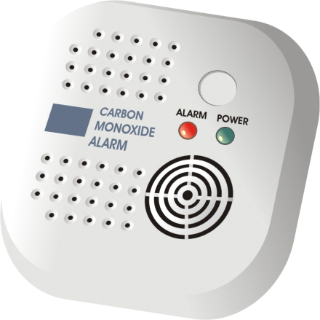
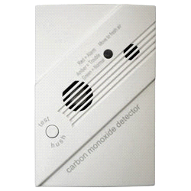
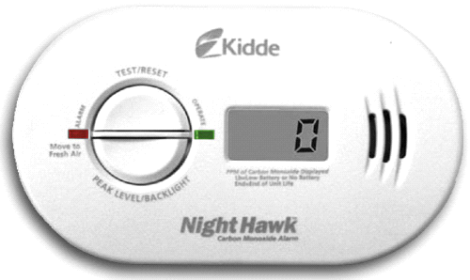
Carbon Monoxide
DETECTORS ARE CRITICAL
24

Slide 25
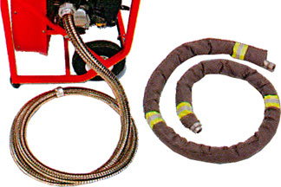
Carbon Monoxide
IS IT OKAY TO EXTEND THE EXHAUST PIPE?
What does your manufacturer recommend?
Flexible exhaust extensions are available in many auto parts stores.
Care should be taken to limit the length of the extension to minimize exhaust back pressure.
25

Slide 26
Hazards Associated with Portable Generators
Fire Hazards
26

Slide 27
Fire Hazards
DANGER FROM HOT ENGINE
Generators become hot while running and remain hot for long periods after they are stopped.
Generator fuels (gasoline, kerosene, etc.) can ignite when spilled on hot engine parts.
Before refueling, shut down the generator and allow it to cool.
27

Slide 28
Fire Hazards
FUEL STORAGE
Gasoline and other generator fuels should be stored and transported in approved containers that are properly designed and marked for their contents and vented.
Keep fuel containers away from flame-producing and heat-generating devices (such as the generator itself, water heaters, cigarettes, lighters, and matches).
Do not smoke around fuel containers.
Escaping vapors or vapors from spilled materials can travel long distances to ignition sources.
Do not store generator fuels in your home.
Store fuels away from living areas.
28

Slide 29
Hazards Associated with Portable Generators
Noise and Vibration Hazards
29

Slide 30
Noise and Vibration Hazards
Generator engines vibrate and create noise.
Excessive noise and vibration could cause hearing loss and fatigue that may affect job performance.
Keep portable generators as far away as possible from work areas and gathering spaces. Wear hearing protection if this is not possible.
30

Slide 31
Hazards Associated with Portable Generators
Prioritizing Needs and Load Planning
31

Slide 32
Sizing an Emergency Generator
PRIORITIZE YOUR NEEDS
Make a list of all critical items you feel must operate in an emergency.
Limit the load on your generator. Higher loads use more fuel. Add the wattages of essential appliances, including “starting wattage” for items that use electric motors.
Use low-watt light bulbs that provide a safe level of light. This reserves power for additional equipment or appliances.
Nameplate information on motors or appliances can help you determine their kilowatt rating:
Power (watts) = Current (amps) x Voltage (volts)
32

Slide 33
Sizing an Emergency Generator
LOAD PLANNING
Electrical appliances have either resistive load or inductive load.
Resistive Load: Electric appliances (electric stoves, electric space heaters, radios, light bulbs, televisions) that have the same starting and operating wattage.
Inductive Load: Electric appliances (power tools, refrigerators, freezers, pumps) that use electric motors requiring two to four times the operating wattage for start-up.
33

Slide 34
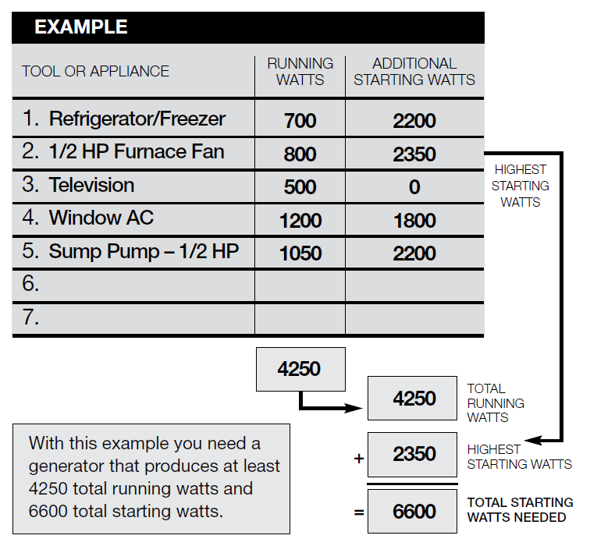
Sizing an Emergency Generator
LOAD PLANNING EXAMPLE
First prioritize the most critical equipment like lights and heat.
Then slowly add devices and appliances to stay under the unit capacity.
In this case a 5,000-watt portable generator would be needed.
34

Slide 35
Load Planning Exercise
Determine your own electrical needs by completing this load calculation worksheet.
Remember, safety first! Try not to overload the capacity of your generator!
35

Slide 36
?
Any Questions?
?
?
36

Slide 37
This publication was made possible by grant number 5 U45 ES006182-19 from the National Institute of Environmental Health Sciences (NIEHS), NIH. Its contents are solely the responsibility of the authors and do not necessarily represent the official views of the NIEHS, NIH.
(304) 253-8674
hazmat@iuoehazmat.org
www.iuoehazmat.org

