Slide 1
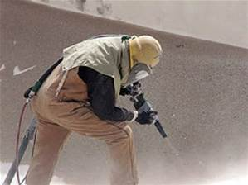
Personal Air Sampling for Crystalline Silica Exposure
Ron Roberson
Sensidyne

Slide 2
Traditional Sampling Methods for Respirable Crystalline Silica
NIOSH 7500: Crystalline Silica via XRD
NIOSH 7601: Crystalline Silica via Visible Spec
NIOSH 7602: Crystalline Silica via IR
OSHA ID-142: Crystalline Silica via XRD
Field methods were similar, but lab method varied

Slide 3
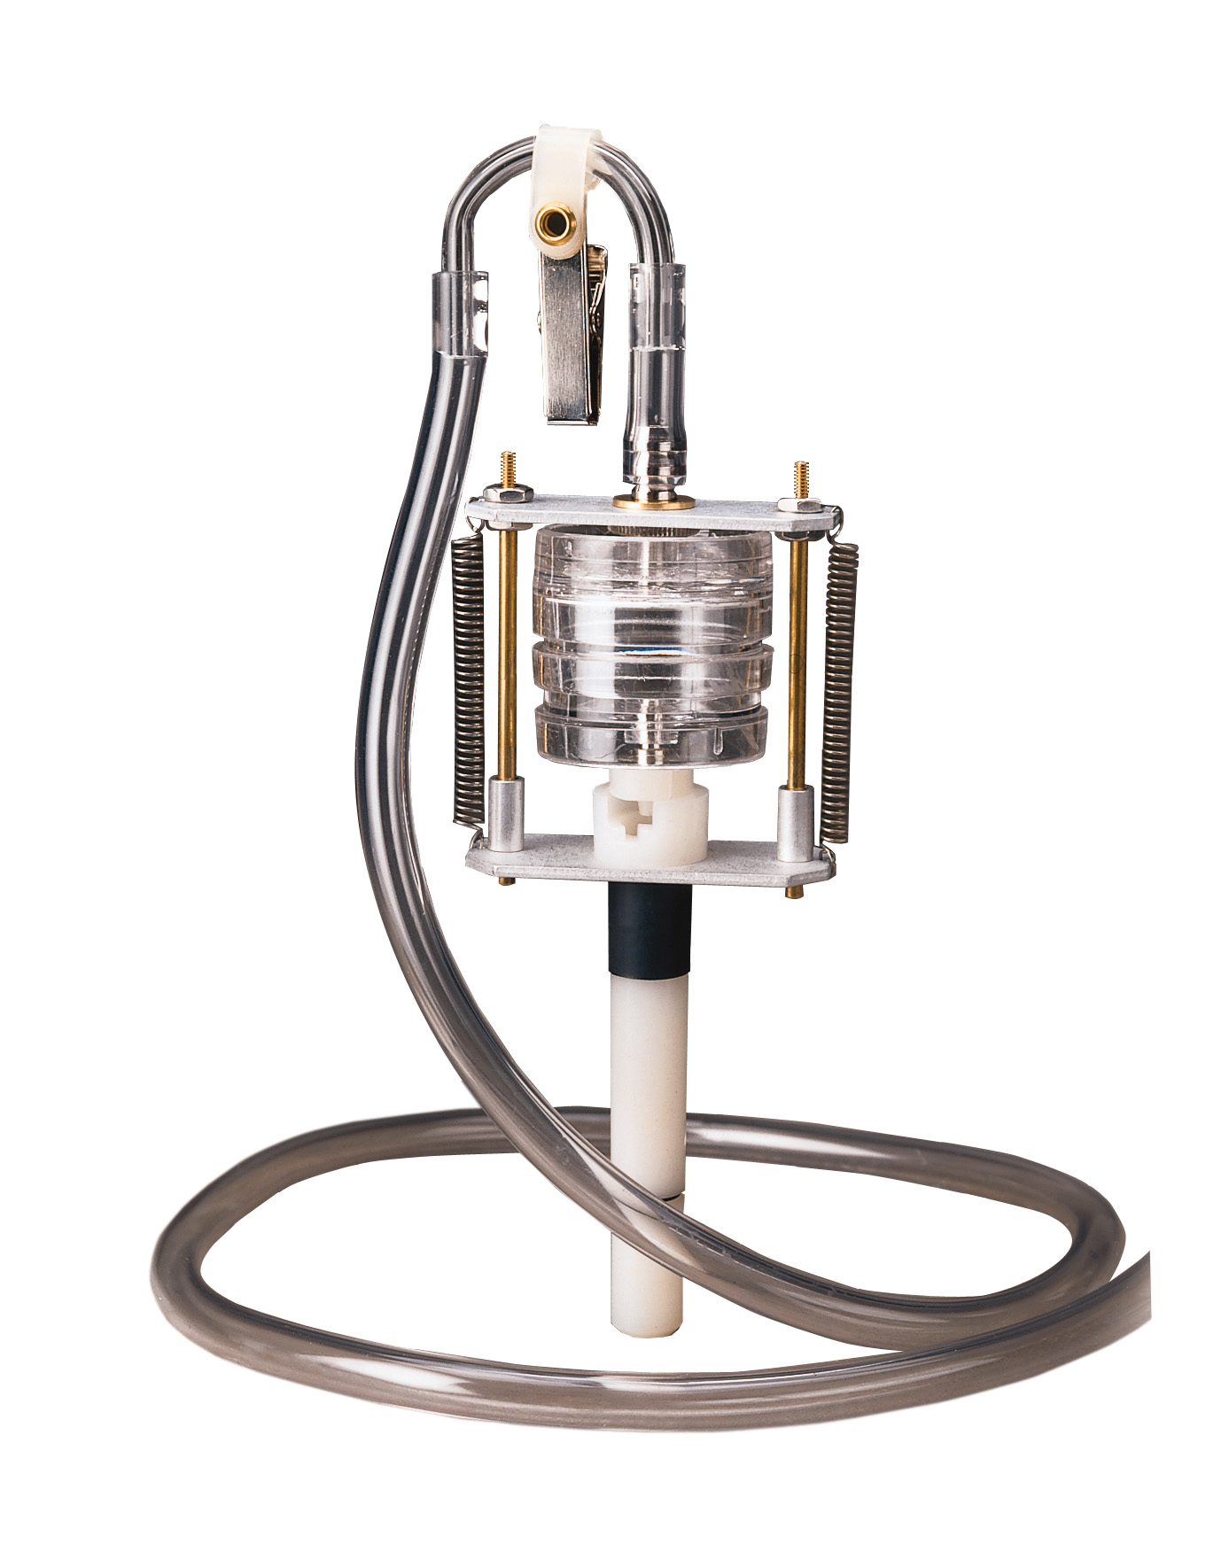
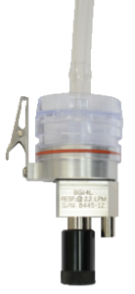
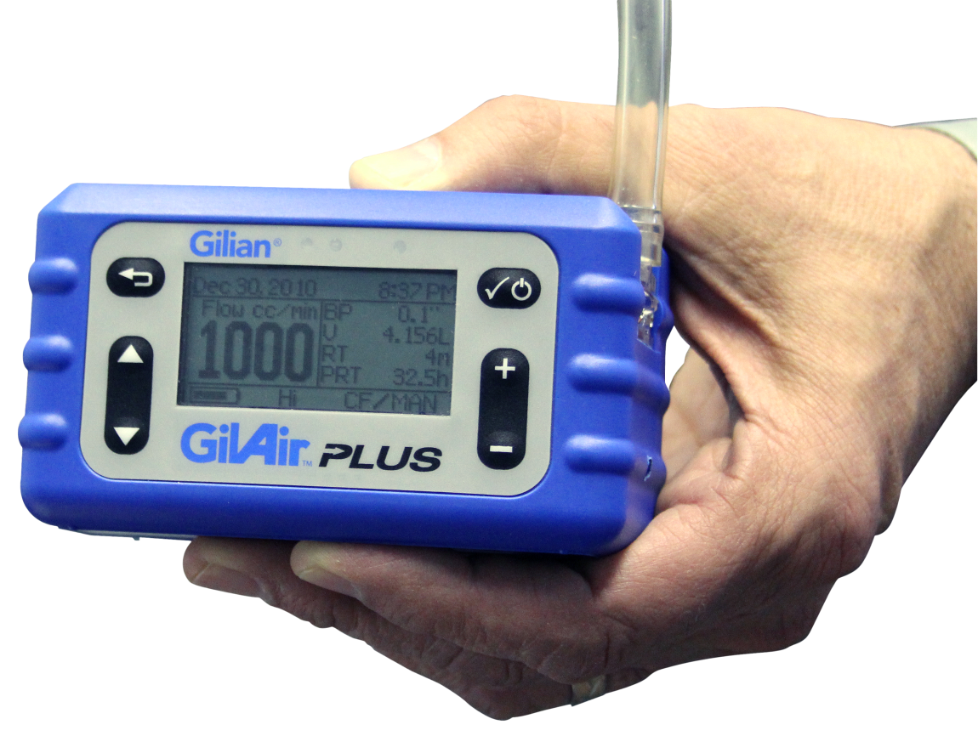
Traditional Cyclones for Respirable Silica Sampling
Dorr-Oliver 10 mm Nylon Cyclone at 1.7 LPM
Higgins-Dewell Cyclone at 2.2 LPM
Aluminum Cyclone at 2.5 LPM

Slide 4
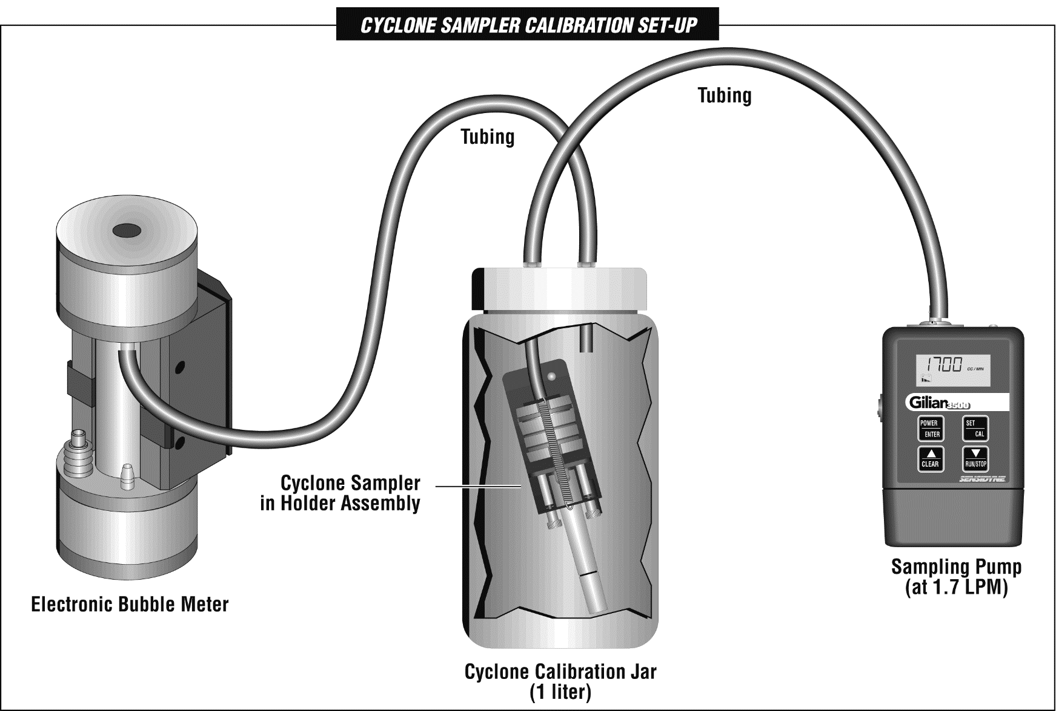
Cyclone Calibration Jar
For Dorr-Oliver Cyclone

Slide 5
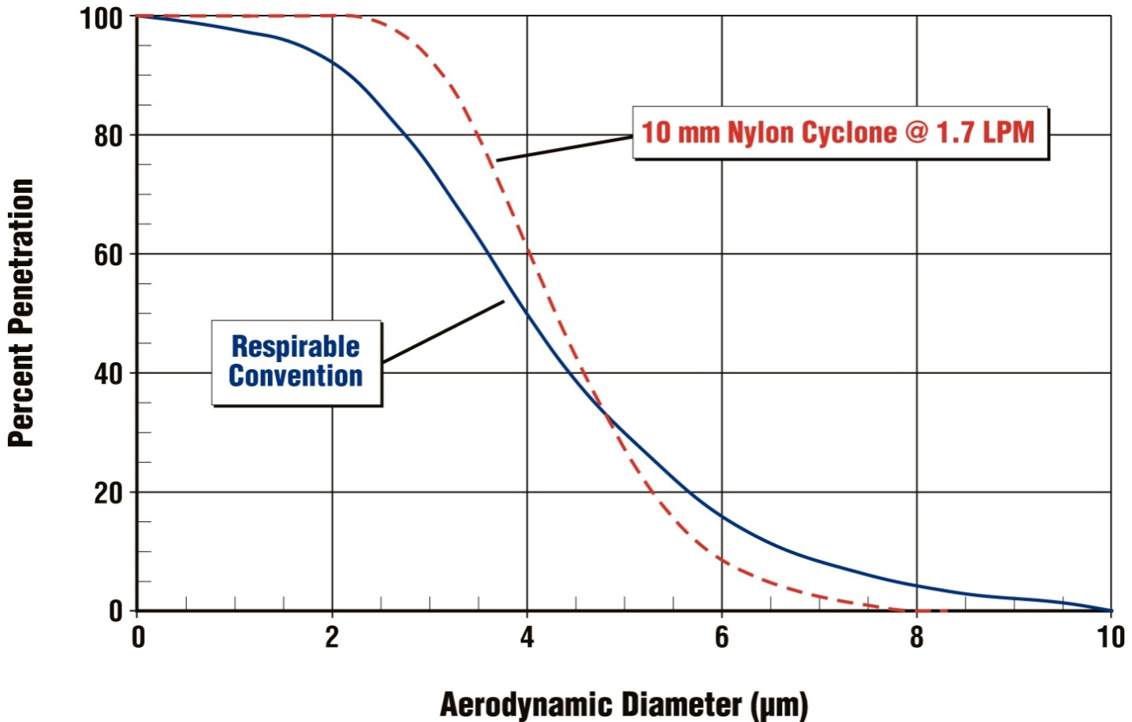
Particle Size Distribution-US ACGIH

Slide 6
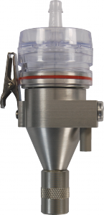
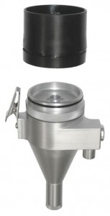
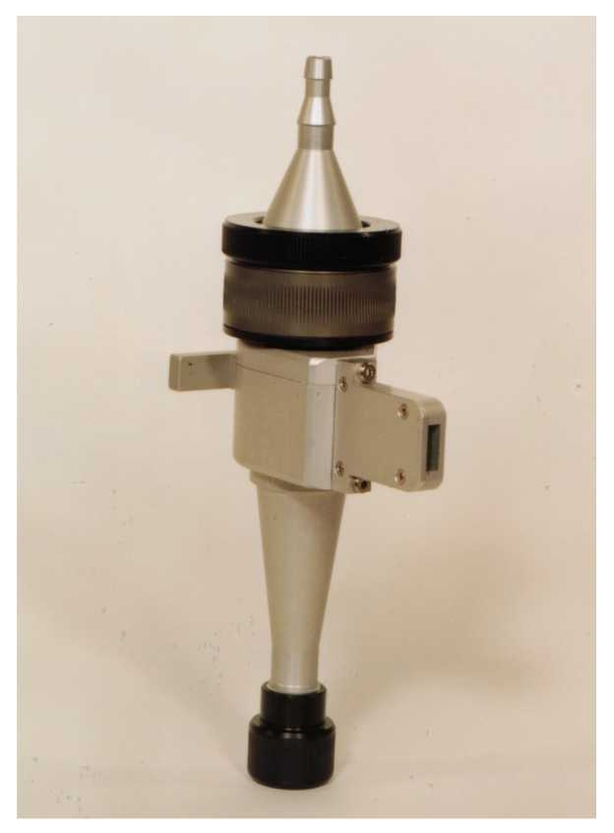
High Flow Rate Cyclones
GK 2.69 at 4.2 LPM (37mm NIOSH Cassette)
GK 4.162 RASCAL at 9 LPM (47mm)
FSP-10 at 11.2 LPM (37mm Euro Cassette)

Slide 7
NIOSH Testing of High Flow Cyclones
Performance of High Flow Rate Samplers for Respirable Particle Collection; NIOSH; Lee, Kim, Chisolm, Slaven & Harper; Amer Occup Hyg; Vol 54, No. 6, 2010.
Quartz Measurement in Coal Dust with High-Flow Rate Samplers: Laboratory Study; NIOSH; Lee, Lee, Kim, Chisolm, Kashon & Harper; Amer Occup Hyg; Vol 56, No. 4, 2011.

Slide 8
Gilian Cyclones
Cyclone Model | Part Number | Construct-ion Material | Overall Height (mm) | Approx. Weight (Kg) | Flow rate ACGIH Resp (50% @ 4 µm) (US) | Flow rate BMRC Respirable (50% @ 5 µm) (Europe) | Flow rate Thoracic (50% @ 10 µm)
10 mm Dorr-Oliver | 800061 | Nylon | 160 | 0.08 | 1.7 LPM
BGI-4L, HD style (US version) | 811-9924-01 | Aluminum | 105 | 0.15 | 2.2 LPM | 2.0 LPM | 1.0 LPM
FSP-2 HD style- European Version | 811-9930-01 | Aluminum | 130 | 0.14 | 2.2 LPM | 2.0 LPM
Medium flow rate GK 2.69 for 37 mm cassettes | 811-9926-01 | Aluminum | 125 | 0.10 | 4.2 LPM |  | 1.6 LPM
High flow rate RASCAL Cyclone with Plastic Filter Holder | 811-9925-01 | Aluminum | 170 | 0.26 | 8.5 to 9.5 LPM
FSP-10, High flow rate cyclone | 811-9931-01 | Aluminum | 203 | 0.26 | 11.2 LPM | 10 LPM

Slide 9
Gilian 10i High Flow Sampling Pump
4 – 10 LPM Flow Rates
Backpressure Capability up to 50” H2O @ 4 LPM
Intrinsically Safe Certified
Built on the Proven-reliable Gilian 5000 Platform

Slide 10
Gilian 12 High Flow Sampling Pump
Flow Rates from 4 – 12 LPM
Extreme Backpressure Capability to 67” H2O @ 4LPM
Designed for high Flow Rate Cyclones
Ideal for Sampling Trains Creating High Backpressure Across the Entire Sampling Period

Slide 11
Appendix A: Methods of Sample Analysis
“This appendix specifies the procedures for analyzing air samples for respirable crystalline silica, as well as the quality control procedures that employers must ensure that laboratories use when performing an analysis required under 29 CFR 1926.1153 (d)(2)(v)”.
References the six methods as acceptable for the laboratory analysis methodology & specifies minimum QA.
Makes the statement: “Optimizes methods and instruments to obtain a quantitative limit of detection that represents a value no higher than 25 percent of the PEL based on sample air volume”.

Slide 12
Methods Listed in Silica Standard For Lab Reference
Method No. | Analysis | LDL (1.7LPM)
OSHA ID-142 | XRD, Redeposition | 12.0 μg/m3 (qtz)
NIOSH 7500 | XRD, Redeposition | 6.12 μg/m3 (8 hr)
NIOSH 7602 | IR, KBr Pellet | 6.12 μg/m3 (8 hr)
NIOSH 7603 | IR, Redeposition | 12.24 μg/m3 (8 hr)
MSHA P-2 | XRD, Redeposition | 24.48 μg/m3 (8 hr)
MSHA P-7 | IR, Redeposition | 24.48 μg/m3 (8 hr)

Slide 13
Air Sampling Review
Must have a large enough sample to obtain a maximum limit of detection of 12.5 micrograms per cubic meter (i.e., 25% of 50 micrograms per cubic meter).
Must use the analysis by XRD or IR, as described in the six listed methods.
The laboratory must meet minimum specified QA requirements.

Slide 14
Air Sampling Equipment Review
Always observe the cyclone flow rate specification for meeting the ACGIH size selection curve (50% at 4 microns).
Always use a constant flow control pump that will keep the flow rate at +/- 5% of set flow.
A medium flow cyclone can meet the detecting limit in an 8 hour sample and still be comfortable to wear.

Slide 15
www.Sensidyne.com
Thank You
800-451-9444 / 727-530-3602

