Slide 1
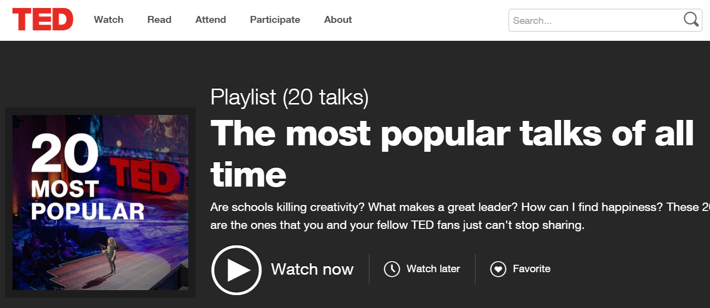

Improving Safety Presentations Using Lessons From TED Talks
Chesapeake Chapter AIHA 6/23/15
Bruce Lippy, Ph.D., CIH, CSP, FAIHA
Director of Safety Research, CPWR
blippy@cpwr.com
Notes:
Trainer Notes:

Slide 2

This is the good fight!
Thanks for your efforts on behalf of workers!

Slide 3
At the end of this session, I would like you to be able to:
List 5 key lessons from TED Talks to improve your presentations
Describe several art principles that can improve your training
Explain several ideas for improving PowerPoint presentations
Relate several sources of excellent non-copywritten images
Describe several delivery techniques that could improve your style (including humor)
Notes:
Questions: how many here use PowerPoint? How many use it to train workers?

Slide 4
List 5 key lessons from TED Talks to improve your presentations
Objective 1
1

Slide 5

What does TED stand for?
TED Talk Addict
“1700+ talks to stir your curiosity”
https://www.ted.com/
TED TIP
Notes:
Technology, Entertainment and Design. This book by Jeremey Donovan is an excellent distillation of the techniques that successful TED presentations have in common.

Slide 6
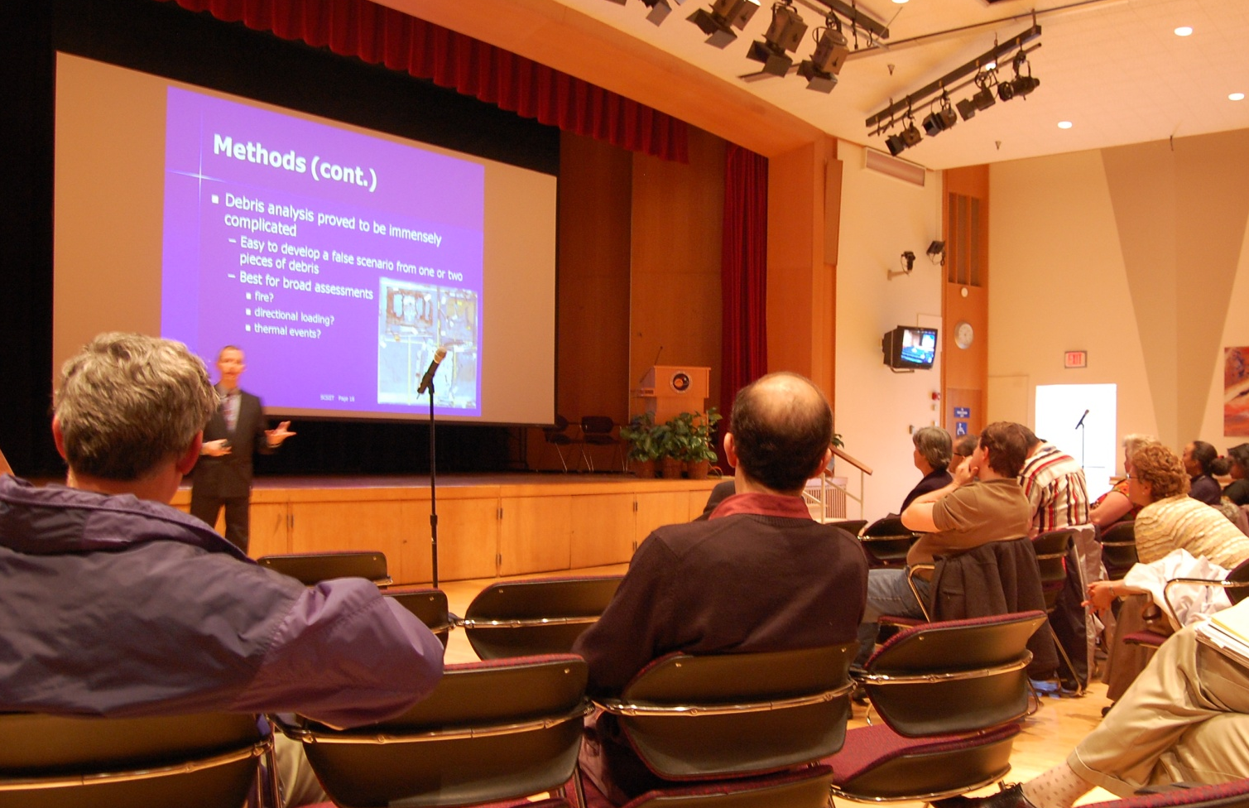
Remember that you speak in service of your audience
Who is that slide for?
TED TIP

Slide 7
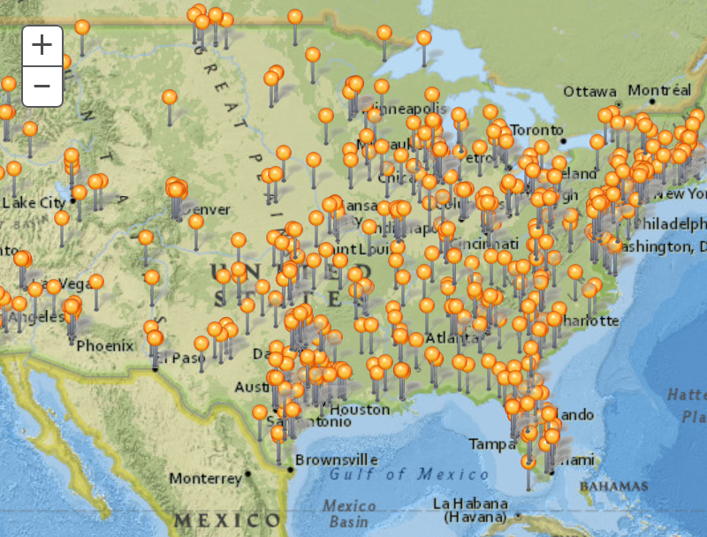
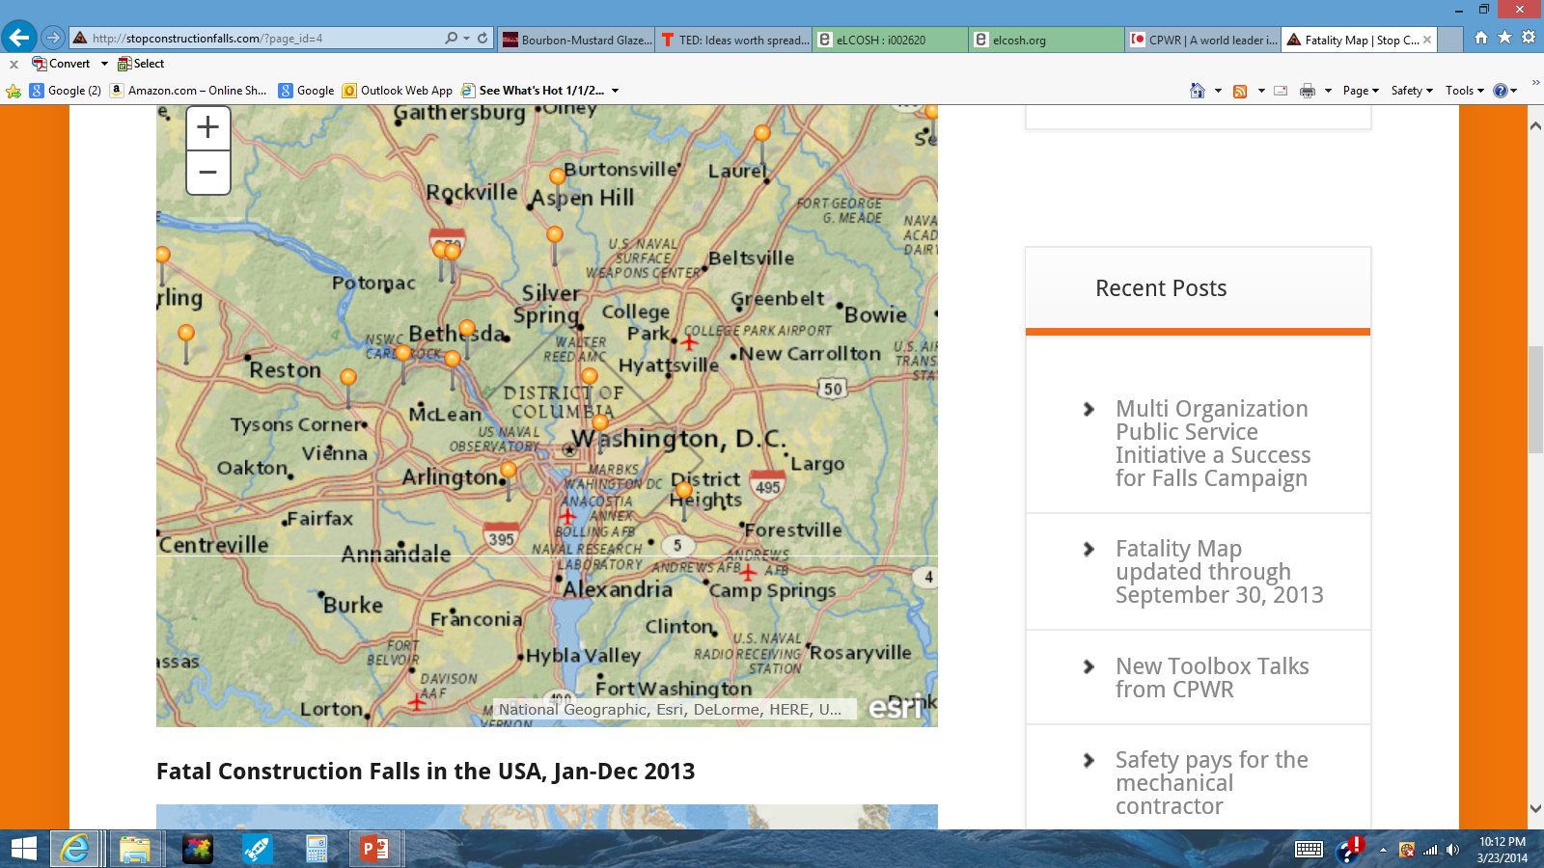

Determine whether you will deliver a story-driven or premise-driven narrative
TED TIP
Notes:
This is from CPWR’s Construction Fatality Map
MELVIN A. LEWIS "Butch"
Monday - 10/7/2013, 7:28am ET
WASHINGTON - An employee of MedStar Washington Hospital Center died Sunday afternoon after responding to a maintenance request and being overcome by fumes. In a news release, MedStar Washington said Melvin Lewis, a 15-year employee of the hospital, responded to a request to fix the air conditioning in the mechanical room of the hospital's East Building when the incident occurred. An employee who worked with Lewis in the engineering department assisted him, as did the Rapid Response Team. Both Lewis and the employee were taken to the emergency department at the hospital. Lewis later died.
From the obituary
On Sunday, October 6, 2013, of Washington, DC, departed from this life. He is survived by his son, Corey A. Lewis of Landover, MD. He also leaves behind two sisters, Kathy Lewis-Shepherd of Upper Marlboro, MD and Marion Young-Perkins of Clinton, MD. He was predeceased by his mother, Marion Lewis-Way; sister, Joanne Lewis and son, Amia James Lewis. Viewing Monday, October 21, 2013, at Johnson & Jenkins Funeral Home, 716 Kennedy St., NW from 6 to 9 p.m. A Celebration of Butch's Life will be held at Community of Hope AME Church, 3701 Branch Ave., Temple Hills, MD 20748, on Tuesday, October 22, 2013. Viewing 9:30 a.m. until time of service at 11 a.m.
- See more at: http://www.legacy.com/obituaries/washingtonpost/obituary.aspx?pid=167596648#sthash.OLIVXio6.dpuf

Slide 8

Do not cram too much into your talk
TED TIP
Photo courtesy Wikimedia and Jorge Royan
TED TIP

Slide 9
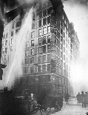
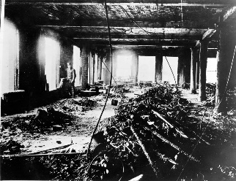
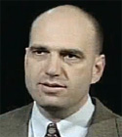

Bring your audience into your setting
Triangle Shirtwaist Factory March 25, 1911
Notes:
David von Drehle does a masterful job of bringing his audience into the 9th floor of that inferno with vivid descriptions that cover all the senses.
The Triangle Shirtwaist Factory fire in Manhattan New York City on March 25, 1911, was one of the deadliest industrial disasters in the history of the city, and resulted in the fourth highest loss of life from an industrial accident in U.S. history. It was also one of the deadliest disasters that occurred in New York City – after the burning of the General Slocum on June 15, 1904 – until the destruction of the World Trade Center 90 years later. The fire caused the deaths of 146 garment workers – 123 women and 23 men ^{[1]} – who died from the fire, smoke inhalation, or falling or jumping to their deaths. Most of the victims were recent Jewish and Italian immigrant women aged sixteen to twenty-three;^{[2][3][4]} of the victims whose ages are known, the oldest victim was Providenza Panno at 43, and the youngest were 14-year-olds Kate Leone and "Sara" Rosaria Maltese.[

Slide 10
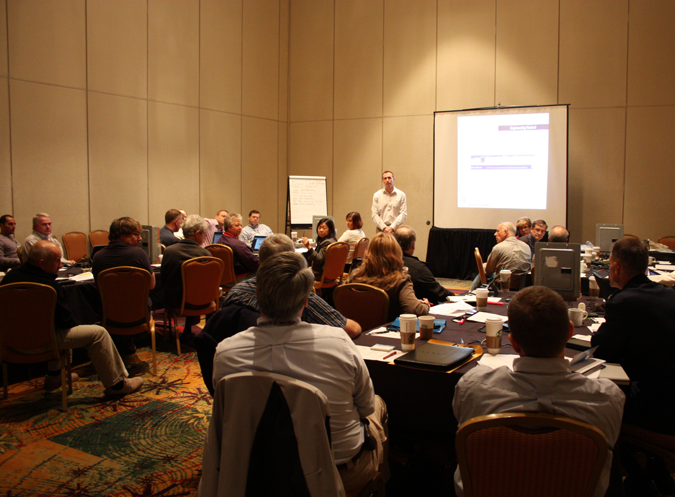
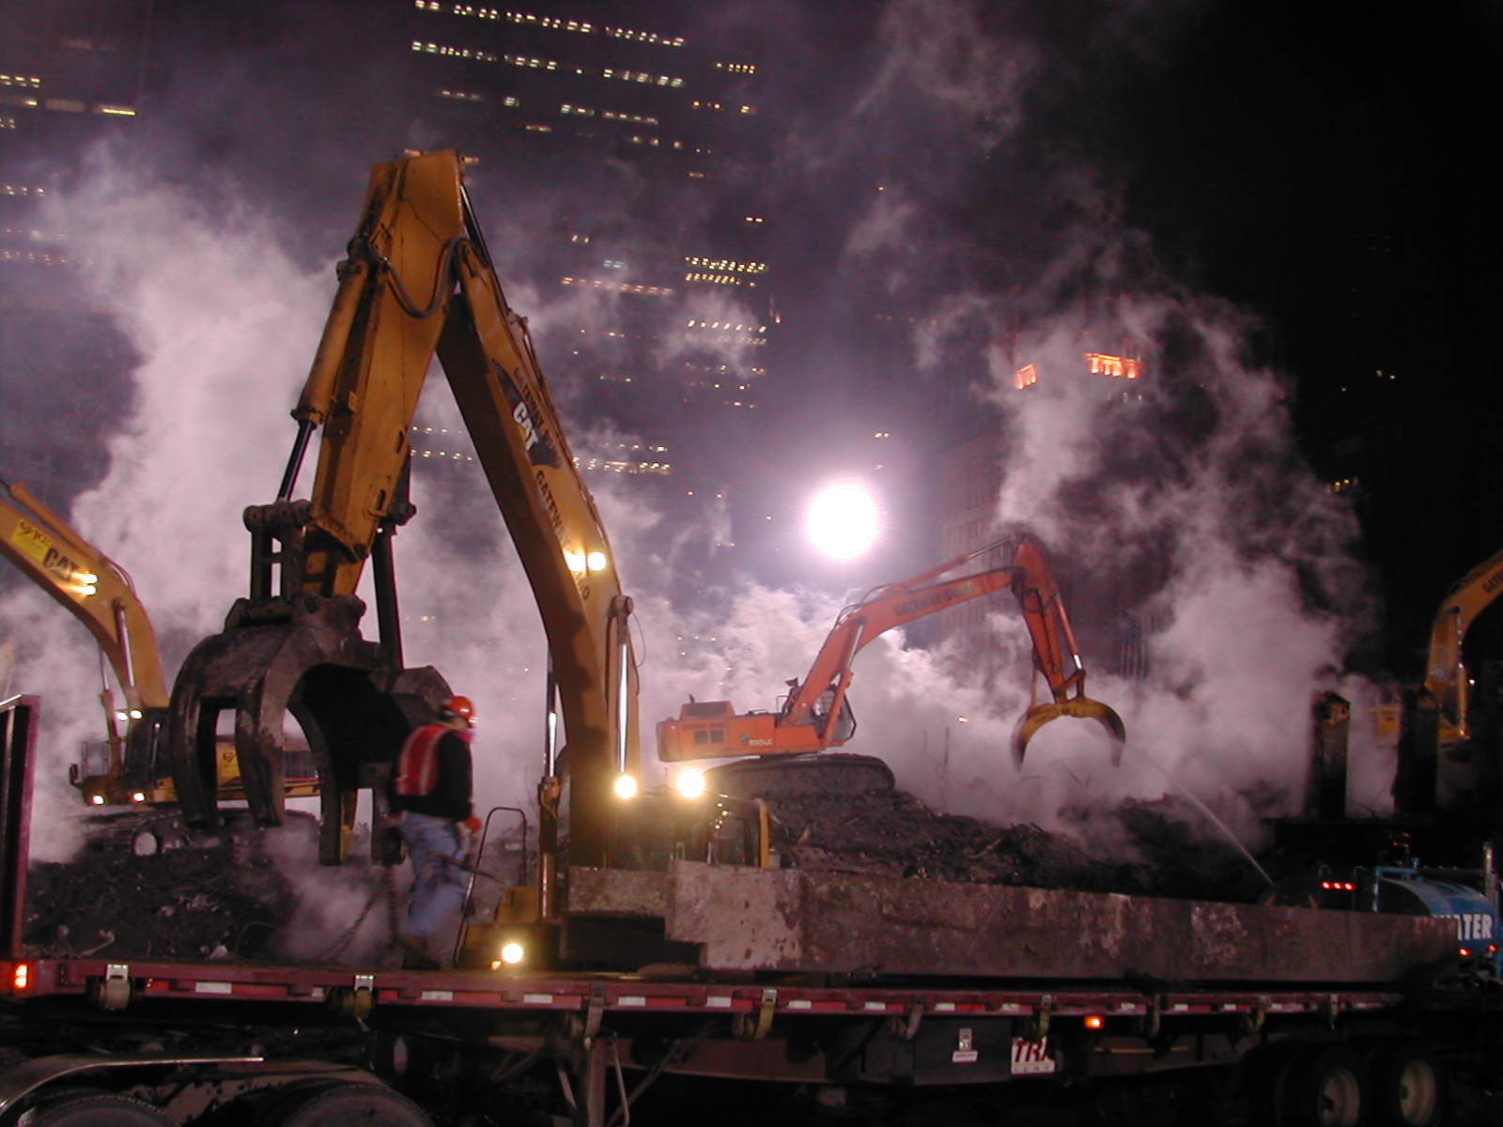
Understand your audience
Central versus Peripheral Processors (Cacioppo and Petty, 1987)
TED TIP
Notes:
Likelihood Elaboration Model of Cacioppo and Petty says that there are two broad ways that people process information that leads to action. Central processors (generally people with higher education) can better handle multiple sources and points of view to come to a decision. They handle dissonance better. Peripheral processors are less comfortable with objective data and bounded results and tend to come to decisions after running information through filters (heuristics) that

Slide 11
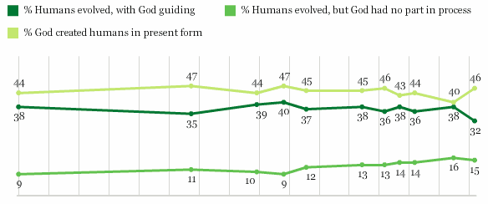
47% of Americans believe that humans were created in their present form within the last 10,000 years
1982
2012
“Almost half of Americans today hold a belief, at least as measured by this question wording, that is at odds with the preponderance of the scientific literature.” Gallup, June 1, 2012
Notes:
Forty-six percent of Americans believe in the creationist view that God created humans in their present form at one time within the last 10,000 years. The prevalence of this creationist view of the origin of humans is essentially unchanged from 30 years ago, when Gallup first asked the question.
As Gallup reported: “Almost half of Americans today hold a belief, at least as measured by this question wording, that is at odds with the preponderance of the scientific literature.” June 1, 2012
This can be seen as an example of peripheral processing of scientific information to fit an accepted belief.

Slide 12
Provide clear verbal and visual cues that you are transitioning between sections
How can we do this?
TED TIP

Slide 13

Employ language that clearly signals you are concluding your talk
Summarize your ideas in your conclusion
TED TIP
Notes:
This is important because people always perk up at the end of the talk so you can hit them again with the key points. They will be more alert according to several sources.

Slide 14
“Your goal should be to become an expert who speaks rather than an expert speaker.”
Jeremey Donovan,
How to Deliver a TED Talk

Slide 15
Describe several art principles that can improve your training
Objective 2
1
2

Slide 16
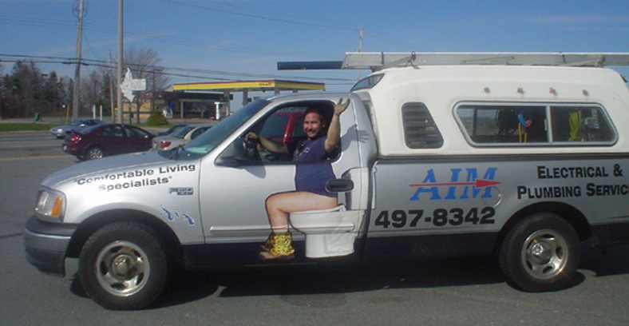
Images are stronger than words

Slide 17
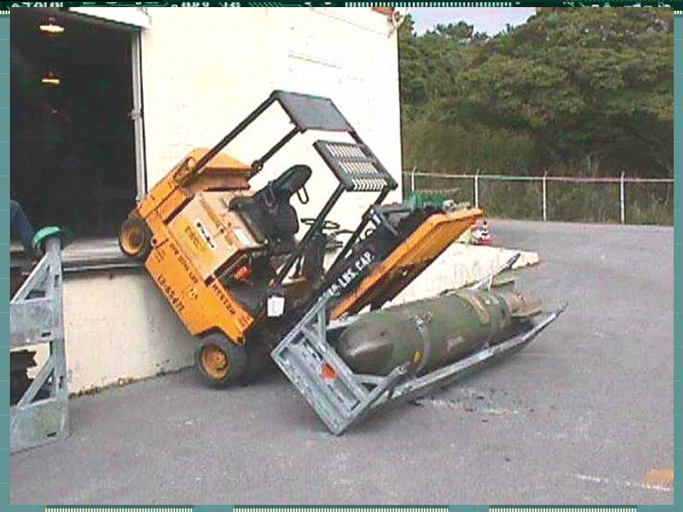
Watch for photo-shopped images
Bomb added

Slide 18
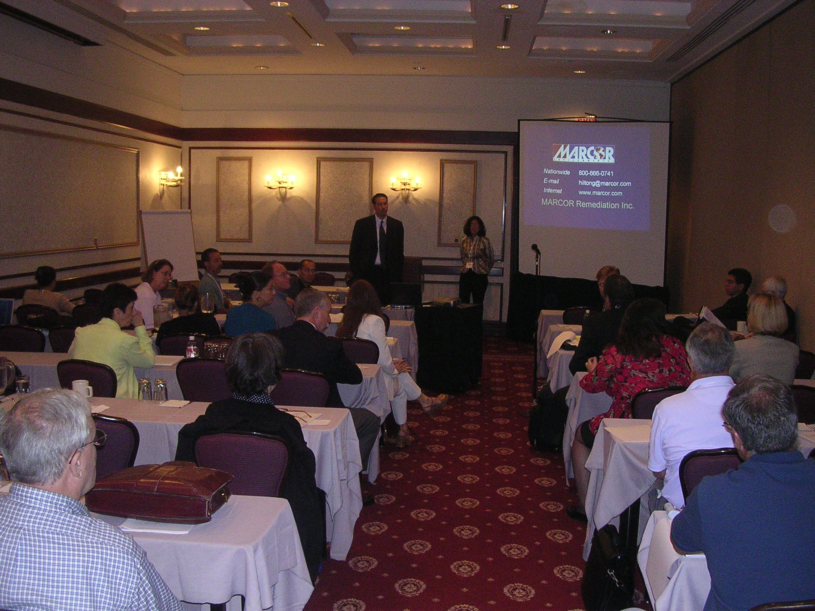
Point size is relative during presentations. Keep it large!

Slide 19
Sans serif faces are easier to read than serif faces. Use Calibri, Arial or Tahoma, bold
Times New Roman has serifs
Serifs

Slide 20
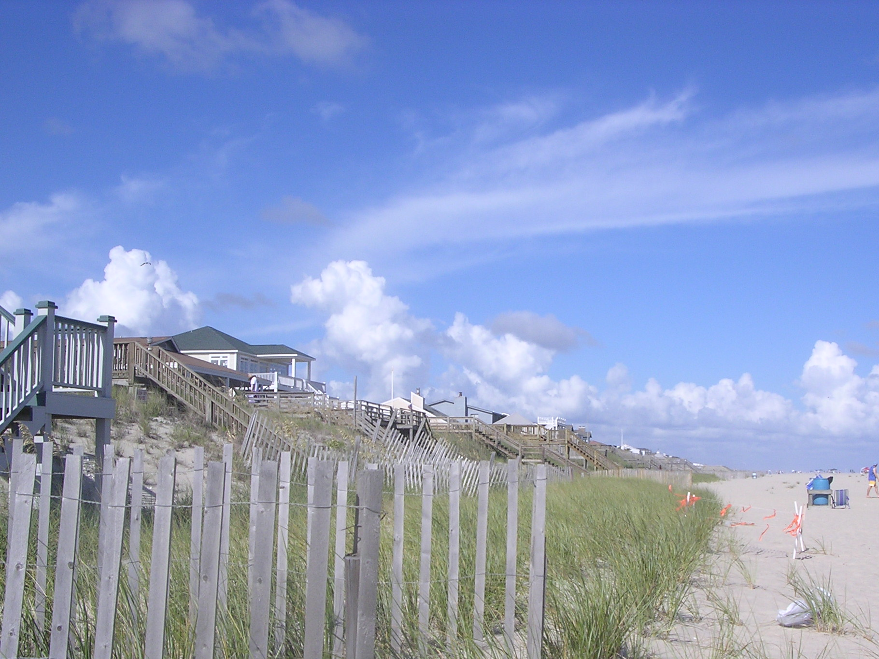
The rule of thirds defines the interesting points in an image. Try it!

Slide 21
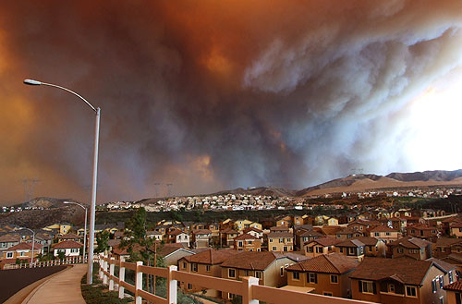
Photo: FEMA

Slide 22
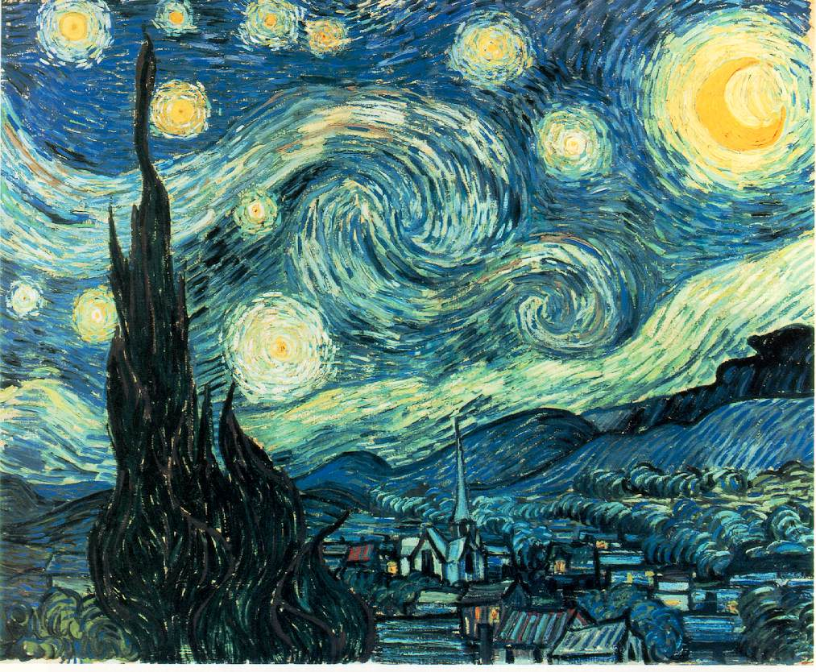
Notes:
This is Van Gogh’s Starry Night

Slide 23

Acknowledge the illusion
Bonus for translation from the French!
Rene Magritte’s painting
Ceci n’est pas une pipe.

Slide 24
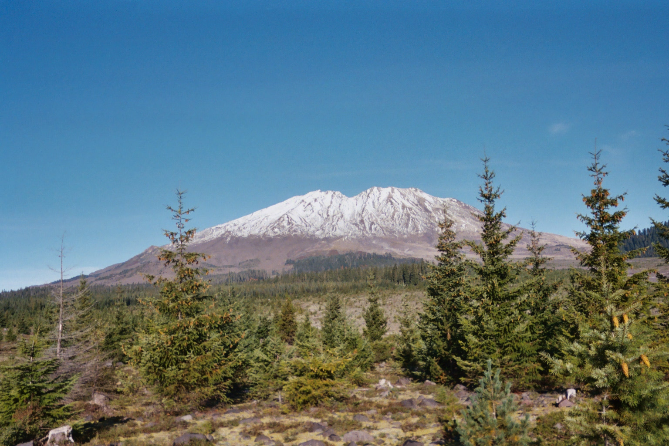
Bring items into the foreground to create 3-D illusion

Slide 25
Keep graphics simple and emphasize what is important
Notes:
Try to avoid 3-dimensional pie charts. They distort the closest section. The red arrows point to the same proportional section of two pie charts, but the one above appear larger

Slide 26
Explain several ideas for improving PowerPoint presentations
Objective 3
1
2
3

Slide 27
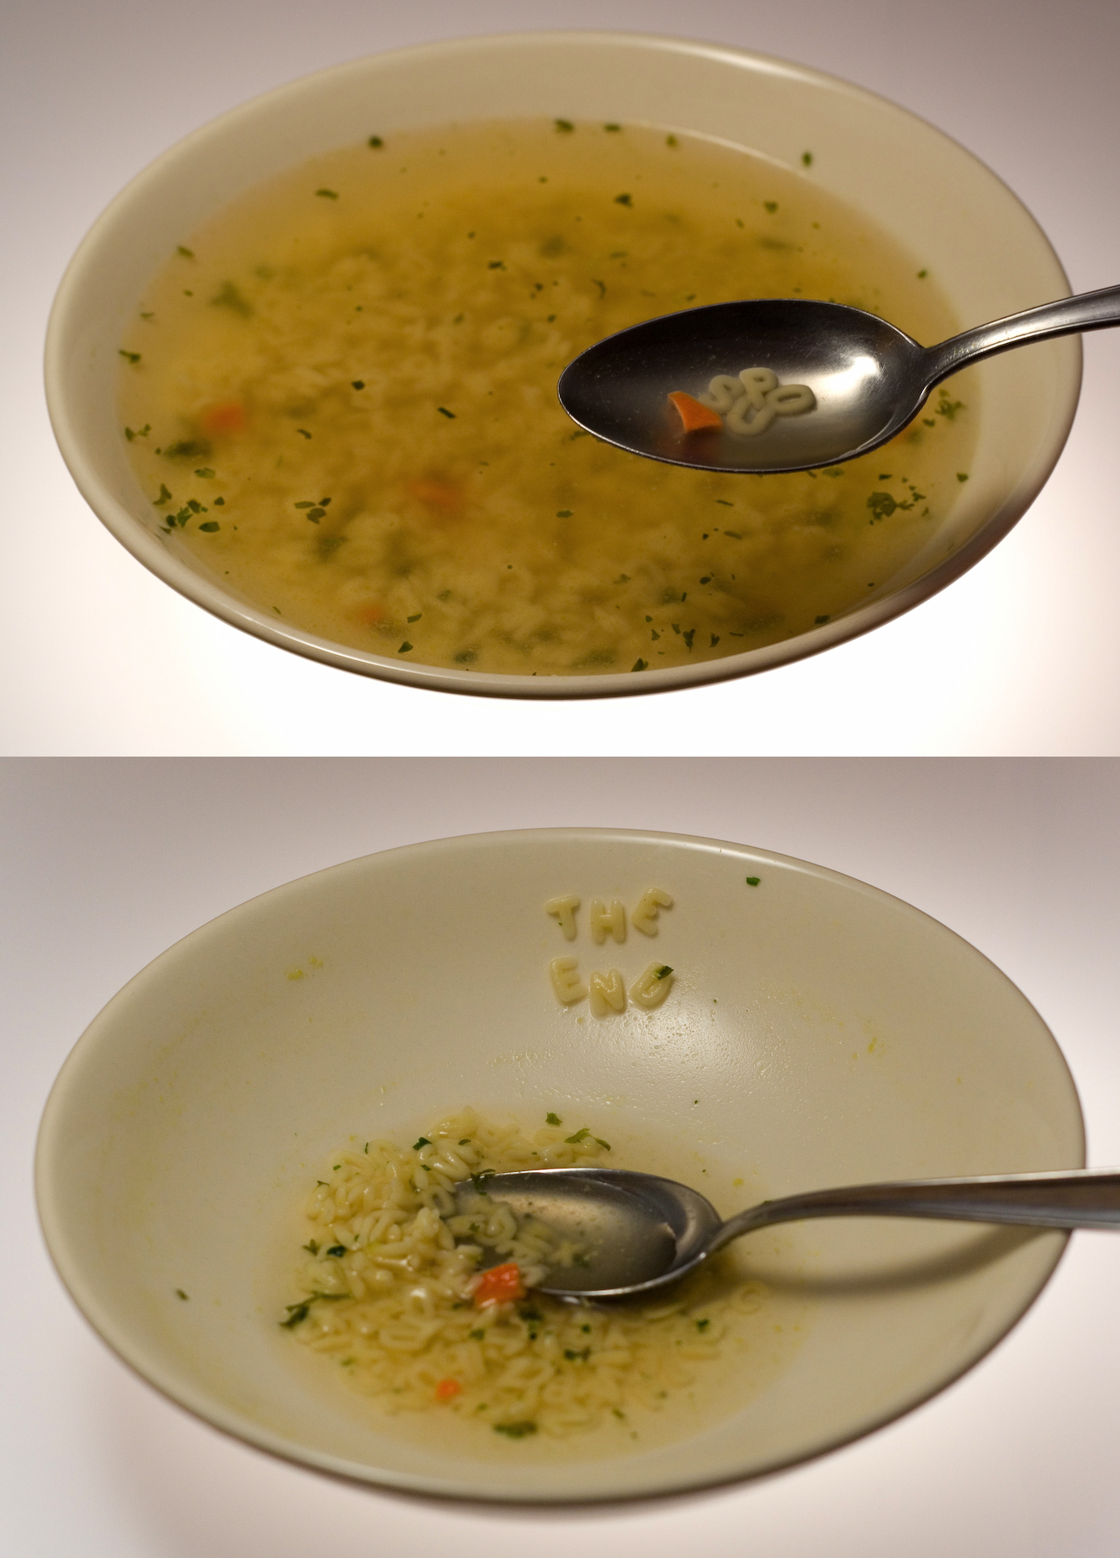
The credibility and energy of the trainer is more important than the technology
Notes:
Wayne Thomas was the safety person at Black & Decker in Hampstead. He created slides by having his wife help him fish out letters from alphabet soup and put them on a velvet cloth to spell words, which he shot on a camera stand. He was tremendously respected at the plant as a safety professional and so folks paid attention to his safety talks. He had credibility.

Slide 28
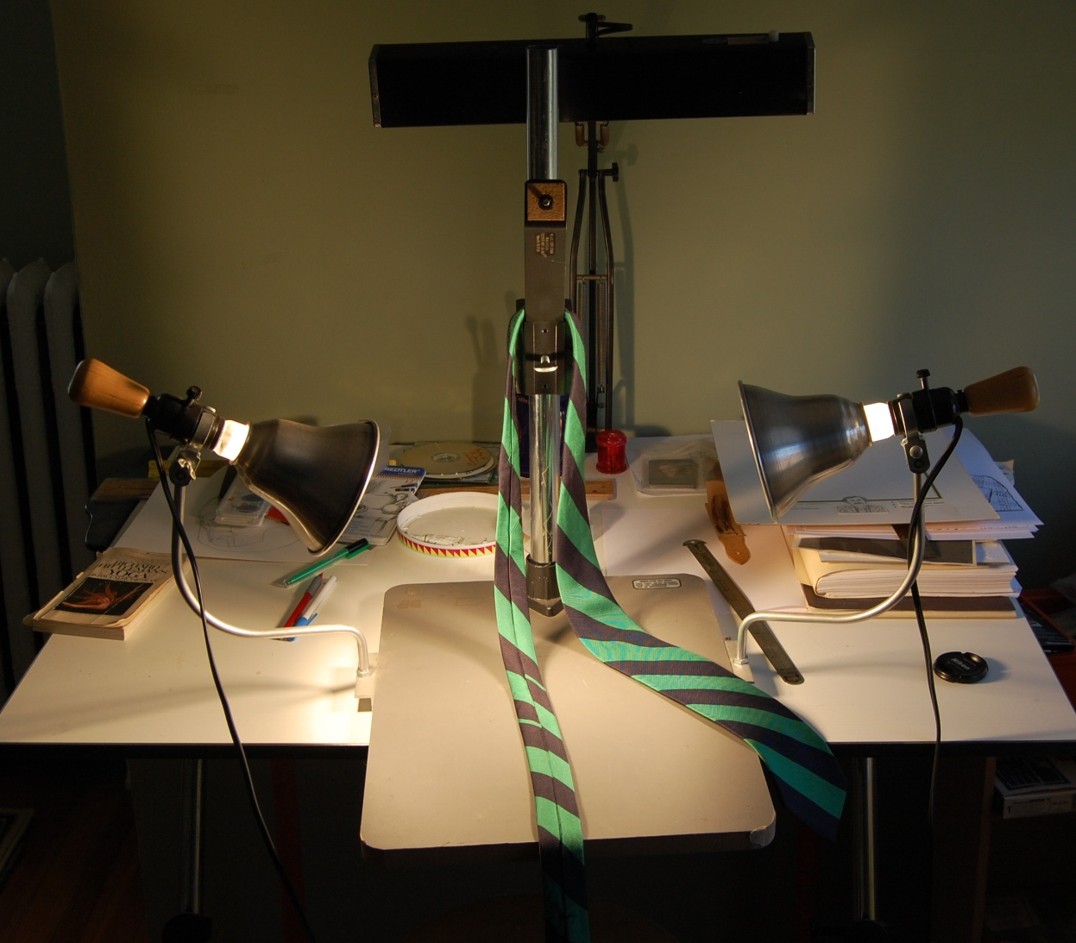
How many here have a love/hate relationship with PowerPoint?
Yeah, me, too!

Slide 29
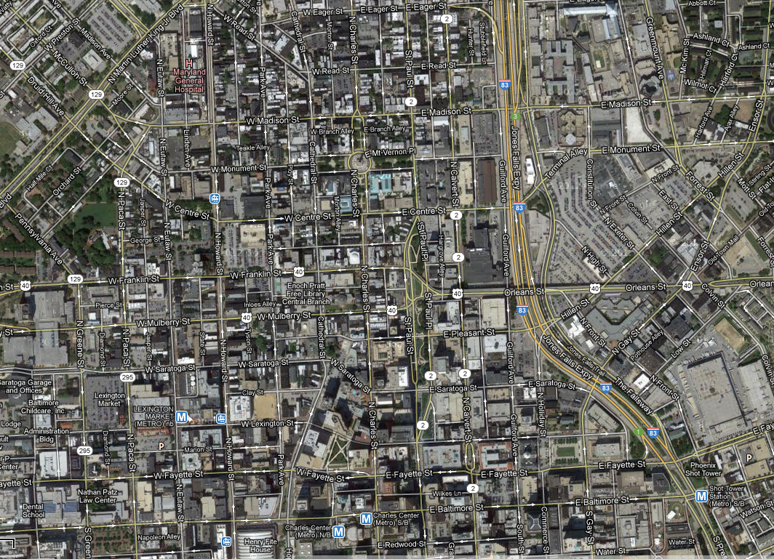
The trail of tears
Notes:
This is the path in Baltimore City I repeatedly took running at full speed in a suit (without my tie) to drop off slides at a lab by 1:00pm so they would be ready at 5:00pm for my Maryland OSHA colleagues who had a speech the next day.

Slide 30
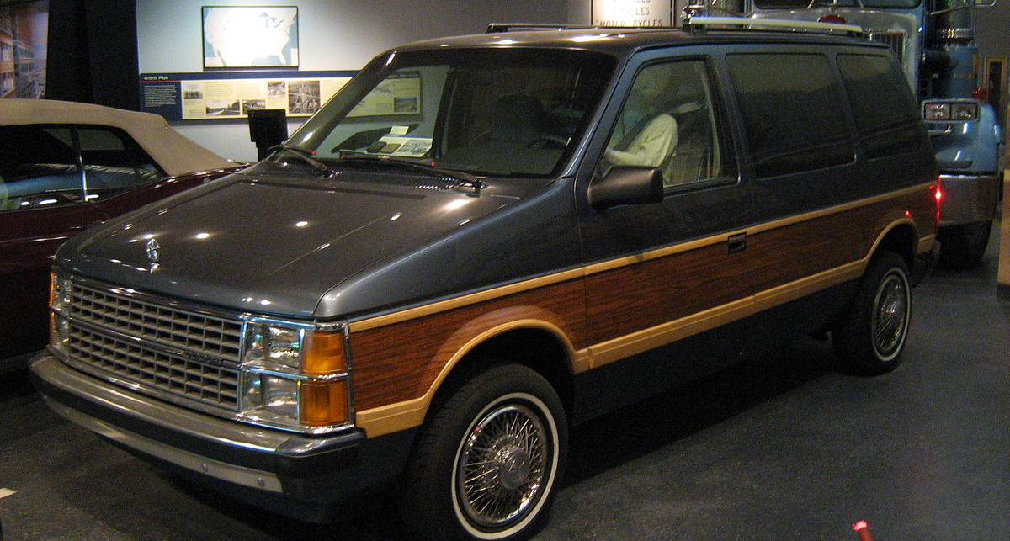
When was PowerPoint created?
1986 Caravan at the Smithsonian American History Museum
1986 by Robert Gaskins and Dennis Austin
Notes:
In 1986 it was difficult to include graphics into software. Who remembers Harvard Graphics?

Slide 31
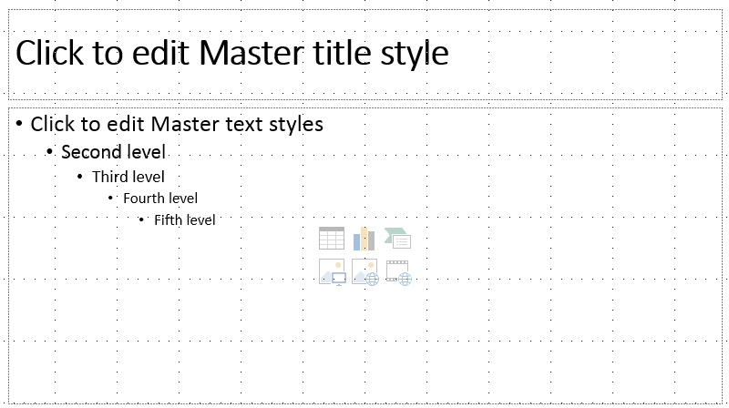
The default for PowerPoint hasn’t changed and was never based on research (Michael Alley, Penn State)
40% of engineering and science presentation used this default
Notes:
Michael Alley and his team reviewed thousands of PowerPoint slides from engineering and science presentations and found 40% used this default.

Slide 32
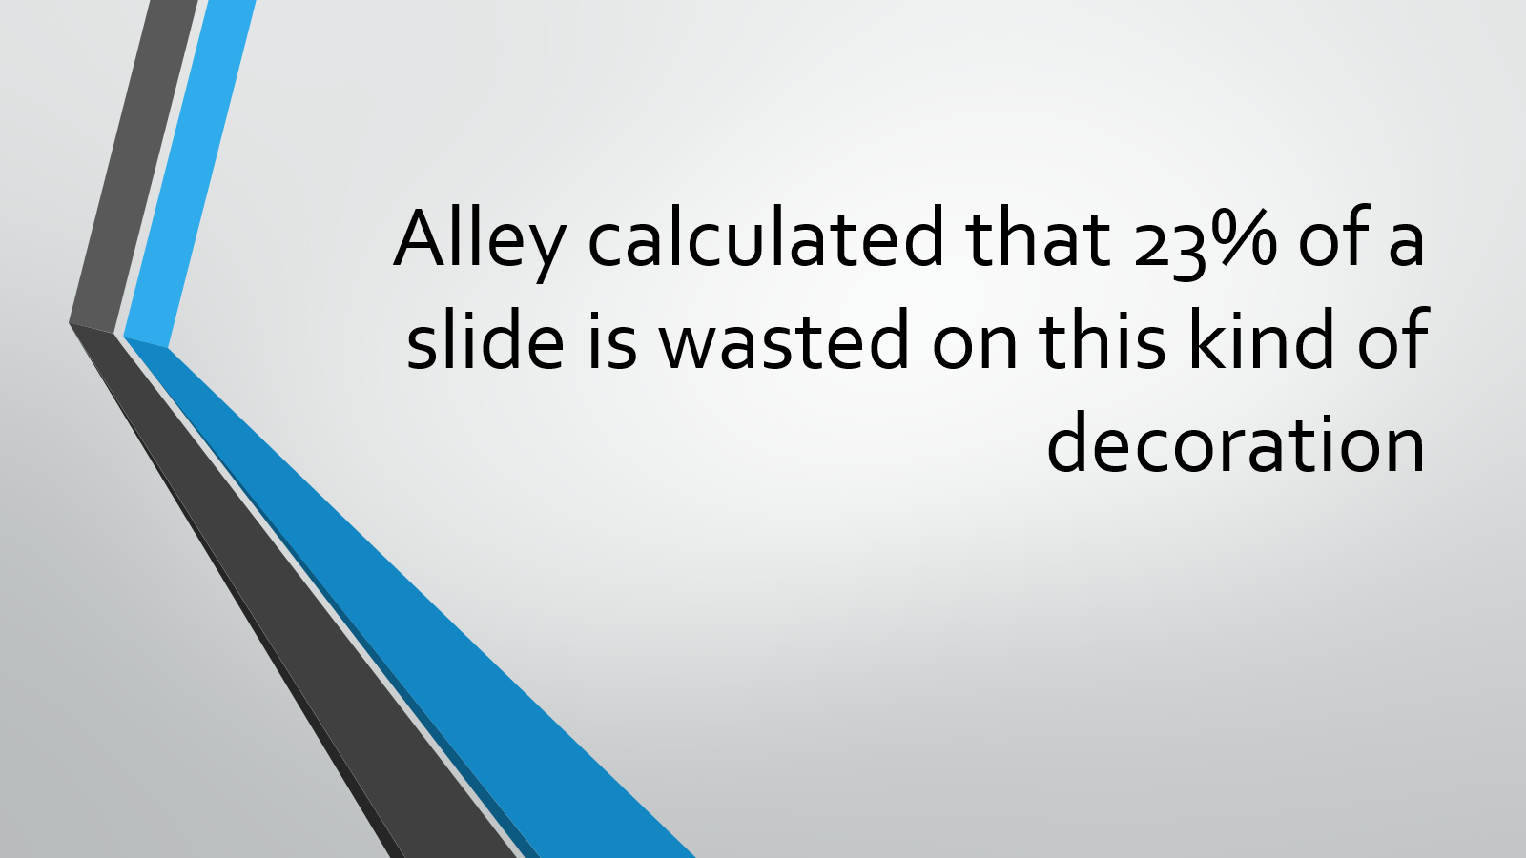
Backgrounds and logos waste space

Slide 33
What do the PowerPoint detractors say?
“Power corrupts. PowerPoint corrupts absolutely.”
Edward Tufte, Professor Emeritus, political science, computer science and graphic design, Yale
Notes:
Julia Keller, from the Chicago Tribune said, “Its astonishing popularity, the way it has spread exponentially through the culture, seems analogous, in a way, to drugs. Think of it as technological cocaine – so effortless to embrace initially, so difficult to relinquish after that. People who once use PowerPoint generally don’t stop using it.

Slide 34
"It's much easier to write a presentation if you're writing in bullet grunts."
Edward Tufte, "The Cognitive Style of PowerPoint"

Slide 35
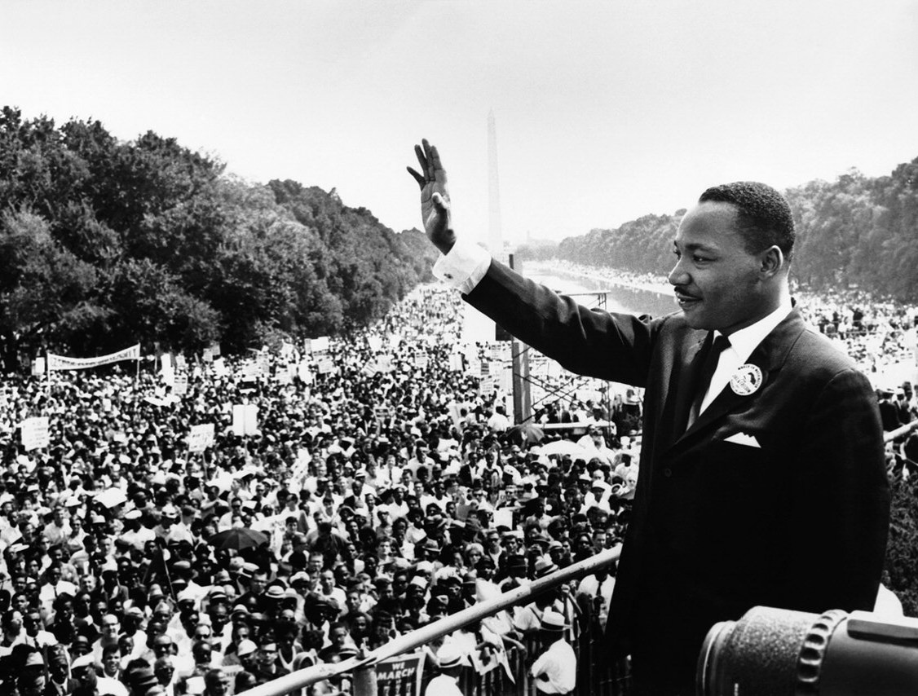
Dr. Martin Luther King did not need PowerPoint
I have a chart

Slide 36
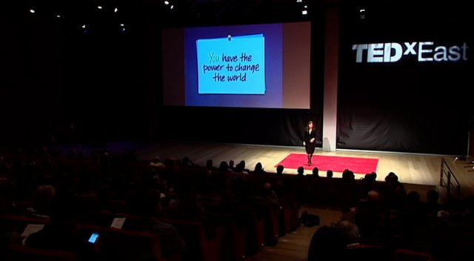
“The audience will either read your slides or listen to you. They will not do both.”
Nancy Duarte at her TED talk
What famous presentation did she create?
Notes:
Nancy Duarte: The audience will either read your slides or listen to you. They will not do both.” Nancy Duarte follows this up with: “So ask yourself this: is it more important that they listen, or more effective if they read?”

Slide 37
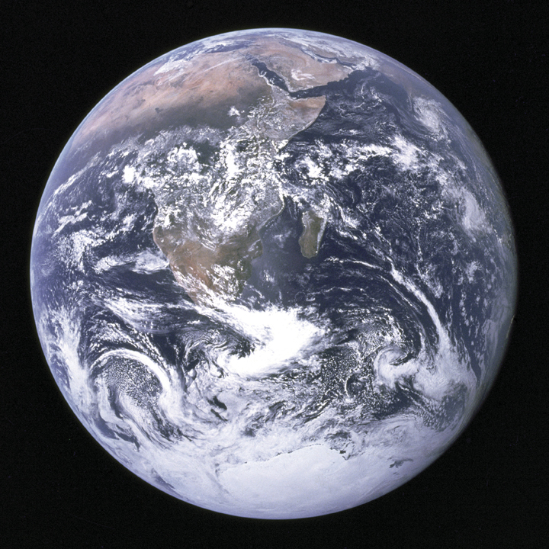
A Convenient Hint
Al Gore’s, An Inconvenient Truth

Slide 38
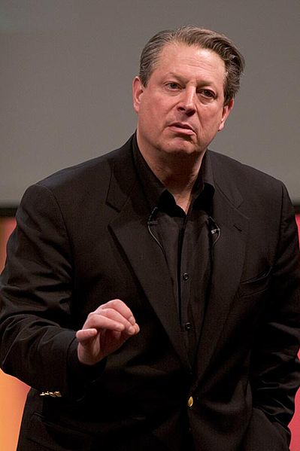
What lessons can we take from Al Gore’s presentation?
Visuals rule
The number of slides doesn’t matter
The audience, not you
Use a remote
Use call-outs
This beats a laser dot
Photo courtesy Wikimedia, Photo copyrighted by Brett Wilson
Notes:
After watching the presentation, few people would be able to tell that there are 266 slides in the presentation. They would also say that they didn’t feel like Mr. Gore was rushing through slides

Slide 39
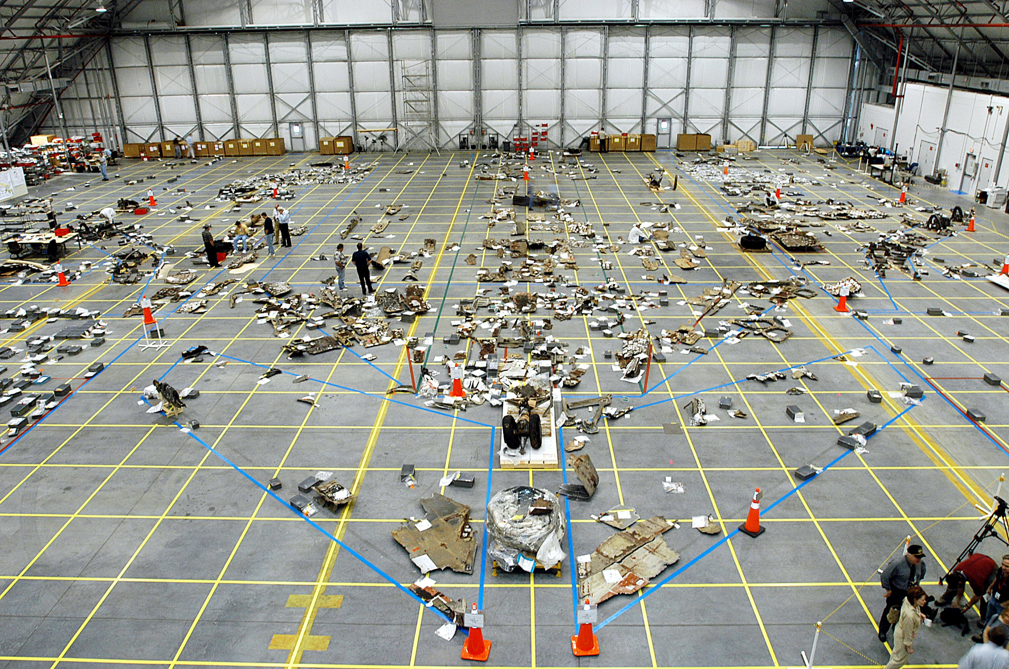
Did PowerPoint contribute to the Columbia Space Shuttle Disaster?
KSC, Photo courtesy NASA
Notes:
No copyright protection is asserted for this photograph. If a recognizable person appears in this photograph, use for commercial purposes may infringe a right of privacy or publicity. It may not be used to state or imply the endorsement by NASA employees of a commercial product, process or service, or used in any other manner that might mislead. Accordingly, it is requested that if this photograph is used in advertising and other commercial promotion, layout and copy be submitted to NASA prior to release.
PHOTO CREDIT: NASA or National Aeronautics and Space Administration
KENNEDY SPACE CENTER, FLA. - A grid on the floor of the RLV Hangar is filling up with pieces of Columbia debris that have been collected by workers in the field. The blue lines reflect the outline of the orbiter. The Columbia Reconstruction Project Team is identifying pieces and placing them on the grid approximating their location on the orbiter to facilitate the investigation into the accident that caused the destruction of Columbia and loss of its crew as it returned to Earth following mission STS-107. To date, about 25 percent of the orbiter has been delivered to the hangar.

Slide 40
Review of Test Data Indicates Conservatism for Tile Penetration
The existing SOFI on tile test data used to create Crater was reviewed along with STS-87 Southwest Research data
  Crater overpredicted penetration of tile coating
  significantly
    Initial penetration to described by normal velocity
      Varies with volume/mass of projectile (e.g. 200ft/sec for 3 cu.in)
    Significant energy is required for the softer SOFI particle to penetrate the relatively hard tile coating
      Test results do show that it is possible at sufficient mass and velocity
    Conversely, once tile is penetrated SOFI can cause significant damage
      Minor variations in total energy (above penetration level) can cause significant tile damage
  Flight condition is significantly outside of test database
    Volume of ramp is 1920 cu in vs 3 cu in for test
Notes:
This is a reproduction of the actual slide used by the Debris Assessment Team to inform the Mission Evaluation Room manager about the amount of potential damage caused by the foam. Note there are four levels of indents. Significant is used throughout with different meanings. The sentence fragments, passive voice led to the upper management perceiving the risk to be lower than the engineers were trying to express. The Accident Investigation Board wrote:
As information gets passed up an organization hierarchy, from people who do analysis to mid-level managers to high-level leadership, key explanations and supporting information is filtered out. In this context, it is easy to understand how a senior manager might read this PP slide and not realize that it addresses a life-threatening situation…The Board views the endemic use of PowerPoint briefing slides instead of technical papers as an illustration of the problematic methods of technical communication at NASA. (August 2003)

Slide 41
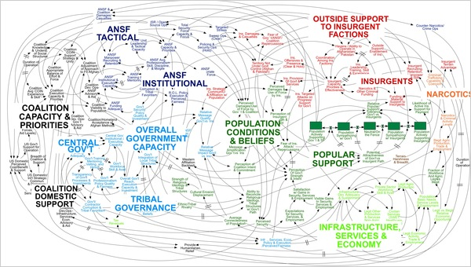
“When we understand that slide, we’ll have won the war,” General McChrystal
The famous Spaghetti slide
http://www.nytimes.com/2010/04/27/world/27powerpoint.html?_r=0
Notes:
http://www.nytimes.com/2010/04/27/world/27powerpoint.html?_r=0

Slide 42


Use real people, not clip-art
Where is my face?
Photo courtesy
Kiewit Power Constructors
Notes:
Photo courtesy of Kiewit Constructors

Slide 43
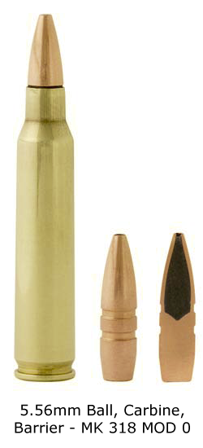
Bullets Kill

Slide 44
Bullet laws from Nancy Duarte
Protect audience
Use sparingly
Write headlines
Use parallel structure
Avoid sub-bullets
Notes:
Protect audience
Use sparingly
Write headlines
Use parallel structure
Avoid sub-bullets

Slide 45
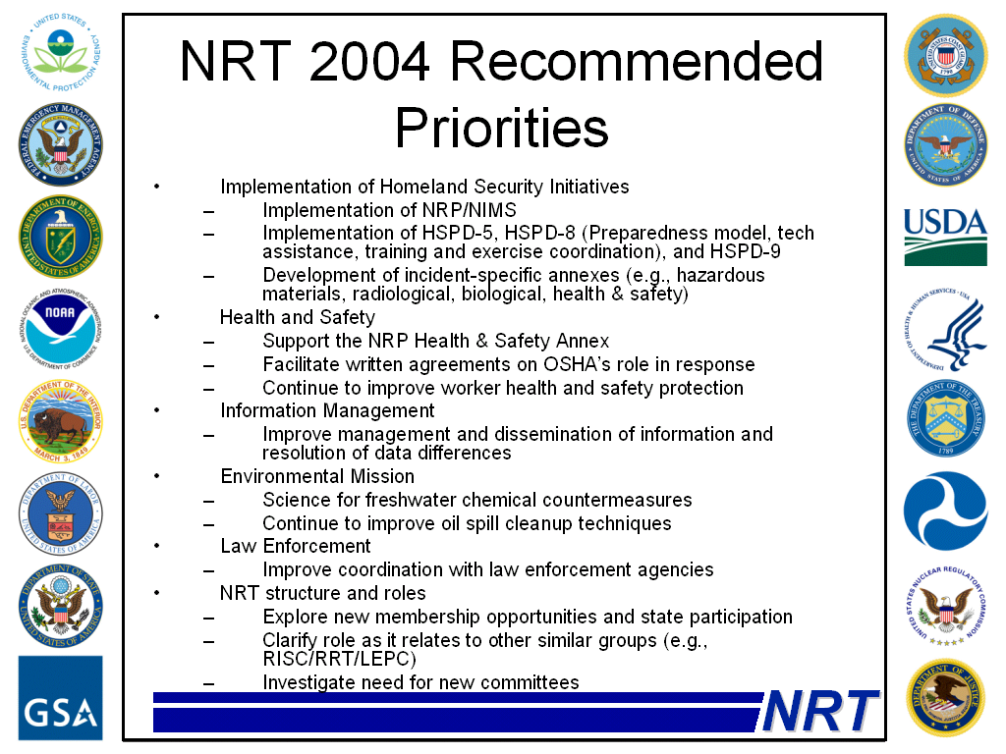
Notes:
This is awful. Too much copy, no complete sentences

Slide 46
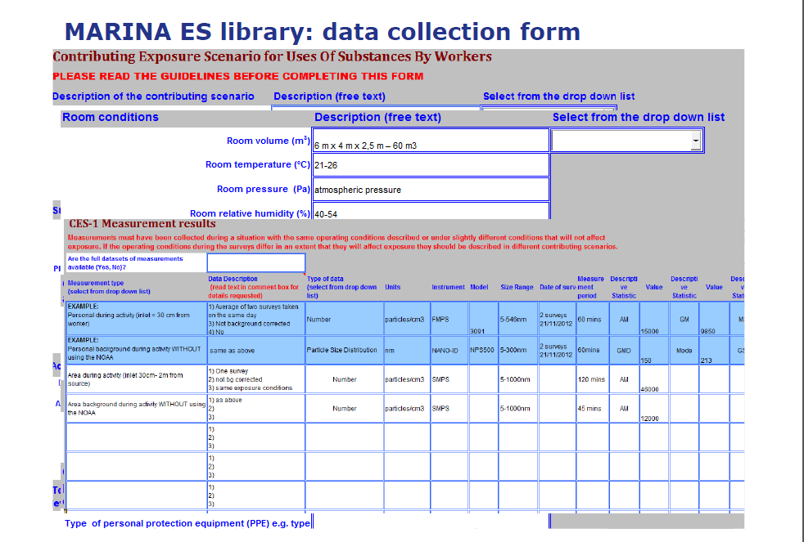
Avoid: “I know you can’t read this” and “Sorry for the eye chart”

Slide 47
How can we emphasize key data?
Unspecified composition | 178 | 38.9
nanofibers | 1 | 0.2
nanomaterials | 15 | 3.3
nanoparticles | 76 | 16.6
nanotechnology | 70 | 15.3
nanotubes | 1 | 0.2
photocatalytic materials | 5 | 1.1
reference to 'nano' | 10 | 2.2
Nanotechnology 70 15.3%
Notes:
178 (38.9%) did not specify the composition.

Slide 48

Researchers suggest using an “Assertion-Evidence” format
Dr. Michael Alley is key proponent
Notes:
Assertion-Evidence Slide Design: A Successful Alternative
As mentioned, over the past two decades, several people have advocated a slide design that is distinctly different from what Microsoft PowerPoint. This alternative slide design features a succinct sentence headline that states the main assertion of the slide. That assertion is then supported by evidence presented in a visual manner. Presented in Figure 1 and Figure 2 are excellent examples of this design. Each headline states the principal assertion of the slide, and each slide body supports that assertion in a visual manner. In each slide body, words are incorporated, but only as needed. Bullet lists are not used.
This assertion-evidence design, which was presented in a November 2005 article in Technical Communication [Alley and Neeley, 2005], addresses the two mentioned weaknesses of the traditional design: unclear main assertion and lack of connections in the evidence. In addition, this assertion-evidence design addresses many of the weak typography and layout defaults of Microsoft PowerPoint. For instance, the new design calls for specific stylistic, typographic, layout, and animation guidelines that have arisen from more than 150 critique sessions, run by Alley, of engineering and scientific presentations at universities, in industry, and at national laboratories. Given in Figure 3 is a contrast of a teaching slide that uses the traditional topic-subtopic design and this new assertion-evidence design.
Came out of Lawrence Livermore and Hughes Aircraft in the 1970s.
Several advantages exist to using this assertion-evidence design [Alley and Neeley, 2005]. First, the assertion headline more readily orients the audience during the presentation to the purpose of each slide. Second, having a sentence headline allows the presenter to clearly emphasize the most important assertion of the slide by giving that assertion more typographical emphasis than it would receive in a bullet list within the body of a traditional slide. Third, according to Professor Stacy Gleixner [2006] who heads the NSF PRiME project for teaching materials science and who has converted the slides in that project to this design, "Following the design would improve my lectures even if the old slides were projected, because when I create a sentence headline, I think about what main assertion I want the students to remember from that slide. Just that act makes my lectures more focused."
Visual evidence in the body of the slide also has major advantages over the traditional bullet list. According to Professor Richard Mayer's principles [2001] for multimedia design, audiences learn better from relevant images coupled with words than from words alone. Mayer, a well regarded cognitive researcher from the University of California at Santa Barbara, also asserts that multimedia is more effective when images are placed close to and presented simultaneously with corresponding text. The assertion-evidence design that is advocated by this web page follows these two principles. Moreover, the requirement of a visual representation in the teaching slide design of this study addresses the major weakness of relying on bullet lists: not making clear the connections between details [Shaw et al., 1998]. As was shown in the transformed slide of Figure 3, the unclear relationships among the elements of the topic-subtopic slide (left) are clarified in the assertion-evidence slide (right).
Recent experimental tests have shown that the assertion-evidence slide design is superior to the traditional design at communicating technical information to an audience. Studies have shown that using the assertion-evidence design in the teaching slides of a large geoscience course led to statistically significant increases (p < 0.001) in the knowledge and comprehension levels of students of course material [Alley et al., 2005]. Those increases are especially evident when the information to be understood and retained lies in the sentence headline [Alley, et al. 2006]. Figure 4 shows an example of a transformation in a teaching slide that led to a statistically significant increase in test scores for a large introductory course in geoscience, and Figure 5 shows a comparison of the test scores from one intervention [Alley et al., 2005]. The testing occurred between historical sections having the same instructor, room, semester time slot, class size (200 students), and number of projected teaching slides.
Several underlying assumptions exist for when the assertion-evidence design should be used. The first assumption is that slides are, in fact, the appropriate visual aid for the presentation. A common criticism of presentation slides is that the medium is used for presentations in which a different visual aid or, more commonly, no visual aid would be appropriate. A second underlying assumption is that the success of the presentation depends on the audience understanding the content. Generally, when engineers and scientists use this design, they receive more questions than if they had used the traditional topic-subtopic design. The reason is that the audience better understands the content. Yet a third underlying assumption for using the assertion-evidence design is that the slides are a visual aid for the audience rather than a visual aid for the speaker. One allure of PowerPoint that critics cite is that it allows presenters to project their "talking points." The assertion-evidence design, on the other hand, presents only the key assertions of the talk, forcing the speaker to know the content well enough that he or she can speak from the assertions and the supporting visual evidence.
A key disadvantage to using this design is that the design requires more time on the part of the presenter than the traditional topic-subtopic design. Not only is more time required to create visual evidence, but more time is needed to craft a succinct sentence headline that states the main assertion of the slide. A second disadvantage is that the design is more challenging than the traditional topic-subtopic design. To create those sentence-assertion headlines, the presenter has to understand purpose and relative importance of details. Yet a third disadvantage is that because this design is so different from what commonly is projected in meeting rooms, classrooms, and professional conferences, a resistance sometimes arises from co-presenters and supervisors to try a different approach.

Slide 49

A/E came out of Lawrence Livermore in the seventies
Notes:
This is work at Lawrence Livermore on a target chamber being assembled from 10-centimeter-thick aluminum panels.

Slide 50

Same part of the brain processes spoken and written words
Cognitive Overload,
John Sweller
Images are processed in a different part
Notes:
Australian psychologist John Sweller calls it cognitive overload. Presenter is saying 120-140 words a minute, while screen carries all that copy. Comprehension rates drops below that of having no slides at all. Richard Mayer, professor of psychology at U of CA at Santa Barbara has found audiences learn more effectively from words and relevant pictures than from words alone. Principle of multimedia learning. Audiences understand and remember more when extraneous info is removed from the presentation, principle of coherence.

Slide 51
Before
Notes:
Traditional slide. Not memorable. Often, the projection of such a slide is accompanied by the tiresome reading of bullet points by the speaker. No real connections are made among the details.

Slide 52

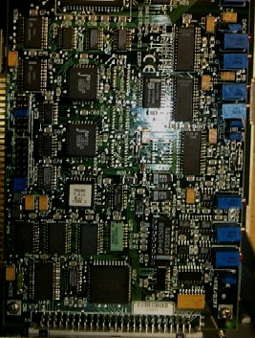


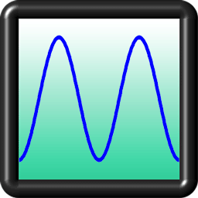


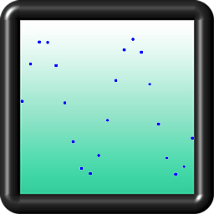

Converting an analog signal to a digital signal requires a sampling of the signal
Hardware converts analog signal to digital
Accelerometer outputs an analog voltage
Computer samples a number of points
Data is exported to popular applications
Excel
[Alley et al., 2006]
Notes:
Revised slide. The sentence headline states the assertion for this part of the presentation and orients the audience to the purpose of this visual aid. The slide’s body then supports this assertion visually. This presentation slide is much more memorable than the original. Also, for an audience reviewing this slide in a set of notes, the sentence-assertion headline orients the audience much better than the original phrase headline does to the role of the slide in the presentation.
Reference:
Robertshaw, Harry, “Class Period 15: Signals and Systems,” classroom presentation in ME 4005 (Blacksburg, VA: Virginia Tech, 16 March 2004).

Slide 53
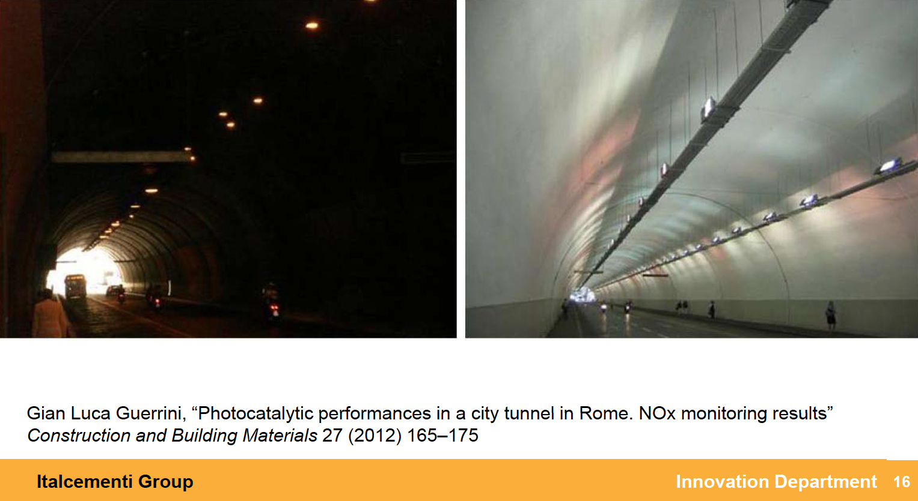
Photocatalytic cement and paint has been applied and tested in Rome
Notes:
This is one of my nanotechnology slides using A/E. Natural sunlight at 400 nm wavelength of light is effective. The catalyst isn’t used up. The materials aren’t on the surface, but throughout the cement. Italcementi has over 2 million square meters of active surfaces.

Slide 54
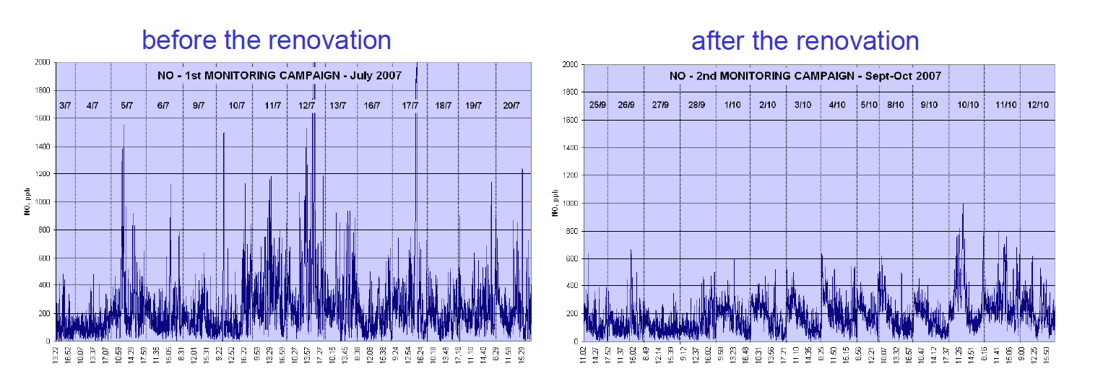
There was a clear reduction of peaks of nitric oxide in the tunnel
Reductions of 20 to 60%
Notes:
This slide is a good example of A/E. The assertion is backed up with real data clearly showing the reduction in peaks.

Slide 55
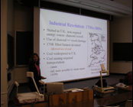

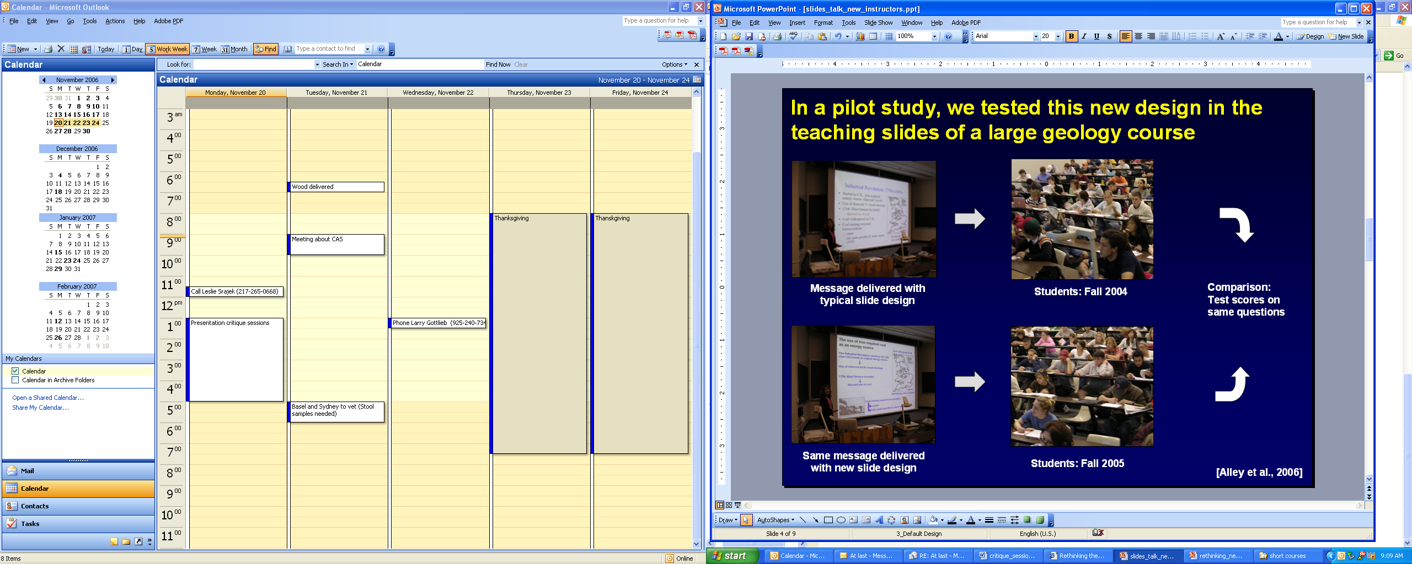
In a pilot study, Alley tested this new design in the teaching slides of a large geology course
Comparison:
Test scores
Improved on
same questions
Message delivered with
typical slide design
Students: Fall 2004
Same message delivered with new slide design
Students: Fall 2005
Alley et al., 2006
Notes:
This slide presents an experimental study that validates the sentence-headline design. The test was run with the same instructor, the same classroom, the same semester time slot for the class, and the same number of students in each section (200). All that changed were the slides projected. The tests occurred after six class periods, and students in both sections had access to the slides through the web. The tests were closed books, closed notes. For a detailed discussion, see the reference below.
Reference:
Alley, Michael, Madeline Schreiber, Katrina Ramsdell, and John Muffo, “How the Design of Headlines in Presentation Slides Affects Audience Retention,” Technical Communication, vol. 53, no. 4 (May 2006), pp. 225-234.

Slide 56
Relate several sources of excellent non-copywritten images
Objective 4
1
2
3
4

Slide 57

Wikimedia Commons is a great source of free and public images

Slide 58
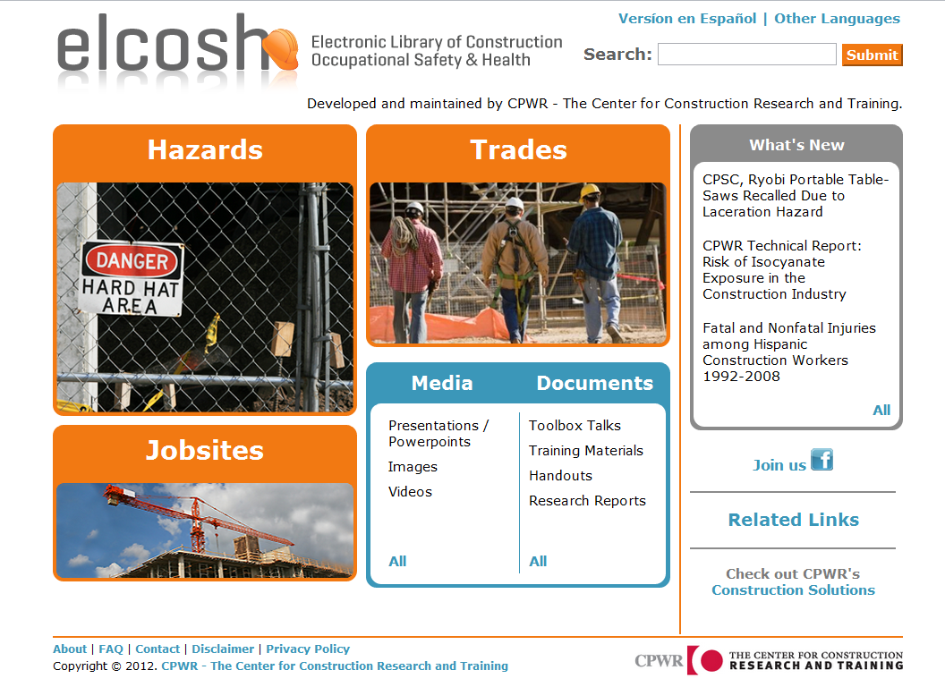
Notes:
Trainer Notes:
Highlight that this is the new look. It is still organized broadly by hazards, trades, jobsites, media, documents and what’s new, but now they are boldly displayed for ease of searching.

Slide 59
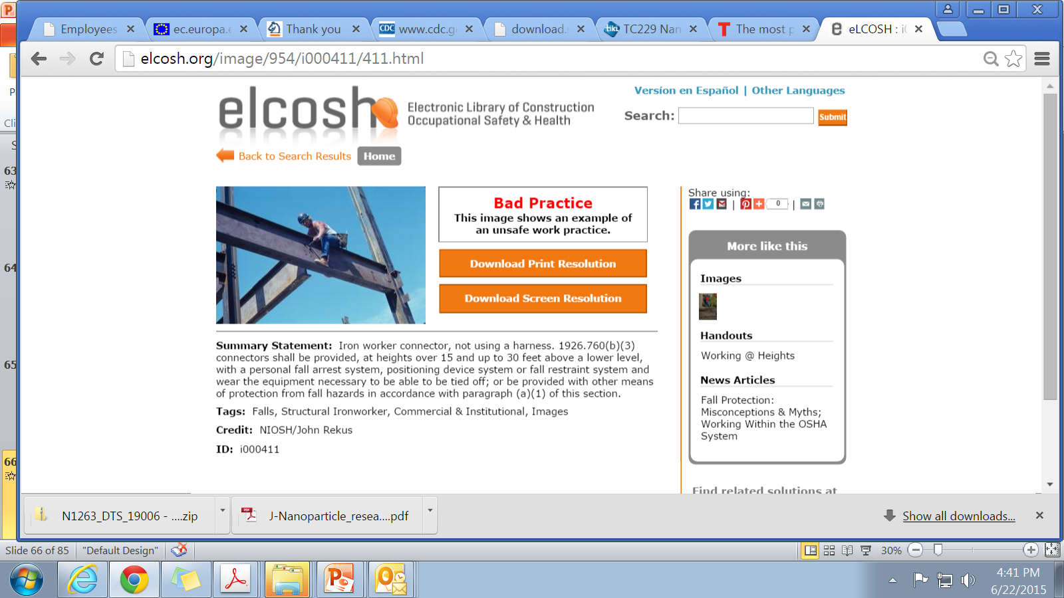
eLCOSH labels bad and good practices
www.elcosh.org
Notes:
Trainer Notes:
eLCOSH’s photolibrary of nearly 1,000 images uses labels to indicate whether it is a good or bad practice. These images can be freely used.

Slide 60
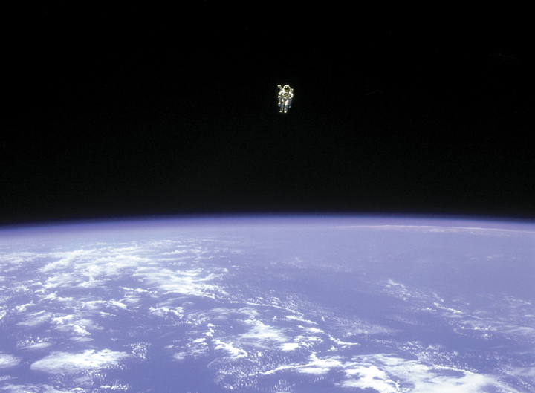
NASA has the right stuff!
Notes:
NASA has great images, also available for free.
Image: Bruce McCandless II free flying with a nitrogen jet-propelled backpack, Space Shuttle Challenger, 1984.

Slide 61
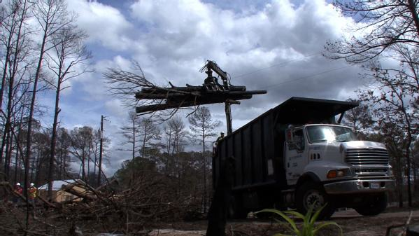
FEMA has great photos with a good search engine
Bastrop Co. Texas, 3-7-12, cleanup after wildfires
Photo courtesy Anne Cates and FEMA
Notes:
Bastrop County, Texas, March 7, 2012 -- Heavy equipment helps remove piles of wildfire-scorched trees in Bastrop County, Texas. FEMA Public Assistance grants are helping the county recover from the Labor Day 2011 wildfires. Photo by Anne Cates/FEMA

Slide 62
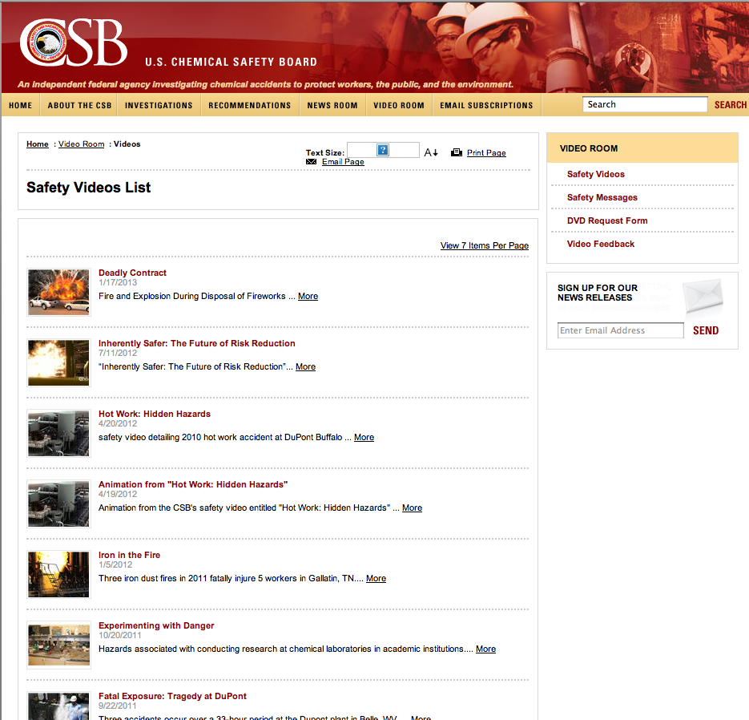
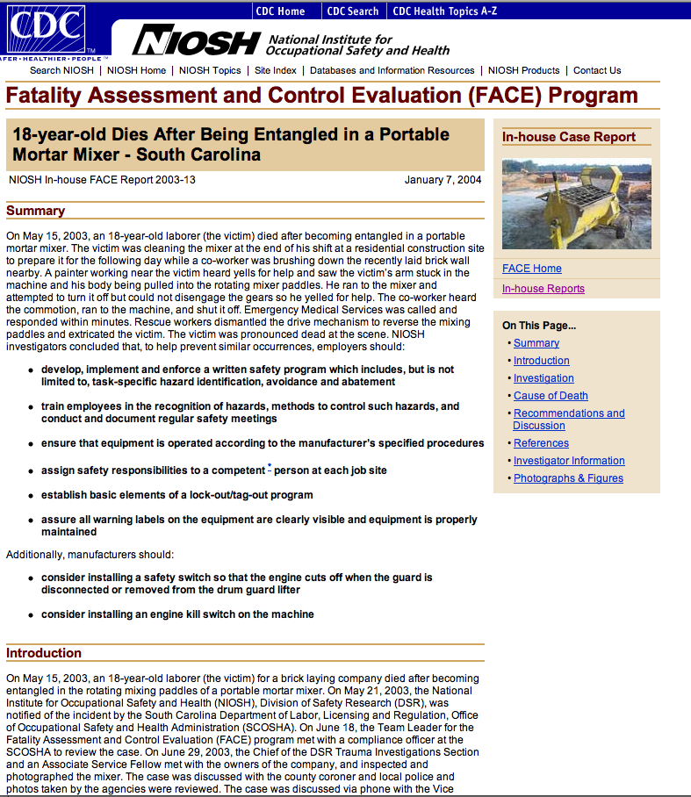
Other federal agencies have useful libraries
Chemical Safety Board
www.csb.gov
NIOSH FACE

Slide 63
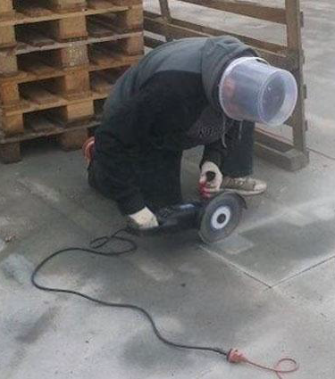
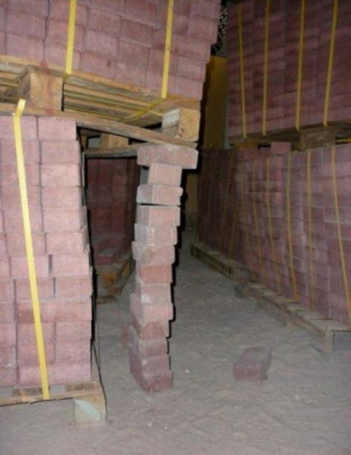
The Navy has images of right and wrong ways to do things
http://www.safetycenter.navy.mil/

Slide 64
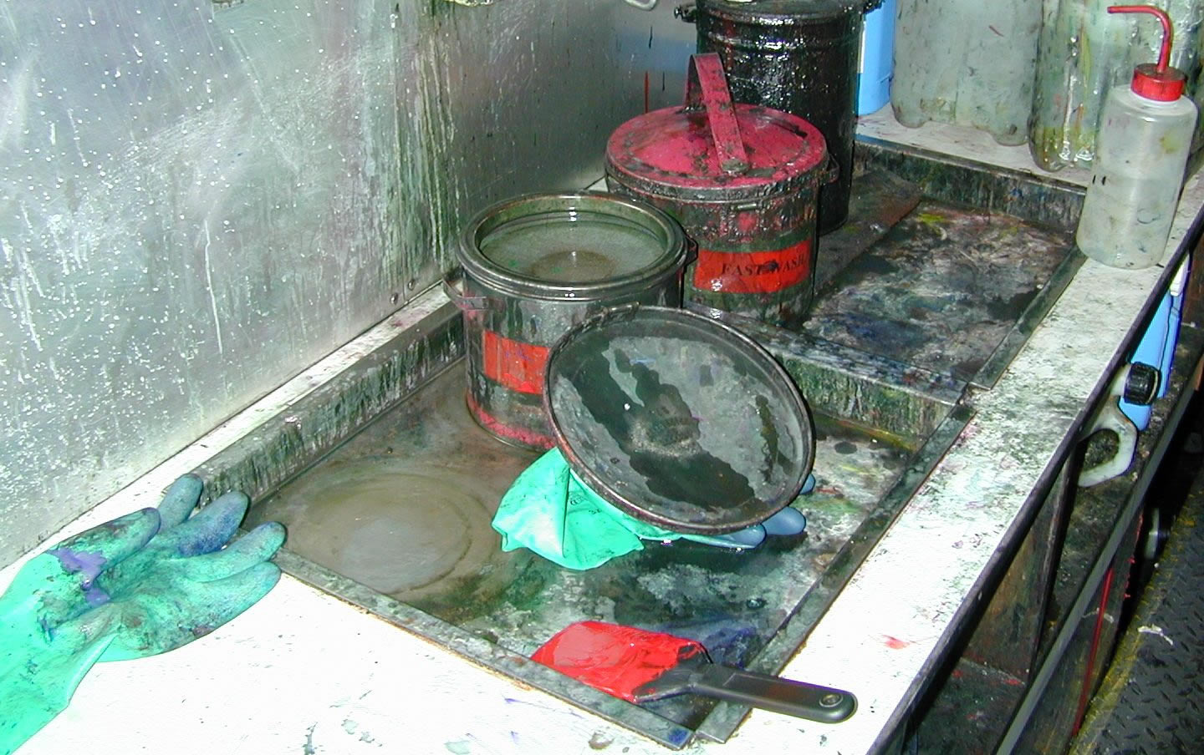
The HSE has a photo-library of useful health-related images
http://www.hse.gov.uk/resources/images.htm?ebul=gd-images

Slide 65
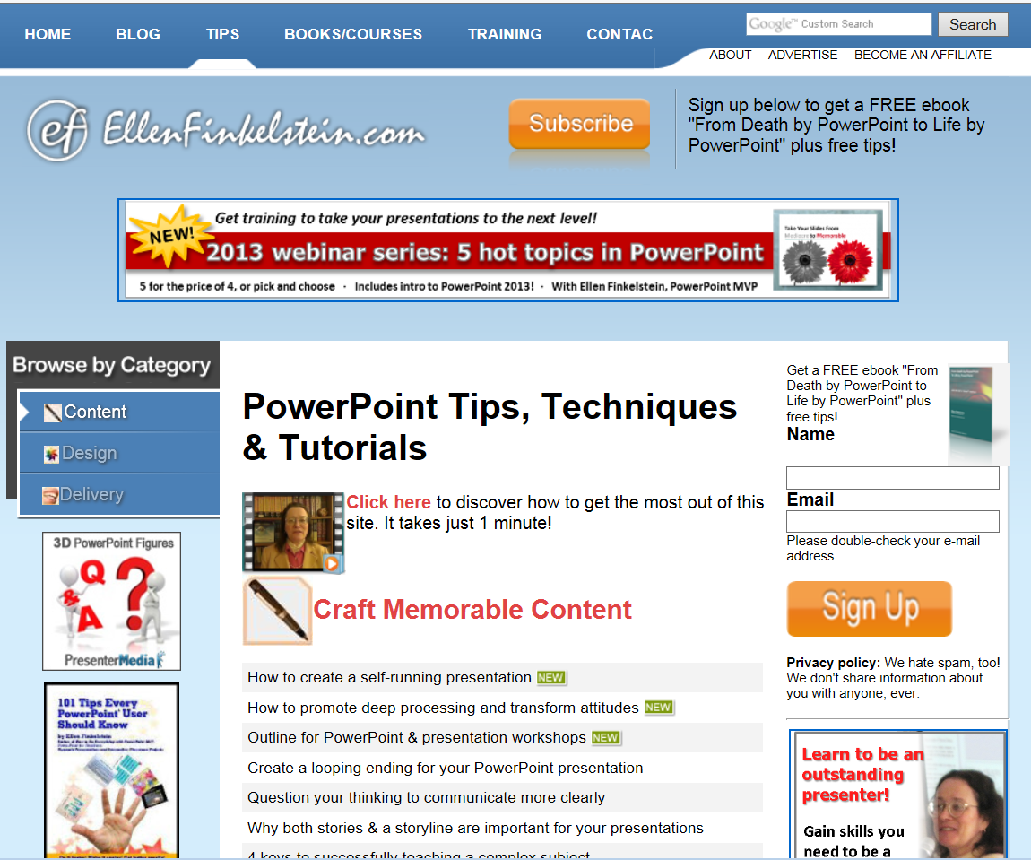
Ellen Finkelstein has an excellent newsletter with tips
http://www.ellenfinkelstein.com/

Slide 66
Describe several delivery techniques that could improve your style
Objective 5
1
2
3
5
4

Slide 67
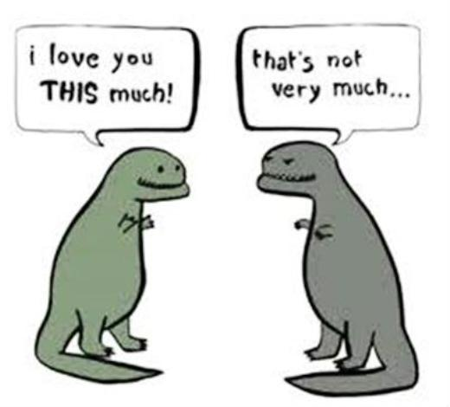
What should we do with our hands and arms?
Allow your arms to drop casually when not gesturing

Slide 68

Use larger gestures for larger audiences

Slide 69


Amy Cuddy recommends getting tough for 2 minutes
TED TIP

Slide 70

Ask questions to engage listeners in conversation and use I, you, and we as you would in a one-on-one conversation
Average for TED talk is 1/minute
TED TIP
Notes:
Average questions in 1/min.

Slide 71
Use the smallest and simplest words to express your message
Flesch-Kincaid average grade level for Ted talks is 6.6
TED TIP

Slide 72
Eliminate all filler words
Try the Burst-and-Pause method
One beat for commas and 2 for periods

Slide 73

Try not to point (it sends the wrong message)

Slide 74
Open discussion questions
How do we become less reliant on PowerPoint?
What else works for you?

Slide 75
Try us out! http://www.elcosh.org for more info contact:
Bruce Lippy, Director of Safety Research blippy@cpwr.com
301-495-8527
410-916-0359 cell
Notes:
Trainer Notes:
Try us out! Go to our site: http://www.elcosh.org or contact our Project Manager, Bruce Lippy:
Office: 301-495-8527
Cell: 410-916-0359

Slide 76
The End

Slide 77
This is the good fight! Be vulnerable. Take lumps. Remember:
Less is more
Always ask if the slide is for you or the audience
Try Assertion-Evidence
Use images
Ask questions
Have fun
Bruce Lippy at blippy@cpwr.com 410-916-0359

