Slide 1

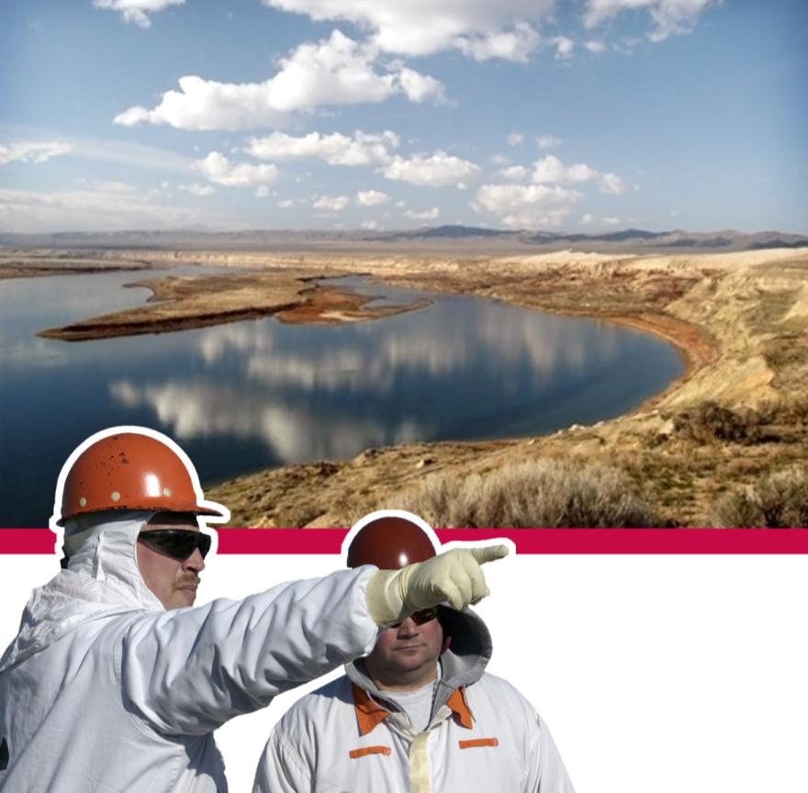
TOC-Pres-15-2199
Physiological Monitoring for Heat Stress Management
Mike Schmoldt, MS, MS, MBA
CIH, PE, CHMM, CPEA
Principal Industrial Hygienist
June 1, 2015

Slide 2
Heat Stress
Consider
“…men over the age of 40 were found to be 10 times more susceptible to heat stroke than were younger men”.
-Environmental Medicine. -Brooks.

Slide 3
Why monitor for heat stress?
AIHce 2003 Dallas TX PD Course 420
Major flaws in poor IH assessments:
Numbers only analysis; reactionary, no prevention
Superficial evaluation of heat stress, not heat strain
No biological monitoring

Slide 4
What is a best practice? 2013 EFCOG Survey
Few responses (6)
Reliance on work/rest tables were common
Monitoring using WBGT used extensively
10 CFR 851 was not always recognized as having a thermal stress limit
No consensus on application of OELs, methods or measurement
Little or no detailed data available

Slide 5
Recent OSHA Guidance
The OSHA Technical Manual is a primary source of guidance on how OSHA compliance officers conduct workplace monitoring. It was updated in Feb. 2014 to modernize and clarify some sections.
  Worker Monitoring Programs
    Every worker who works in extraordinary conditions that increase the risk of heat stress should be personally monitored. These conditions include wearing semipermeable or impermeable clothing when the temperature exceeds 21°C (69.8°F), working at extreme metabolic loads (greater than 500 kcal/hour), etc.
    Personal monitoring can be done by checking the heart rate, recovery heart rate, oral temperature, or extent of body water loss.
OSHA website. https://www.osha.gov/dts/osta/otm/otm_iii/otm_iii_4.html

Slide 6
Physiological Monitoring for Thermal Stress
Why do Physiological Monitoring?
No OSHA specific requirements- except general duty clause,
  guidance document and requirements for selection of appropriate
  PPE limitations
10 CFR 851 Worker Safety and Health
  -2005 ACGIH TLVs and BEIs ‘Heat Stress and Strain’
  -later ACGIH versions may/should be considered if more stringent
ISMS programs and VPP
Prior DOE-ORP repeat findings on heat stress management
Series of internal corrective actions on: acclimatization, metabolic rate and clothing protection factors and work/rest schedules
Need for documentation of worker exposure and hazard assessment

Slide 7
Hanford Tank Farms Thermal Stress Issues
Extended outdoor work in anti-contamination clothing and respiratory protection
Desert environment (high radiant loading/low humidity)
Tropical work shift schedule options
Record setting heat levels in 2014 and expected in 2015
High exertion work requirements
Past difficulty implementing engineering and admin. controls as part of planned work
Aging workforce/high bump and roll influx of newer workers
Worker job jeopardy concerns
Bargaining unit labor contract issues
Legacy issues of prior programs and practices
Past reliance on ‘self-identification’ of heat stress symptoms

Slide 8
Changes to Program Elements
Educate management and field work supervisors
Created a Heat Stress committee (IH/Mgt./labor)
Update heat stress procedure
Research and selection of instrumentation
Develop procedures and training for IH and IHT staff
Communication Plan
Memorandum Of Agreement with Bargaining Unit
Field application with field work supervisors IH/IHTs
Detailed data analysis of results for future work

Slide 9
Changing the
Heat Stress Monitoring Program
Updated to address 2005 ACGH-TLV thermal stress requirements
Minimized used of acclimatization and work/rest schedules
Updated clothing protection factors and metabolic level tables
Trained IH and IHTs on use of equipment and documenting results
Required documented evaluation using a heat stress mitigation that documents the expected controls present, environmental conditions, PPE and level of exertion
Required field work supervisor monitoring >85°F dry bulb or if listed heat stress precursor conditions were likely

Slide 10
What is Physiological Monitoring?
A basic way to measure the level of an individual’s heat strain in response to heat stress conditions. This includes, but is not limited to, heart rate monitoring & body temperature measurement.
It does not include parameters which may be considered medical monitoring (measuring blood pressure, oxygen saturation, urine testing, or cardiac rhythm).
By contrast: the WBGT measures environmental temperature conditions useful to establish work/rest schedules and exposure hazard evaluation (i.e., heat stress) but does NOT monitor worker specific physiological responses (heat strain response) to the thermal dose received.

Slide 11
Physiological Monitoring may be required when:
WBGT monitoring is not sufficient or feasible.
Work will occur that is likely outside of the established work/rest regimens
Additional information on worker heat stress is needed
Work will occur in semi- or impermeable clothing ensembles such as polyethylene coated Tyvek or vapor barrier coveralls
Heavy to very heavy work is performed, regardless of clothing level

Slide 12
Physiological Monitoring Instrumentation
Physiological monitoring is conducted using an IH approved device following manufacturer’s instructions (e.g., Nonin Onyx heart rate monitor, Polar sensor, Infrared tympanic membrane thermometer or other device
A variety of instruments were evaluated and the technical literature was reviewed to make an informed decision
Seminars and discussion with Dr. Thomas Bernard, U. of Florida (ACGIH/AIHA) were valuable in identifying limitations of each.
Instrument should be field practical, minimally invasive and accurate enough for heat stress evaluation
The IH program and Occupational Medical Provider (HPMC) reviewed and accepted the instruments selected

Slide 13
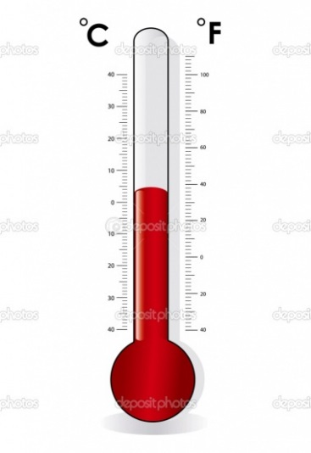
Temperature Monitoring
Physiological measurement is used to obtain a core body temperature for the purpose of evaluating heat strain to workers
  Available Methods:
    Invasive (unacceptable to most people)
    Biological sampling (urine stream)
    Surface temperature (highly variable)
    Oral (strongly affected by breathing/air temperature
    or drinking liquids)
    Aural: ear canal or tympanic
This is an objective physiological measurement
  It is not a medical or clinical procedure
  It must be accurate enough for assessing heat strain

Slide 14
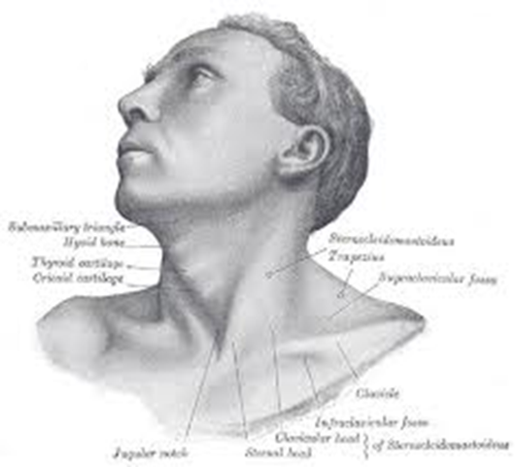
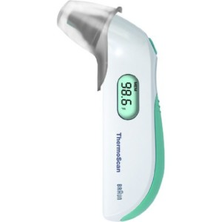
Temperature Monitoring
Braun Thermoscan or similar type of infrared ear thermometer
Used to collect and report baseline and periodic heat strain evaluation data

Slide 15
Heat Stress Physiological Monitoring
Tympanic Temperature
  Principle of the method
    This method measures tympanic temperature NOT ear canal temperature
    Blood flow from the internal carotid artery supplies the hypothalamus and the area around the eardrum.
    The hypothalamus is the part of the brain that senses and reacts to body core temperature
    There is little ‘thermal inertia’ with the eardrum
    Temperature changes are rapidly reflected
    Temperature of the eardrum does not require a correction factor when read using an infrared thermometer to approximate body core temperature
    Extreme environmental temperatures may require a minute to adjust air temperature to blood temperature

Slide 16
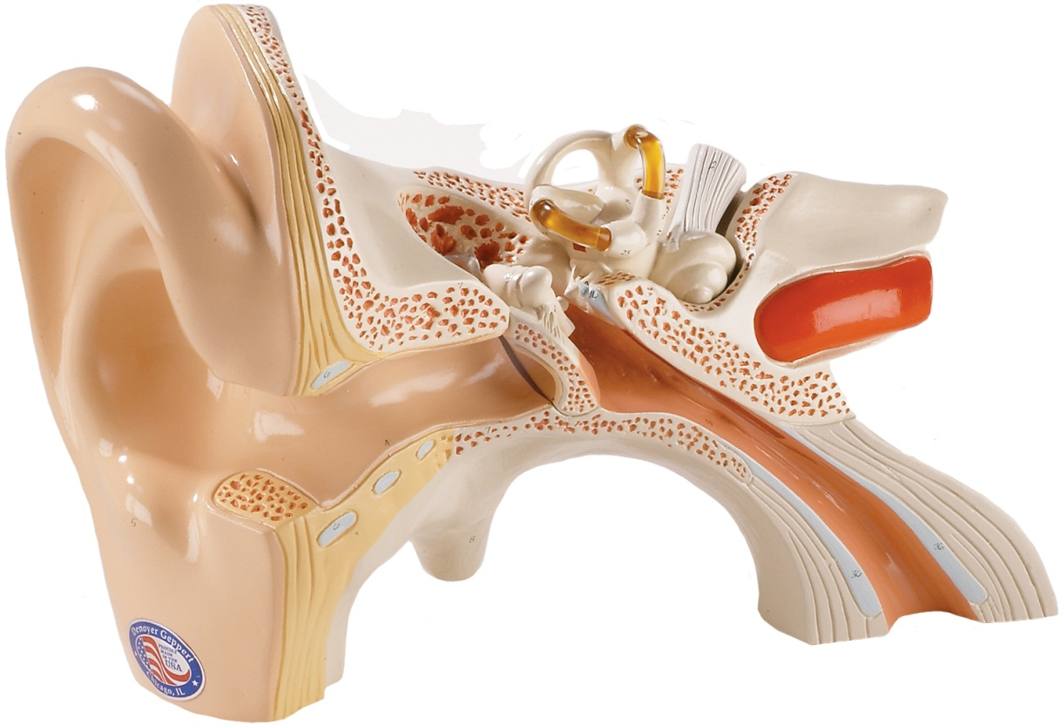
Theory of Operations
Measurement requires a direct line of sight to the ear canal
  Some people’s ear canal shape may make this impossible
  Ear wax may impede the ability to get an accurate measurement
  Pull UP and
  BACK to
  straighten the
  ear canal

Slide 17
Thermoscan Readings
If temperature measured is >100.4°F, discontinue exposure to thermal stress immediately and take precautions to cool the worker
Surveying workers out of radiation control areas may result in partial recovery and not represent peak exposure
Consider whether symptoms are present which require first aid or medical assistance

Slide 18
Thermoscan specifications
Operating Range 50-104° F.
Maximum humidity 95%
Allow 30 minutes for the instrument to stabilize in the environment where it will be used before taking a reading
Meets ASTM standard E1965-98: Infrared Thermometers for Intermittent Determination of Patient Temperatures

Slide 19
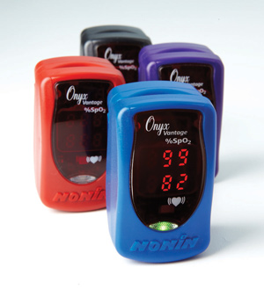
Nonin Pulse Rate Measurement
Nonin pulse oximeter (Onyx or Vantage models)
Baseline and periodic heat strain evaluation data

Slide 20
Nonin Pulse Rate Measurement
Physiological heart rate measurements are used to obtain an estimate of heat strain experienced by a worker
This device collects a short time sample, but does not represent the overall worker heart rate variability over the work period
We do not use the oximeter reading as part of the heat stress control program (NFPA does)
This is an objective physiological measurement
  It is not a medical or clinical procedure
  It must be accurate enough to evaluate heat strain

Slide 21
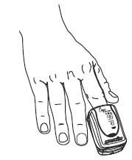
Theory of operations
Infra red light is transmitted by an LED through the finger to a sensor where the intensity and rate of change of the light is read. A microcomputer calculates the transmissivity of the infrared light, which is proportional to hemoglobin concentration. The unit calculates both oxygen saturation and pulse rate from this information.

Slide 22
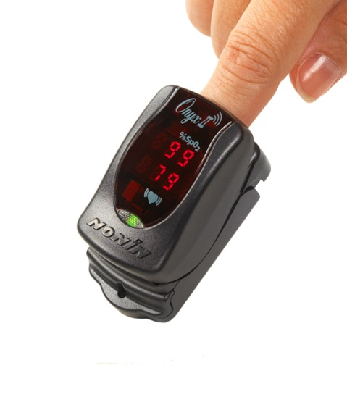
General Instructions for Use
Collect a baseline pulse rate prior to beginning work and donning PPE clothing
Collect periodic pulse rates based in instructions by the IH
Collect a recovery heart rate as soon as the work stress ends if possible. Record the time work ended and when the reading occurred

Slide 23
Applicable Standards
The Nonin was designed and certified to meet the following ISO standards. No user calibration or adjustment is required. The device performs self-function checks and does not require calibration or periodic maintenance
ISO 9910:2005 criteria for heart rate testing
ISO 10993-1 Biological evaluation of medical devices –Part 1: Evaluation and testing

Slide 24
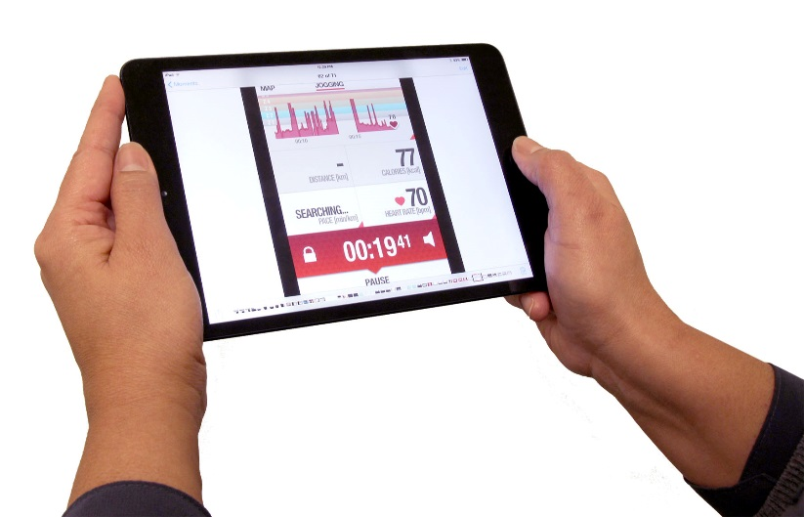
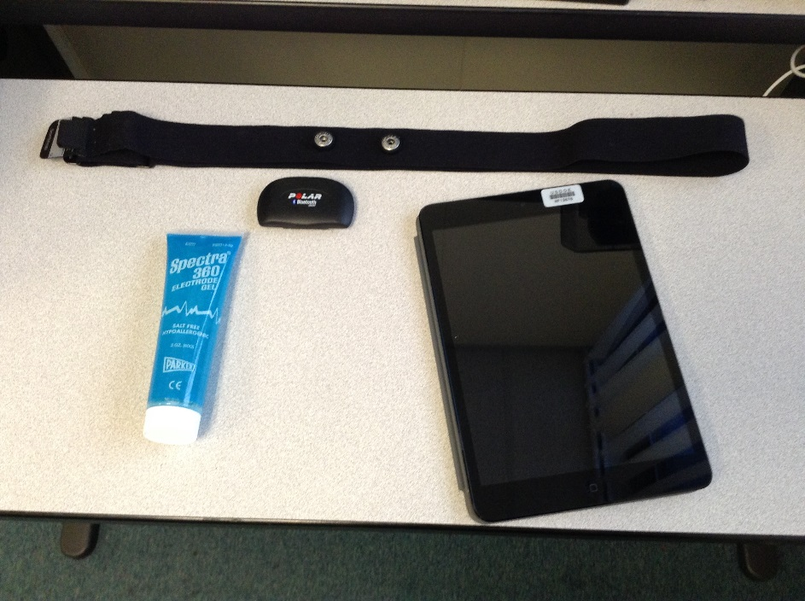
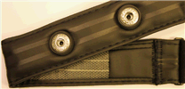
Continuous Heart Rate Monitoring
Physiological monitoring pulse rate using a Polar H7 pulse oximeter.

Slide 25
Introduction
Physiological heart rate measurements are used to obtain an estimate of heat strain experienced by a worker
This device can provide real time reading as well as continuous readings to allow peak rate and recovery rate data to be collected in graphical and data file format
This is an objective physiological measurement
  It is not a medical or clinical procedure
  It must be accurate enough to evaluate heat strain

Slide 26
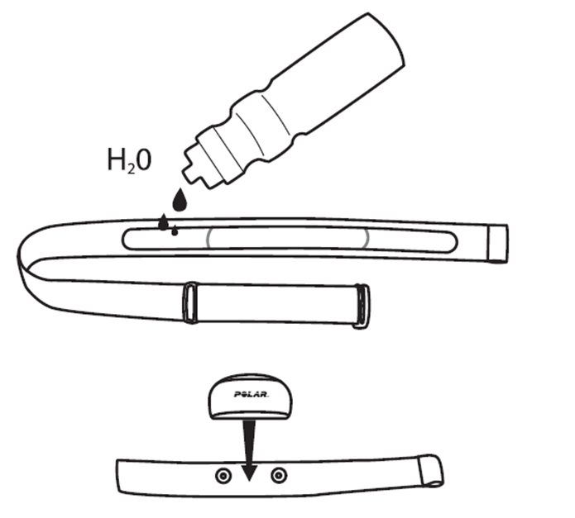
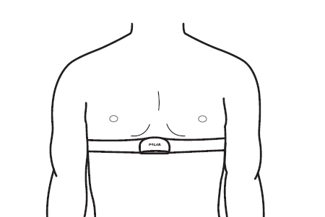
General Instructions for use
Moisten the electrode areas on the back of the strap with water or electrode gel
Attach the transmitter to the strap. Adjust the strap to fit tightly but comfortably

Slide 27
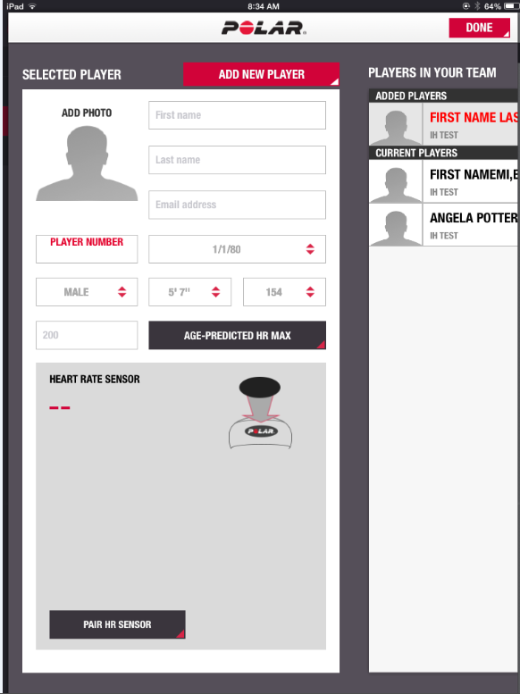
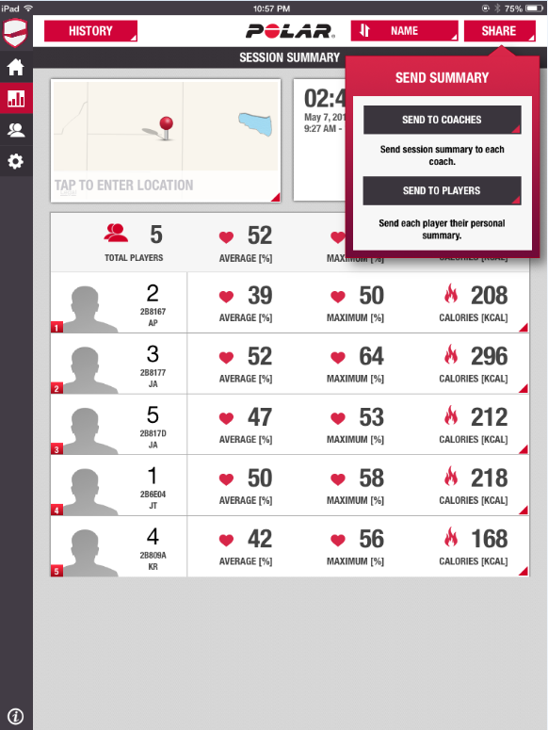
Linking Polar Monitor to IPAD application

Slide 28
Theory of operations
The body regulates metabolic activity by reacting with increases in heart rate, glucose metabolism, oxygen uptake and blood pressure
Electrocardiogram skin resistance is a direct indicator of cardiac muscle activity and heart rate
Resistance is measured by the chest strap, translated into heart rate data and transmitted to a receiver
Transmissions are digitally encrypted Bluetooth signal so multiple units don’t interfere with each other and data is only available to the receiving device selected
IPAD acts as both data logger, field notes record and real time graphical display on up to 20 workers at once.

Slide 29
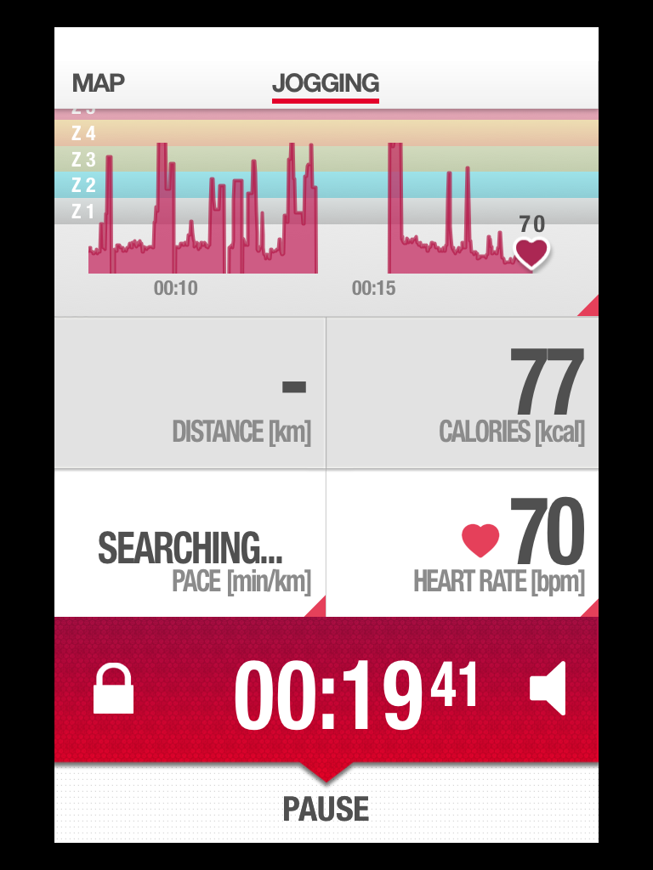

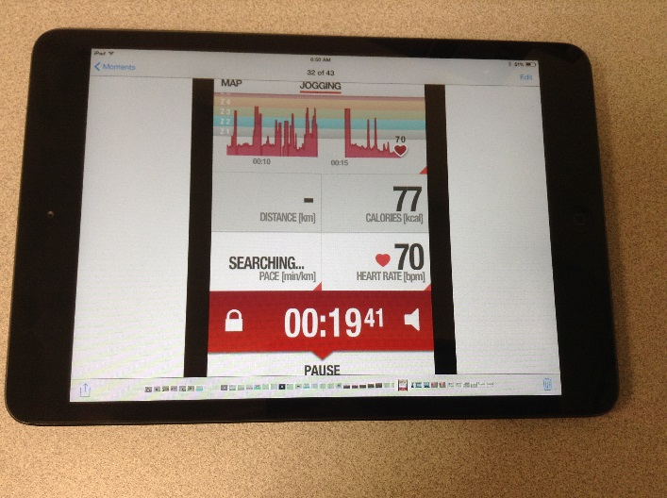
Examples of Polar Heart Rate Results

Slide 30
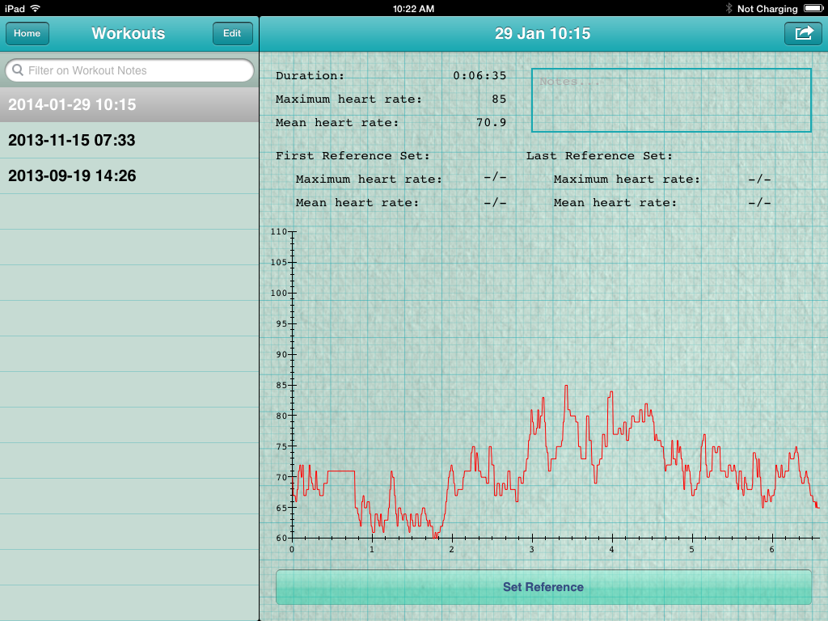
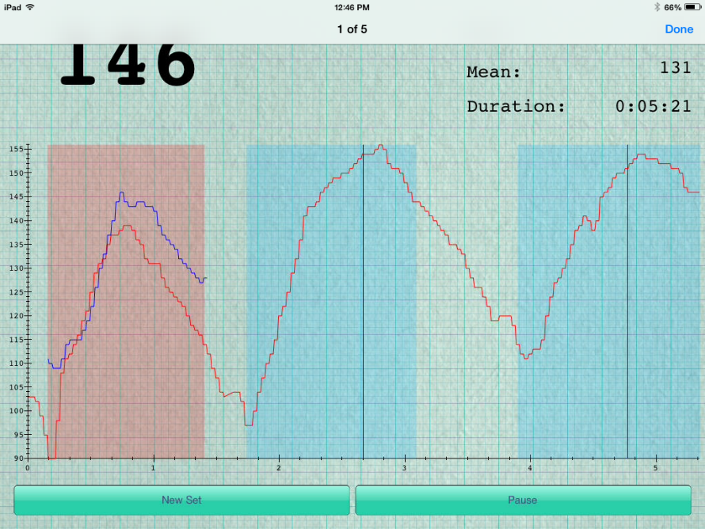
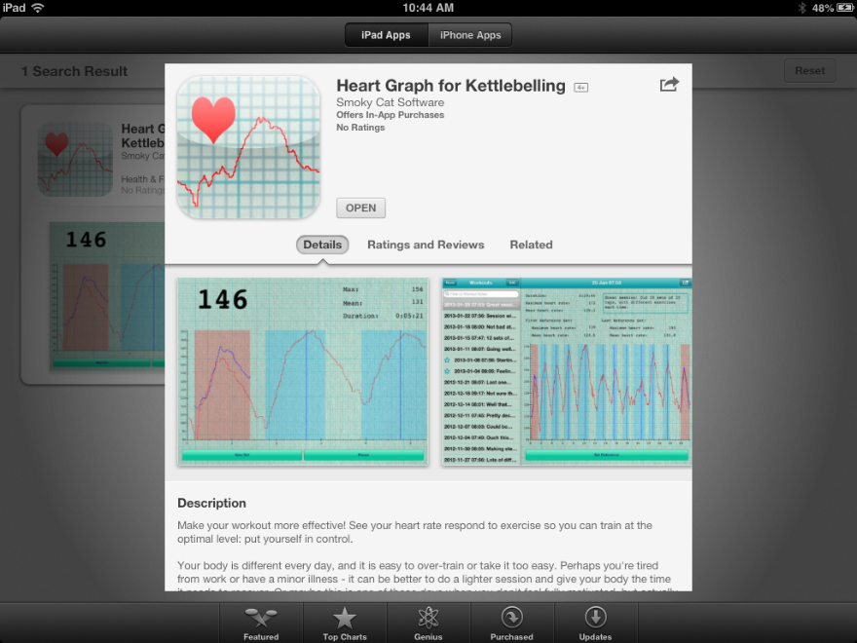
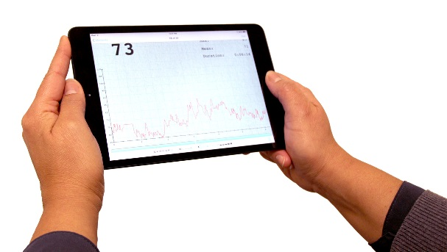
Examples of Heart Rate Results

Slide 31
Heat Stress Monitoring Data for FY 2014
328 employees were scheduled to work at heat stress related tasks
318 of the 328 employees were monitored for heat strain utilizing physiological monitoring (10 of the 328 employees were not needed to perform assigned tasks and were not monitored)
17 employees (5%) were removed from heat stress related tasks due to physiological monitoring.
  NO EXCEEDENCES (>OEL were observed)
  NO REPORTED HEAT STRESS INCIDENTS

Slide 32
Results of Physiological Monitoring
Physiological monitoring removed employees from heat stress related tasks before exceeding the exposure limits or Heat Stress illnesses symptoms developed
Provided management with a quantitative measurement of each employee’s response to heat strain.
Helped build employee confidence in the IH Heat Stress Control Program
Provided data for detailed analysis to plan future exposure assessments, development of similar exposure group classifications and hazard analysis
No reported issues with job jeopardy or medical limitations (use of stimulants does raise heart rate)
Ability to demonstrate compliance with 10 CFR 851

Slide 33
Contact information for the authors
Questions:? Contact
    Mike Schmoldt michael_j_Schmoldt@rl.gov
    Edward Sinclair edward_e_sinclair@rl.gov
    Mr. Sinclair is the current heat stress SME for Washington River Protection Solutions, LLC at the Hanford, WA site.

