Slide 1
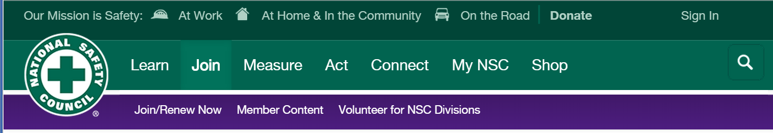
Nanotechnology Follow-up
National Safety Council Labor Division, Charlotte, NC, April 21, 2015
Mark D. Hoover, PhD, CHP, CIH (mhoover1@cdc.gov) National Institute for Occupational Safety and Health. Morgantown, WV
Bruce Lippy, PhD, CIH, CSP (blippy@cpwr.com), CPWR , Silver Spring, MD
The findings and conclusions in this presentation are those of the authors
and do not necessarily represent the views of their respective organizations.
Mention of company names or products does not constitute endorsement.
Notes:
Trainer Notes

Slide 2
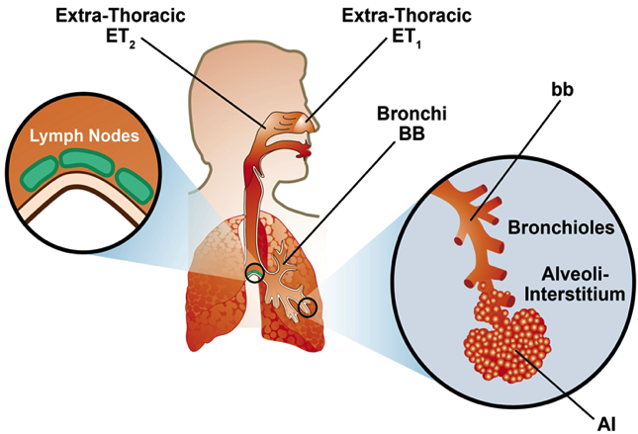
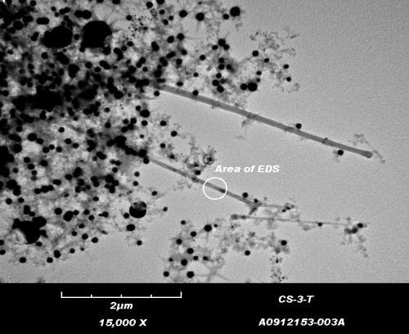
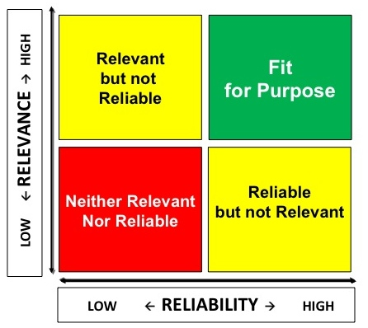
What is the context for the NSC Labor Division?
Safety, Health,
Well-being, and
Productivity
*
Emerging
Technology
Risk Management
Adapted from L. J. Cash (2014)

Slide 3





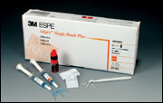

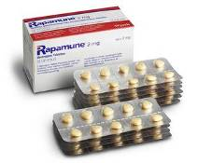
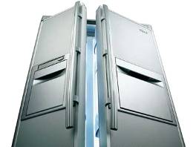











Nano-enabled products are on the market
Mercedes CLS-class
Wilson Double Core tennis balls
Eddie Bauer Ruston Fit Nano-Care khakis
3M Adper Single Bond Plus dental adhesive
Wyeth Rapamune immuno-suppressant
Smith & Nephew Acticoat 7 antimicrobial wound dressing
Samsung Nano
SilverSeal Refrigerator
Laufen Gallery washbasin with Wondergliss
Kodak EasyShare LS633 camera
Hummer H2
NanoOpto subwavelength
polarizing beam splitter/combiner
Gibbs, 2006

Slide 4


























NIOSH participates in the National Nanotechnology Initiative (NNI)
Government Departments and Agencies
Federal agencies that participate in the National Nanotechnology Initiative under the auspices of the Nanoscale Science, Engineering and Technology (NSET) Subcommittee of the National Science and Technology Council.
www.nano.gov

Slide 5


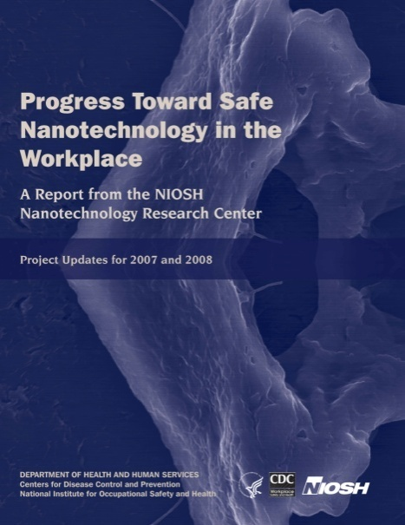
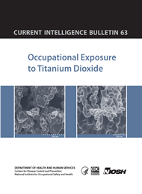

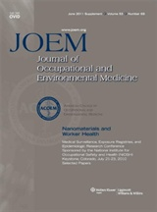



Key guidance is available from NIOSH on Nanotechnology
www.cdc.gov/niosh/topics/nanotech
5

Slide 6
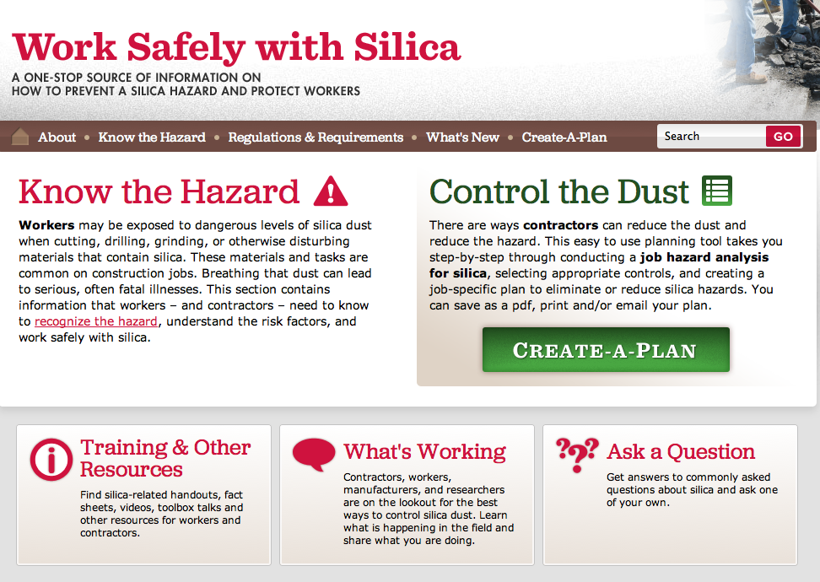
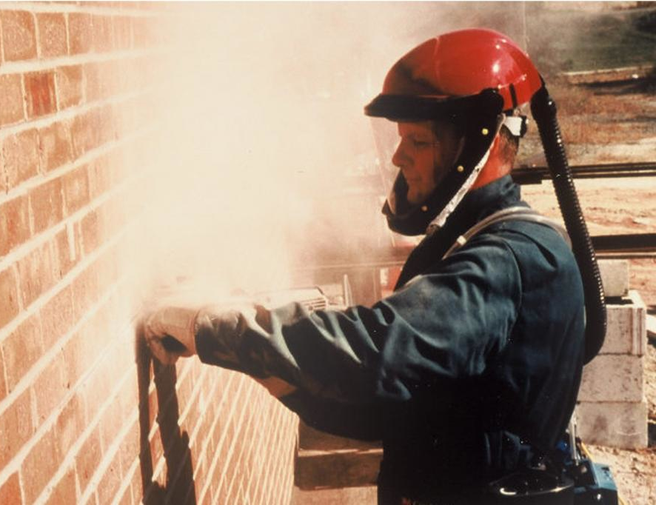
Everyone heard of CPWR?
NIOSH-funded National Center for Construction Safety and Health for 20 years
Construction Solutions

Slide 7

Who has used eLCOSH?
Notes:
Trainer Notes:
This is the new look. It is still organized broadly by hazards, trades, jobsites, media, documents and what’s new, but now they are boldly displayed for ease of searching.

Slide 8

We just launched a web-based construction nanomaterial inventory with 458 products

Slide 9
At the end of this session, you will be able to:
Explain engineered nanoparticles in terms workers can understand
Describe recent regulatory developments
Discuss the availability and limitations of nanoproduct inventories
Describe the applications of nanomaterials your trade may encounter
Explain what we know about the health problems posed by nanoparticles
Describe the current state of hazcom for nano
Apply the hierarchy of controls to nanomaterials and explain what we know about controls
List several resources that might be useful
Notes:
Explain engineered nanoparticles in terms workers can understand
Describe recent regulatory developments
Discuss the availability and limitations of nanoproduct inventories
Describe the applications of nanomaterials your trade may encounter
Explain what we know about the health problems posed by nanoparticles
Discuss the difficulties around life cycle issues
Apply the hierarchy of controls to nanomaterials and explain what we know about controls
List several resources that might be useful

Slide 10
Explain engineered nanoparticles in terms workers can understand
1
Objective 1

Slide 11
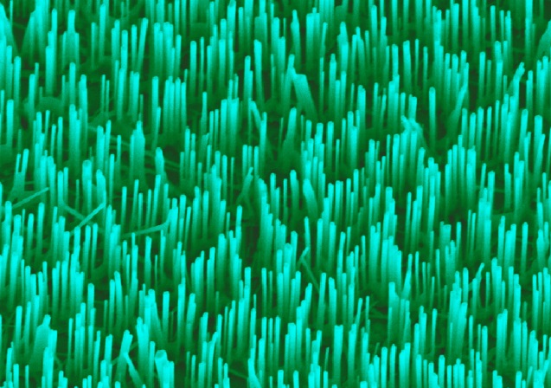
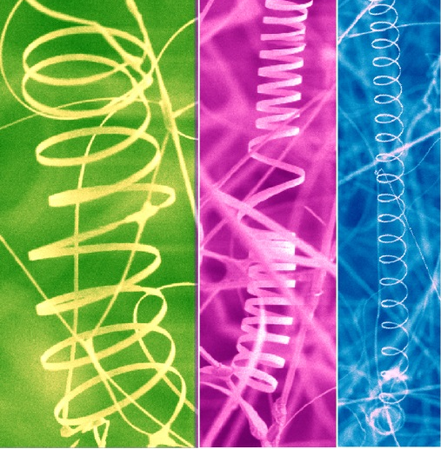

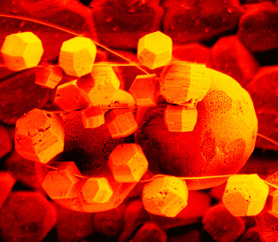

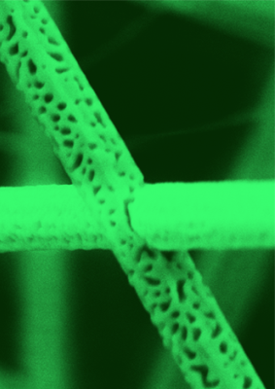

What are the key concepts for workers?
Incredibly small, amazing properties, tremendous variety and created for some purpose
Notes:
These are all the the same material, zinc oxide

Slide 12
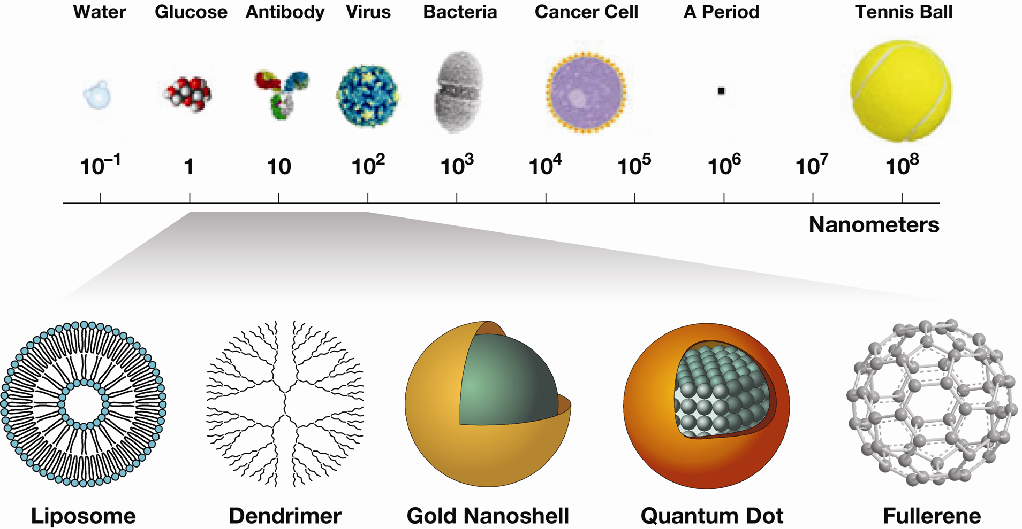
A range of particle sizes, shapes, and types
Human Cell
National Cancer Institute
Notes:
Bacteria can be a large as 6 um (e.g. E. coli can be that long, although some can be as huge as 600 um) and as small as 100 nm (Mycoplasma). Nanochlorum eukaryotum is the smallest eukaryote with size about 1 um. Eukaryotic cells range between 1 and 100 um (red blood cell is about 7 um). Average viruses are 10 to 300 nm (filovirus up to 1400 nm in length, mimivirus up to 400 nm in diameter). Size of botulinum toxin type c is 7.4 nm

Slide 13


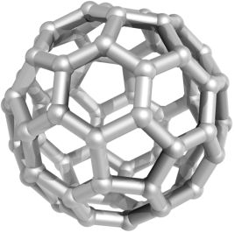
Getting a handle on size
Notes:
Earth is approximately on hundred million times larger than a soccer ball. This same ratio is upheld when describing the difference in size between the soccer ball and a nanoparticle of C-60 approximately 0.7 nm in diameter.

Slide 14
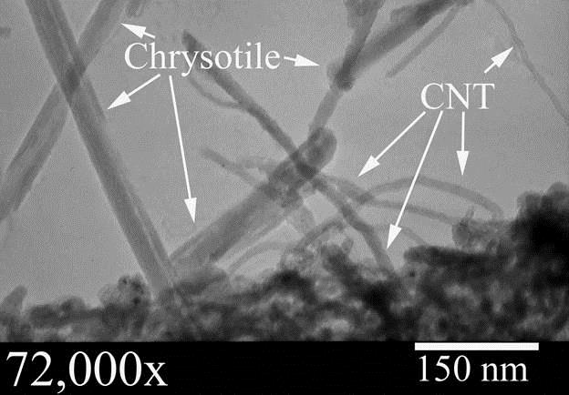
Carbon nanotubes are smaller than asbestos fibers
Photo courtesy Andreas Saldivar, AMA Analytical

Slide 15

How can we communicate this in training?
1 Billion nanometers = 1 meter ≈ 1 yard

Slide 16
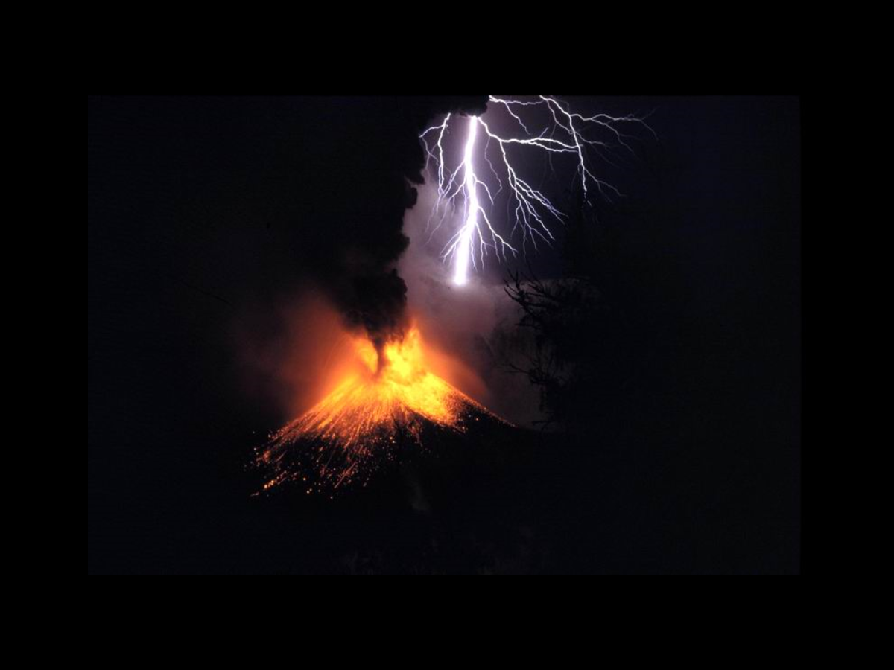
Humans have dealt with natural nanoparticles for a long time
Mount Rinjani in Indonesia, Image courtesy Wikimedia
Notes:
Mount Rinjani is a Volcano in Indonesia

Slide 17
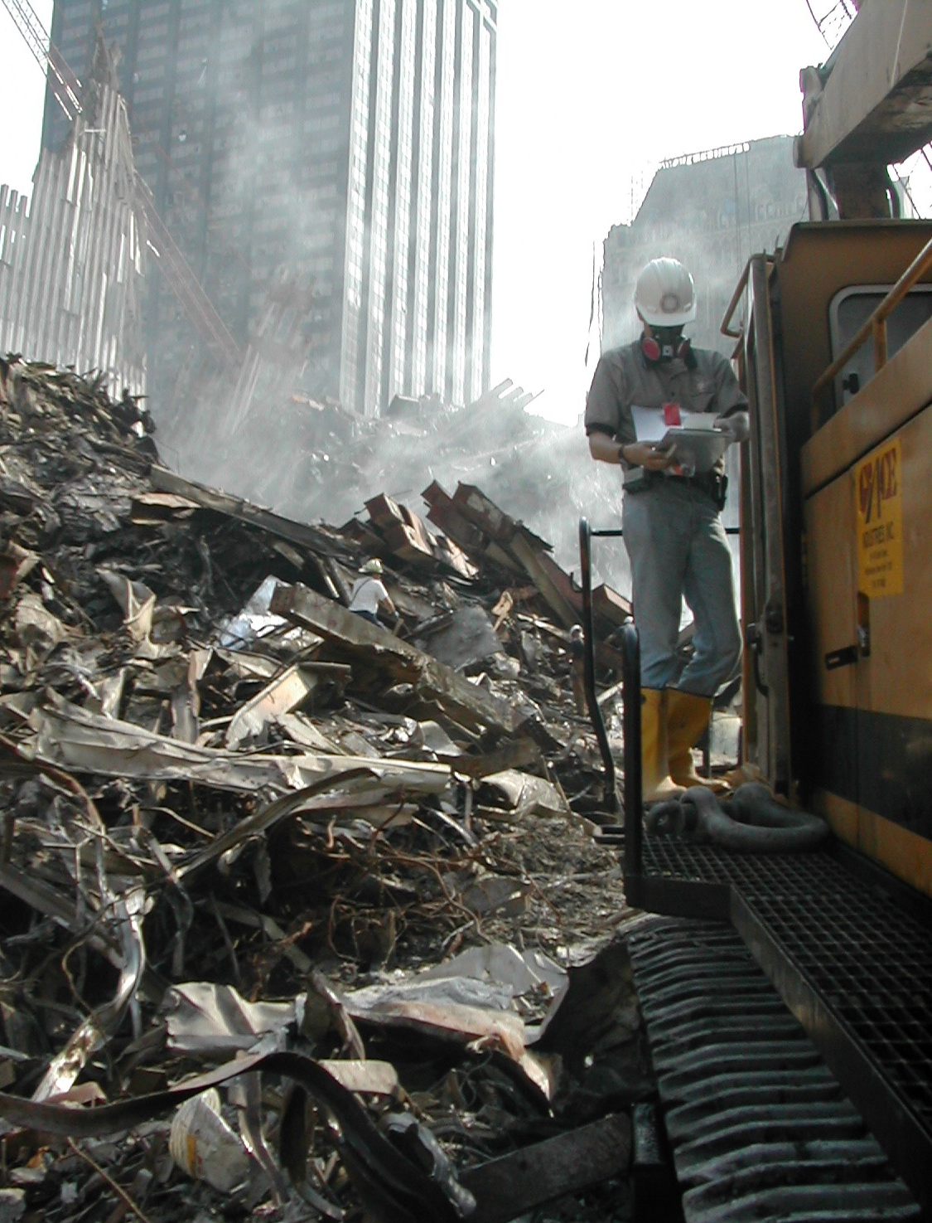
Carbon nanotubes were in the air at Ground Zero.
ENPs?
No, incidental

Slide 18
Describe recent regulatory developments
1
2
Objective 2

Slide 19

FDA has announced it may broaden its definition
Engineered to exhibit properties or phenomena, including physical or chemical properties or biological effects, that are attributable to its dimension(s), even if these dimensions fall outside the nanoscale range, up to one micrometer (1,000 nm).
Considering Whether an FDA-Regulated Product Involves the Application of Nanotechnology: Guidance for Industry, June 2014
Notes:
Considering Whether an FDA-Regulated Product Involves the Application of Nanotechnology
Guidance for Industry
June 2014
FDA has not established regulatory definitions of “nanotechnology,” “nanomaterial,” “nanoscale,” or other related terms

Slide 20
“FDA has not established regulatory definitions of nanotechnology, nanomaterial, nanoscale, or other related terms.” June 2014
Considering Whether an FDA-Regulated Product Involves the Application of Nanotechnology: Guidance for Industry, June 2014
Nonbinding Recommendations
Notes:
Titanium Dioxide Nanoparticles in Food and Personal Care Products, Weir, Westerhoff, Fabricius, Hristovski, and von Goetz, Environ. Sci. Technol., 2012, 46 (4), pp 2242–2250

Slide 21

EPA continues to regulate nanomaterials under TSCA’s SNURs for Premanufacture Notices (PMN)
July 8, 2014 promulgate SNUR for 2 CNTs
Requires: PPE, defined volume of production, and no surface water releases
Notes:
Source: Lynn L. Bergeson, Bergeson & Campbell, P.C. Nanotechnology Now
On July 8, 2014, the U.S. Environmental Protection Agency (EPA) promulgated significant new use rules (SNUR) under the Toxic Substances Control Act (TSCA) for 13 chemical substances that were the subject of premanufacture notices (PMN). The rule includes two PMN substances, P-10-5 and P-11-339, that were the subject of TSCA Section 5(e) consent orders and whose reported chemical names include the term "carbon nanotube" (CNT) or "CNT." EPA states that, because of a lack of established nomenclature for CNTs, the TSCA Inventory names for CNTs are currently in generic form, e.g., CNT, multi-walled carbon nanotube (MWCNT), double-walled carbon nanotube (DWCNT), or single-walled carbon nanotube (SWCNT).
PMN Number P-10-5
Chemical Name: Single-walled carbon nanotubes (generic)
CAS Number: Claimed confidential
The PMN states that the uses of the substance will be as a component for a conductive coating using the PMN substance in a dispersion or ink, and as an additive in resins/thermoplastics/elastomers for mechanical reinforcement. The consent order requires:
1. Use of personal protective equipment (PPE);
2. Use of the substance only as a component for a conductive coating using the PMN substance in a dispersion or ink or as an additive in resins/thermoplastics/elastomers for mechanical reinforcement;
3. Manufacture of the substance at a volume not to exceed a confidential volume specified in the consent order unless the company has submitted the results of certain health studies and physical/chemical properties data; and
4. No surface water releases of the PMN substance, except for limited water releases resulting in no more than one part per billion (ppb) waste water effluent concentration determined by monitoring. The company shall analyze the concentration of the PMN substance in waste water discharged to the city sewer from the facility every year and adhere to the monitoring procedure referenced in the consent order.
The SNUR designates as a "significant new use" the absence of these protective measures.
PMN Number P-11-339
Chemical Name: Multi-walled carbon nanotubes (generic)
CAS Number: Claimed confidential
The PMN states that the use of the substance will be as an additive in resins, thermoplastics, and elastomers for mechanical reinforcement and enhanced electrical performance, as a coating on metallic foils for battery applications, or in the manufacture of fabric composites. The consent order requires:
1. Use of PPE;
2. Use of the substance only as an additive in resins, thermoplastics, and elastomers for mechanical reinforcement and enhanced electrical performance, as a coating on metallic foils for battery applications, or in the manufacture of fabric composites;
3. Manufacture of the substance at a volume not to exceed a confidential volume specified in the consent order unless the company has submitted the results of certain health studies and physical/chemical properties data; and
4. No surface water releases of the PMN substance, except for limited water releases resulting in no more than one ppb waste water effluent concentration determined by monitoring. The company shall analyze the concentration of the PMN substance in waste water discharged to the city sewer from the facility every year and adhere to the monitoring procedure referenced in the consent order.
The SNUR designates as a "significant new use" the absence of these protective measures.
The SNURs are effective on September 8, 2014. Written adverse or critical comments or notice of intent to submit adverse or critical comments, on one or more of these SNURs is due August 7, 2014. If EPA receives written adverse or critical comments, or notice of intent to submit adverse or critical comments, on one or more of these SNURs, EPA will withdraw the relevant sections of the direct final rule before its effective date.

Slide 22
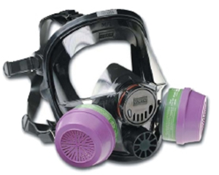
EPA requires full-face N-100 cartridge respirators for CNT manufacturers under a consent order, unless they prove no exposure.
Elimination
Substitution
Modification
Containment
Ventilation
Work Practices
Personal Protection
Any issues with this?
Image courtesy North Company
Notes:
Trainer Notes:
[Again, reiterate that we are moving from more protective to less protective as we move down the hierarchy.]

Slide 23
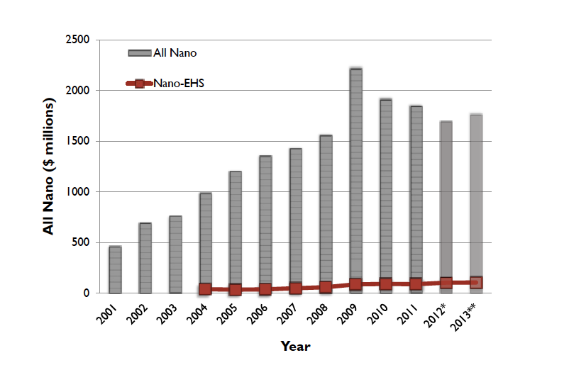
EHS research made up 7% of the 2015 federal nanotechnology

Slide 24
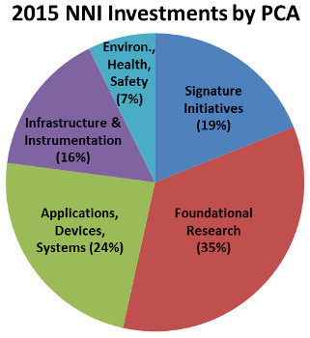
NIOSH’s portion of the total federal nano research budget for 2015 is 0.7%
Notes:
Although EHS made up 7% of the 2015 federal budget, the portion going to NIOSH was quite small.

Slide 25
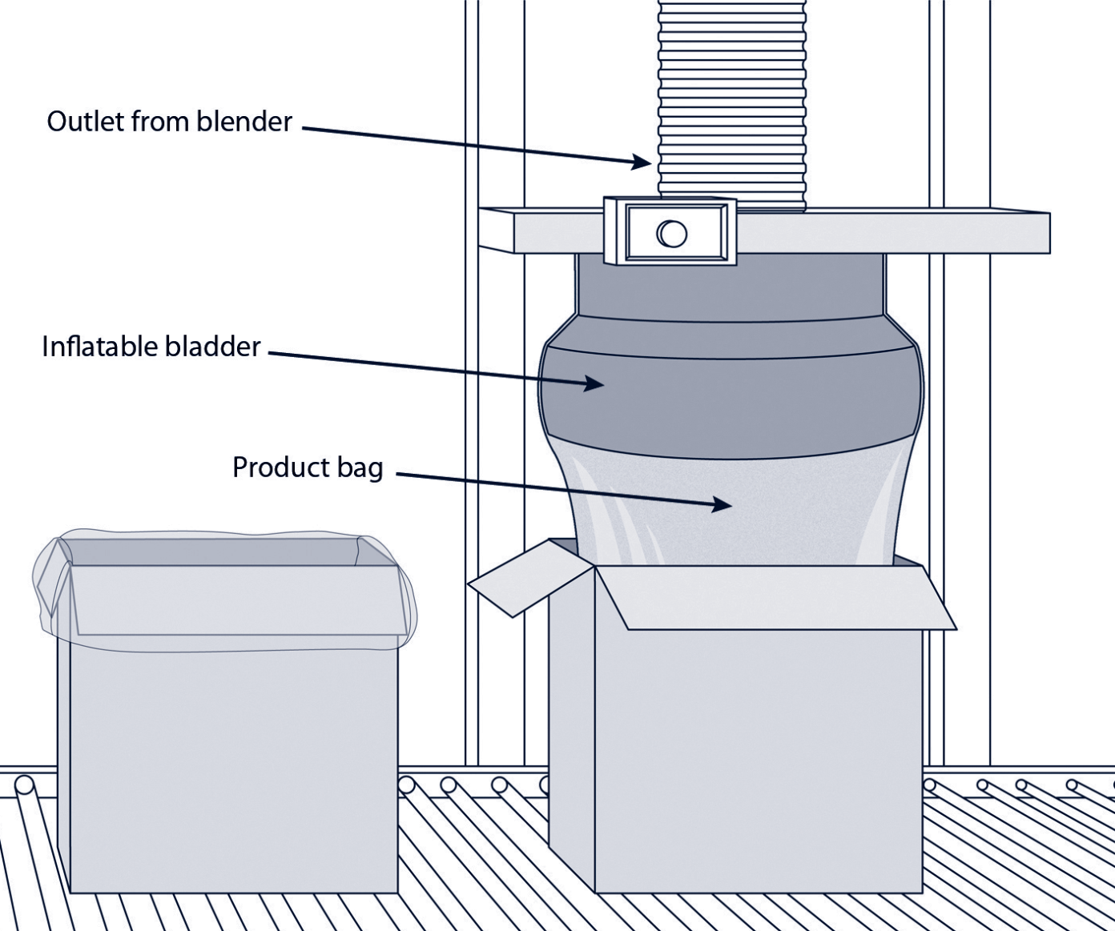
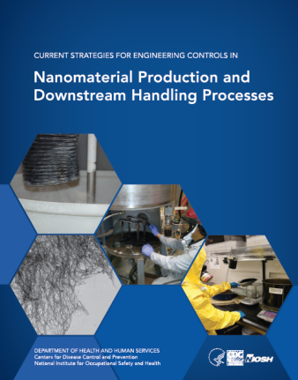
NIOSH has created solid guidance on controlling exposures during production and downstream handling

Slide 26
There are no OSHA PELs, but there are recommended OELs
Nanomaterial | OEL (mg/m³) | Ref | Year
Titanium dioxide | 0.3 ultrafine 2.4 fine | NIOSH REL | 2011
MWCNTs | 0.05 | Bayer Co. | 2010
CNTs and nanofibers | 0.001 | NIOSH REL | 2013

Slide 27

1-30-15, ACGIH announced “nanoscale primary particle notation” is under study for a TLV
Comments are solicited
Notes:
Source: Bergeson and Campbell Law firm, 2-12-15
“On January 30, 2015, the American Conference of Governmental Industrial Hygienists (ACGIH®) announced the under study list for its Threshold Limit Values for Chemical Substances (TLV®-CS) Committee. See http://www.acgih.org/tlv/CSTLVStdy.htm The under study list includes, under other issues under study, "nanoscale primary particle notation." According to ACGIH®, the under study list serves as "notification and invitation to interested parties to submit substantive data and comments to assist the committees in their deliberations." See http://www.acgih.org/TLV/DevProcess.htm The TLV®-CS Committee will consider only those comments and data that address issues of health and exposure, but not economic or technical feasibility. ACGIH® states that comments must be accompanied by copies of substantiating data, preferably in the form of peer-reviewed literature. By July 31, 2015, ACGIH® will update the TLV®-CS Committee's under study list into a two-tier list:
- Tier 1 consists of chemical substances and physical agents that may move forward as a notice of intent to change (NIC) or notice of intent to establish (NIE) in 2016, based on their status in the development process; and
- Tier 2 consists of chemical substances and physical agents that will not move forward, but will either remain on, or be removed from, the under study list in 2016.
ACGIH® states that the best time to submit comments is in the early stages of the TLV® development process, preferably while the substance or agent is on the under study list.”

Slide 28
Discuss the availability and limitations of nanoproduct inventories
1
2
3
Objective 3

Slide 29
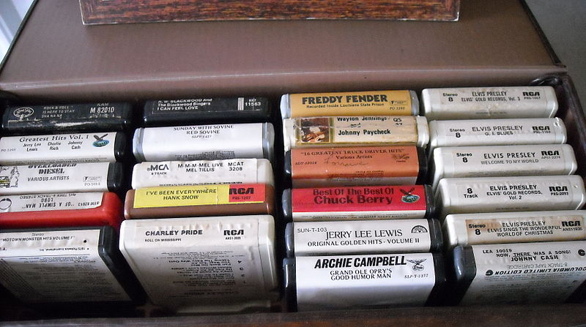
Does anyone know how many nano-enabled products are in commerce?
Yes
No
Notes:
It is a good bet that Freddy Fender 8-tracks don’t use engineered nanoparticles. Seriously, no one has a definitive count for the number of nano-enabled materials in commerce.

Slide 30

The Wilson Center’s Project for Emerging Nanotechnology has nearly 2,000 consumer products on their site
Notes:
The Wilson Center’s Project for Emerging Nanotechnology has nearly 2,000 consumer products on their site

Slide 31
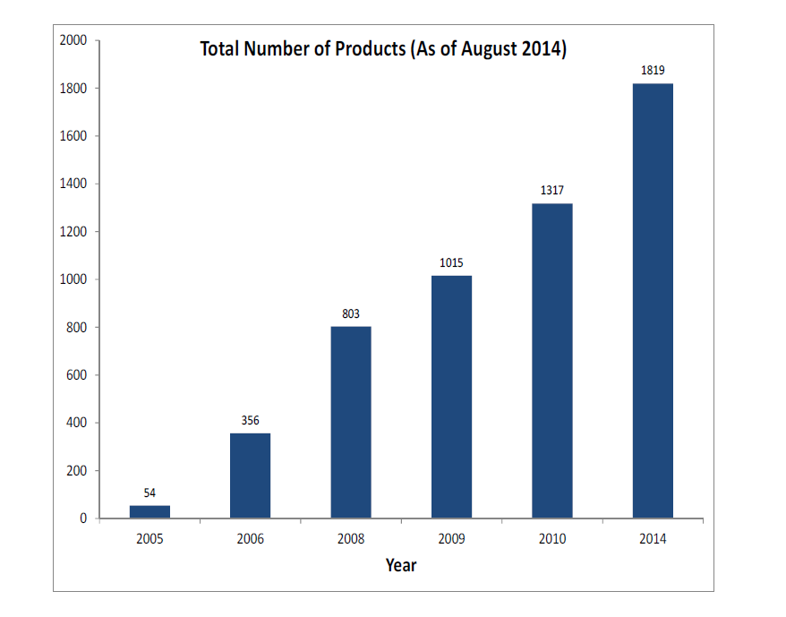
The PEN consumer product inventory has grown significantly since 2005
From Todd Kuiken’s presentation at NanoSafe2014
Notes:
The PEN consumer product inventory has grown significantly since 2005.
This graphic was taken from Todd Kuiken’s presentation at NanoSafe2014 about the PEN inventory.

Slide 32
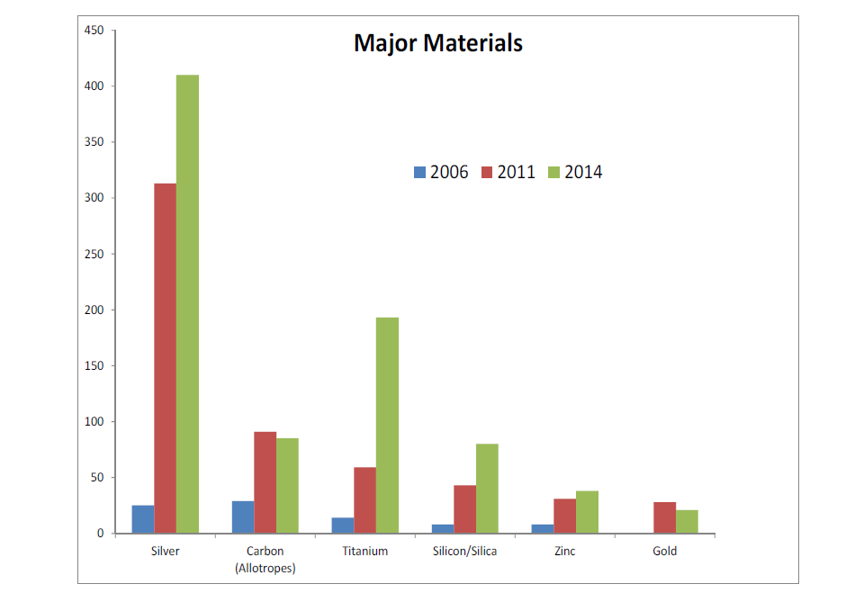
Silver has been the most common nanomaterial in the PEN database
From Todd Kuiken’s presentation at NanoSafe2014
Notes:
Silver has been the most common nanomaterial in the PEN database.
This graphic was taken from Todd Kuiken’s presentation at NanoSafe2014 about the PEN inventory.

Slide 33
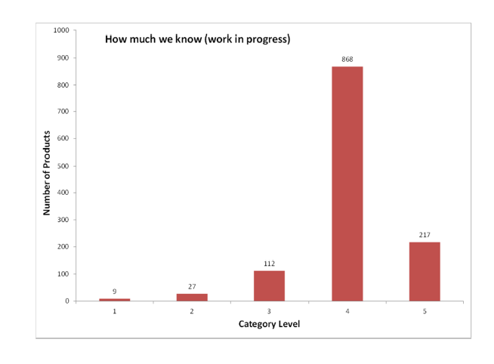
PEN assigns confidence to entries
Unsupported
Not advertised by manufacturer
Manufacturer-supported claim
Extensively verified
verified
From Todd Kuiken’s presentation at NanoSafe2014
Notes:
PEN assigns confidence to entries.

Slide 34

CPWR maintains an inventory of construction-related nanomaterials
What is our criteria?
Manufacturer’s reference to nano
Use of term “nano” in product or company names
Product description suggests presence of nano
Product cited elsewhere as using nano
Notes:
CPWR maintains an inventory of construction-related nanomaterials:
What is our criteria?
Manufacturer’s reference to nano
Use of term “nano” in product or company names
Product description suggests presence of nano
Product cited elsewhere as using nano

Slide 35
CPWR has identified 458 products that are probably nano-enabled

Slide 36
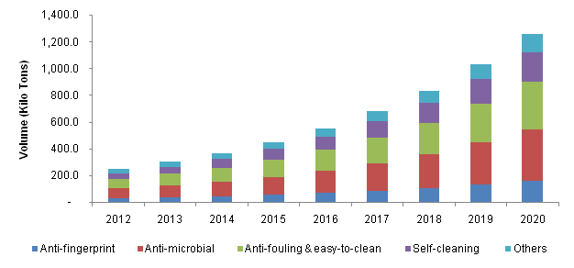
Nanocoatings revenues are estimated to be $8.17 billion by 2020
Graphic courtesy Grand View Research, Inc.
Notes:
Nanocoatings Set for Mega Growth. From Paint Square News, Friday, October 17, 2014
Gaining quickly on conventional coatings, nanocoatings are headed for exponential growth, with revenue expected to reach $8.17 billion by 2020 and market volume hitting 1,262.9 kilo tons, according to Nanocoatings Market Analysis by Product, by Application and Segment Forecasts to 2020, from Grand View Research Inc.
Nanocoatings Market Analysis By Product (Anti-Fingerprint, Anti-Microbial, Anti-Fouling & Easy-To-Clean, Self-Cleaning), By Application (Healthcare, Food, Packaging, Marine, Water Treatment, Electronics, Construction, Automotive, Energy) And Segment Forecasts To 2020
Published: October 2014 | ISBN Code: 978-1-68038-247-1
The nanotech products are in demand for their "superior properties and lesser VOC emissions as compared to other commercially used coatings in the market," the report says.
By way of example, the global market for nanocoatings in 2012 was 255 kilo tons with an estimated value of $1.49 billion. In 2013, the market volume was 309.5 kilo tons.
Anti-fingerprint coatings, popular in electronics and automotive applications, are expected to be the fastest-growing segment with an estimated Compound Annual Growth Rate (CAGR) of 23.2 percent from 2014 to 2020.
Anti-microbial coatings, already widely used in the healthcare and building industries, are also likely to continue their boom, with a CAGR of 22.9 percent from 2014 to 2020. The segment totaled 90.9 kilo tons and revenues of $541.6 million in 2013.
According to the report, the healthcare industry is the largest market for nanocoatings; demand by the industry was estimated at 43.7 kilo tons in 2013, due to increased use of anti-fingerprint and anti-microbial coatings.
By Region
North America leads the world's nanocoating consumption, with 2013 demand estimated at 128.7 kilo tons. The region accounted for more than 40 percent of global demand.
"Increased infrastructural spending in the current fiscal budget coupled with high demand for automobiles and advanced healthcare facilities in the region are expected to be major factors responsible for nanocoatings market development," the report said.
The European market is likely to see significant growth due to stringent VOC regulations on the paints and coatings industry and increasing raw-material costs for conventional coatings.

Slide 37
208 of our 458 nanoproducts(45%) have a specified composition
 | Products (N) | %
Specified composition | 208 | 45.5
aluminum oxide | 8 | 1.8
austenite | 1 | 0.2
boehmite | 1 | 0.2
calcium hydroxide | 1 | 0.2
carbon | 4 | 0.9
carbon nanotubes | 12 | 2.6
cerium oxide | ---------------4 | 0.9
diamond | 1 | 0.2
lithium | 8 | 1.8
magnesium | 1 | 0.2
multiple | 10 | 2.2
nanoscale pores | 17 | 3.7
polycarbon | 51 | 11.1
polycarbonate | 1 | 0.2
polysiloxane | 3 | 0.7
silane | 2 | 0.4
silica | 21 | 4.6
silica fume | 2 | 0.4
silicone | 3 | 0.7
siloxane | 6 | 1.3
silver | 9 | 2.0
titanium dioxide | 22 | 4.8
titanium nitride | 2 | 0.4
tungsten carbide | 4 | 0.9
tungsten disulfide nanofullerenes | 3 | 0.7
zinc oxide | 11 | 2.4
Notes:
208 out of 458 nanoproducts (45%) have a specified composition.

Slide 38
72 (15.7%) have a partially specified composition
Partially specified composition | 72 | 15.7 %
acrylic | 3 | 0.7
acrylic-urethane | 1 | 0.2
ceramic | 5 | 1.1
crystal | 2 | 0.4
fluorochemical | 1 | 0.2
nanostructured | 27 | 5.9
oxide | 11 | 2.4
polymer | 22 | 4.8
Notes:
72 (15.7%) have a partially specified composition.

Slide 39
178 (38.9%) did not specify the composition
Unspecified composition | 178 | 38.9
nanofibers | 1 | 0.2
nanomaterials | 15 | 3.3
nanoparticles | 76 | 16.6
nanotechnology | 70 | 15.3
nanotubes | 1 | 0.2
photocatalytic materials | 5 | 1.1
reference to 'nano' | 10 | 2.2
Notes:
178 (38.9%) did not specify the composition.

Slide 40
Three-quarters of the products in our inventory are probably available in the U.S.

Slide 41

Alibaba.com is the 500 pound e-gorilla in the room
Sept 2014 IPO value of $231 billion US
World’s largest online business-to-business trading platform for small businesses (WSJ)
Importers and exporters >240 countries
Many construction products with ‘nano’ claims we’ve not attempted to tackle
Notes:
Alibaba.com is the 500 pound e-gorilla in the room.
Sept 2014 IPO value of $231 billion US
World’s largest online business-to-business trading platform for small businesses (WSJ)
Importers and exporters >240 countries
Many construction products with ‘nano’ claims we’ve not attempted to tackle

Slide 42

N=871 ‘Nanotechnology’ Flooring Tiles
Notes:
http://offer.alibaba.com/products/nanotechnology/----------------------------------10-100014246.html
N=871 ‘Nanotechnology’ Flooring Tiles
The Ali Baba database contains 871 floor tiles for sale that have nanotechnology associated with them.

Slide 43

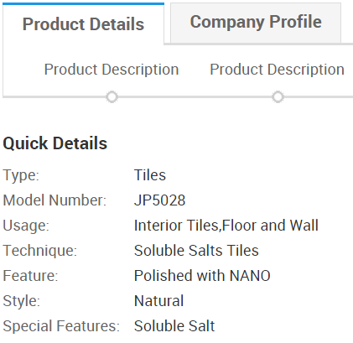
Example: “Polished with NANO”
Notes:
Example: “Polished with NANO”.
We don’t know what this means, nor whether this is truly a nano-enabled product.
http://www.alibaba.com/product-detail/Nanotechnology-Soluble-Salt-Tile-Porcelain-Polished_60053393890/showimage.html

Slide 44
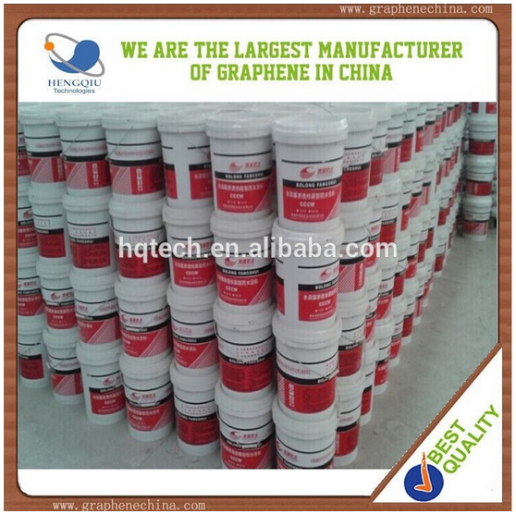
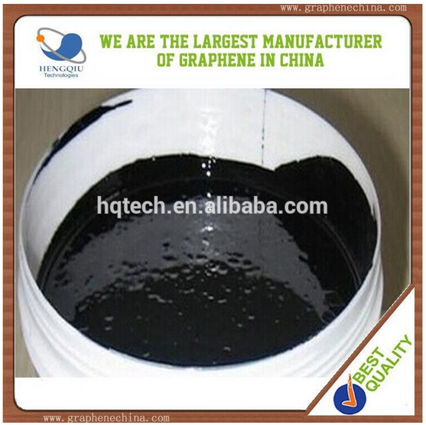
Carbon nanotube thermal coating for boat paint and building construction
“It does no harm to human body before and after construction.”
Notes:
Carbon nanotube thermal coating for boat paint and building construction. This product uses carbon nanotubes, but contains a description “It does no harm to human body before and after construction.”
http://www.alibaba.com/product-detail/China-new-products-carbon-nanotube-thermal_60126956705.html

Slide 45
Describe the applications of nanomaterials your trade may encounter
1
2
3
4
Objective 4

Slide 46
There are many products that your members will encounter
Union members | Products
Aerospace workers | Forged components, thermal spray powders & coatings, light alloys, cermented carbides and tooling
Autoworkers | Lubricants and auto parts
Electrical workers | Electrical coatings and metal coatings
Machinists | Lubricants and coatings
Teamsters | Lubricants, coatings, and tires
Transportation workers | Asphalt additives and cement coatings

Slide 47
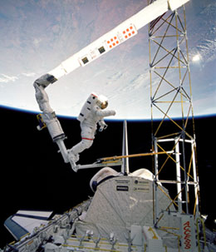
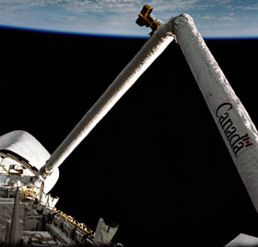
Lubricants for equipment used in space are being nano-enabled with molybdenum disulfide and graphite
Notes:
“Shuttles and equipment used in space consist of numerous elements and have several friction-prone details, the surface of which must be greased to ensure smooth operation. Due to extreme temperature, pressure and radiation conditions, conventional oils and greases cannot be used in space. This is why solid substances such as molybdenum disulfide and graphite are preferred for space usage.”

Slide 48
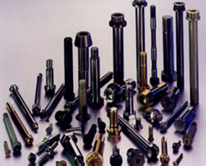
Forged nano alloy components are being used in aerospace, sports and recreation
Fasteners
  Bolts, studs, pins
Precision Components
  High Tolerances, forged
Performance Metal Matrix Composite
  Al with 5%, 10%, 15% reinforcement with ceramic fibers like silicon carbide or graphite
  Cermets
Notes:
http://nano.elcosh.org/index.php?module=Search&company_filter=57&title=California%20Nanotechnologies,%20Inc.
http://calnanocorp.com/products/forged-components/
(no SDS online)
California Nanotechnologies, Inc.
California Nanotechnologies manufacturers forged nano alloy components for applications in the aerospace to sports and recreation industries.

Slide 49

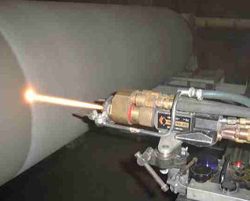
Thermal spray powders & coatings are used in oil & gas, pulp & paper, energy and sporting goods
Nano additions increase hardness and strength
Nano improves wet abrasion resistance
Finer tungsten-carbide nano grain gives smoother “as sprayed” surface, reducing grinding and finishing
Notes:
http://nano.elcosh.org/index.php?module=Search&company_filter=57&title=California%20Nanotechnologies,%20Inc.
http://calnanocorp.com/products/thermal-spray-coatings/
Any material that contains grains or particles in the size range from 1 to 100 nm is considered a nanocrystalline material.
California Nanotechnologies, Inc. provides several tungsten carbide-cobalt based cermet powders for thermal spraying in a variety of applications.
CNO cermets provide the benefits of WC-based materials plus the benefits of nano-enhanced properties. Potential applications include aerospace, oil & gas, pulp and paper, energy, sporting goods and many other industries.
The nano-scale additions provide increases in mechanical properties (hardness, strength) and performance (wet abrasion resistance, etc.). The finer WC grain nano enhancement provides a smoother "as-sprayed" surface significantly reducing grinding and finishing operations which significantly reduce costs.

Slide 50
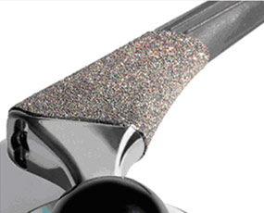
Light nano alloys have better grain structure and reinforcement over base materials
  Spark Plasma Sintering
  Machining
  Extruding
  Cold forging
Notes:
http://nano.elcosh.org/index.php?module=Search&company_filter=57&title=California%20Nanotechnologies,%20Inc.
http://calnanocorp.com/products/light-alloys/
California Nanotechnologies, Inc. provides several light alloy powders including aluminum and aluminum alloys, titanium and titanium alloys and magnesium and magnesium alloys with nano enhanced grains. Light alloy billets are available.
CNO light alloys provide the benefits of the original base material plus the benefits of nano-enhanced grain structure and potential reinforcement. Applications range from the aerospace industry to the sports & recreation industry.
Consolidation of nano enhanced powders is available with vacuum sintering, HIPing, Spark Plasma Sintering and standard wire/rod extrusion processes. These materials may be further machined or cold forged.
Light alloys in general are used in building construction: http://www2.iccsafe.org/states/Florida2001/FL_Building1/PDFs/Chapter%2020_Light%20Metal%20Alloys.pdf

Slide 51


VW Nanospyder 2006 concept car includes fuel cells, solar power, wheel-mounted electric motors
Notes:
Volkswagen Nanospyder futuristic concept car anytime soon. This entrance to the 2006 Los Angeles Design challenge was supported by hydrogen fuel cells, solar power, wheel-mounted electric motors and inflatable organic body panels combine to form the unusual shape of the two-seater concept.According to its creators – designers based at the Volkswagen Design Center in Santa Monica – the Nanospyder would be formed out of a latticework of billions of tiny programmable nano devices measuring less than half a millimeter in diameter. Each of these tiny devices can be programmed to be as strong or weak as required meaning active crumple zones can be created. Clothing the nano-lattice are panels formed out of a mix of organic materials some of which can inflate to provide further cushioning in the result of an impact. The material doubles as a power source as polysynthesis generates small amounts of electricity. This coupled with hydrogen fuels generates power to drive the tiny electric motors mounted within the hubs of all four wheels.
Read more: Nanotechnology in the automotive industry
1976 Dodge Dart Swinger

Slide 52
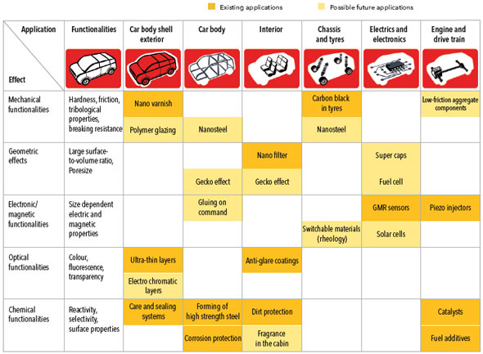
Nanotech is big in the automotive industry
existing
possible
Notes:
http://www.nanowerk.com/spotlight/spotid=18972.php (not sure what products in our inventory fit the applications below)
Existing Applications:
Nano varnish
Carbon black in tires
Nano filter
GMR sensors
Piezo injectors
Ultra-thin layers
Anti-glare coatings
Care and sealing systems
Forming of high strength steel
Dirt Protection
Catalysts
Corrosion protection
Fuel additives

Slide 53

Nanoprotech Electric
“NANOPROTECH Electric displaces moisture, lubricates mechanisms, securely proofs electrical components even in damp environment, and improves performance of the equipment.”
SDS
Notes:
http://nano.elcosh.org/index.php?module=NanoProduct&id=445&title=NANOPROTECH%20Electric%20Industry
http://www.nanoprotech.org/Products/ELECTRIC-INDUSTRY-1-Gal
(couldn’t find SDS online)
Due to its molecular structure, based on nanotechnology, NANOPROTECH will penetrate even through layers of paint.
http://www.nanoprotech.org/Products
protects electronic devices against moisture (steam, condensate water, rain, chlorinated and salt water etc.)
increases service life of electrical equipment;
restores, maintains and improves dielectric resistance of electrical equipment in wet conditions;
restores performance and conductivity of moisture damaged parts from corrosion and oxidation;
protects against short circuits, malfunctioning and freezing of equipment;
protects against insulation breakdown and current leakage;
improves dielectric conductivity of the surfaces;
protects against oxidation, mildew and fungi on electrical contacts;
eliminates soot, carbon deposit and dirt;
cleans and protects contacts of electrical equipment against dust and dirt

Slide 54
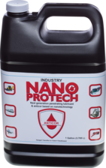
Nanoprotech Anticor Industry
“Anticorrosion protection should be used on all stages of production and operation of metal parts and mechanisms. Average loss due to corrosion accounts for about 12% of annual volume of metal production.”
SDS
Notes:
http://nano.elcosh.org/index.php?module=NanoProduct&id=446&title=NANOPROTECH%20Anticor%20Industry
http://www.nanoprotech.org/Products/ELECTRIC-INDUSTRY-1-Gal
(couldn’t find SDS online)
Due to its molecular structure, based on nanotechnology, NANOPROTECH will penetrate even through layers of paint.
http://www.nanoprotech.org/Products
protects metals and mechanisms against moisture (vapor, humidity, water condensate, splashes, fog, rain, acid rain, chlorinated and salt water);
displaces moisture;
builds powerful elastic protective coating;
protects against breakage of metal and steel mechanisms;
significantly increases service life of mechanisms;
protects moving parts from corrosion;
protects mechanisms against wear and tear;
eliminates soot, carbon deposit and dirt;
helps to loosen rust (bolts, screws, etc.);
eliminates squeaking
protects scratches and cracks on metal surfaces against corrosion;
provides stable operation of equipment in winter;
has high penetration rate
efficient in protection of bearings against humidity;
significantly increases service life of moving mechanisms,equipment, and details in adverse condition.

Slide 55
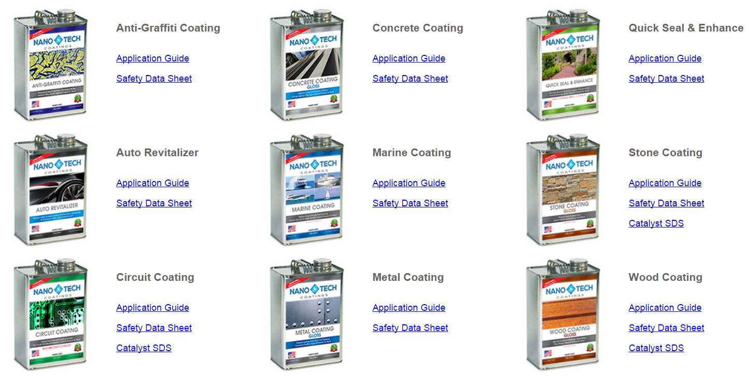
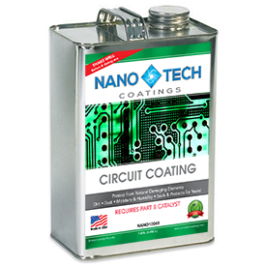
Solvent-based coatings are available for most surfaces
We will look at the SDS for this product
Notes:
http://nano.elcosh.org/index.php?module=NanoProduct&id=295&title=NanoTech%20Metal%20Coating
http://www.nanotechcoatings.com/msds/
eals & Protects - Electrical Components
NanoTech Circuit Coating is non-conductive and provides superior protection for most circuits, PCBs, and other electrical components from damaging elements. Using proprietary nanotechnology, we at NanoTech Coatings have formulated a long lasting, durable, environmentally friendly line of nanocoatings for a wide variety of substrates. Our Circuit Coating repels dirt, sand, and moisture, thus preventing corrosion. This superior protection prevents the need for costly circuit replacements. Our NanoTech Circuit Coating is also ideal for protecting and waterproofing expensive electronics such as computers, that may be exposed to harsh elements of the environment.

Slide 56
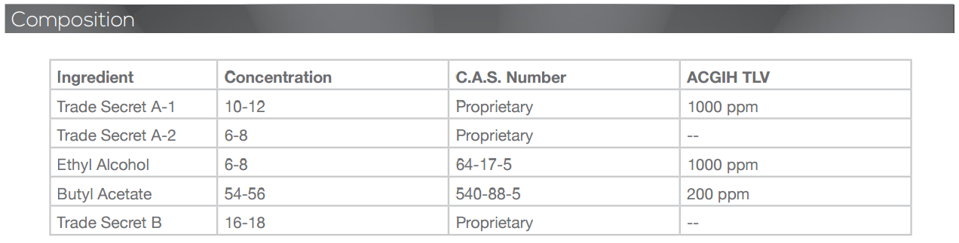
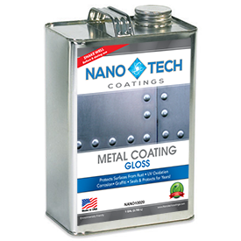
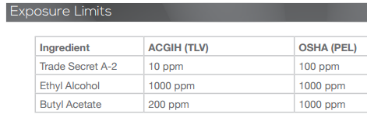
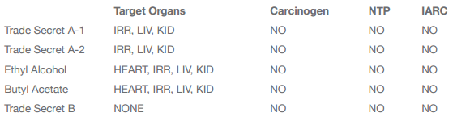
NanoTech Coatings SDS for metal coating
“Shake the contents thoroughly to re-suspend the nanoparticles that have settled to the bottom.”
Notes:
http://nano.elcosh.org/index.php?module=NanoProduct&id=295&title=NanoTech%20Metal%20Coating
http://www.nanotechcoatings.com/metal-coating/
http://www.nanotechcoatings.com/msds/
Using proprietary nanotechnology, we at NanoTech Coatings have formulated a long lasting, durable, environmentally friendly line of nanocoatings for a wide variety of substrates. Our Metal Coat provides protection against all types of corrosion from water, salt spray, chemical exposure, as well as other damaging environmental elements. Due to its anti-corrosion properties, our Metal Coat also eliminates the need to polish easily tarnished metals, such as aluminum, silver, and brass. NanoTech Metal Coating also provides UV protection for the metal surface and reduces ice adhesion. NanoTech Metal Coating is designed to protect metals in industrial situations like bridges, pipelines, and other large equipment as well as everyday metals in the home, such as door knobs and stainless steel kitchen appliances.
Recent project featured on the bottom of the product page shows a cement mixer truck coated with this coating by NanoTech Coatings Mexico. Company is based in Colorado.
Only mention of ‘nanoparticles’ I could find online: “Shake the contents thoroughly to re-suspend the nanoparticles that have settled to the bottom.” pg. 2 of application guide on product page

Slide 57
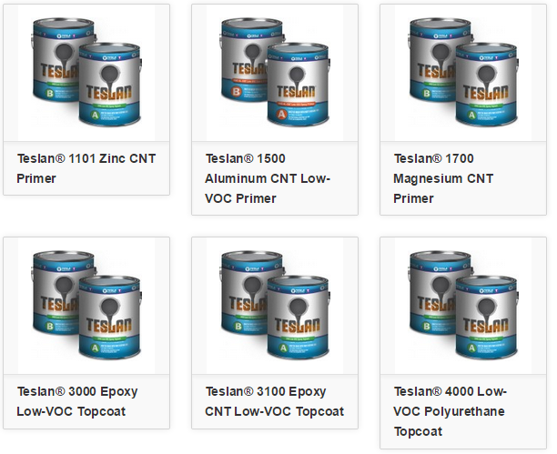
Tesla Nanocoatings prevent corrosion and contain CNTs
Notes:
http://www.teslanano.com/products/ (I need to update our elcosh nano pages, they’ve updated their site)
Teslan® 1500 Aluminum CNT Primer can be applied directly to prepared steel surfaces. It is a solvent-based, two-component aluminum carbon nanotube (CNT) epoxy-polyamide primer designed to protect metal surfaces in corrosive environments.
Teslan 1500 primer is durable and protects against impact and mechanical damage while delivering superior corrosion protection. The primer is formulated with CNTs and aluminum, in the form of sacrificial aluminum dust. The CNTs align in long and strong ropelike structures that provide the ultimate in corrosion protection.
Salt fog test results and a long-term independent laboratory study finds that the combination of Tesla’s CNT technology with sacrificial aluminum dust allows for a reduction in the aluminum load required, while providing an improvement n performance compared to traditional organic zinc-rich systems.
Teslan® 1700 Magnesium CNT Primer is formulated with carbon nanotubes (CNTs) and magnesium to deliver corrosion protection to steel and other metal surfaces. It is a solvent-based, two-component magnesium-CNT epoxy-polyamide primer designed to be applied directly to prepared metal surfaces and to be the foundation for Teslan topcoats.
(SDSs available online, H&S of CNTs not addressed)
Over the highway and off the road, Teslan keeps transportation rolling: http://www.teslanano.com/markets/trucking-construction-agriculture/
Our R&D team works closely with transportation industry experts to ensure Teslan is the right choice for corrosion-resisting protective application. In trucking, mining, construction and other transportation and heavy equipment industries, Teslan can protect your investment from the ravages of corrosion and the costs associated with downtime and repair. Trailers, tankers, material handling and other heavy equipment can stay in service longer and require fewer maintenance dollars.
Users report ROI as high as 900 percent. Our customers realize on average 30 percent reductions in labor, material costs and variable costs.
Teslan® 1700 Magnesium CNT Primer is formulated with carbon nanotubes (CNTs) and magnesium to deliver corrosion protection to steel and other metal surfaces. It is a solvent-based, two-component magnesium-CNT epoxy-polyamide primer designed to be applied directly to prepared metal surfaces and to be the foundation for Teslan topcoats.
Teslan 1700 primer’s CNTs align in long ropelike structures that are bound tougher than diamonds and which provide the ultimate in corrosion protection. The primer is durable and protects against impact and mechanical damage while delivering superior corrosion protection. This primer can be directly topcoated without application of an intermediate epoxy or urethane coating.
Application is easy, using conventional air-spray, air-assisted airless or airless spray equipment.
Teslan is the world’s most durable corrosion-resistant two-coat protective coating system. Teslan primers and topcoats are recommended for any application where steel or aluminum must withstand rust and corrosion, even in the most extreme environments.

Slide 58
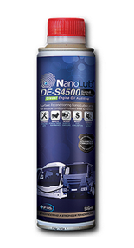
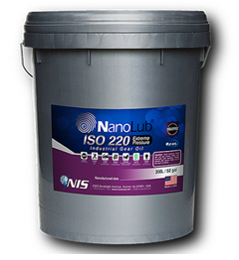

Many nano-enabled lubricants are on the market
SDS
NanoLub® Gear lubricant
NanoLub® Metal Forming Fluid
NanoLub® Heavy Duty Diesel Engine Oil Additive
http://www.apnano.com/products/nanolub-de-m4600-heavy-duty-diesel-engine-oil-additive/
Notes:
proprietary nano-sized inorganic fullerene-like tungsten disulfide (IF-WS₂) particles engineered to provide outstanding load-bearing, anti-wear and ultra-low friction. NanoLub® ISO-220EP is a blend of solid IF-WS₂ nanoparticles and other high-quality multifunctional lubricant additives dispersed in a premium grade mineral oil designed for heavy industrial enclosed gear systems. NanoLub® ISO-220EP can be used in other extreme gearing applications such as power plants, mining equipment, steel mills and cement plants replacing conventional gear lubricants.
IF-WS₂ nanoparticles based lubricant is specially designed for heavy-duty cold metalworking applications. It is chlorine and boron free with no active sulfur. The special additive package allows excellent anti-wear and ultra-pressure properties to this metal working fluid.
NanoLub® DE-M6000 Marine Diesel Engine Oil Additive is a new generation surface-reconditioning nano lubricant for engine oil, based on formulated Mineral Oil concentrate mixed with NIS’s proprietary super strong tungsten disulfide (WS₂ ) multilayered nano-fullerene particles.

Slide 59

CurTran LiteWire is carbon nanotube technology in wires and cables, directly replacing copper
Notes:
http://nano.elcosh.org/index.php?module=NanoProduct&id=377&title=LiteWire (no SDS online)
LiteWire is a carbon nano-tube conductor in wire form. LiteWire is a direct replacement for copper wire. It also replaces any other metallic conductor used today.
Weatherford Gains Exclusivity of Nanotube Wire and Cable Products in the Oil and Gas Industry
http://www.marketwatch.com/story/curtran-and-weatherford-sign-long-term-contract-for-new-litewire-nanotechnology-2014-04-09
HOUSTON, April 9, 2014 /PRNewswire/ -- CurTran LLC today announced that it has signed its first contract for LiteWire products with Weatherford International Ltd. Per the agreement, Weatherford will use, sell, and distribute LiteWire, the first commercial scale production of a carbon nanotube technology in wire and cable form.

Slide 60


Reynobond, a coil-coated architectural panel that cleans itself and the air around it
Notes:
http://nano-admin.elcosh.org/index.php?module=DBRE&id=236
http://www.alcoa.com/bcs/aap_eastman/ecoclean/en/home.asp (Alcoa Product Page)
Alcoa Architectural Products has developed a proprietary process that leverages HYDROTECT™ technology from TOTO® to apply a titanium dioxide (TiO₂) coating, called EcoClean™, to the pre-painted aluminum surface of Reynobond®. The result is the world's first coil-coated aluminum architectural panel that helps clean itself and the air around it.
There is a video of the process shown on the slide on the product page.
Brochure: 10,000 square feet of Reynobond with EcoClean has the approximate air cleansing power of 80 trees. That’s enough cleaning power to offset the smog created by
the pollution output of four cars every day.
"Just as plants harness light for photosynthesis in nature, HYDROTECT nanotechnology does the same for manmade surfaces. An integrated part of the manufacturing process, HYDROTECT uses nontoxic titanium dioxide (TiO2) in the glazing and coating process." (see HYDROTECT brochure under ‘Technical Info’ on product page)
View SDSs for Alcoa Reynobond here (search for ‘Reynobond’):
http://www.alcoa.com/global/en/environment/msds_search.asp?name=&id=1426&langType=English
Not clear which corresponds to Reynobond Ecoclean.
REYNOBOND NATURAL TITANIUM COMPOSITE MATERIALS (SDS):
Titanium 15-30%
Thermoplastic polymer (proprietary) 20-50%
Fire retardant (proprietary) 0-35%
Other ingredients as well.
Serious health effects noted for exposure to dust from processing (e.g. can cause lung cancer due to presence of strontium chromate <0.05%)
"following health effects are not likely to occur unless sawing or cutting generates dust or unless material is heated to melting"

Slide 61


Reynobond with Ecoclean (cont.)
Notes:
From FAQ: http://www.alcoa.com/bcs/aap_eastman/ecoclean/en/faqs.asp
Pictures from product brochure
What is the difference between EcoClean™ and other technologies that claim self-cleaning properties and show photos of water beading up on a panel’s surface?
EcoClean™ is superhydrophilic – meaning that it loves water, while others are hydrophobic in nature – water hating. Thus, water does not bead up on the surface of EcoClean™ like you see on competitors’ materials; rather it spreads out and wets the surface completely. With EcoClean™, dirt is undercut and washed off. With a hydrophobic surface, water will bead up – carrying dirt as the beads roll down the panel’s surface. Unfortunately, water beads leave streaks as well as concentrations of dirt on the bottom-most building panels where the beads evaporated.

Slide 62


GFRC Spray Coat and Reinforcement Mixes for shower walls, concrete countertops and fireplaces
The Xtreme Series uses cement, sand along with 3 types of fiber (PVA, Glass AR, and Nano)
Notes:
http://nano.elcosh.org/index.php?module=NanoProduct&id=462&title=GFRC%20SPRAY%20COAT%20AND%20REINFORCEMENT%20MIXES
http://www.surecretedesign.com/gfrc/
interior and exterior wall panels, shower walls, concrete countertops, facades, lightweight architectural trim, balusters, fireplaces and many other precast opportunities
The Xtreme Series technology uses cement, sand along with 3 types of fiber (PVA, Glass AR, and Nano)

Slide 63

Nano zinc added to asphalt reduces hydrogen sulfide release
SDS
LMGI Asphalt Additives
Notes:
http://nano.elcosh.org/index.php?module=NanoProduct&id=464&title=LMGI%20Asphalt%20Additives
http://www.liquidminerals.com/asphalt.html
(no SDS online)
Sulfur is often added to asphalt as a binder and extender. When heated to lower asphalt viscosity, hydrogen sulfide is often formed. Hydrogen sulfide is not only an odor nuisance for workers and neighbors, but it can also be extremely dangerous. Liquid Minerals Group, Inc.’s oil soluble nanoparticle zinc additives have been found to help to control and or eliminate hydrogen sulfide at modest dosage levels.

Slide 64

We spend 2.4% of our GDP on transportation infrastructure
Spending still 60% below what is needed
550 million tons of hot-mix asphalt annually
Stronger asphalt is critical (NSF)
Potholes and poor roads are large contributors to the 30,000 vehicular deaths each year
NYC, Photo courtesy
NY Daily News

Slide 65

Carbon nanotubes reinforce cement at the nano scale
CNTs bridging a gaps in OPC
Notes:
CNTs have a high tensile strength and Young’s modulus, display elastic behaviour [31] and excellent thermal properties [32]. Indeed, the tensile strength and
Young’s modulus of CNTs are hundreds and tens of times that of steel, respectively, although their weight per volume of CNTs is a mere fraction that of steel. CNTs reinforce concrete at the nanoscale rather than the macro scale in the manner of traditional steel reinforcement bars.

Slide 66


Aerogels are incredible insulators
Matches on a piece of aerogel over a propane torch
A 5 pound brick supported by a piece of aerogel with a mass of 2 grams
Photos courtesy Wikimedia and NASA
Notes:
Aerogels are good thermal insulators because they almost nullify two of the three methods of heat transfer (convection, conduction, and radiation). They are good conductive insulators because they are composed almost entirely from a gas, and gases are very poor heat conductors. Silica aerogel is especially good because silica is also a poor conductor of heat (a metallic aerogel, on the other hand, would be less effective). They are good convective inhibitors because air cannot circulate through the lattice. Aerogels are poor radiative insulators because infrared radiation (which transfers heat) passes right through silica aerogel.
Owing to its hygroscopic nature, aerogel feels dry and acts as a strong desiccant. Persons handling aerogel for extended periods should wear gloves to prevent the appearance of dry brittle spots on their skin.
3.4. Safety aspects and fire behaviour
Aerogel insulation sheets suffer from dust production. As most of the commercial aerogel insulation products consist of complete amorphous (and thus 0% crystalline) silica, exposure limits in the range of 5 mg/m³ for respirable dust count in the US OSHA. However, the International Agency for Research on Cancer (IARC) considers synthetic amorphous silica to be not classifiable as to its carcinogenicity to humans (i.e. group 3). No evidence of silicosis has been found from epidemiological studies of workers with long-term exposure to synthetic silica, whereas studies of various animal species show that amorphous silica can be completely cleared from the lungs [48] and [82].
Monolith silica aerogels consists of SiO₂ with a −CH₃ treated surface for hydrophobisation. They are generally non-flammable and non-reactive. Also commercial products containing silica aerogels are considered to have the same properties [71]. Even more, aerogel insulation is used as fire-protecting material [1] and [55] where the PET fibres generally used for reinforcement are replaced [2].

Slide 67

They can be translucent, too

Slide 68

Translucent aerogel is used for thermal insulation and lighting
Baetens , Jelle & Gustavsen
Energy and Buildings Volume 43, Issue 4

Slide 69

Aerogels are great at insulating and reducing noise
Average attenuations of -60 dB for a thickness of 70mm.
“Aerogel insulation sheets suffer from dust production.”
R. Baetens, Nanotechnology in eco-efficient construction, 2013

Slide 70

NIOSH conducted an HHE of Aerogel insulation for the insulators union
Mark Methner, NIOSH
Feldmann, Musolin and Methner, March 2015
Notes:
NIOSH conducted an HHE of Aerogel insulation at the request of the insulators union. This is a shot of the first meeting to discuss aerogel in Cincinnati. The actual measurements took place at an insulators local in Chicago in January 2014. The NIOSH team took measurements with standard industrial hygiene instruments and a real-time monitor. They also collected samples for analysis by electron microscopy.

Slide 71

The March 2015 HHE reported:
Exposures for amorphous silica approached OELs
Exposures for crystalline silica, aluminum, titanium and iron were below OELs
Most of the particulate released during aerogel handling was respirable
Many participants reported upper respiratory tract irritation or very dry or chapped skin
Notes:
NIOSH’s March 2015 HHE reported that:
Exposures for amorphous silica approached OELs
Exposures for crystalline silica, aluminum, titanium and iron were below OELs
Most of the particulate released during aerogel handling was respirable
Many participants reported upper respiratory tract irritation or very dry or chapped skin

Slide 72

Self-cleaning windows can reduce worker exposures
March 16, 2015
CPWR’s offices
Notes:
Self-cleaning windows could put people out of work, but would also reduce these kind of exposures.

Slide 73
Explain what we know about the health problems posed by nanoparticles
1
2
3
4
5
Objective 5

Slide 74
The first case of human health effects was just documented
26 year-old female chemist
Weighed nickel nanoparticles on a lab bench with no protective measures
Developed nickel sensitization
Had difficult time returning to work even in other parts of the building
NIOSH has commented on this case:
http://blogs.cdc.gov/niosh-science-blog/2014/05/28/nickel-nano/
Journeay & Goldman, 2014 AJIM
Notes:
A 26-year-old female chemist formulated polymers and coatings usually using silver ink
particles. When she later began working with nickel nanoparticle powder weighed out and
handled on a lab bench with no protective measures, she developed throat irritation, nasal
congestion, “post nasal drip,” facial flushing, and new skin reactions to her earrings and
belt buckle which were temporally related to working with the nanoparticles. Subsequently
she was found to have a positive reaction to nickel on the T.R.U.E. patch test, and a normal
range FEV1 that increased by 16% post bronchodilator. It was difficult returning her to
work even in other parts of the building due to recurrence of symptoms. This incident
triggered the company to make plans for better control measures for working with nickel
nanoparticles. In conclusion, a worker developed nickel sensitization when working with
nanoparticle nickel powder in a setting without any special respiratory protection or
control measures. Am. J. Ind. Med. 2014 Wiley Periodicals, Inc.

Slide 75

Mesotheliomas have been produced in mice with MWCNTs that are fibers with long aspect ratios (Takagi 08, Poland 08)
Remind you of anything?
Multi-walled carbon nanotube penetrating the pleura of the lung. Courtesy of Robert Mercer, and Diane Schwegler- Berry, NIOSH

Slide 76

What is the main route of entry for nanoparticles?
Up to 50% of inhaled nanoparticles may deposit in gas exchange region (Schulte)
Inhaled NPs may enter the blood stream and translocate to other organs
Image courtesy Wikimedia
Notes:
Trainer Notes:
The ability of a particle to deposit in the respiratory tract depends on its size. Particles larger than about 10 microns (10,000 nm) get trapped by the mouth, nose and throat; only particles less than ~10 microns enter the conductive airways (trachea and bronchi). Many of these particles are trapped by mucus and ultimately ingested. Nanoparticles’ small size permits them to be inhaled into the alveolar (deep) region of the lung where gas exchange occurs. For this reason, many studies and guidance documents have focused on inhalation as the primary route of exposure to nanoparticles in the workplace.
Animal studies have indicated that nanoparticles in the lung may be able to enter the bloodstream and translocate to other organs.
In many of these studies the nanoparticles were modified to prevent them from agglomerating together into particles larger than 2-3 microns. Some studies have shown that the primary effect of nanoparticles in the lung was asphyxiation when the particles clumped together and physically blocked the airways. The actual impact of a nanoparticle encountered in the workplace will depend critically on whether or not that nanoparticle agglomerates prior to or after entering the body.
SOURCE
Image: http://upload.wikimedia.org/wikipedia/commons/3/36/Respiratory_Tract.png

Slide 77

Skin cannot be ruled out as a potential route of exposure, but results are mixed
Several studies show little penetration of nanoscale oxides beyond surface skin layers
Quantum dots were found to penetrate intact pig skin within 8-24 hours at occupationally relevant doses
Notes:
Trainer Notes:
Research on skin as a route of exposure is more limited than that on inhalation. The methods for measuring skin penetration are still evolving and better validation and standardization are needed.
Dozens of papers demonstrate the ability of intact skin to protect against penetration of nanoparticles beyond the surface layers of the skin. This is particularly evident for titanium dioxide and zinc oxide nanoparticles used in topical sunscreens.
Fluorescently tagged polysaccharide (dextran) beads of 500- and 1000-nm diameter were found to penetrate to the dermis when the skin was mechanically flexed. Silver nanoparticles embedded in a wound dressing caused elevated levels of silver to be detected in plasma and urine and graying of the skin (argyria) of a burn patient.
Quantum dots of various sizes, surface coatings and shapes were found to penetrate intact skin to the epidermal and dermal layers within 8 hours. The researchers concluded that the time scale (typical work day) and dosage were relevant for occupational exposures.
Sources
Int Arch Occup Environ Health (2009) 82:1043–1055
IMAGE: http://en.wikipedia.org/wiki/File:HumanSkinDiagram.jpg

Slide 78


Metal nanoparticles have been shown to penetrate flexed, damaged or diseased skin
We have lots in the trades
Int Arch Occup Environ Health (2009) 82:1043-1055
Notes:
Trainer Notes:
Fluorescently tagged polysaccharide (dextran) beads of 500- and 1000-nm diameter were found to penetrate to the dermis when the skin was mechanically flexed.
Source : Int Arch Occup Environ Health (2009) 82:1043–1055
The worker on the left is using a 2x4 to hand screed concrete. Hand screeding normally requires workers to bend forward at the waist and grip the straight edge with a flexed wrist pinch grip. The awkward posture and high force necessary to pull the board along the concrete can result in back, wrist or hand injuries due to overuse

Slide 79

Ingestion is a viable route of entry, particles can translocate throughout the body
How do we ingest nanoparticles?
Ingested nanoparticles translocate to other organ systems
  SWCNT delivered into gut for treating Alzheimer’s disease were found in liver, brain and heart
Nano Mac?
Notes:
Trainer Notes:
Unintentional ingestion of nanoparticles may result subsequent to inhalation when mucus moves up out of the respiratory tract and is swallowed. (This clearance mechanism is called the mucociliary escalator.)
And, as is the case with other substances in the workplace, poor work practices, such as eating or smoking in the work area, can result in unintentional ingestion.
Occupational exposure via ingestion is perhaps the least well researched of the three pathways discussed in this module. However, the use of nanoparticles as drug delivery agents is a huge area in medical research. Some of these agents are meant to be ingested and then translocate to other areas of the body. This is itself demonstrates that ingested nanoparticles have routes out of the digestive tract and into other bodily systems. For example recently a single-walled carbon nanotube (SWCNT) agent introduced into rodent stomachs through gastrogavage was subsequently found in the liver, heart and brain as well as the lower intestine.
Excess ingestion of “colloidal” silver (much of which contains nanosilver) can result in a permanent discoloration of the skin (argyria) and eyes (argyrosis) from silver depositing into these tissues.
Sources
IMAGE: Microsoft image gallery
SWCNT: Nanomedicine: Nanotechnology, Biology, and Medicine 6 (2010) 427–441
Silver: Journal of Applied Biomedicine 2008, 6(3): 117-129

Slide 80
Describe the current state of hazard communication for nano
1
2
3
4
5
6
Objective 6

Slide 81
Lippy Group reviewed NIOSH’s collection of nano MSDSs in 2008
N = 49 MSDSs
Reviewed all of NIOSH’s MSDSs
33% did not identify the nano component
52% did not have any cautionary language

Slide 82
62% just referenced PELs and TLVs for the macro size
Only 6% used cautionary language about using PELs/TLVs

Slide 83

The new NIOSH REL for carbon nanotubes is 1 ug/m³
“Nuisance” dust standard for synthetic graphite:
15 mg/m³ total
5 mg/m³ resp
Notes:
This respirable amount is 5,000 times greater.

Slide 84
Workers may be at risk of lung lesions exposed to SWCNTs 20 days at 5 mg/m³
Shvedova et al., Am. J. Physiol. Lung Cell Mol. Physiol. 2005
Notes:
Shvedova et all estimate that workers may be at risk of developing lung lesions if they were exposed to SWCNTs over 20 days at the PEL of 5 mg/m3

Slide 85
The majority (67%) of SDSs NIOSH collected in 2010-2011 “still provided insufficient data for communicating the potential hazards of ENM.”
Date collected | Satisfactory | In Need of Improvement | In Need of Significant Improvement
2007-2008, n = 32 | 7 (21.8%) | 13 (40.6%) | 12 (37.5%)
2010-2011, n = 21 | 7 (33.3%) | 10 (47.6%) | 4 (19.1%)
2007-2008, recollected in 2010-2011, n = 23 | 4 (17.4%) | 8 (34.8%) | 11 (47.8%)
Eastlake, Hodson, Geraci and Crawford, J. Chem. H&S, Sept/Oct. 2012
Notes:
The majority (67%) of SDSs NIOSH collected in 2010-2011 “still provided insufficient data for communicating the potential hazards of ENM.”

Slide 86


Safe Work Australia found SDSs lacking (2010)
Nano metals, metal oxides, silicates and carbon nanotubes
(84%) were “not sufficient to fulfill an appropriate risk assessment”
Many presented data for the bulk material
Notes:
Source: In†the†know April†2013
The SAFENANO Team
“Safe Work Australia (SWA), an Australian national policy-setting body, carried out an evaluation of the quality of SDS for a range of nanomaterials, including metals, metal oxides, silicates and carbon nanotubes C NT) (SWA, 2010). SWA found that a large majority of the evaluated SDS (84%) presented information
that was not sufficient to fulfil an appropriate risk assessment. Moreover, many of the SDS presented data for the bulk material, without any consideration of the validity of this information for the nano form of the substance in terms of toxicology, exposure limits and control measures.”

Slide 87

ISO has published a 2012 technical report for writing nano SDSs that is quite good!
ISO/TR 13329
Nanomaterials: Preparation of
Material Safety Data Sheet (MSDS)

Slide 88
The ISO recommends an precautionary approach
Provide an SDS for nanomaterials and nanomaterial-containing products regardless of whether the material is classified as hazardous
Notes:
“This Technical Report considers the precautionary approach in terms of toxicity and other risks
associated with nanomaterials and thus recommends providing an SDS for nanomaterials and
nanomaterial-containing products regardless of whether or not the material is classified as hazardous,
unless there is existing data for the nanomaterial which demonstrates that it is non-hazardous, or if it is not envisaged that they can be released as nano-objects, or their agglomerates and aggregates greater than 100 nm (NOAA), during handling or use.”

Slide 89
Nano SDSs should consider fire risks
Nano powders may show “unusually high reactivity for fire, explosion and catalytic reactions”
Nanomaterials reactivity may not be anticipated based on chemical composition alone
Decreasing particle size reduces minimum ignition energy
Notes:
4.2.5 Fire-fighting measures
Manufactured nanomaterial forms, particularly powders, of some materials, might show unusually
high reactivity, especially for fire, explosion and catalytic reactions, when compared with equivalent
materials with larger particle sizes. Nanomaterials have been known to exhibit characteristics of
reactivity that would not be anticipated from their chemical composition alone (see Reference [13]).
Decreasing the particle size of combustible materials has the potential to reduce minimum ignition
energy and increase combustion potential and rate. Some normally stable powders become pyrophoric
if deposited on a filter and subject to high airflow, such as the conditions inside a vacuum cleaner. This
means that they can release energy at a much faster rate, tending towards to the explosion scenario.
This suggests that some manufactured nanomaterials should be handled as sources of ignition that have the potential to result in fire or explosion. Generally, the maximum explosion pressure, rates of pressure rise and equivalent KSt (dust deflagration index) of powders containing manufactured nanomaterials have been found to be broadly similar to conventional micron-scale powders probably due to the agglomeration of particles. However, if particles are dispersed more efficiently, then the KSt and Pmax (peak maximum explosion pressure) might be increased beyond those of micron-scale powders. Therefore, the minimum ignition energies of some powders containing manufactured nanomaterials have been found to be lower than those for the equivalent micron-scale material

Slide 90


Minimum ignition energy decreases exponentially with particle diameter
Polyethylene
Minimum ignition energy (mJ)
Aluminum
Netherlands Organization for Applied Scientific Research
Median diameter (um)
Notes:
Minimum ignition energy: the lowest spark energy capable of igniting a sample when dispersed in the form of a dust cloud. Line for aluminum continues to at least 0.3 um or 300 nm. Comment: polyethean (dutch) – polyethylene.

Slide 91
Nano SDS exercise
Work in five groups. Review your SDS and answer these questions and provide support:
Can you identify the nano-sized component?
Is there any warning about nano health effects?
Does the SDS reference a “bulk” OEL with no explanation?

Slide 92
Apply the hierarchy of controls to nanomaterials and explain what we know about controls
1
2
3
4
5
6
7
Objective 7

Slide 93
This model has underpinned industrial hygiene control efforts for a long time
Elimination
Substitution
Modification
Containment
Ventilation
Work Practices
Personal Protection
Engineering controls
Notes:
Trainer Notes:
Adapted from http://www.cdc.gov/niosh/topics/ctrlbanding/images/hierarchy_of_controls.jpg
This graphics shows the industrial hygiene hierarchy of controls. Controls are listed in decreasing order of preference. Modification, containment and ventilation are considered engineering controls and will be discussed in this presentation. Elimination and substitution were previously discussed and are preferred over engineering controls. Work practices, or administrative controls, and personal protective equipment are less desirable controls than engineering controls and will be discussed in the near future.

Slide 94
How do we actually apply the hierarchy to engineered nanoparticles?
The hierarchy predominated in governmental guidance internationally
(Engman et al, JOEM, 9/13)
Notes:
Trainer Notes:
[Ask the question and allow time for discussion.]
How do we actually apply the hierarchy of controls to engineered nanoparticles?

Slide 95

NIOSH has recent guidance that may prove useful

Slide 96

Elimination
Elimination
Substitution
Modification
Containment
Ventilation
Work Practices
Personal Protection
Why would we eliminate nanoparticles? Why is this the least practical control approach?
Fullerine nanogears, photo courtesy NASA and Wikimedia
Notes:
Trainer Notes:
Elimination: Why would we eliminate nanoparticles? Why is this the least practical control approach?
[These are important questions because engineered nanoparticles have obviously been added because they provide some added capability to the product that will go away if the nanoparticles are eliminated. Consider generating a discussion and writing the answers on the board. They might include:
Evaluation showed that the product released nanoparticles into the environment.
The added benefits were just marginal and the unknown risks weren’t acceptable.
Health complaints were being received from users of the product that may have been associated with the nano-sized component.]

Slide 97
Substitution
Elimination
Substitution
Modification
Containment
Ventilation
Work Practices
Personal Protection
Is substitution more likely than elimination?
What are possible difficulties with substitution?
Notes:
Trainer Notes:
[Ask these questions and try to generate a response before moving to the answer.]
Is substitution more likely than elimination?
What are possible difficulties with substitution?

Slide 98

Nanotechnology Gasoline combines 60% gasoline with 40% drinking water plus proprietary nanotechnology
How does this work as a substitute for MTBE, tetra-ethyl lead or benzene?
Nano Labs Corp.
Notes:
Nano Labs Corp. (OTCQB:CTLE) is pleased to present the industry with promising test results relating to a proprietary nanotechnology which replaces commercial gasoline.
The Company has successfully tested their Nanotechnology Gasoline (NG). The technology combines 60% commercial grade gasoline with 40% ordinary drinking water plus the Company’s proprietary nanotechnology. The result may mean an alternative to existing additives, like Ethanol, MTBE, Benzene, Methanol, and Aromatics additives that are harmful to the environment.
The Company has replaced 40% of gasoline with water and nanotechnology which thereby dramatically reduces the need of gasoline by over a third, thereby increasing fuel efficiency and reducing environmental emissions.
The Company reports that five gasoline mixtures were successfully tested; the tests were repeated three times over a period of thirteen months.
“Our new nano gasoline mixture combines our technology with normal tap water and gasoline which does not separate. In fact, it has remained intact after many months of testing. Also, the nano fuel does not freeze at temperatures of minus 40 degrees Celsius,” states Dr. Victor Castano, Chief Innovations Officer of Nano Labs. “This is by far one of the most interesting projects our teams are working on right now, a game changer in the energy sector.”
- See more at: http://nanolabs.us/press-releases/nano-labs-announces-promising-developments-in-nanotechnology-gasoline/#sthash.bff7gkMv.dpuf

Slide 99
Engineering Controls: Modification
Elimination
Substitution
Modification
Containment
Ventilation
Work Practices
Personal Protection
What modification could we make to a process to reduce airborne nanoparticles?
Notes:
Trainer Notes:
[Ask the question.] “What modifications could we make to a process to reduce airborne nanoparticles?”
[The next slide answers this: keeping raw materials wet, if possible, can make a major difference.]

Slide 100




Effect of Surface Modifications
Courtesy Sally Tinkle, NIEHS
Fullerene
Derivatized Fullerene
C₆₀
C₆₀(OH)₂₄
Sayes et al., NanoLet, 2004
Notes:
Fullerines, Bucky Balls C-60 named after Buckminster Fuller, the creator of the Geodesic Dome. But this work by Sayes and colleagues in 2004 shows that there is a clear difference in the uptake of the same unit if there are surface modifications, in this case, the addition of hydroxyl groups. Note the activity in the lungs for the Fullerines.

Slide 101
Engineering Controls: Containment
Elimination
Substitution
Modification
Containment
Ventilation
Work Practices
Personal Protection
What are some examples of containment for nanoparticles?
Notes:
Trainer Notes:
Ask the question: “What are some examples of containment for nanoparticles?” The class should be able to give you some examples.

Slide 102

Nanocomp (NH) produces CNTs in these enclosed furnaces
Photo courtesy NIOSH and Nanocomp Technologies, Inc.
Notes:
Trainer Notes:
These furnaces are used to produce carbon nanotubes and are enclosed while production is underway.

Slide 103

Broader view of manufacturing containment
Photo courtesy NIOSH and Nanocomp Technologies, Inc.
Notes:
Trainer Notes:
[This shows the ventilation pulling from all of the furnaces up through a high-efficiency filter and then outside.]

Slide 104

Gloveboxes are a type of containment being used for handling nanoparticles
?
Nanomaterial testing. Photo courtesy EPI Services, Inc.
Notes:
Trainer Notes:
Gloveboxes are a type of containment that can contain work with raw nanoparticles. Point out the 25 mm cassette pulling air inside the box to determine how much gets airborne.

Slide 105
Engineering Controls:
Ventilation
Elimination
Substitution
Modification
Containment
Ventilation
Work Practices
Personal Protection
Notes:
Trainer Notes:
[Again, reiterate that we are moving from more protective to less protective as we move down the hierarchy.]

Slide 106


LEVs work on construction, too, as CPWR has demonstrated

Slide 107

What is the most penetrating particle size?
Efficiency
Particle diameter
Courtesy Roland Berry-Ann, NIOSH
Notes:
Trainer Notes:
This is a concept that many people don’t understand because it isn’t intuitive. Most people when they think of filters, think of screens and assume that particles below a certain size naturally get through. This graph points out that the reason HEPA is defined as a filter that is 99.97 percent efficient at a 0.3 micrometer Median Mass Aerodynamic Diameter. That is the toughest particle size to capture because it is too small to catch with impaction, but too large to operate by diffusion. It operates under Brownian Motion. Consequently, if you can capture particles of 0.3 micrometer dimension at 99.97% efficiency, you do better with larger particles and with smaller partlcles, as this graph indicates.

Slide 108
PPE
Elimination
Substitution
Modification
Containment
Ventilation
Work Practices
Personal Protection
Should respirators work against nanoparticles?
EPA requires full-face N-100 cartridge respirators for CNT manufacturers under a consent order, unless they prove no exposure.
Notes:
Trainer Notes:
[Again, reiterate that we are moving from more protective to less protective as we move down the hierarchy.]

Slide 109
List several resources that might be useful
1
2
3
4
5
8
6
7
Objective 8

Slide 110

NIEHS has the only guidance on training workers about nanotechnology risks
Notes:
Trainer Notes:
This NIEHS guidance on training workers is in final form and available on the web.

Slide 111


An 8-hour course is available for free at two locations
The GoodNanoGuide
OSHA Training Institute
www.goodnanoguide.org

Slide 112

NIOSH Nanotechnology Topic Page
http://www.cdc.gov/niosh/topics/nanotech/default.html
Recommendations and Guidance
News on OHS

Slide 113

AIHA Nanotechnology Working Group

Slide 114

Thanks! Questions?
Bruce Lippy, Ph.D., CIH, CSP
Director of Safety Research blippy@cpwr.com
301-578-8500
410-916-0359 cell http://www.elcosh.org
Notes:
Trainer Notes:
Try us out! Go to our site: http://www.elcosh.org or contact our Project Manager, Bruce Lippy:
Office: 301-578-8500
Cell: 410-916-0359

