Slide 1

Hazard Communication Training as revised in 2012
4-hour course in accordance with 29 CFR1910.1200
Notes:
Trainer Notes:
Throughout these notes you will see some copy in brackets. These are suggestions for you, the instructor. Notes outside brackets are, in order:
The direct information on the slide.
Background information that you may find helpful.
[Emphasize that this course covers the latest information from OSHA under the new Global Harmonization of the Hazard Communication Standard, 29 CFR1910.1200.]

Slide 2

Let’s do an icebreaker
In your group discuss chemicals that you are exposed to on your job and discuss the harm they can cause. Do you know of any specific incidents involving chemicals?
Photo courtesy Wikimedia and U.S. NOAA
M1
Notes:
Trainer Notes:
Icebreaker
[Assign 3-4 students to a group. Allow each group to discuss the chemicals they are exposed to on their jobs and the harm these chemicals can cause. Students should write their responses in their student manuals. Write responses on a flip chart or chalk board.]
In your group discuss chemicals that you are exposed to on your job and discuss the harm they can cause. Do you know of any specific incidents involving chemicals?

Slide 3
This course is delivered in 8 sections
Course introduction
Hazard Communication Standard (HCS) overview
Review of common health effects
Chemical overview
Measurement and exposure limits
Other ways of communicating hazards
Controlling hazards
Emergencies and first aid
M1
Notes:
Trainer Notes:
This course is delivered in 8 sections
Course introduction
Hazard Communication Standard (HCS) overview
Review of common health effects
Chemical overview
Measurement and exposure limits
Other ways of communicating hazards
Controlling hazards
Emergencies and first aid

Slide 4
After completing this course you will be able to:
Discuss the 5 key elements of OSHA’s Hazard Communication Standard (Hazcom).
Describe your rights under OSHA’s Hazcom standard.
Identify the new OSHA label symbols and explain what each means.
Describe the 4 routes of entry for chemicals and give an example of a chemical known to enter the body through each.
M2
Notes:
Trainer Notes:
After completing this course you will be able to:
Discuss the 5 key elements of OSHA’s Hazard Communication Standard (Hazcom).
Describe your rights under OSHA’s Hazcom standard.
Identify the new OSHA label symbols and explain what each means.
Describe the 4 routes of entry for chemicals and give an example of a chemical known to enter the body through each.

Slide 5
After completing this course you will be able to:
State three ways to find information about chemicals found on your jobsite.
Describe several methods to control chemical exposures and rank them for greater worker protection.
Using a product’s safety data sheet, assess whether it is flammable, heavier than air and has an OSHA PEL.
M2
Notes:
Trainer Notes:
State three ways to find information about chemicals found on your jobsite.
Describe several methods to control chemical exposures and rank them for greater worker protection.
Using a product’s safety data sheet, assess whether it is flammable, heavier than air and has an OSHA PEL.

Slide 6
Course Introduction
Section 1
M2
Notes:
Trainer Notes:
Section 1
Course Introduction

Slide 7
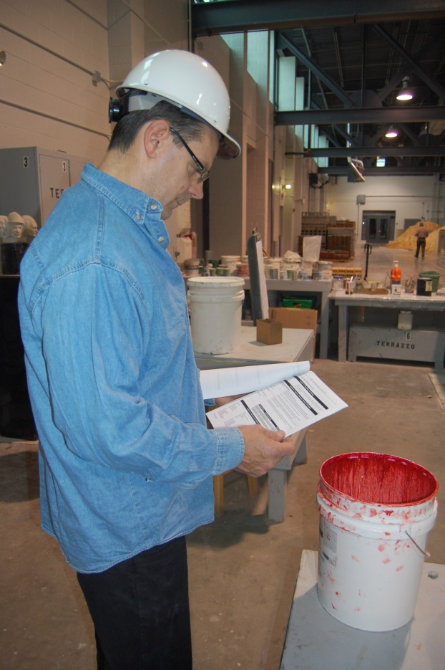
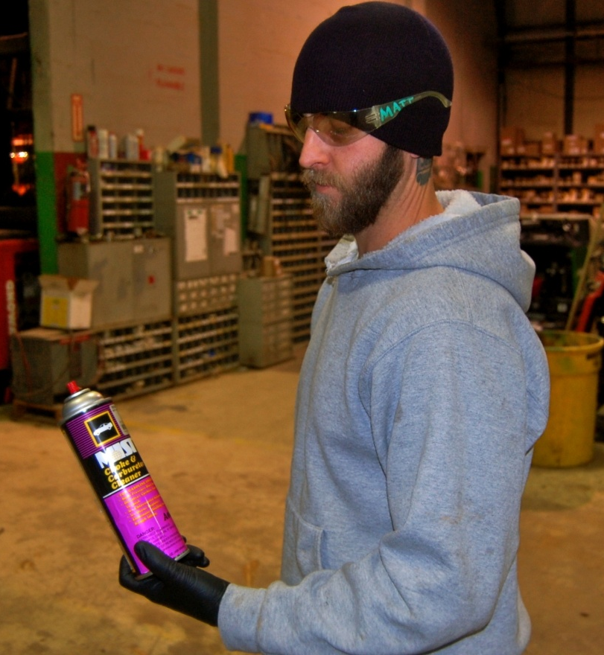
The OSHA Hazard Communication standard gives you the right to understand the chemical hazards on your job and ways to protect yourself
M2
Notes:
Trainer Notes:
The OSHA Hazard Communication standard gives you the right to understand the chemical hazards on your job and ways to protect yourself.

Slide 8

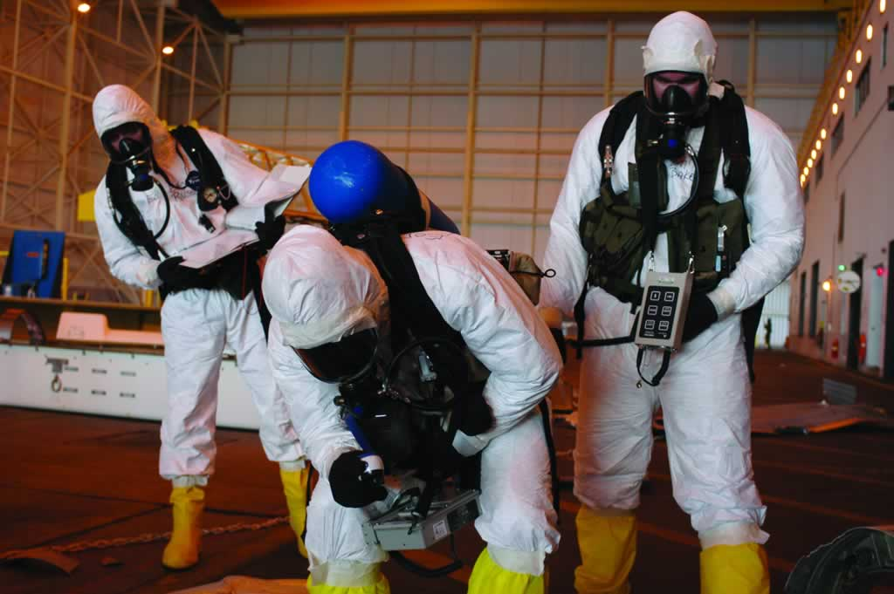
This course will not train you to clean up spills and releases
M2
Notes:
Trainer Notes:
This course will not train you to clean up spills and releases.

Slide 9


This course will not teach you about the specific chemical hazards on your job site. Your employer must do that.
M2
Photography by Neil Lippy
Notes:
Trainer Notes:
This course will not teach you about the specific chemical hazards on your job site. Your employer must do that.

Slide 10
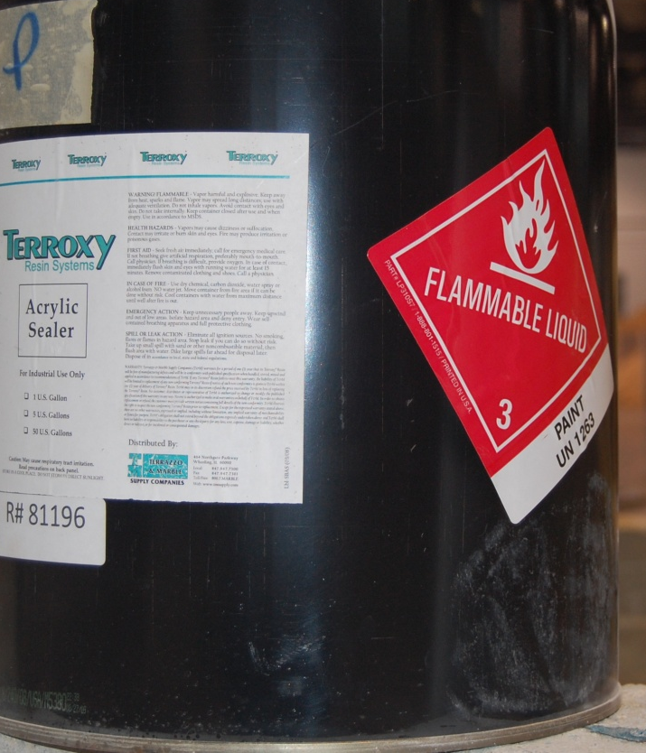
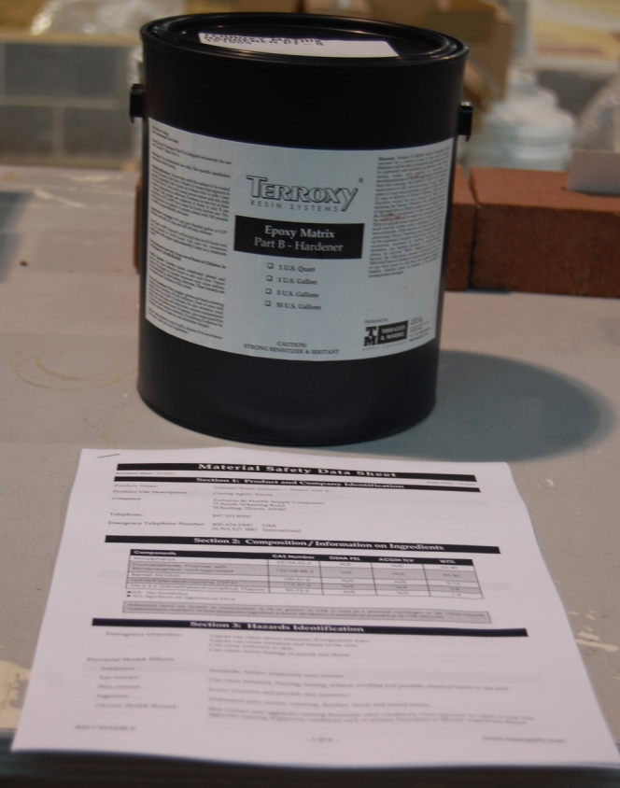
Hazcom training will prepare you to find and use information about chemicals on your job
Photos courtesy of International Masonry Institute
M2
Notes:
Trainer Notes:
Hazcom training will prepare you to find and use information about chemicals on your job.

Slide 11
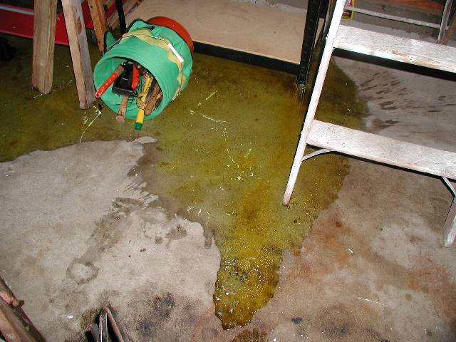
This training will teach you to report releases of hazardous chemicals to qualified response personnel and to avoid exposure
An unknown spill
M2
Notes:
Trainer Notes:
This training will teach you to report releases of hazardous chemicals to qualified response personnel and to avoid exposure.

Slide 12
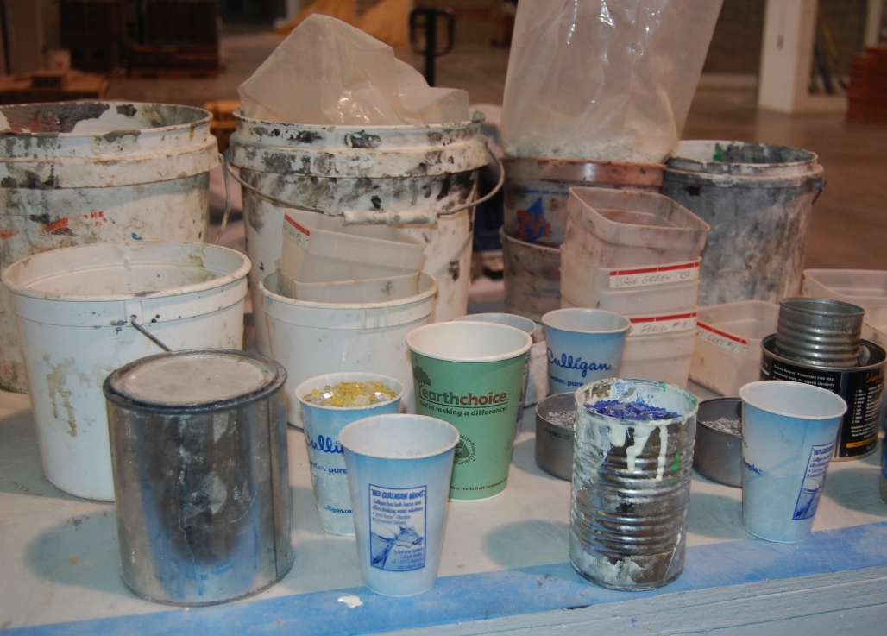
Let’s do Activity 1, but first…
How many have had Hazcom training before?
What elements of the standard do you remember?
M3
Notes:
Trainer Notes:
[Ask students to raise their hands if they have had Hazcom training. Have students volunteer some of the key elements of the standard that they learned. This will orient the trainers as to how much the participants already know about hazard communication basics. ]

Slide 13

Activity One: Test your group’s knowledge of Hazcom. True or false?
True
False
a. The standard requires all employers to provide workers with information about the hazardous chemicals to which they are exposed.
b. Employers are required to provide workers with a safety data sheet (SDS) within the work shift in which it is requested.
c. Chemical importers, manufacturers, and distributors initiated the OSHA Hazard Communication standard because they were concerned about liability.
d. Employers are required to provide annual training in hazard communication.
✔
✔
✔
✔
M3
Activity
Notes:
Trainer Notes:
[Have students work from their workbooks.]
a. true
b. true
c. false. Unions and occupational and public health advocates fought vigorously for workers' "right-to-know" about chemical hazards, passing over 20 state right-to-know laws, prior to chemical manufacturers and employers conceding to a national OSHA standard.
d. false. The HCS requires only an initial training at the time of hire or assignment that involves exposure to hazardous chemicals and additional training when new chemicals are introduced. Some state's still enforce a "right-to-know" law that requires annual training. Check with your state labor department for more information.

Slide 14
Activity One: Test your group’s knowledge of chemicals. How many…
b.
Possible answers
a. 500
b. 5,000
c. 10,000
d. 50,000
e. >50,000
workers die each year from occupational injuries?
workers die each year from occupational diseases caused by chemical exposures?
chemical-specific standards does OSHA enforce?
chemical products used in the workplace?
e.
a.
e.
Activity
M3
Notes:
Trainer Notes:
[Work this exercise in groups if you can. Otherwise, have everyone mark the answers they think are correct in their manual. Solicit answers from them before clicking the right answers. You can see if any group got them all correct and acknowledge them.]
Activity One: Test your group’s knowledge of chemicals. How many…
b. workers die each year from occupational injuries? (5,000)
e. workers die each year from occupational diseases caused by chemical exposures? (>50,000)
a. chemical-specific standards does OSHA enforce? (500)
chemical products used in the workplace? (>50,000)
According to the US Bureau of Labor Statistics 4,609 workers (private and public sectors) died from occupational injuries in 2011. Of 4,114 worker fatalities in private 721 or 17.5% were in construction. The leading causes of worker deaths on construction sites were falls (251), followed by electrocution (67), struck by object (73), and caught-in/between (19). These "Fatal Four" were responsible for nearly three out of five (57%) fatalities.
According to a study by Paul Leigh, the estimated number of deaths due to occupational diseases in 2007 was 53,000 at a cost of $46 billion. More on the job deaths are due to occupational diseases than injuries. About a third of the disease deaths are due to occupational cancers.
OSHA enforces chemical standards for about 450 substances. When OSHA was formed in 1970, they adopted national consensus standards including the 1968 ACGIH TLVs (American Conference of Governmental Industrial Hygienist Threshold Limit Values). In its 52 year existence, OSHA has created less than 30 new chemical standards. In 1989 OSHA tried to update its chemical standards to the 1988 ACGIH PELs, but it was overturned by the Supreme Court. Some states have adopted the 1988 ACGIH TLVs such as California. Check with your state labor department to see which standard they are using.
According to OSHA, there are more than 650,000 thousand chemical products in the workplace with thousands of new ones being introduced annually.
J Paul Leigh, The Economic Burden of Occupational Injury & Illness in the US, The Milbank Quarterly, Vol. 89, No. 4, 2011 (pp. 728–772)

Slide 15
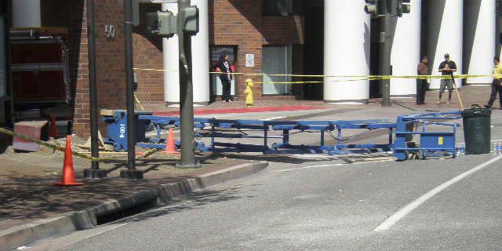
Every day around four construction workers die on the job
Image courtesy of California FACE Report #10CA008
M4
Notes:
Trainer Notes:
Every day approximately four construction workers die on the job.
[This is a June 2010 NIOSH Fatality report from California (#10CA008) construction worker died when the fully extended scissor lift from which he was working fell over. The victim and two co-workers were in a scissor lift that was fully extended 20 feet above the ground. They were attempting to remove a planter box from the exterior wall of a parking structure. The work crew was shoveling dirt out of the planter box into a plastic trash container on the platform of the scissor lift. While the work crew was removing the planter box from the wall, it suddenly shifted and struck the scissor lift, knocking it over. The scissor lift was rated for 500 pounds.
The CA/FACE investigator determined that, in order to prevent future incidents, construction companies that use scissor lifts should:
Ensure that employees use scissor lifts that are the appropriate size and capacity for the job.
Ensure that employees are specifically trained on the appropriate load capacity and materials handling of scissor lifts.

Slide 16
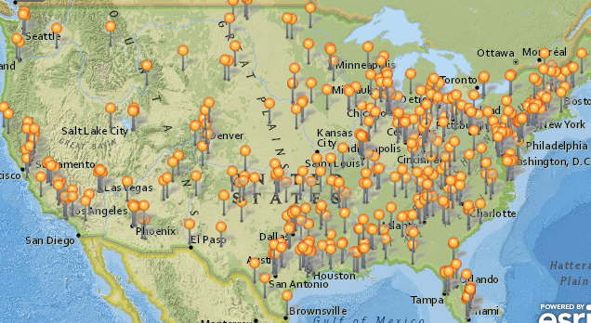
This shows the deaths on construction jobs in 2012 as tracked by CPWR
http://stopconstructionfalls.com/
M4
Notes:
Trainer Notes:
This map is a part of the Stop Construction Falls campaign and is maintained by CPWR. It is the result of a comprehensive effort to document every death on construction sites in the United States for the calendar year 2012. If you go to the website you can click on any of these pushpins and read about the specific fatality. For trainers this is a powerful tool when in a new location.

Slide 17
Hazard Communication Standard Overview
Section 2
Notes:
Trainer Notes:
Section 2
Hazard Communication Standard Overview

Slide 18
What led up to OSHA developing the Hazcom Standard in 1983?
A short history
M4
Notes:
Trainer Notes:
[Ask this question of the class to begin Section 2.]
What led up to OSHA developing the Hazcom Standard in 1983?

Slide 19
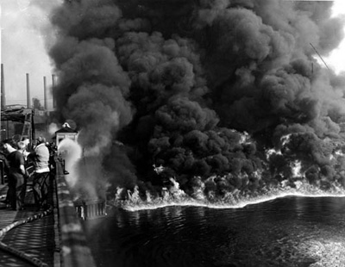
In 1952 and 1969, the Cuyahoga River caught fire
This led to the creation of the EPA and a focus on chemical pollution
M4
Notes:
Trainer Notes:
In 1952, the Cuyahoga River caught fire. This led, in part, to the creation of the EPA and a focus on chemical pollution.
From Wikipedia: At least 13 fires have been reported on the Cuyahoga River, the first occurring in 1868. The largest river fire in 1952 caused over $1 million in damage to boats and a riverfront office building. Fires erupted on the river several more times before June 22, 1969, when a river fire captured the attention of Time magazine, which described the Cuyahoga as the river that "oozes rather than flows" and in which a person "does not drown but decays". The 1969 Cuyahoga River fire helped spur an avalanche of water pollution control activities, resulting in the Clean Water Act and the creation of the federal Environmental Protection Agency.

Slide 20

Unions and environmental groups led the fight for protections from hazardous chemicals
In 1977, 60 workers at a chemical plant in California making the pesticide DBCP were found to be sterile
http://www.youtube.com/watch?feature=player_detailpage&v=75__L8hX-1o
M5
Notes:
Trainer Notes:
Unions and environmental groups led the fight for protections from hazardous chemicals.
One example comes from a chemical plant in Lathrop California (near Stockton). Workers in one area of the plant worked on the DBCP production line. 1,2-Dibromo-3-chloropropane, DBCP is a pesticide which was used in the United States to control nematodes. During lunch time and breaks, employees started talking about the problems they had trying to start a family. They started to notice no employees in their particular area of the plant were successful. These employees went to their doctors, and found out they were all sterile. Several years earlier literature had been published by a UCSF researcher who found that DBCP was a reproductive hazard. This was published information but workers were never informed about this particular hazard. Fortunately for these workers, the effects of the exposure was not long term. Once they were removed from the DBCP production line, the reproductive effects from the DBCP exposure were reversed. The DBCP case triggered legislative hearings which resulted in California passing a new statute in the California Labor Code in 1981. This statute is commonly known as the Hazard Communication Regulation. The new regulation required the California Department of Industrial Relations to create a list of hazardous substances. It required manufacturers to develop material safety data sheets (MSDS) for hazardous substances which they manufactured and to provide a copy of the MSDS to employers who purchased the hazardous substances from them. State chemical “right-to-know” laws led to the original OSHA Hazcom standard in 1983.
Further information on Proposition 65 can be found at: http://oehha.ca.gov/prop65.html

Slide 21

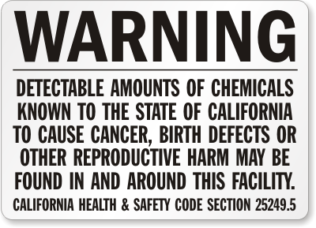
State chemical “right-to-know” laws led to the original OSHA Hazcom standard in 1983
California’s Hazcom standard was triggered by the DBCP pesticide case
M5
Notes:
Trainer Notes:
[Make the point that the states’ having Hazcom standards put pressure on OSHA to act, but also that businesses wanted OSHA to set a national standard because they were having a terrible time trying to comply with dozens of individual state requirements.]
State chemical “right-to-know” laws led to the original OSHA Hazcom standard in 1983. California’s Hazcom standard was triggered by the DBCP pesticide case.

Slide 22
Why is the hazard communication standard important?
Discuss this and write your answers in the student manual
M5
Activity
Notes:
Trainer Notes:
[In their groups allow students time to discuss why the standard is important and write their answers in their manuals. Write responses on a flip chart or chalk board.]
Why is the hazard communication standard important?
Possible good answers:
Hazcom standards help workers:
Reduce their risks to chemicals
Avoid dangerous chemicals
Obtain proper education about chemicals
Select proper PPE

Slide 23

32 million workers are potentially exposed to chemicals
OSHA
Roughly one-quarter of workplace diseases and injuries are caused by chemicals
International Labor Organization
M5
Notes:
Trainer Notes:
[Point out these are also reasons that the standard is important.]
32 million workers are potentially exposed to chemicals according to OSHA.
Roughly one-quarter of workplace diseases and injuries are caused by chemicals, according to the International Labor Organization.
The ILO is an agency of the United Nations responsible for drawing up and overseeing international labor standards. The ILO brings together representatives of governments, employers and workers to jointly shape policies and programs promoting Decent Work for all. This unique arrangement gives the ILO an edge in incorporating 'real world' knowledge about employment and work.

Slide 24

Hazcom was the second most cited standard in FY 2012
4,696 citations (16% of all citations)
Source: Safety + Health December 2012
M5
Notes:
Trainer Notes:
Hazcom was the second most cited standard in FY 2012. There were 4,696 citations, which represents 16% of all citations.
This is from Safety + Health Magazine from December 2012.

Slide 25
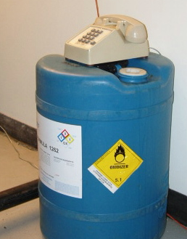
The Hazard Communication Standard is also known as:
Hazcom
Right to Know
Right to Understand
OSHA 29 CFR 1910.1200 (general industry)
OSHA 29 CFR 1926.59 (construction)
?
Is this phone part of good hazard communication?
M6
Notes:
Trainer Notes:
The Hazard Communication Standard is also known as:
Hazcom
Right to Know
Right to Understand
OSHA 29 CFR 1910.1200
OSHA 29 CFR 1926.59 (construction)
The Hazard Communication Standard (HCS) is based on a simple concept: workers have both a need and a right to know the identities of the chemicals they are exposed to when working and the hazards associated with these chemicals. They also need to know what protective measures are available to prevent adverse effects from occurring.
The HCS will help employers provide safer workplaces for their workers. When employers have information about the chemicals being used, they can take steps to reduce exposures, substitute less hazardous materials, and establish proper work practices. These efforts will help prevent the occurrence of work-related illnesses and injuries caused by chemicals.
The HCS addresses the issues of evaluating and communicating hazards to workers. The HCS is designed so that employers who simply use chemicals, rather than produce or import them, are not required to evaluate the hazards of those chemicals. Hazard determination is the responsibility of the producers and importers of the materials. Producers and importers of chemicals are then required to provide the hazard information to employers that purchase their products. Employers that don't produce or import chemicals need only focus on those parts of the rule that deal with establishing a workplace program and communicating information to their workers.

Slide 26
Is the OSHA Hazcom standard for construction, 1926.59, different than 1910.1200?
NO. This is the whole standard:
“The requirements applicable to construction work under this section are identical to those set forth at 1910.1200.”
M7
Notes:
Trainer Notes:
[Ask the question and solicit an answer before advancing the answer.]
Is the OSHA Hazcom standard for construction, 1926.59, different?
NO.
This is the whole standard: “The requirements applicable to construction work under this section are identical to those set forth at 1910.1200.”

Slide 27

OSHA revised its standard to be part of the Global Harmonization System (GHS), effective 5-25-12
World-wide standardized hazard communication
Consistent hazard classifications
16-section safety data sheets (SDS)
Standard labeling
M7
GHS Purple Book
Notes:
Trainer’s Notes:
OSHA has revised its standard to be part of the Global Harmonization System (GHS), effective 5-25-12.
The GHS, first adopted by the Sub-Committee on the Globally Harmonized System of Classification and Labeling of Chemicals (SCEGHS) in December 2002, is an initiative to establish international consensus on criteria for classifying chemical hazards for international distribution, and to create consistent requirements for MSDSs. The GHS has been revised twice: once in 2005, and again in 2007. According to the GHS Sub-Committee of Experts, the GHS is now ready for worldwide implementation.
It is a common and coherent approach to defining and classifying hazards, and communicating information on labels and safety data sheets. There are 16 sections in the safety data sheets. The GHS provides the underlying infrastructure for the establishment of national, comprehensive chemical safety programs. Its target audience includes workers, consumers, transport workers, and emergency responders.

Slide 28
OSHA is allowing a phase-in period for the requirements
December 1, 2013: Employers must train workers on the new label and SDS format
June 1, 2015: Manufacturers, importers and employers must implement all provisions, except:
December 1, 2015: GHS-compliant shipping labels must be used
June 1, 2016: Employers must implement their updated Hazcom programs
M7
Notes:
Trainer Notes:
[You should emphasize the following about the phase-in period.]
OSHA is allowing time for complying with requirements
December 1, 2013: Employers must train workers on the new label and SDS format
June 1, 2015: Manufacturers, importers and employers must implement all provisions, except:
December 1, 2015: GHS-compliant shipping labels must be used
June 1, 2016: Employers must implement their updated Hazcom programs
From OSHA’s website Q&A: “During the phase-in period, employers would be required to be in compliance with either the existing HCS or the revised HCS, or both. OSHA recognizes that hazard communication programs will go through a period of time where labels and SDSs under both standards will be present in the workplace. This will be considered acceptable, and employers are not required to maintain two sets of labels and SDSs for compliance purposes.”

Slide 29
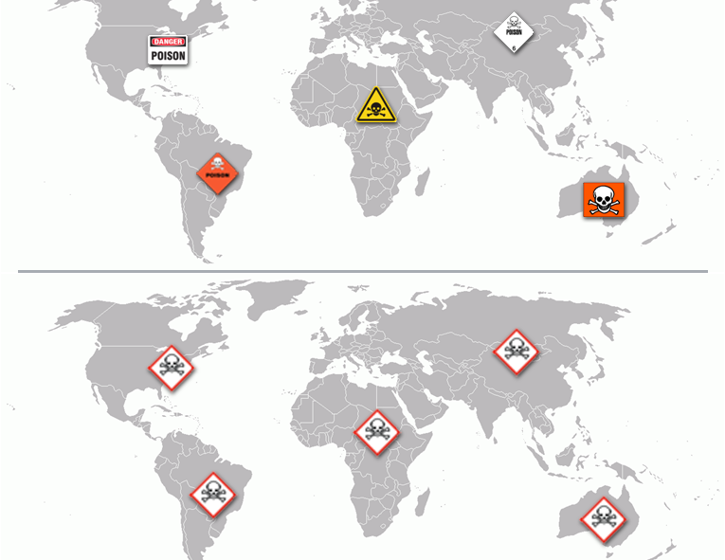

Why was GHS created?
To go from this mix…
…to this consistency
Activity
M8
Notes:
Trainer Notes:
[Ask the class to give reasons for creating the GHS. There is space in their manual to write an answer. Then click the answer.]
Why was GHS created?
To go from a real mix of approaches and symbols to a consistent world-wide system.

Slide 30
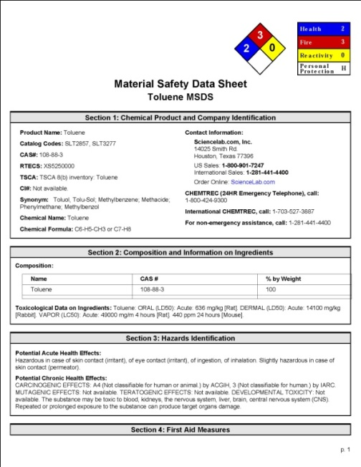
What are the five key elements in the OSHA Hazcom standard?
Employers must have a written Hazcom Program
Containers must be labeled and labels must follow a consistent format
SDSs must be available for hazardous substances in the workplace
Workers must be trained
Employers must have an updated chemical inventory
M8
Notes:
Trainer Notes:
What are the key elements in the OSHA Hazcom standard?
Employers must have a written Hazcom Program
Containers must be labeled and labels must follow a consistent format
SDSs must be available for hazardous substances in the workplace
Workers must be trained
Employers must have an updated chemical inventory
There are exclusions under the OSHA standard that you should be aware of. Here is a slightly edited version of the standard under 1910.1200(b)(6): This section does not apply to:
Any hazardous waste as such term is defined by the Solid Waste Disposal Act, as amended by the Resource Conservation and Recovery Act of 1976, when subject to regulations issued under that Act by the Environmental Protection Agency;
Any hazardous substance as such term is defined by the Superfund Act (CERCLA) when the hazardous substance is the focus of remedial or removal action being conducted under CERCLA;
Tobacco or tobacco products;
Wood or wood products, including lumber which will not be processed, where the chemical manufacturer or importer can establish that the only hazard they pose to employees is the potential for flammability or combustibility
Articles
Food or alcoholic beverages which are sold, used, or prepared in a retail establishment.
Any drug, as that term is defined in the Federal Food, Drug, and Cosmetic Act.
Cosmetics which are packaged for sale to consumers in a retail establishment, and cosmetics intended for personal consumption by employees while in the workplace.
Any consumer product
Nuisance particulates
Ionizing and nonionizing radiation
Biological hazard

Slide 31
Hazcom programs must have all of these parts
Hazcom
Written Program
Labels
Training
Chemical inventory
SDSs
M8
Notes:
Trainer Notes:
[Point out we will be working our way around this circle starting with the highlighted element.]
Hazcom programs must have all of these parts.

Slide 32
Written Hazard Communication
Program
First major requirement of OSHA’s Hazcom Standard
1910.1200 (e)
M9
Photo courtesy eLCOSH
Notes:
Trainer Notes:
Written Hazard Communication Program
First major requirement of OSHA’s Hazcom Standard
1910.1200 (e)
Employers must develop, implement, and maintain a written Hazcom program at the workplace.
A written hazard communication program ensures that all employers receive the information they need to inform and train their employees properly and to design and put in place employee protection programs. It also provides necessary hazard information to employees, so they can participate in, and support, the protective measures in place at their workplaces. You have the right to review the program on work time!

Slide 33
The written Hazcom program must be available at the job site and must include:
A list of the hazardous chemicals known to be present
The methods the employer will use to inform workers about labels and SDSs
The methods the employer will use to inform employees of the hazards of non-routine tasks
Methods the employer will use to provide the other employers on-site access to SDSs on multi-employer sites
M9
Notes:
Trainer Notes:
The written Hazcom program must be available at the job site and must include:
A list of the hazardous chemicals known to be present
The methods the employer will use to inform workers about labels and SDSs
The methods the employer will use to inform employees of the hazards of non-routine tasks
Methods the employer will use to provide the other employers on-site access to SDSs on multi-employer sites

Slide 34
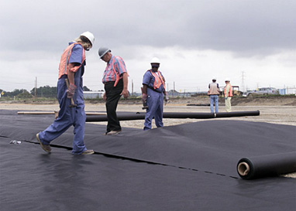
You have the right under OSHA’s Hazcom standard to:
Review the written program
Receive information regarding hazardous substances
Have your physician or union rep receive information on your behalf
Exercise your rights without getting fired or other punishment
M10
Notes:
Trainer Notes:
[It is important to emphasis that workers have the RIGHT to learn about the hazards of chemicals they work with or that are used in their area of work. This is a good place to discuss some issues that may arise when employees try to act upon or insist upon their rights.]
You have the right under OSHA’s Hazcom standard to:
Review the written program
Receive information regarding hazardous substances
Have your physician or union rep receive information on your behalf
Exercise your rights without getting fired or other punishment

Slide 35
Labels: Second major requirement
Hazcom
Written Program
Labels
Training
Chemical Inventory
SDSs
1910.1200 (f)
M10
Notes:
Trainer Notes:
Labels, the second major requirement under the OSHA Hazcom standard. They can look it up at 1910.1200(f).

Slide 36
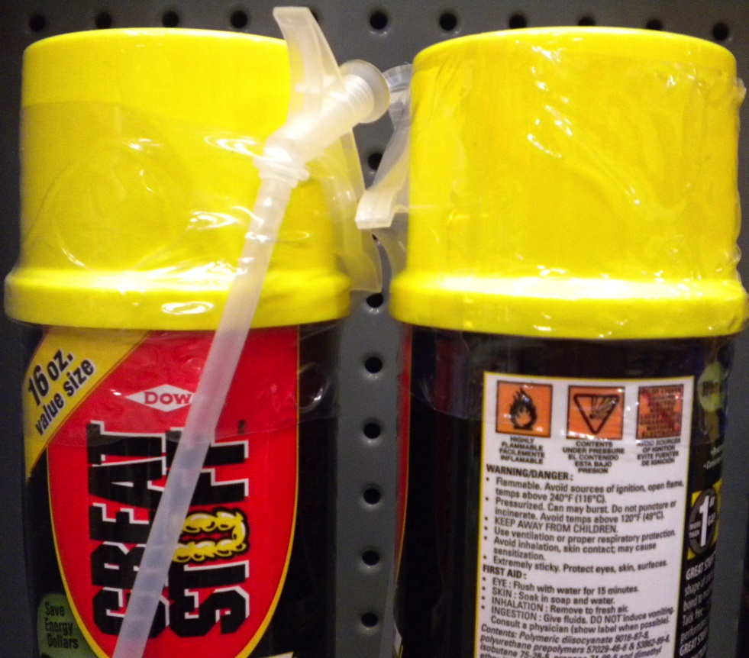
OSHA now requires that labels contain these elements:
Signal words
Hazard statement
Hazard pictograms
Precautionary statements
M10
Notes:
Trainer Notes:
OSHA now requires that labels contain these elements:
Signal word means a word used to indicate the relative level of severity of hazard and alert the reader to a potential hazard on the label. The signal words used are "danger" and "warning." "Danger" is used for the more severe hazards, while "warning" is used for the less severe.
Hazard statement means a statement assigned to a hazard class and category that describes the nature of the hazard(s) of a chemical, including, where appropriate, the degree of hazard.
Hazard pictograms means a composition that may include a symbol plus other graphic elements, such as a border, background pattern, or color, that is intended to convey specific information about the hazards of a chemical. Eight pictograms are designated under this standard for application to a hazard category.
Precautionary statement means a phrase that describes recommended measures that should be taken to minimize or prevent adverse effects resulting from exposure to a hazardous chemical, or improper storage or handling.

Slide 37
Additional information must be included on labels
Product Identifier
Supplier Identification
Supplemental Information
M11
Notes:
Trainer Notes:
Additional information must be included on labels, such as:
Product Identifier - the name or number used for a hazardous chemical on a label or in the SDS
Supplier Identifier - name, address, and telephone number of the chemical manufacturer, importer, or other responsible party
Supplemental Information -

Slide 38
One of two signal words is required on labels to emphasize hazard. Which communicates greater hazard,
Danger or
Warning?
✔
M11
Activity
Notes:
Trainer Notes:
[Ask for a volunteer to answer the question and explain their answer.]
One of two signal words is required on labels to emphasize hazard. Which communicates greater hazard?
DANGER means severe hazard
WARNING means the product is less hazardous

Slide 39
Labels must also contain standard
Precautionary Statements to describe how to prevent harm
Here are some examples:
“Only use non-sparking tools”
“Store in a cool, well ventilated and locked place”
“Do not breathe vapors”
“Wear protective gloves”
M11
Notes:
Trainer Notes:
Labels must also contain standard Precautionary Statements to describe how to prevent harm.
Here are some examples:
“Only use non-sparking tools”
“Store in a cool, well ventilated and locked place”
“Do not breathe vapors”
“Wear protective gloves”

Slide 40
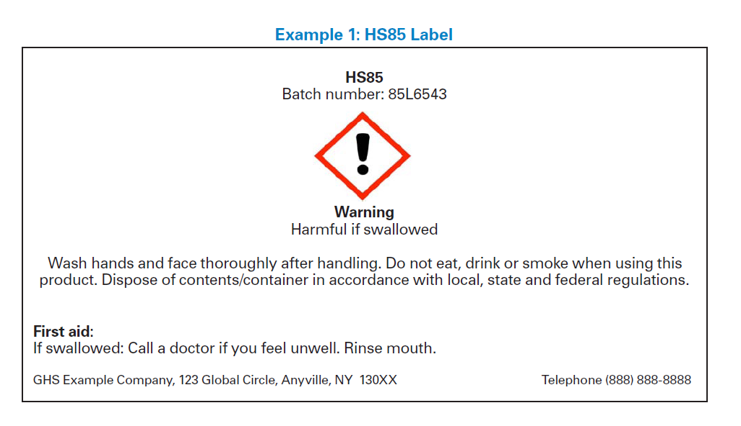
Let’s review an OSHA sample label
M12
Notes:
Trainer Notes:
[Go over this example label from OSHA with the class so they can see all of the key elements. If you have time ask them to label in their books the following items:
Pictogram
Signal word
Hazard statement
Precautionary statements]
The Substance: HS85, Batch Number: 85L6543
Step 1: Perform Classification
Class: Acute Oral Toxicity; Category 4
Step 2: Gather Labeling Information
Pictograms: exclamation point
Signal Word: WARNING
Hazard Statements: Harmful if Swallowed
Precautionary Statements:
Prevention:
• Wash hands and face thoroughly after handling.
• Do not eat, drink or smoke when using this product.
Response:
• If swallowed: Call a doctor if you feel unwell.
• Rinse mouth
Storage: None specified
Disposal: Dispose of contents/container in
accordance with local/regional/national/
international regulations.3
Step 3: Create the Label
Putting together the above information on HS85, a label might list the information found on the

Slide 41
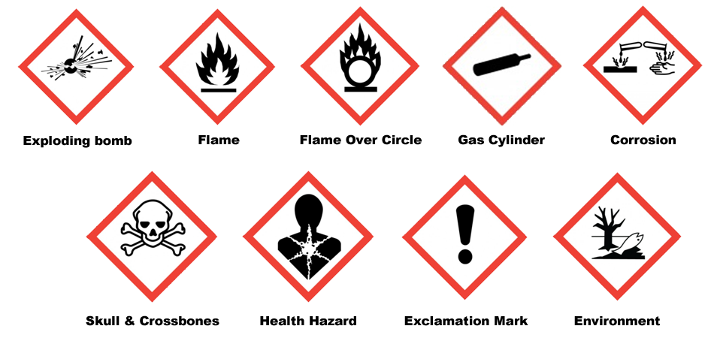
There are 9 symbols called pictograms that we will discuss
Images courtesy Wikimedia
M12
Notes:
Trainer Notes:
[Emphasize to the class that although these aren’t required by OSHA until June 1, 2015, they are showing up now because of U.S. companies doing business overseas meeting the GHS requirements in place throughout the world. Don’t try to read each one at this point. There will be considerable explanation and review following.]
There are 9 symbols called pictograms that we will discuss.

Slide 42
There are physical hazards
And there are health hazards
M12
Notes:
Trainer Notes:
[This slide emphasizes the difference between physical and health hazards. There are only 8 pictograms shown here. The environmental one isn’t included because OSHA does not regulate that area, which is not a direct hazard for workers.]

Slide 43

Flame Pictogram
What kinds of chemicals does this describe?
Flammables
Self-Reactives
Pyrophorics
Self-heating
Emits Flammable Gas
Organic Peroxide
M13
Notes:
Trainer Notes:
[This is a series of 9 pictograms that follow the same format. You should ask for their opinion about the kinds of chemicals that are depicted and then click the answer after sufficient discussion.]
Flammables - a gas having a flammable range with air at 20°C (68°F) and a standard pressure of 101.3 kPa (14.7 psi), a liquid having a flash point of not more than 93°C (199.4°F) or a solid which is a readily combustible solid, or which may cause or contribute to fire through friction.
Self-Reactives are thermally unstable liquid or solid chemicals liable to undergo a strongly exothermic decomposition even without participation of oxygen (air). This definition excludes chemicals classified under this section as explosives, organic peroxides, oxidizing liquids or oxidizing solids. A self-reactive chemical is regarded as possessing explosive properties when in laboratory testing the formulation is liable to detonate, to deflagrate rapidly or to show a violent effect when heated under confinement.
Pyrophorics means a liquid or solid which, even in small quantities, is liable to ignite within five minutes after coming into contact with air.
Self-heating is a solid or liquid chemical, which, by reaction with air and without energy supply, is liable to self-heat; this chemical differs from a pyrophoric liquid or solid in that it will ignite only when in large amounts (kilograms) and after long periods of time (hours or days).
Emits Flammable Gas - solid or liquid chemicals which, by interaction with water, are liable to become spontaneously flammable or to give off flammable gases in dangerous quantities.
Organic Peroxide means a liquid or solid organic chemical which is considered a derivative of hydrogen peroxide. Organic peroxides are thermally unstable chemicals, which may undergo exothermic self-accelerating decomposition.

Slide 44

Flame Over Circle
What kinds of chemicals does this describe?
Oxidizers
M13
Notes:
Trainer Notes:
[This is not an obvious symbol. You should tell them that the letter O in the symbol should be a memory clue for oxidizer.]
Flame over Circle Pictogram. What kind of chemical does this describe?
Oxidizing liquid means a liquid which, while in itself not necessarily combustible, may, generally by yielding oxygen, cause, or contribute to, the combustion of other material.
Oxidizing solid means a solid which, while in itself is not necessarily combustible, may, generally by yielding oxygen, cause, or contribute to, the combustion of other material.

Slide 45

Exclamation Mark
What kinds of chemicals does this describe?
Irritant
Dermal Sensitizer
Acute Toxicity (harmful)
Narcotic Effects
Respiratory Tract Irritation
M13
Notes:
Trainer Notes:
[This is also not an obvious symbol. When noting that this means acute toxicity, it is referring to “harmful” not “severe” toxicity which is represented by the skull and crossbones. These two symbols can never be used together, just one or the other.]
Exclamation Mark Pictogram. What kinds of chemicals does this describe?
Irritant - A chemical, which is not corrosive, but which causes a reversible inflammatory effect on living tissue by chemical action at the site of contact. A chemical is a skin irritant if, when tested on the intact skin of albino rabbits by the methods of 16 CFR 1500.41 for four hours exposure or by other appropriate techniques, it results in an empirical score of five or more.
Dermal Sensitizer - a chemical that will lead to an allergic response following skin contact.
Acute Toxicity (harmful) - refers to those adverse effects occurring following oral or dermal administration of a single dose of a substance, or multiple doses given within 24 hours, or an inhalation exposure of 4 hours.
Narcotic Effects - Central nervous system depression including narcotic effects in humans such as drowsiness, narcosis, reduced alertness, loss of reflexes, lack of coordination, and vertigo are included. These effects can also be manifested as severe headache or nausea, and can lead to reduced judgment, dizziness, irritability, fatigue, impaired memory function, deficits in perception and coordination, reaction time, or sleepiness;
Respiratory Tract Irritation - (characterized by localized redness, edema, pruritis and/or pain) that impair function with symptoms such as cough, pain, choking, and breathing difficulties are included.

Slide 46

Exploding Bomb
What kinds of chemicals does this describe?
Explosives
Self-Reactives
Organic Peroxides
M13
Notes:
Trainer Notes:
Exploding Bomb Pictogram. What kinds of chemicals does this describe?
Explosives - a solid or liquid chemical which is in itself capable by chemical reaction of producing gas at such a temperature and pressure and at such a speed as to cause damage to the surroundings. Pyrotechnic chemicals are included even when they do not evolve gases.
Self-Reactives - are thermally unstable liquid or solid chemicals liable to undergo a strongly exothermic decomposition even without participation of oxygen (air). This definition excludes chemicals classified under this section as explosives, organic peroxides, oxidizing liquids or oxidizing solids. A self-reactive chemical is regarded as possessing explosive properties when in laboratory testing the formulation is liable to detonate, to deflagrate rapidly or to show a violent effect when heated under confinement.
Organic Peroxides - means a liquid or solid organic chemical which is considered a derivative of hydrogen peroxide.. Organic peroxides are thermally unstable chemicals, which may undergo exothermic self-accelerating decomposition.

Slide 47

Corrosion
What kinds of chemicals does this describe?
Corrosives
M13
Notes:
Trainer Notes:
Corrosion Pictogram. What kinds of chemicals does this describe?
Skin corrosion is the production of irreversible damage to the skin; namely, visible necrosis through the epidermis and into the dermis, following the application of a test substance for up to 4 hours. Corrosive reactions are typified by ulcers, bleeding, bloody scabs, and, by the end of observation at 14 days, by discoloration due to blanching of the skin, complete areas of alopecia, and scars. Histopathology should be considered to evaluate questionable lesions.

Slide 48

Gas Cylinder
What kinds of chemicals does this describe?
Gases under pressure
M13
Notes:
Trainer Notes:
Gas cylinder pictogram. What kinds of chemicals does this describe?
Gases under pressure

Slide 49

Health Hazard
What kinds of chemicals does this describe?
Carcinogen
Respiratory Sensitizer
Reproductive Toxicity
Target Organ Toxicity
Mutagenicity
Aspiration Toxicity
M13
Notes:
Trainer Notes:
[Point out that this symbol covers a lot of health effects.]
Health Hazard Pictogram. What kinds of chemicals does this describe?
Carcinogen means a substance or a mixture of substances which induce cancer or increase its incidence. Classification of a substance or mixture as posing a carcinogenic hazard is based on its inherent properties and does not provide information on the level of the human cancer risk which the use of the substance or mixture may represent.
Respiratory Sensitizer means a chemical that will lead to hypersensitivity of the airways following inhalation of the chemical.
Reproductive Toxicity - includes adverse effects on sexual function and fertility in adult males and females, as well as adverse effects on development of the offspring.
Target Organ Toxicity - causes harm in specific organs
Mutagenicity - A mutation is defined as a permanent change in the amount or structure of the genetic material in a cell. The term mutation applies both to heritable genetic changes and to the underlying DNA modifications. The term mutagenic and mutagen will be used for agents giving rise to an increased occurrence of mutations in populations of cells and/or organisms.
Aspiration Toxicity Aspiration is a medical term referring to sucking in fluid. When you drink soda through a straw you are aspirating it into your mouth. In first aid and medical care it means getting fluids (or small solid particles) into the airways (trachea or lungs). It includes severe acute effects such as chemical pneumonia, varying degrees of pulmonary injury or death following aspiration.

Slide 50

Skull and Crossbones
What kinds of chemicals does this describe?
Acute Toxicity (severe)
M13
Notes:
Trainer Notes:
[Again, point out that this symbol is the severe version of the exclamation mark and if the skull and crossbones is used, the exclamation point can’t be used.]
Skull and Crossbones. What kinds of chemicals does this describe?
Acute Toxicity (severe)

Slide 51

Environmental pollutant
OSHA doesn’t enforce environmental regulations!
Part of GHS, but not 1910.1200
M13
Notes:
Trainer Notes:
Environmental pollutant
OSHA doesn’t enforce environmental regulations!
This is part of GHS, but not 1910.1200

Slide 52








Match pictograms with their meanings
A
B
C
D
E
F
G
H
Flammables
Narcotic Effects
Oxidizers
Self-heating
Irritant
Organic Peroxides
Explosives
Gases Under Pressure
Carcinogen
Dermal Sensitizer
Acute Toxicity (harmful)
Respiratory Tract Irritation
Self-Reactives
Corrosives
Respiratory Sensitizer
Reproductive Toxicity
Target Organ Toxicity
Mutagenicity
Group Exercise
Activity
M14
Notes:
Trainer Notes:
[This exercise is in their student manual. You can have them do it individually or in a group.]
Match pictograms with their meanings
Flammables
Narcotic Effects
Oxidizers
Self-heating
Irritant
Organic Peroxides
Explosives
Gases Under Pressure
Carcinogen
Dermal Sensitizer
Acute Toxicity (harmful)
Respiratory Tract Irritation
Self-Reactives
Corrosives
Respiratory Sensitizer
Reproductive Toxicity
Target Organ Toxicity
Mutagenicity

Slide 53



This is an example of a signal word, precautionary statement and pictograms on a label
WARNING
Causes Skin And Eye Irritation
No skin or eye protection
How is the label working?
M14
Notes:
Trainer Notes:
[Ask if the label is working. What you are really asking is whether the users of this product are protecting their skin and eyes. This is an important lesson you can draw about the effectiveness of administrative controls which are towards the bottom of the hierarchy of controls, as we will see in Section 7.]
This is an example of a signal word, precautionary statement and pictograms on a label.

Slide 54
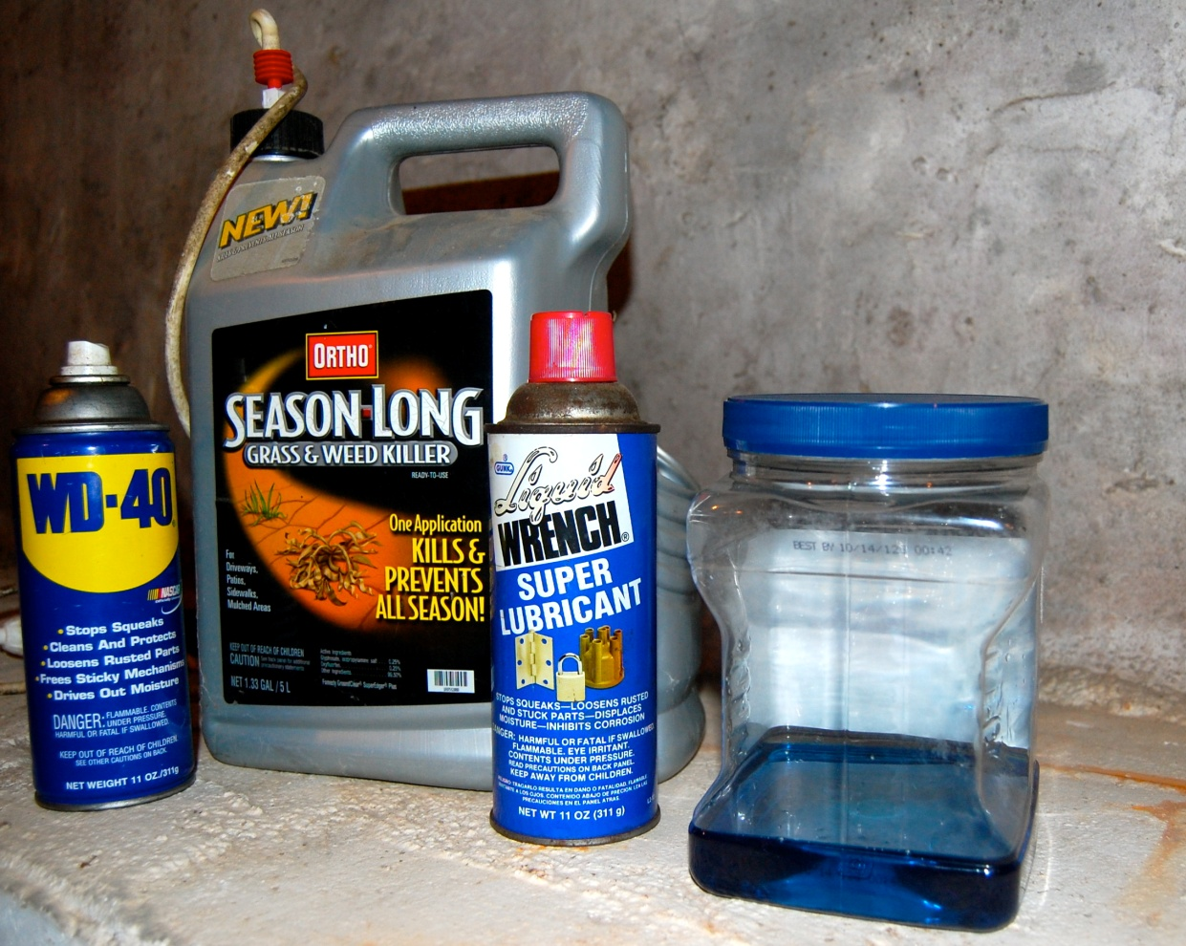
If you pour anything into a container it must be labeled unless you are going to use it within the work shift and control it
M15
Notes:
Trainer Notes:
If you pour anything into a container it must be labeled unless you are going to use it within the work shift and control it.
Employers can go beyond the minimum standard and require labeling for all containers.

Slide 55
Safety Data Sheets:
Third major requirement
Hazcom
Written Program
Labels
Training
Chemical Inventory
SDSs
1910.1200 (g)
M15
Notes:
Trainer Notes:
Safety Data sheets are the third major requirement under the OSHA Hazcom standard. They can look it up at 1910.1200(g).

Slide 56
The key term has changed from material safety data sheet to safety data sheet
Material Safety Data Sheet
Safety Data Sheet
M15
Notes:
Trainer Notes:
The key term has changed from material safety data sheet to safety data sheet.

Slide 57
Safety Data Sheets must use a format with 16 sections, based on ANSI Z400.1
Identification
Hazard(s) Identification
Composition, information on ingredients
First-aid measures
Fire-fighting measures
Accidental release measures
Handling and storage
Exposure controls, personal protection
M16
Notes:
Trainer Notes:
[Take time to explain the ANSI (American National Standards Institute) Z440.1 standard before going through the explanation of the sections. This standard was developed by the Chemical Manufacturers Association, but adopted by ANSI in 1993. It has become adopted internationally under the GHS.]
Safety Data Sheets must use a format with 16 sections, based on ANSI Z400.1.
They are:
Section 1: Identification includes the product identifier, the name of the manufacturer or distributor along with the phone number and an emergency number. It also lists the recommended use of the of the product as well as restrictions.
Section 2: Hazard(s) identification includes all the dangers about the chemical.
Section 3: Composition/information on ingredients lists the different chemicals in the product and any trade secret claims.
Section 4: First-aid measures describes the important symptoms, immediate or delayed health effects, and required treatment.
Section 5: Fire-fighting measures list the proper ways to extinguish fires, the equipment, and chemical hazards from fire.
Section 6: Accidental release measures explain the emergency procedures, protective equipments and proper methods of containment and cleanup.
Section 7: Handling and storage describe precautions for safe handling and storage, including other chemicals that are not compatible with the product.
Section 8: Exposure controls/personal protection lists OSHA’s Permissible Exposure Limits, Threshold Limit Values along with appropriate engineering controls and personal protective equipment

Slide 58
The sections are in order of importance and 12 -15 aren’t mandatory
Physical and chemical properties
Stability and Reactivity
Toxicological information
Ecological information
Disposal considerations
Transport information
Regulatory information
Other information
M16
Notes:
Trainer Notes:
The sections are in order of importance and 12 -15 aren’t mandatory.
Section 9: Physical and chemical properties list the product’s characteristics such as vapor density, flash point or explosive limits.
Section 10: Stability and reactivity refer to the chemical’s stability and the possibility of hazardous reactions.
Section 11: Toxicological information includes the ways the chemical can enter the body the various health effects it can cause.
(Nonmandatory)
Section 12: Ecological information refers to damage the chemical can cause to the environment but is not enforced by OSHA.
Section 13: Disposal considerations cover possible dangers when disposing the chemical but is not enforced by OSHA.
Section 14: Transport information concerns potential hazards when transporting the chemical but is not enforced by OSHA.
Section 15: Regulatory information is not enforced by OSHA.
Section 16: Other information includes the date the SDS was prepared or the last revision.

Slide 59

Whenever the employer receives a new or revised SDS that could impact your health, you must be informed within 30 days after receipt
M17
Notes:
Trainer Notes:
Whenever the employer receives a new or revised SDS that could impact your health, you must be informed within 30 days after receipt.
From the OSHA standard:
“…such information shall be provided to employees on a timely basis not to exceed 30 days after receipt, if the new information indicates significantly increased risks to, or measures necessary to protect, employee health as compared to those stated on a material safety data sheet previously provided.”

Slide 60

Where are SDSs located at your site?
Notes:
Trainer Notes:
[Ask for a volunteer to answer and explain their answer.]
Where are SDSs located at your site?
[Recommend that if a worker doesn’t know where to start they should go to the general contractor’s trailer. If that isn’t possible, they can go to the subcontractor trailers to find the appropriate SDS.]

Slide 61

Reviewing a Safety Data Sheet
Photo courtesy Whiting Turner Construction Co. and George Washington U., Neil Lippy, Photographer
M18
Notes:
Trainer Notes:
Activity: Reviewing a Safety Data Sheet
[In this activity, there is a SDS for toluene in the appendix that the class can use, but on your resource disc, there are folders organized by trade that contain SDSs that are much more appropriate. Use one of those, if at all possible. There are also exposure data that can be referenced.]

Slide 62
Table of products and exposures
Trade | Task | Product | Chemical of Concern | Available Exposure Data
Carpenter | Coating wood Gluing | MINWAX Fast Drying Polyurethane PL300 | Mineral spirits or Stoddard solvent Respirable silica | 31 ppm (15-minute sample) <0.025 mg/m³
Painter | Applying paint | Sherwin Williams PRO INDUSTRIAL™ Multi-Surface Acrylic Eg-Shel | 2-Butoxyethanol | 0.04 to 367 ppm
Sheet metal worker | Duct installation | 3M Fastbond 900 Sealer | n-hexane | 0.3 ppm
Masonry | Repair joints or seal cracks | Sikaflex Crack Flex Sealant | Methylene diphenyl diisocyanate (MDI) | <0.001 to <0.002 ppm
Roofers | Coal tar application | Durapax Coal Tar Roofing Pitch | Coal tar pitch volatiles | 0.14 to 1.93 mg/m³
M18
Notes:
Trainer Notes:
[You have these SDSs in the resource disc. Feel free to use them however you see fit. You can pass out just one SDS for the specific trade you are teaching or several to allow the class to see the chemicals other trades are exposed to.]

Slide 63
Review a SDS of a product used for a specific task and consider the chemical of concern and exposure data provided
What health effects may be experienced when using this product?
Are exposures likely to be over the OELs? The PELs?
Is your product combustible? Flammable?
Are there additional chemicals that you are concerned about?
M19
Activity
Notes:
Trainer Notes:
[Explain to the class that OELs stands for Occupational Exposure Limits and includes Threshold Limit Values by the American Conference of Governmental Industrial Hygienists and the Recommended Exposure Limits of NIOSH. PELs are the OSHA Permissible Exposure Limits and are the only occupational exposure limits that are regulations the employers must follow.]
Review a SDS for product used for a specific task and consider the chemical of concern and exposure data provided
What health effects may be experienced when using this product?
Are exposures likely to be over the OELs? The PELs?
Is your product combustible? Flammable?
Are there additional chemicals that you are concerned about?

Slide 64
Employee Information and Training: Fourth major requirement
Hazcom
Written Program
Labels
Training
Chemical Inventory
SDSs
1910.1200 (h)
M20
Notes:
Trainer Notes:
Employee Information and Training, This is the fourth major requirement of OSHA Hazcom Standard. 1910.1200 (h)

Slide 65

Workers must be trained on:
Requirements of the Hazcom standard
Operations in their work area where hazardous substances are present
The physical and chemical nature of those hazards
M20
Notes:
Trainer Notes:
Workers must be trained on:
Requirements of the Hazcom standard
Operations in their work area where hazardous substances are present
The physical and chemical nature of those hazards

Slide 66
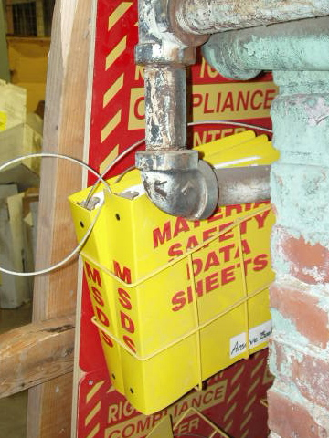
Workers must also be trained on:
Methods to detect the presence or release of a hazardous substance
Protective measures to take
Location and details of their employer’s written Hazcom program
Location and availability of SDSs
Special employee rights under Hazcom
Labeling systems
M20
Notes:
Trainer Notes:
Workers must also be trained on:
Methods to detect the presence or release of a hazardous substance
Protective measures to take
Location and details of their employer’s written Hazcom program
Location and availability of SDSs
Special employee rights under Hazcom
Labeling systems
Special employee rights may include additional training if a new chemical (with new hazards) is introduced into the work area, that employer has ensured each worker has an efficient level of knowledge with regard to the hazards in the workplace, their familiarity with the requirements of the standard, and the employer's hazard communication program, etc. This special rights may also be work site, or chemical specific.

Slide 67
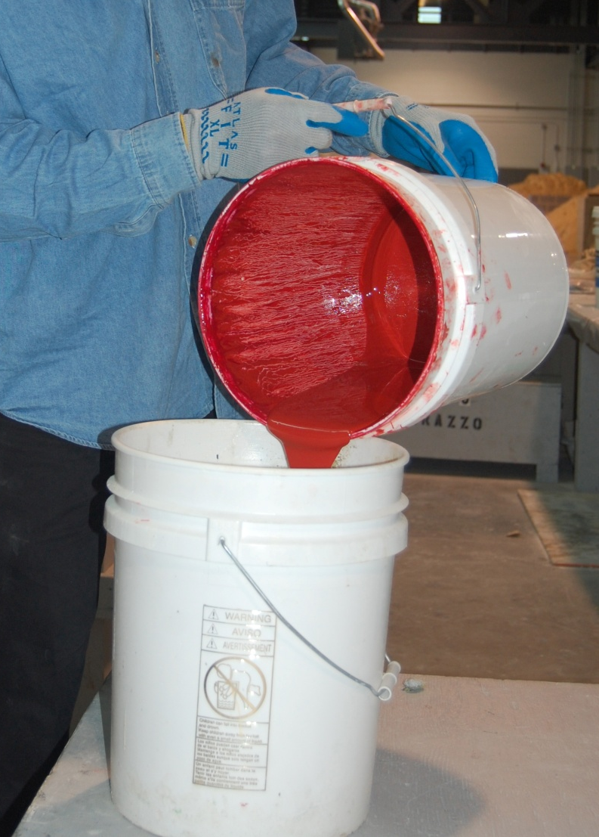
Is there an annual Hazcom training requirement?
NO.
OSHA requires training at time of initial assignment and whenever a new chemical hazard is introduced into the work area
Activity
Image courtesy International Masonry Institute
M20
Notes:
Trainer Notes:
[This is one of the major misunderstandings about the standard. Ask this question before clicking to the answer.]
Is there an annual Hazcom training requirement? NO.
OSHA requires training at time of initial assignment and whenever a new chemical hazard is introduced into the work area
From the standard:
Employers shall provide workers with effective information and training on hazardous substances in their work area at the time of their initial assignment and whenever a new hazard is introduced into their work area.
Photo shows a mason pouring a red colorant for grout.

Slide 68
A list of hazardous chemicals known to be present at your site must be available for your review
Hazcom
Written Program
Labels
Training
Chemical Inventory
SDSs
1910.1200 (e)(1)(i)
Notes:
Trainer Notes:
A list of the hazardous chemicals known to be present must be available for your review.
The list must use a product identifier that is referenced on the appropriate safety data sheet (the list may be compiled for the workplace as a whole or for individual work areas).

Slide 69
Review of Common Health Effects
Section 3
Notes:
Trainer Notes:
Review of common health effects

Slide 70
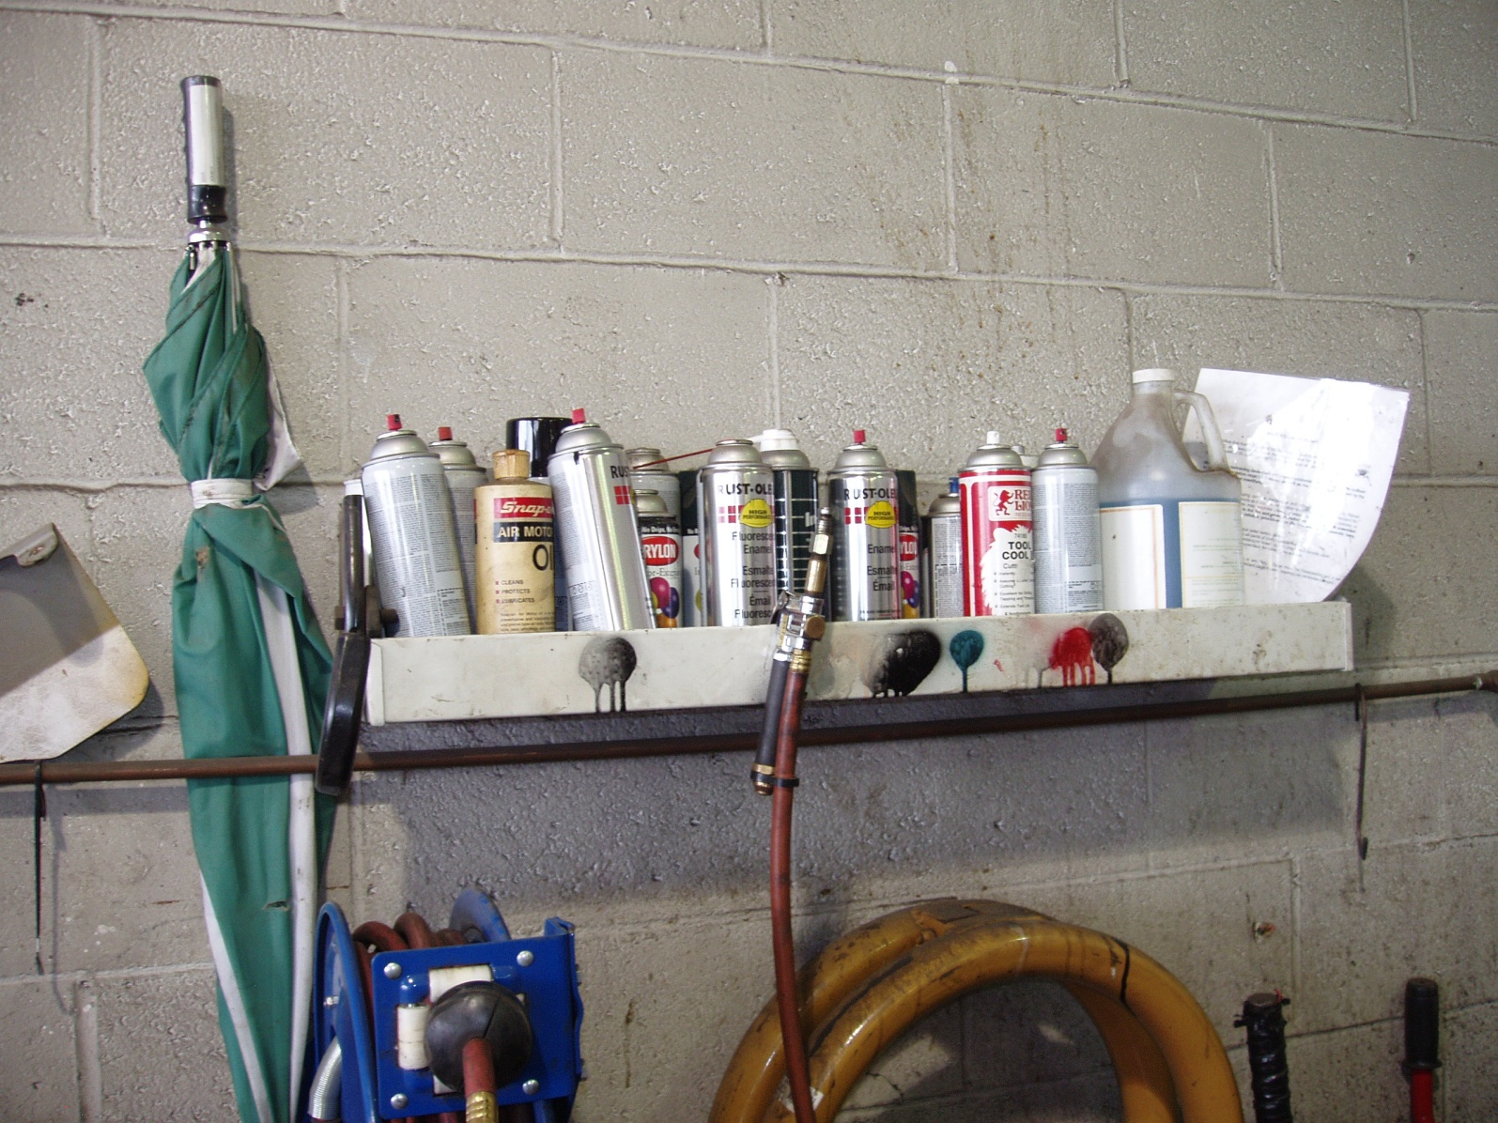
There is a range of health effects caused by chemicals
M21
Notes:
Trainer Notes:
There is a range of health effects caused by chemicals.

Slide 71
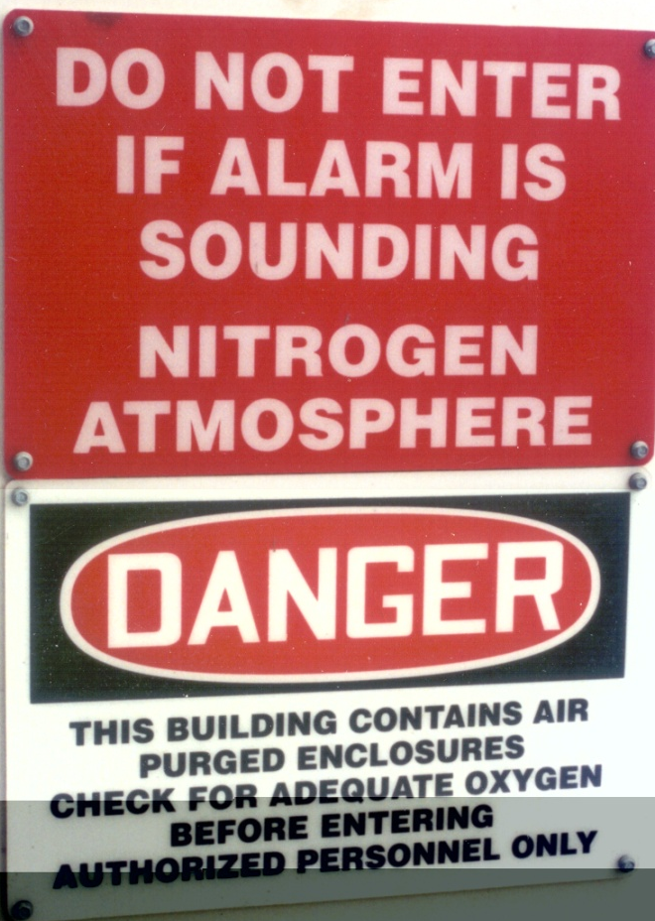
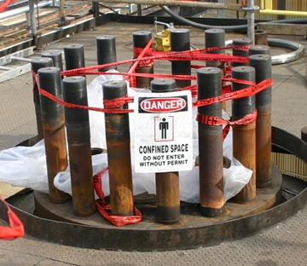
If a chemical replaces so much air that there isn’t enough oxygen to breathe, it can cause simple asphyxiation
M21
Notes:
Trainer Notes:
[Point out that 2 workers died in this particular confined space in 2006. The case study by the Chemical Safety Board summarized below. There is a video of the incident at the CSB site.]
If a chemical replaces too much air there isn’t enough oxygen to breathe causing simple asphyxiation.
This Case Study describes the Valero Delaware City refinery asphyxiation death of two contractor employees who were preparing to reassemble a pipe on a pressure vessel while it was being purged with nitrogen. The first worker, in an attempt to retrieve a roll of duct tape from inside the vessel, was overcome by nitrogen, collapsed in the vessel,
and died. His co-worker, the crew foreman, was asphyxiated while attempting to rescue him.
Link to the case study: http://www.csb.gov/assets/document/Valero_Case_Study.pdf
Link to the video and more: http://www.csb.gov/investigations/detail.aspx?SID=25&Type=2&pg=1&F_All=y

Slide 72
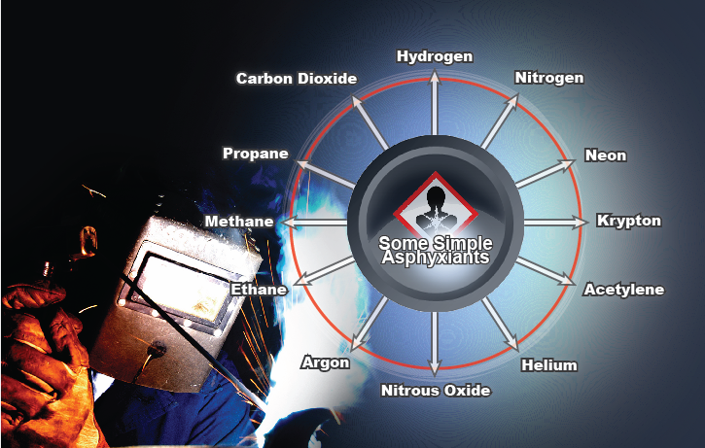
There are many simple asphyxiants
M21
Notes:
Trainer Notes:
[Ask the class, which of these gases could be found on a construction job.]
There are many simple asphyxiants.

Slide 73

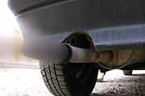
Chemical asphyxiants reduce the blood's ability to carry oxygen which can lead to suffocation
  Examples?
Hydrogen sulfide
Carbon monoxide
Hydrogen cyanide
M22
Notes:
Trainer Notes:
Chemical asphyxiants reduce the blood's ability to carry oxygen which can lead to suffocation.
Examples:
Hydrogen sulfide
Carbon monoxide
Hydrogen cyanide

Slide 74

Sensitizers and allergens set up a reaction in the body so that even minor exposures can cause a reaction
  Examples?
Activity
Photo courtesy Chicago Spray Foam and Steve Becker
M22
Notes:
Trainer Notes:
[Ask for an example and guide them towards poison ivy and oak as something everyone is familiar. Ask about the photo, which is a photo of sprayed foam insulation which contains isocyanates, very potent sensitizers that we saw in the SDS exercise for Sikaflex Sealant.]
Sensitizers and allergens set up a reaction in the body so that even minor exposures can cause a reaction so that once sensitized or allergic, smaller and smaller exposures can cause a reaction, and the reaction can become more severe.
Examples:
Sprayed foam insulation with isocyanates, oil-based paints, wood dust, poison oak and ivy (Rhus family plants)

Slide 75
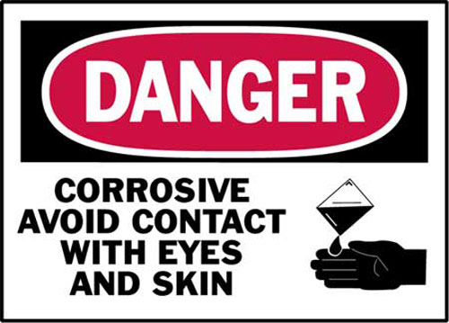
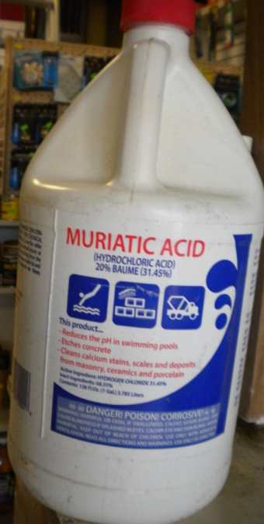
Corrosives can severely damage the body
  Acids and bases are corrosive chemicals
  Damaging to the skin, eyes and lungs
  Extent of damage depends on how long the corrosive is on the skin and the strength of the corrosive
M23
Notes:
Trainer Notes:
Corrosives can severely damage the body
Acids and bases are corrosive chemicals
Damaging to the skin, eyes and lungs
Extent of damage depends on how long the corrosive is on the skin and the strength of the corrosive

Slide 76

Mutagens cause genetic changes and can lead to birth defects or other problems in following generations
  Examples?
Model of DNA, courtesy Spiffistan
  Examples?
Ionizing radiation, hydrogen peroxide, bromine
M23
Notes:
Trainer notes:
Mutagens cause genetic changes and can lead to birth defects or other problems in following generations.
Examples?
Ionizing radiation, hydrogen peroxide, bromine

Slide 77

What are teratogens?
  Compounds that can harm the developing fetus, causing birth defects or death
  Examples on construction jobs??
  Heavy metals, particularly lead and mercury
M24
Notes:
Trainer Notes:
What are teratogens? Answer: Compounds that can harm the developing fetus, causing birth defects or death
Examples on construction jobs?? Answer: Heavy metals, particularly lead and mercury
[Ask the questions before clicking the answers.]
Background:
The worst case of a teratogen exposure to a population was the Minamata Bay, Japan incident which was discovered in 1956. In this case, Methyl Mercury was used as a catalyst in a chemical process at Chisso Corporation’s chemical factory, which continued to dump the product from 1932 to 1968 into Minamata Bay.
Lead has been shown to a powerful teratogen, causing learning disabilities and other problems in children whose mothers are exposed to lead dust while pregnant. Even children who suffer no damage from lead in the womb, can have lots of problems caused by lead from living in houses with lead-based paint. Dr. Herbert Needleman conducted an innovative study using the baby teeth of children to identify high lead levels and followed them for years showing higher rates of dropping out of school, behavioral problems and trouble with the law. Here is a link to a Wikipedia account of his work:
http://en.wikipedia.org/wiki/Herbert_Needleman

Slide 78
Cancer-causing chemicals must be listed on an SDS even if the amount is only 0.1 percent of the product
M24
Notes:
Trainer’s Notes:
Cancer-causing chemicals must be listed on an SDS even if the amount is only 0.1 percent of the product. Other chemicals must be listed on an SDS if the amount is 1.0 percent of the product.

Slide 79
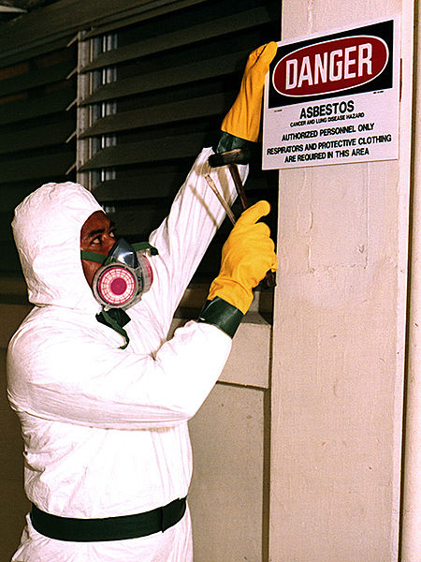
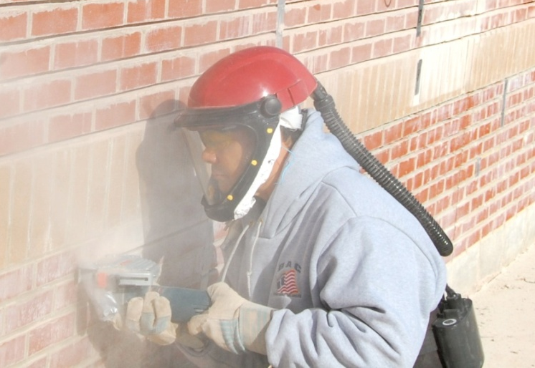

Here are a few known and suspected human carcinogens
Asbestos
Benzene
Beryllium
Cadmium
Asphalt fume
Silica
Photography Neil Lippy for eLCOSH
Photo courtesy U.S. govt.
Photo courtesy Wikimedia
M24
Notes:
Trainer Notes:
[NIOSH states that there is no know safe exposure level for carcinogens. Ask what that means for working with carcinogens.]
Here are a few known and suspected human carcinogens.
Asbestos
Benzene
Beryllium
Cadmium
Asphalt fume
Silica
[NIOSH states that there is no know safe exposure level for carcinogens. Ask what that means for working with carcinogens.]

Slide 80
Chemical effects on the body depend on the:
Physical form of the chemical
How chemicals get into the body (route of entry)
Dose
Toxicity
Individual’s reaction to the chemical
M25
Notes:
Trainer Notes:
[This slide is a summary slide for the overview of chemicals and their effects on the body.]
Chemical effects on the body depend on the:
Physical form of the chemical
How chemicals get into the body (route of entry)
Dose
Toxicity
Individual’s reaction to the chemical

Slide 81

“The dose makes the poison”
All substances are poisons; there is none which is not a poison. The right dose differentiates a poison from a remedy."
Paracelsus (1493-1541)
M25
Notes:
Trainer Notes:
A sixteenth-century Swiss chemist named Paracelsus gave us the most basic rule of toxicology: "The dose makes the poison." Practically every substance on earth (including water and Vitamin C) can kill you if it's concentrated enough in your stomach or your bloodstream.
For instance, let’s take a very common substance, caffeine. If a person consumes 10 grams of caffeine at one time, that amount would be fatal. However, caffeine is a common substance which is found in our food and beverages.

Slide 82
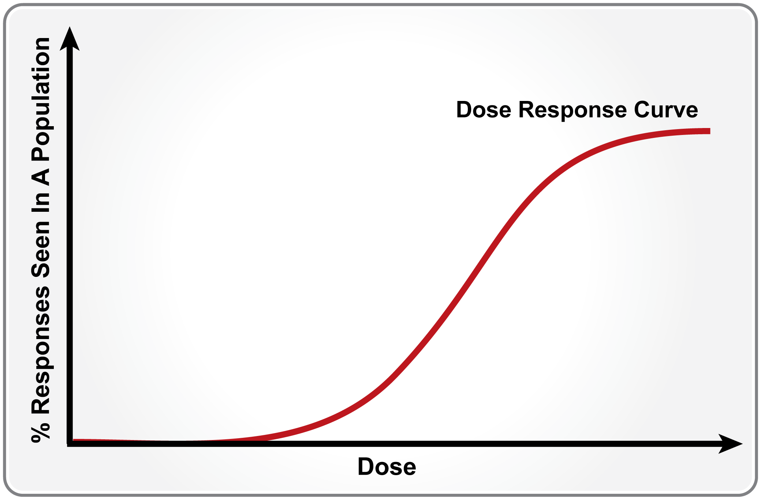
The dose response curve shows how people respond to toxic chemicals
M25
Notes:
Trainer Notes:
[You should point out that as the dose increases along the horizontal axis, there is no response at first. But as the dose increases, the most sensitive people in the population start to respond and then a higher and higher percentage is affected until all of the population is affected and the curve levels off. No more people left who aren’t affected by the chemical.
The dose response curve shows us how people respond to toxic chemicals.

Slide 83
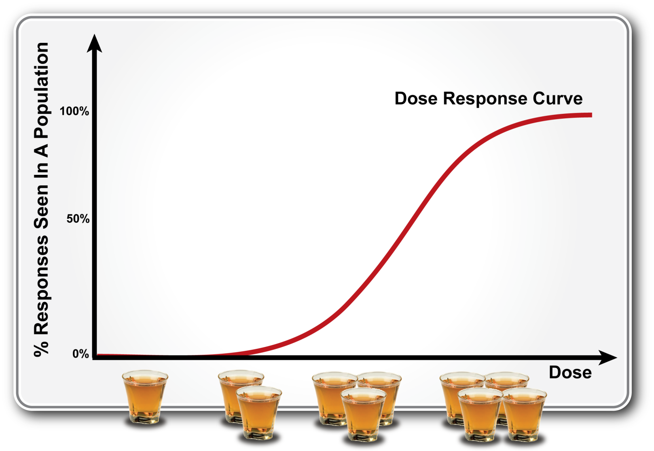
Let’s look at the dose response curve for alcohol consumption
M25
Notes:
Trainer Notes:
Let’s look at the dose response curve for alcohol consumption
[The amount of a chemical, just like drinks, can have a cumulative effect. We don’t show any effect with just one drink, but as we continue showing effects until the amount is so great everyone would have an effect. You can ask, “Why do some people react differently to chemical exposures?” Continuing with the alcohol example, this is really asking what factors may impact different levels of impairment beside number of drinks. Your class may answer: weight, metabolism, pre-existing medical conditions. This is also true for exposure to chemicals." ]

Slide 84
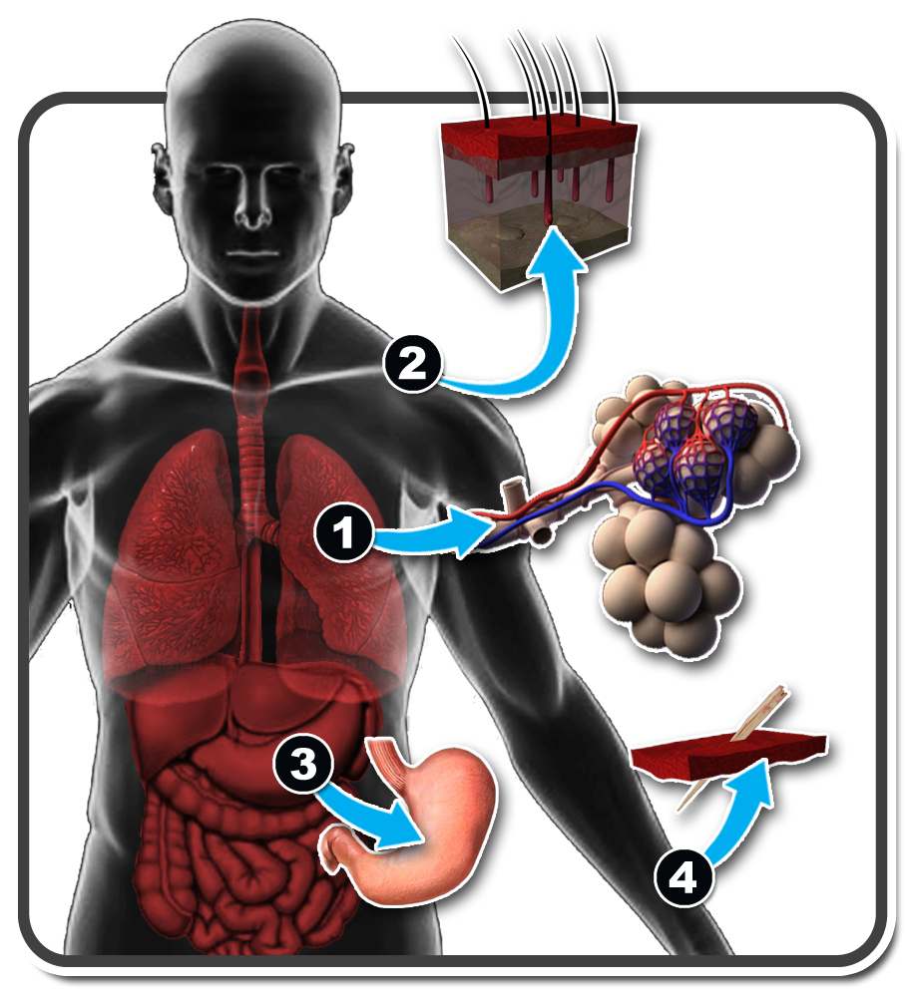
How do chemicals enter your body?
Breathing (Inhalation)
Absorption through the skin
Swallowing (Ingestion)
Injection
Which one is the most common route?
M26
Notes:
Trainer Notes:
Chemicals are only a hazard when you have been exposed to them. There are four major routes in which chemicals can enter your body. The most common type of exposure is through inhalation. You inhale the chemical, which would then enter your lungs, where it would be absorbed into your bloodstream. The majority of our exposure to chemicals is through inhalation. We breathe approximately 20-to-25 thousand breaths in one day, which averages a total volume of 10,000 –14,000 liters of air in a day.
The second most common type of workplace chemical exposure is absorption through the skin. For certain chemicals, once it is absorbed through the skin, it goes into the bloodstream.
The third most common type of chemical exposure is through ingestion, where the chemical enters the body through your mouth and is absorbed through the digestive tract. To minimize the ingestion route, good hygiene practices need to be observed–wash your face and hands prior to eating and drinking.
The last type of chemical exposure is through injection in which the chemical enters the body through a sharp object like a needle.

Slide 85
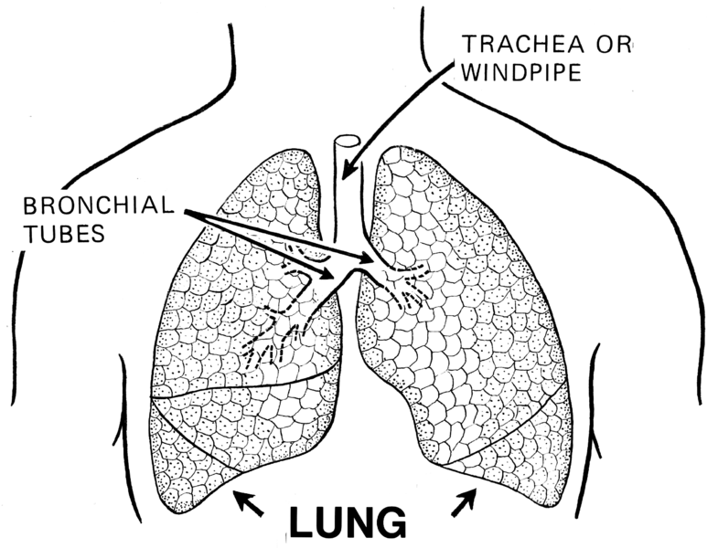
1. Inhalation
Airborne chemicals are breathed in through the mouth or nose
Gases and vapors can reach the deep lungs
Particle and droplet size affects where the chemical settles in the respiratory tract, which influences symptoms and disease
Illustration courtesy Pearson Scott Foresman and Wikimedia
M27
Notes:
Trainer Notes:
1. Inhalation
Airborne chemicals are breathed in through the mouth or nose
Gases and vapors can reach the deep lungs
Particle and droplet size affects where the chemical settles in the respiratory tract, which influences symptoms and disease

Slide 86

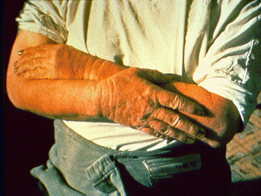
2. Absorption
If chemicals get onto your body they may be able to pass through to your bloodstream
Open wounds can increase absorption
Chemical properties affect absorption
Are all areas of the skin equally protective?
Photo courtesy John Rekus and NIOSH
Dermatitis from kerosene/eLCOSH
M28
Activity
Notes:
Trainer Notes:
[Review the information and then click on the question, “Are all areas of the skin equally protective?” Have the class check either yes or no in their manual before going to the next slide.]
2. Absorption
If chemicals get onto your body they may be able to pass through to your bloodstream
Some areas are more at risk than others (eye, reproductive area, forehead)
Open wounds can increase absorption
Chemical properties affect absorption
[The photos are from eLCOSH]

Slide 87
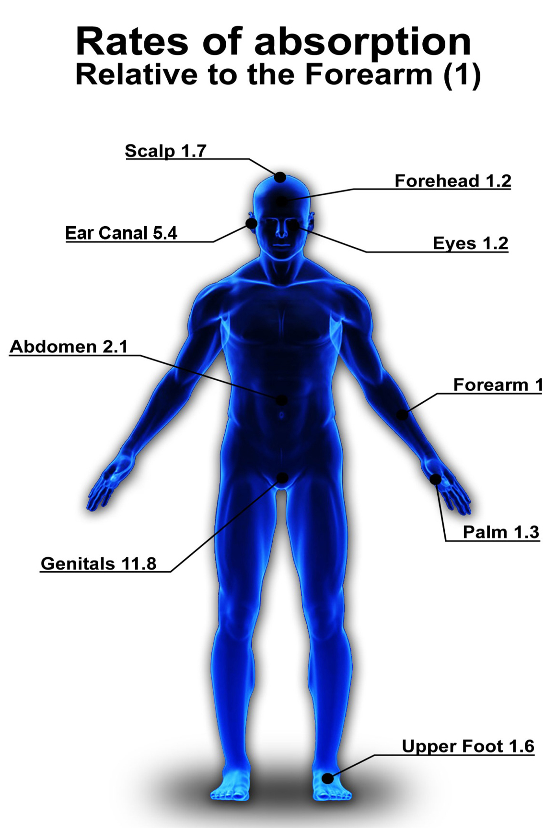
No! All areas of the skin are not equally protective?
Graphic courtesy IUOE Hazmat Program
M29
Notes:
Trainer Notes:
No. All areas of the skin are not equally protective.
[The important point to bring up in the diagram is that chemicals can penetrate almost 12 times faster through the crotch area than the forearm and 1.6 times faster through the upper foot and 5 times faster through the ear. The point is that the students need to understand that these areas warrant additional protection. They shouldn’t walk through chemicals on the floor, for instance and must be careful not to transfer chemicals from their hands to disposable hearing protection that is inserted into the ear.]

Slide 88

3. Ingestion
How are chemicals ingested?
Chemicals can be accidentally transferred to food or drink and be swallowed! Airborne dusts can get onto face
M30
Notes:
Trainer Notes:
[Ask the students how would it be possible for workers to ingest chemicals? The following are some possibilities for how chemicals can enter the digestive tract.]
3. Ingestion
How are chemicals ingested?
Chemicals can rub off dirty hands and contaminate food, drinks or tobacco products
Chemicals in the air can settle on food or drink and be swallowed
Chemicals can be caught in mucus and be swallowed

Slide 89
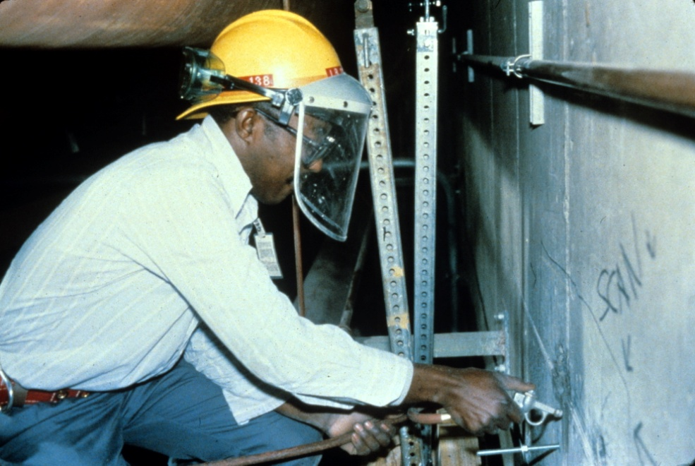

4. Injection
Anything that pierces your skin allows chemicals to enter your bloodstream immediately
Blowing out drill holes with high pressure air. Photo courtesy eLCOSH
M30
Activity
Notes:
Trainer Notes:
[Point out that high pressure washers or paint sprayers can inject water or product under the skin and can cause infections that can be serious.]
Anything that pierces your skin allows chemicals to enter your bloodstream immediately!

Slide 90
What is the difference between acute and chronic exposure?
Acute
High exposure over a short time period (minutes to a few days)
After exposure stops, damage may or may not reverse
Chronic
Low exposure over a long time period (years)
Can cause disease or other irreversible effects
M31
Notes:
Trainer Notes:
Acute exposure is a short term or immediate high dose. Acute exposures can lead to disease or injury which develops immediately or within days. Generally, the effects wear off soon after the exposure ends. Sometimes, however, a permanent illness, such as asthma from chemicals, or cell death from ionizing radiation, can be caused by such an exposure. Eye and throat irritation from Portland cement dust is an example of an acute effect.
Chronic exposure is a repeated, low-to-mid dose of chemical which may lead to disease that develops slowly, over a period of months or years or manifests itself years after exposure. Asbestosis and cancer are examples of chronic illnesses.

Slide 91

What chronic conditions can result from cement finishing?
Photo courtesy of eLCOSH
M31
Notes:
Trainer Notes:
[Ask for ideas. Cement is a caustic material and will dry out the skin, causing the hands to get coarse and red. Someone in the class may mention the chronic condition of stooping posture leading to back problems. Not chemically induced, but definitely a chronic condition!]
What chronic conditions can result from cement finishing?

Slide 92
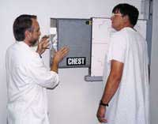
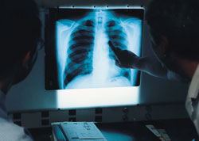
What is a latency period? What is an example?
Example: Asbestosis and mesothelioma can take up to 25 years from initial exposure to appear
A radiologist prepares a potential asbestos victim for an X-ray
M31
Activity
Notes:
Trainer Notes:
[Ask the questions and ask them to write the answers in their student manual. After they have written their answers, advance the slide.]
What is a latency period?
A latency period is the time between an exposure and the emergence of a health problem, usually a period of years.
What is a classic example?
Asbestosis and mesothelioma can take up to 25 years from initial exposure to appear

Slide 93
What is the difference between local and systemic harm?
Some chemicals harm the body at the site of their exposure, such as an acid burn
Other chemicals can affect entire body systems, such as lead and alcohol
Some can do both, such as alcohol and organic solvents you may use at work
M31
Notes:
Trainer Notes:
What is the difference between local and systemic harm?
Some chemicals harm the body at the site of their exposure, such as an acid burn
Other chemicals can affect entire body systems, such as lead and alcohol
Some can do both, such as alcohol and organic solvents you may use at work

Slide 94
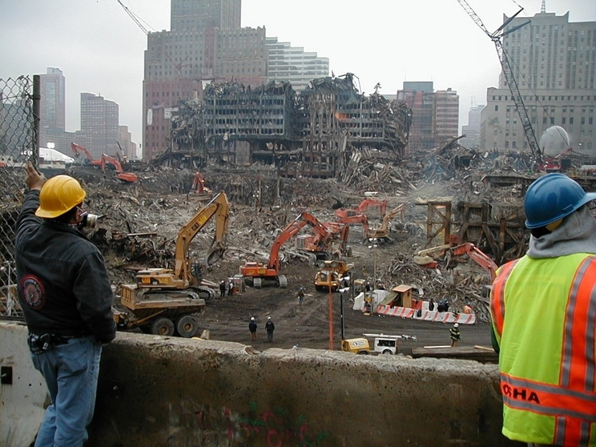
Multiple chemicals may have magnified effects when combined in your body
Alcohol and solvents
Asbestos and cigarette smoke
Exposures at the WTC cleanup
M32
Notes:
Trainer Notes:
Multiple chemicals may have unique effects when combined in your body
Alcohol and solvents
Asbestos and cigarette smoke
Exposures at the WTC cleanup
[Point out that we have almost no information on how more than one chemical acts simultaneously on the body. We know that for some the result is much more harmful than just adding the effects of the two chemicals. Asbestos and cigarette smoke is a classic example. Exposures at the WTC are another example. In that case, thousands of air samples were collected and most were below the OSHA standards, but still upwards of 40% of the responders have health problems. This action is called synergism.]

Slide 95
Overview of Chemical Hazards
Section 4
Notes:
Trainer Notes:
Overview of Chemical Hazards

Slide 96
All chemicals are found in one of three forms: solid, liquid or gas. Examples of categories?
Form | Examples
Solid | dust, fiber, fume
Liquid | aerosol, mist, gels, adhesives
Gas | acetylene, oxygen, carbon monoxide, nitrogen
M33
Activity
Notes:
Trainer Notes
All chemicals are found in one of three forms: solid, liquid or gas.
[Ask the class to think of some examples and fill in the table in their student manual before your show them the answers.]

Slide 97


Solids released into the air can get into your body and harm you!
Welding fumes
Dust from sanding
Photography Neil Lippy for eLCOSH
Photo courtesy eLCOSH
M34
Notes:
Trainer Notes:
Solids released into the air can get into your body and harm you!
Dust in the air can settle out on work surfaces, cups, plates, utensils, food, etc. The settled dust can be swallowed with food or drinks or stirred back into the air.

Slide 98


Liquids can come into contact with the skin or eyes and harm that area or be absorbed into the body
M34
Notes:
Trainer Notes:
Liquids can be sprayed and form mists or evaporate and form vapors which can be inhaled.
Mists can settle on the skin and be absorbed or settle and contaminate food or drink.

Slide 99


Gases and vapors that a worker breathes can reach the lungs and cause harm
Photo courtesy eLCOSH
M34
Notes:
Trainer Notes:
Gases and vapors that a worker breathes can reach the lungs and cause harm.
The asphalt job shows a slight “haze” near the paver. Hot asphalt, along with its additives, will giver off a number of gases and vapors.

Slide 100
It is important to understand these physical properties of chemicals
pH
Vapor pressure
Flash Point
Ingredients for a fire
Explosive Limits
Vapor Density
M35
Notes:
Trainer Notes:
[Briefly review this list of physical properties of chemicals with the class; use a white board or easel and paper to cover the properties in greater depth. These are not all physical properties but they are ones that most affect workers’ health and safety. The student manual has a nice explanation of these.]
It is important to understand these physical properties of chemicals
pH: corrosive power
Vapor pressure (VP): chemical’s volatility
Flash Point (Fl.P.): temperature at which it can burn
Ingredients for a fire: Fire tetrahedron
Explosive limits: fuel in the air required for fire
Vapor Density (VD): where it will be in the air

Slide 101

With corrosives, concentration is critical
Acetic Acid:
90% solution destroys skin (pH<2),
6% is vinegar we put it on salads (pH~4.5)
M35
Notes:
Trainer Notes:
With corrosives, concentration is critical
Acetic Acid:
90% solution destroys skin,
6% is vinegar we put it on salads

Slide 102
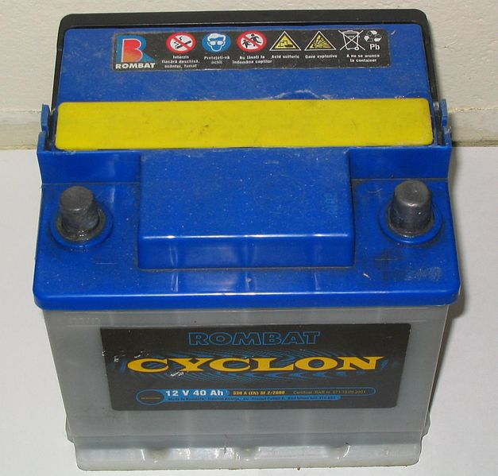
What does vapor pressure of sulfuric acid say about the inhalation hazard from a spill?
Sulfuric acid Vapor Pressure
(VP) = 0.001 mm Hg
M35
Notes:
Trainer Notes:
What does vapor pressure of sulfuric acid say about the inhalation hazard from a spill?
Since sulfuric acid’s VP is almost zero, it should not be a serious respiratory hazard unless workers approach it closely. There isn’t going to be much evaporation.

Slide 103

What is a chemical’s flash point?
The temperature at which a liquid gives off enough vapor to flash if there is a source of ignition
Photo courtesy Streicholz and Wikimedia
M36
Activity
Notes:
Trainer Notes:
[Ask this question and see if they know the unit that the answer is in.]
What is a chemical’s flash point?
The temperature at which a liquid gives off enough vapors to burn if there is a source of ignition.

Slide 104

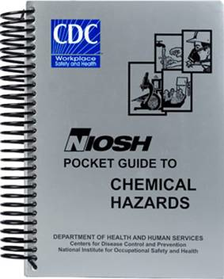
Flash Point Class Exercise
Look up and record the flash point for the chemicals below and put in order of most to least flammable
Chemical | Flash Point | Order of flammability
Diesel fuel
Gasoline
Benzene
Turpentine
136°F
4
-45°F
1
12°F
2
95°F
3
http://wiser.nlm.nih.gov/
http://www.cdc.gov/niosh/npg/
M36
Activity
Notes:
Trainer Notes:
Flash point group exercise.
Look these up in any source and put in the order of most to least flammable.
[Only attempt this exercise if you have some resources to look these up. If the classroom has wireless internet, you can have students go out on the web to the NIOSH Pocket Guide site. WISER is a web-based app from the National Library of Medicine that gives a great deal more information than the NIOSH Pocket Guide. Encourage those in your class with a smart phone to download the free app and put it to work. If class is unfamiliar with resources, you can bring up a volunteer for each chemical and work with them to look up the flash point and write it on the board. Everyone should then be able to determine the order of flammability when the flash points are all on the board. The answers are all on the slide so you can click through individually.]
Diesel fuel = 136 degrees F
Gasoline = - 45 degrees F
Benzene = 12 degrees F
Turpentine = 95 degrees F
[The order is gasoline: benzene, turpentine, diesel fuel]

Slide 105
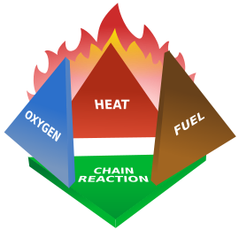
What are the ingredients for a fire?
What is a chain reaction?
M37
Notes:
Trainer Notes:
[You can help the class understand this by pointing out that flash point is the lowest temperature where a vapor will flash, but that is not the same thing as sustaining a fire. The chain reaction must ]
What are the ingredients for a fire? What is a chain reaction?
Flammability is the ability of a solid, liquid or gas to ignite and produce a flame. Four elements are required in specific ratios for combustion to occur: fuel, oxygen, heat, and a chain reaction. This relationship is described by the fire tetrahedron. The fire can be extinguished by taking away any one element of the fire tetrahedron. This used to be a fire triangle, but chain reaction was added because the reaction must continue if a fire is to be sustained. Think about lighting a cigarette lighter beneath a 2 by 4 for a second . There is heat, oxygen and fuel, but no chain reaction. If the 2 by 4 was ground into sawdust, the reaction would go forward because the ratios were right.

Slide 106
Explosive limit is the range that vapors will burn in air
Look up and record the lower and upper explosive limit for these chemicals
Chemical | Lower explosive limit (%) | Upper explosive limit (%)
Kerosene
Gasoline
Methylene chloride (furniture stripper)
0.7%
5%
1.4%
7.6%
13%
23%
http://wiser.nlm.nih.gov/
http://www.cdc.gov/niosh/npg/
M37
Activity
Notes:
Trainer Notes:
[If the class has access to the internet or the resources shown, have them look it up. If they don’t or time doesn’t allow, just write the answers on the board. The answers are all on the slide and you can click through them.]
Explosive limit is the range that vapors will burn in air
Kerosene = LEL: 0.75, UEL: 5
Gasoline = LEL: 1.4, UEL: 7.6
Methylene Chloride: = LEL: 13. UEL: 23
[Ask what this means. They should say that it takes a lot more methylene chloride in the air for ignition based on the LEL. You can also tell them that 1 percent equals 10,000 parts per million, so most chemicals become toxic before they become flammable. For instance, methylene chloride has an OSHA Permissible Exposure Limit of 25 ppm, but doesn’t become flammable until the concentration reaches 130,000 ppm (13%).]

Slide 107
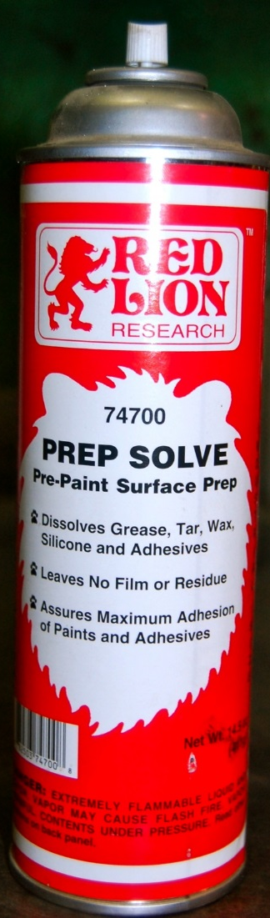
What is the rule about vapor density for most chemicals encountered in construction work?
✔
Heavier than air
Lighter than air
M38
Activity
Notes:
Trainer Notes:
[Ask the question and let them respond. You should ask for a show of hands. The answer is heavier than air. This Red Lion pre-paint surface preparation spray indicates on the SDS that the vapor density is greater than 1, which means it is heavier than air. You can ask them what the implications are for this information. The answer is that vapors often accumulate at the lowest point, which is particularly important in trenches and confined spaces. ]
What is the rule about vapor density for most chemicals encountered in construction work?

Slide 108
Measurement and Exposure Limits
Section 5
Notes:
Trainer Notes:
Measurement and Exposure Limits

Slide 109


Why do we monitor?
Photography Neil Lippy for eLCOSH
M38
Notes:
Trainer Notes:
Why do we monitor?
[This is a photo from a 2012 CPWR research project to see the effectiveness of ventilation controls for tuck pointing. Ask this question and possibly write down the answers on a flip chart, if you have time.]
Some possible answers:
To ensure respirators are sufficiently protective
To demonstrate the effectiveness of control technologies
To ensure compliance with OSHA standards

Slide 110
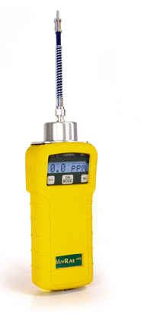
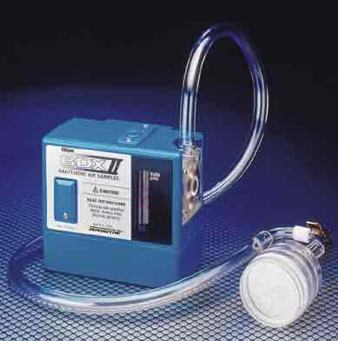

There are two types of monitoring: real-time and samples that are sent to a lab
Multi-Gas Meter
Real-time instruments
Photo courtesy Lawrence Berkeley National Laboratory
PID
M39
Notes:
Trainer Notes:
There are two types of monitoring: real-time and samples that are sent to a lab.

Slide 111
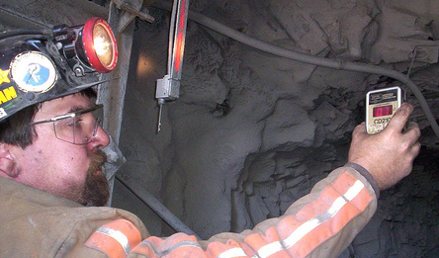
Real-time equipment can give immediate chemical exposure measurements
Combustible gases
Toxic vapors and gases
Oxygen
Photo courtesy NIOSH
M39
Notes:
Trainer Notes:
Real-time equipment can give immediate chemical exposure measurements
Combustible gases
Toxic vapors and gases
Oxygen
[This slide is not meant to be an in-depth review of air monitoring equipment. Give the class enough background (along with the units on the next slide) so that they know there are methods that their employer can take to monitor their exposures. Let the class know it is also a worker’s right to know the results of their monitoring data.]
Use information from the CPWR HAZWOPER courses for background information on various air monitoring meters.

Slide 112
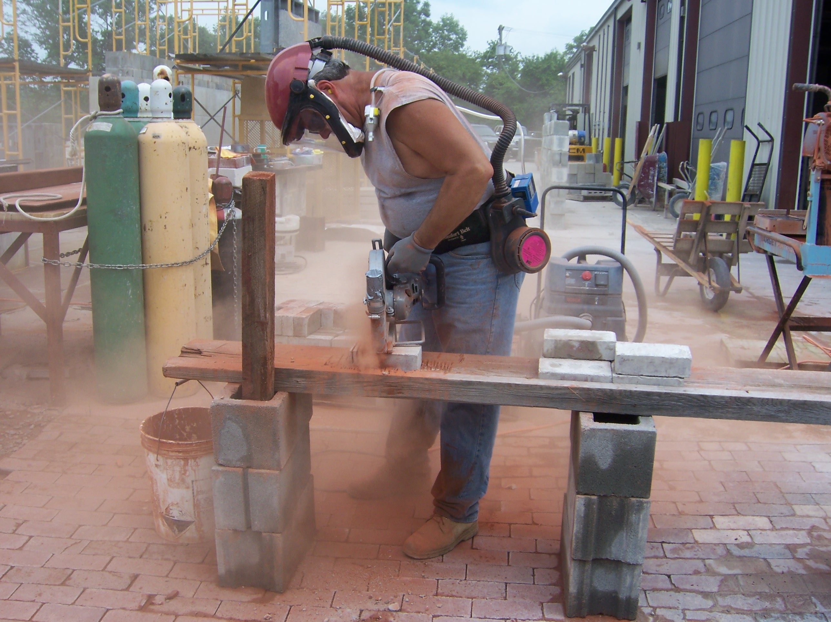

Personal monitoring in the breathing zone determines a specific employee’s exposure
Air sampling pump
Sampler
M39
Photo courtesy CPWR
Notes:
Trainer notes:
[Point out the sampling pump and cyclone with 37 millimeter filter cassette. You may also want to point out the powered air purifying respirator (PAPR) that the worker is wearing. This was part of a CPWR research project looking at ventilation or vacuum controls.]
Personal monitoring in the breathing zone determines a specific employee’s exposure.

Slide 113
Recognizing these units will help you understand exposure results and OSHA limits
Parts per million (ppm)
Parts per billion (ppb)
Milligrams per cubic meter (mg/m³)
Micrograms per cubic meter (µg/m³)
Percent (%)
Fibers per cubic centimeter (fibers/cc)
M39
Notes:
Trainer Notes:
[There are several slides to help you explain these terms]
Recognizing these units will help you understand exposure results
Parts per million (ppm)
Parts per billion (ppb)
Milligrams per cubic meter (mg/m³)
Percent (%)
Fibers per cubic centimeter (fibers/cc)

Slide 114

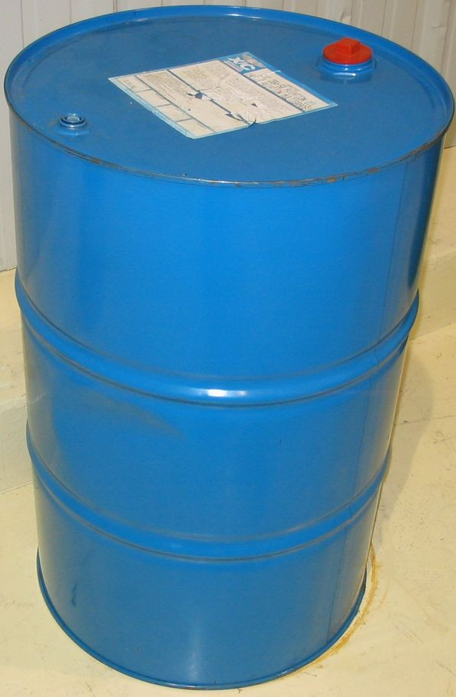
Parts per million (ppm) is a very small amount
4 drops of ink in a 55-gallon drum = 1 ppm
M39
Notes:
Trainer Notes:
Parts per million (ppm) is a very small amount. 4 drops of ink in a 55-gallon drum is 1 ppm.

Slide 115



Parts per billion (ppb) is one thousand times less than ppm
One tissue in a roll from NYC to London
M39
Notes:
Trainer Notes:
Parts per billion (ppb) is one thousand times less than ppm.
Ppb would equal one separate tissue in a roll of toilet tissue stretched from NYC to London.

Slide 116

Gram is a measure of weight
1 paperclip = 1 gram
Milligram (mg) = one-thousandth of a gram (1,000th)
Microgram (μg) = one millionth of a gram (1,000,000th)
M39
Notes:
Trainer Notes:
Gram is a measure of weight
1 paperclip = 1 gram
Milligram (mg) = one-thousandth of a gram (1,000th)
Microgram (μg) = one millionth of a gram (1,000,000th)

Slide 117

Milligram per cubic meter is a measure of mass in air
Milligrams per cubic meter (mg/m³)
Micrograms per cubic meter (μg/m³)
1 meter = 100 centimeters = approx. 3’
M39
Notes:
Trainer Notes:
[Point out that this cube is 3 feet x 3 feet x 3 feet. There is a yard stick at the bottom. In this box of air would be 1,000th of a paperclip in weight of dust particles for a mg/m3. It is important to emphasize for toxic materials like lead that it doesn’t take much mass of airborne materials to cause health problems. With lead, OSHA has a Permissible Exposure Limit of 50 micrograms per cubic meter of air.]
Milligram per cubic meter is a measure of mass in air
Milligrams per cubic meter (mg/m³)
Micrograms per cubic meter (μg/m³)
1 meter = 100 centimeters = approx. 3’

Slide 118

Cubic centimeter is a measure of volume
A thimble holds around 3 cubic centimeters of air.
M39
Notes:
Trainer Notes:
[Make sure you have a transition explaining that there are 1,000,000 cubic centimeters in 1 cubic meter. We are talking about a limited numbers of fibers in this space. ]
Cubic centimeter is a measure of volume. A thimble holds around 3 cubic centimeters of air.

Slide 119
OSHA has Permissible Exposure Limits (PELs), but it is critical to remember…
Most are from 1968 American Conference of Governmental Industrial Hygienists (ACGIH) Threshold Limit Values (TLVs)
Current TLVs are often lower
NIOSH Recommended Exposure Limits (RELs) are usually lower
Most chemicals have no exposure limits set
M40
Notes:
Trainer Notes:
[Explain that ACGIH is the American Conference of Governmental Industrial Hygienists. This voluntary organization had been setting non-mandatory recommendations for worker exposures called Threshold Limit Values for decades prior to OSHA. The ACGIH continues to update its standards, while OSHA has not been able to do so.]
Exposure limits are a way to compare a worker's exposure on the job with an assumed “safe” limit, which was derived from scientific study. It can be argued that many exposure limits are too low and most chemicals do not have an exposure limit. However, they are all we have to assist us in protecting workers. Some exposure limits are guidelines (usually more protective) and some are the Law (though usually not as protective as guidelines). Below are the three main exposure limits used to protect workers.
OSHA Permissible Exposure Limits (PELs). PELs are the Law!
ACGIH Threshold Limit Values (TLVs)
NIOSH Recommended Exposure Limits (RELs)
Exposure limits are based on 8-hour time weighted averages (TWA) for OSHA and ACGIH or 10-hour TWAs for NIOSH RELs, ceilings (cannot exceed), or 15-minute peak exposures. Exposures must be kept below OSHA PELs. Most exposure limits are for airborne exposures. Exposure limits do not take into account exposure from multiple chemicals.

Slide 120
Most exposure limits are based on an average over 8 hours
exposure
limit
Increasing
Exposures
6:30 9:30 11:30 1:30 3:30
time
M40
Notes:
Trainer Notes:
Most exposure limits are based on an average over 8 hours.

Slide 121
Some chemicals have ceilings that can’t be exceeded
ceiling
exposure
limit
Increasing
Exposures
6:30 9:30 11:30 1:30 3:30
time
M40
Notes:
Trainer Notes:
Some chemicals have ceilings that can’t be exceeded
[Point out the line that goes above the exposure limit can be a ceiling value. Show the dip for work stopping at lunch. It is questionable whether this would exceed the 8-hour time weighted average.]

Slide 122
Other ways to communicate hazards
Section 6
Notes:
Trainer Notes:
Other ways to communicate hazards

Slide 123
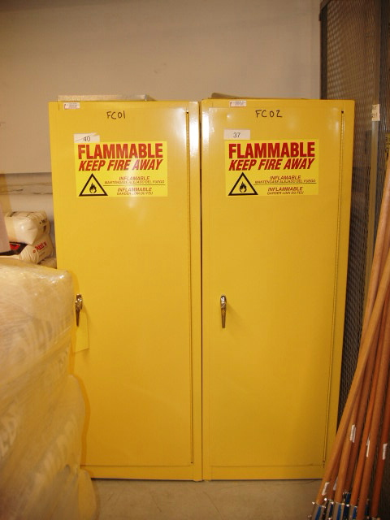
You will see other types of labeling systems
Hazardous Material Information System (HMIS)
National Fire Protection Association (NFPA) 704 M
Department of Transportation (DOT) placards
M41
Notes:
Trainer Notes:
Hazardous Material Information System (HMIS)
National Fire Protection Association (NFPA) 704M placard system
Department of Transportation (DOT)

Slide 124


Color-coded HMIS ranks hazards and recommends PPE
M41
Notes:
Trainer Notes:
Color-coded HMIS ranks hazards and recommends PPE.
[Point out that this approach is commonly used on products, but it is a proprietary system. There is a good description in their student manual on page 41.]

Slide 125

NFPA’s 704 M Diamond is widely used
For this example chemical,
What is the greatest hazard?
What is the specific hazard?
Activity
M42
Notes:
Trainer Notes:
[Ask the questions and have the students write the answers in their manual. It is fine to have them work together.]
NFPA’s 704M Diamond is widely used. For this example chemical,
What is the greatest hazard?
What is the specific hazard?
[The answers are:
Reactivity is the greatest risk with a score of 3, “Shock and heat may detonate.”
The specific hazard is that it is radioactive. This is a really hazardous chemical!]
According to the International Association of Fire Fighters (IAFF) master trainers, all “special hazard” symbols may be listed in the white diamond and it is taught in the fire and emergency services this way. NFPA committee states that only the water reactive and oxidizer should be allowed in the box. IAFF members make up the NFPA committees; mention any symbol may be seen, that covers all possibilities.

Slide 126

Department of Transportation requires placards on vehicles carrying hazardous chemicals
M43
Notes:
Trainer Notes:
The U.S. Department of Transportation divides regulated hazardous materials into the following nine classes, most of which are further divided into divisions. Here are some examples:
Class 1: Explosives
1.1 - Explosives with a mass explosion hazard (dynamite, TNT, black powder)
1.2 - Explosives with a projection hazard (aerial flares, power device cartridges, detonating cord)
1.3 - Explosives with predominantly a fire hazard (propellant explosives, liquid-fueled rocket motors)
1.4 - Explosives with no significant blast hazard (signal cartridges, practice ammunition, line-throwing rockets)
Class 2: Gases
2.1 - Flammable gases (propane, methyl chloride, butadiens)
2.2 - Non-flammable, non-toxic gases (compressed nitrogen, cryogenic argon)
2.3 - Toxic Poisonous; can injure or kill people or other organisms gases (chlorine, hydrogen fluoride, arsine, methyl bromide)
Class 3: Flammable liquids and combustible liquids
Class 4: Flammable Solid, Spontaneously Combustible, and Dangerous When Wet
Class 5: Oxidizing substances and organic peroxides
Class 6: Poison (Toxic), Poison Inhalation Hazard, Infectious Substance
6.1 - Poisonous liquids or solids (aniline, arsenic compounds, hydrocyanic acid, chemical warfare agents)
6.2 - Infectious/bio-hazardous substances (anthrax, botulism, tetanus)
Class 7: Radioactive
(uranium hexafluoride, yellowcake, radiological waste)
Class 8: Corrosive
(nitric acid, sulfuric acid, sodium hydroxide)

Slide 127
Controlling hazards
Section 7
Notes:
Trainer Notes:
Controlling hazards

Slide 128
The hierarchy of controls can protect you from hazardous chemicals
Most Effective
Elimination
Substitution
Engineering Controls
Administrative Controls
PPE
Least Effective
M44
Notes:
Trainer Notes:
The hierarchy of controls can protect you from hazardous chemicals
[The hierarchy of controls is a very effective and OSHA-mandated method for reducing workers’ risks to hazards. Take a few moments to introduce (or refresh) workers on the hierarchy of controls.]
The hierarchy of controls is a list of methods, in order from most desirable to least desirable, which emphasizes controlling a hazard at its source. This is done by giving preference to eliminating the hazard altogether; then to the use of the engineering controls. These types of strategies should be used first, where possible, because they are subjected less to human error and because they are less disruptive and uncomfortable for people to use and for people working in the area. Whichever methods you use, remember that in each case, their effectiveness should be monitored regularly.
The overall idea is to design or redesign the workplace to fit the needs of workers. Training workers and providing personal protective equipment is necessary but, creating as safe and healthy a workplace as possible is the ultimate goal. To achieve this goal, we must substitute dangerous chemicals and processes with less dangerous ones, design workstations to cause less harm to workers, and ensure that health and safety concerns are integrated into the design stages of workplaces.

Slide 129

Eliminate or substitute chemicals you currently use with less harmful ones
Any chemicals you could eliminate or replace in your work?
JobCorps uses a soy-based foam insulation that is safer
Jobcorps student practices applying soy-based foam insulation
M44
Notes:
Trainer Notes:
Eliminate or substitute chemicals you currently use with less harmful ones
Any chemicals you could eliminate or replace in your work?
JobCorps uses a soy-based foam insulation that is safer than the products with isocyanates in them.

Slide 130

Just because it is “green” doesn’t mean it is safe
Hardieplank: 10-50% silica
Weatherboard: 45-55% silica
Hardieplank siding material
M45
Notes:
Trainer Notes:
Fiber-cement board is a concrete-like material used in roof shingles, panel units, floor underlayment, and siding. It is strong, durable, mold and weather resistant, and non-combustible. It is however potentially dangerous to workers due to its crystalline silica composition. Workers who cut it or work with it in such a way as to produce dust are at risk of silica exposure. Other workers in proximity to this work may also be affected by the silica hazard.
WISHA is the Washington Industrial Safety and Health Act enforcement group.
WISHA inspection data: 5 of 7 workers using circular saws outdoors on fiber-cement siding were exposed above ACGIH-TLV for silica

Slide 131

There are wet method engineering controls to reduce dust exposures on construction jobs
Engineering Controls
Photo courtesy Bricklayers Local 1, Philadelphia
M45
Notes:
Trainer Notes:
There are wet methods engineering controls to reduce dust exposures on construction jobs.

Slide 132



Vacuum controls are effective for construction dust exposures
without vacuum
with vacuum
M46
Notes:
Trainer Notes:
Ventilation controls are effective for construction dust exposures
[This was from a CPWR test of ventilation systems for tuck pointers, which is a very dusty process as the upper photo on the right demonstrates. Point out that tuckpointing without a vacuum in the top photo required a full-face powered air purifying respirator, while the respirator worn in the bottom picture is a half-face negative pressure respirator.]

Slide 133

CPWR’s Construction Solutions can help you select effective controls for your trade http://www.cpwrconstructionsolutions.org http://www.consol.mobi From your mobile device
M46
Notes:
Trainer Notes:
CPWR’s Construction Solutions can help select effective controls for your trade
[Make sure the class understands that CPWR maintains a site called Construction Solutions that is organized by trade and then by task and hazards. Links to commercial controls that are available are included in each “solution.” If time allows, use the link to focus on the trades in your class.]
http://www.cpwrconstructionsolutions.org
http://www.consol.mobi

Slide 134

eLCOSH is a great source of training materials and information for workers
M47
Notes:
Trainer Notes:
It is organized broadly by hazards, trades, jobsites, media, documents and what’s new, but now they are boldly displayed for ease of searching.

Slide 135

Administrative controls can also reduce chemical exposures
Training and information
Signage
Maintenance of equipment to prevent leaks and releases
Standard Operating Procedures (SOPs)
Worker rotation
Scheduling tasks when chemical use is low
M47
Notes:
Trainer Notes:
Administrative controls can also reduce chemical exposures
Administrative controls (or work practice controls) are changes in work procedures such as written safety policies, rules, supervision, schedules, and training with the goal of reducing the duration, frequency, and severity of exposure to workplace hazards (chemical, safety, etc.).

Slide 136



Personal protective equipment is at the bottom of the hierarchy of controls. Why?
Elimination
Substitution
Engineering Controls
Administrative Controls
PPE
M48
Activity
Notes:
Trainer Notes:
Activity: Explaining the position of Personal Protective Equipment in the hierarchy of controls. Why the bottom?
[Allow 5 to 10 minutes for this activity. You can solicit responses from the class together or by going from group to group. Here are some possible answers:
The toxin is always there
If the PPE fails, you have no protection
The employer must do an assessment to make sure the PPE is correct
PPE is uncomfortable]

Slide 137

Training on Personal Protective Equipment (PPE) is a requirement under Hazcom
Photographer Neil Lippy/courtesy IMI
M48
Notes:
Trainer Notes:
PPE is a required component of training for the Hazcom standard; 29 CFR 1910.1200(h)(3)(iii)

Slide 138



NIOSH-approved respirators can protect your lungs from chemical exposure
APR
PAPR
½ face APR
N-95
M48
Notes:
Trainer Notes:
NIOSH-approved respirators can protect your lungs from chemical exposure
Powered Air Purifying Respirators (PAPR)
Air Purifying Respirators (APR)
Full Face
Half Face
N-95 filtering facepiece respirator

Slide 139

Employers must have a written respiratory protection program that includes medical clearance, fit testing, training and proper selection
M48
Notes:
Trainer Notes:
Employers must have a written respiratory protection program that includes medical clearance, fit testing, training and proper selection.
Proper selection includes adherence to the NIOSH selection protocol, including determining if there is enough oxygen for workers to breath (no lower than 19.5%), and a evaluation of the type of chemical, concentration, exposure duration, etc. If a APR may be worn, is there a cartridge or canister for use with the chemical(s) in the work area? Lastly, some chemicals, such as benzene and asbestos, have their own requirements for respirator selection and use which must followed.

Slide 140
Whenever you use PPE, be sure to
Use PPE that has been selected for a given hazard and fits correctly
Use PPE only if you’ve been trained
Always inspect PPE before use
NEVER use damaged PPE
Only use PPE as a last resort
M49
Notes:
Trainer Notes:
Whenever you use PPE, be sure to
Use PPE that has been selected for a given hazard and fits correctly
Use PPE only if you’ve been trained
Always inspect PPE before use
NEVER use damaged PPE
Only use PPE as a last resort

Slide 141

Are there any health and safety issues from wearing PPE?
Heat stress
Limited movement
Limited vision
Limited hearing
Claustrophobia
A responder working at the Pentagon after the 9/11 disaster takes a much-needed break
M49
Notes:
Trainer Notes:
Are there any health and safety issues from wearing PPE?
Heat stress
Limited movement
Limited vision
Limited hearing
Claustrophobia
[Photo is of a responder working at the Pentagon after the 9/11 disaster taking a much-needed break.]

Slide 142
Emergencies and First Aid
Section 8
Notes:
Trainer Notes:
Emergencies and First Aid

Slide 143


Learn about first aid arrangements on your jobsite and read labels and SDSs before using chemicals
M49
Notes:
Trainer Notes:
Learn about first aid arrangements on your jobsite and read labels and SDSs before using chemicals

Slide 144
What happens if you encounter a spill or a leak?
REMEMBER: Hazcom training is not emergency response training
Inform supervisor
Inform coworkers, leave area of spill
Follow employer’s spill response program
M49
Notes:
Trainer Notes:
What happens if you encounter a spill or a leak?
REMEMBER: Hazcom training is not emergency response training
Inform supervisor
Inform coworkers, leave area of spill
Follow employer’s spill response program

Slide 145

You must be trained to respond to a fire of any size. Learn about the policy on fighting fires at your site.
Photo courtesy Whiting Turner Construction Company and GW University
M49
Notes:
Trainer Notes:
You must be trained to respond to a fire of any size. Learn about the policy on fighting fires at your site.
[Note the good practice of Whiting Turner Construction Company of mounting fire extinguishers on free-standing, job-made holders spray painted orange.]

Slide 146
If you have been exposed to a chemical, take these actions
Let your supervisor and union know
Identify the chemical(s) involved
Follow SDS first aid directions
Get medical attention as needed
M50
Notes:
Trainer Notes:
If you have been exposed to a chemical, take these actions
Let your supervisor and union know
Identify the chemical(s) involved
Follow SDS first aid directions
Get medical attention as needed
Call health and safety to evaluate situation and cause of exposure before returning to work

Slide 147

Now that you have had this class, what actions will you take at your jobsite to find out more about the chemicals you work with?
M50
Activity
Notes:
Trainer notes:
Now that you have had this class, what actions can you take at your worksite to find out about hazardous chemicals you work with?
[Possible Answers:
Ask for chemical inventory
Make sure you have been trained on each chemical you work with
Find out where the SDSs are kept
Inspect containers to make sure they have labels you can read
Use your health and safety committee to evaluate chemicals and find substitute products that are less hazardous.]

Slide 148

Comments or Questions?
Photo Courtesy eLCOSH
Notes:
Trainer Notes:
Comments or questions?
Photo courtesy elCOSH

