Slide 1

Engineered Nanoparticle Exposures in Construction: Presentation to the ACCSH
November 27, 2012
Bruce Lippy, Ph.D., CIH, CSP
Director of Safety Research
301-495-8527 work
410-916-0359 cell
Notes:
Trainer Notes:

Slide 2
I would like to address four questions:
What nanomaterials are found in construction?
What do we know about exposure to nanoparticles in construction?
How are the hazards being communicated to workers?
What is CPWR planning to do about nanomaterials as the NIOSH-funded National Construction Center?

Slide 3
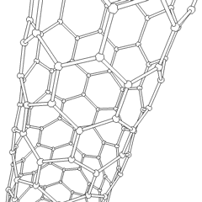
What nanomaterials are found in construction?
Question One
Photo courtesy PNNL/DOE
Notes:
Trainer Notes:

Slide 4
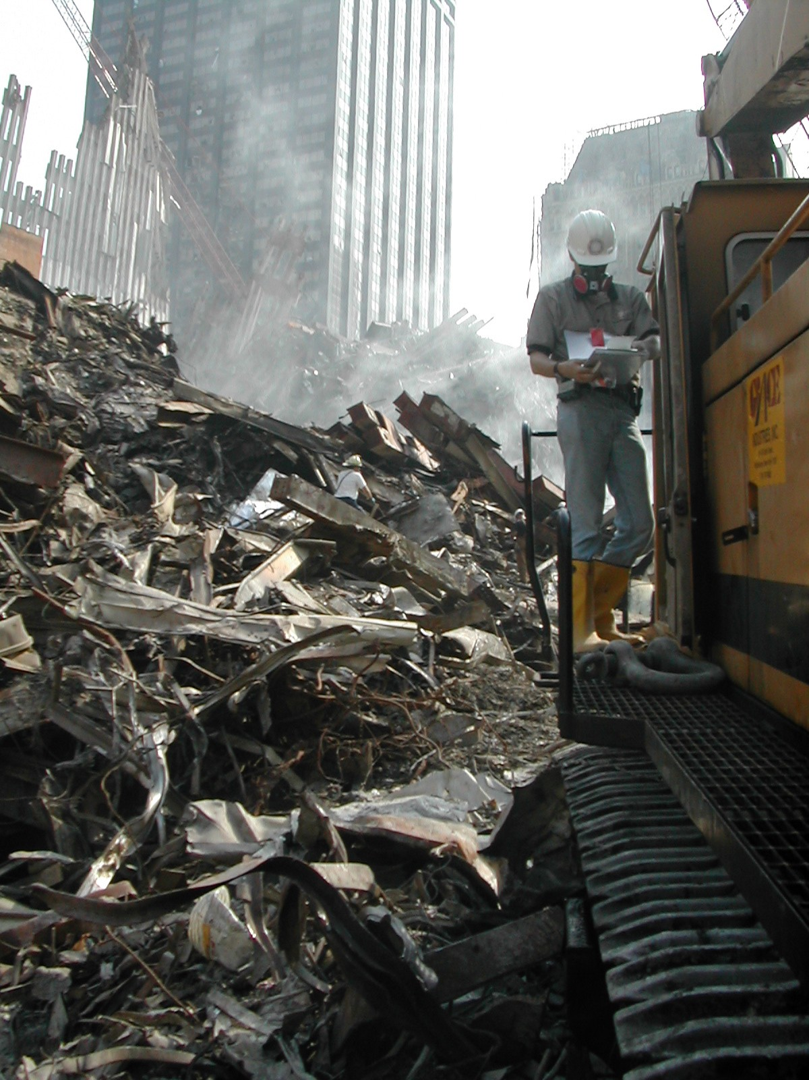
A recent study found carbon nanotubes in the airborne particles at Ground Zero
This presentation is focused on engineered nanoparticles

Slide 5
There are many promising applications in construction, but limited commercialization at this point
ENP | Construction materials | Benefits
Carbon nanotubes | Concrete | Mechanical durability; crack prevention
SiO₂ | Concrete | Reinforcement in mechanical strength
TiO₂ | Cement | Rapid hydration; self-cleaning; pollution reduction
Fe₂O₃ | Concrete | Increased compressive strength; abrasion-resistant; stress monitoring
Ag | Coating/painting | Biocidal activity
Lee, Mahendra & Alvarez (2010)

Slide 6
“Cost and the relatively small number of practical applications, for now, hold back much of the prospects for nanotechnology.”
Nanoforum Report: Nanotechnology and Construction, November 2006

Slide 7
There is more activity in Europe, mostly in coatings, cement and concrete
94 available products identified
reduced weight of concrete with silica fume*
increased strength and elasticity of concrete
improved weathering of exterior surfaces
biocidal surfaces for walls of surgery rooms
*Aggregate of amorphous SiO₂ nanoparticles
Broekhuizen et al. 2011

Slide 8

These tiles contain nano-titanium dioxide
We would like to test exposures

Slide 9
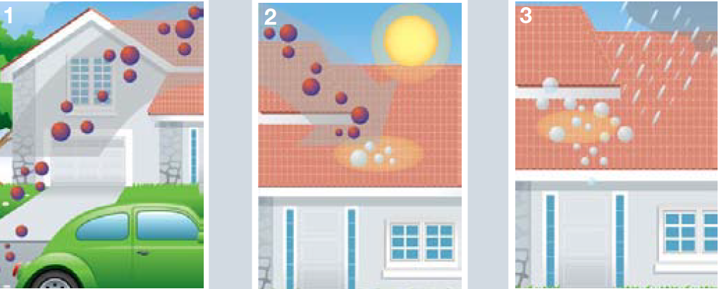
One roof can oxidize NO₂ from 10,800 miles of driving, according to the manufacturer

Slide 10
Emaco NanoCrete patching compounds does not contain nanoparticles.
From the manufacturer: “Nanotechnology does NOT mean nano-sized particles: We do not use any nano-particles in our cement formulations.”
Photos courtesy Emaco

Slide 11
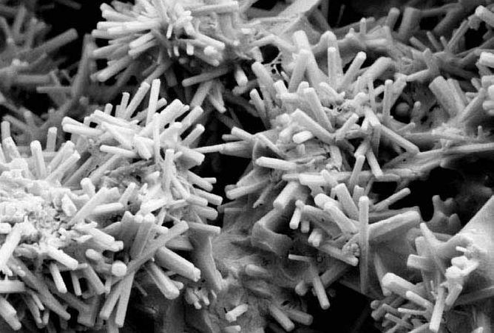
These hydrated silicates are nano-structured; they have nano-sized holes

Slide 12
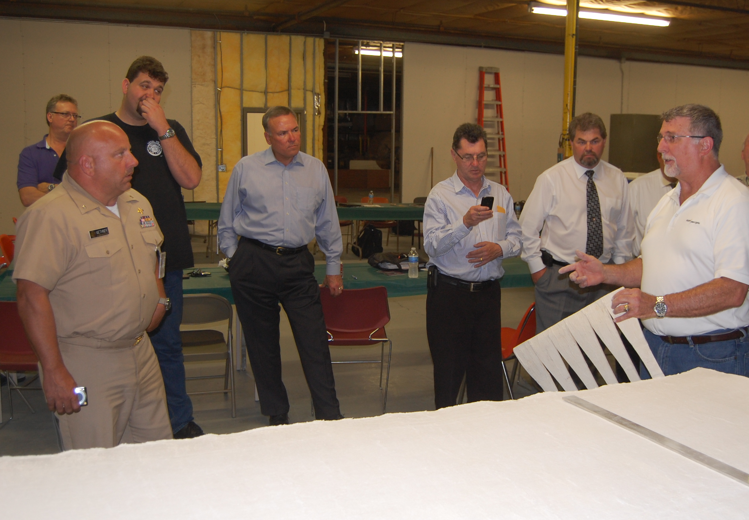
NIOSH has begun an HHE looking at Aspen Aerogel insulation, another nanostructured product
Mark Methner, NIOSH

Slide 13
What do we know about exposure to engineered nanoparticles in construction?
Question Two
Photo courtesy PNNL/DOE
Notes:
Trainer Notes:

Slide 14
Not much!

Slide 15
We know construction workers may be at risk
“Inhalation of manufactured nanomaterials during coating, molding, compounding, and incorporation can pose a respiratory health risk to workers.”
Lee, J., Mahendra, S. & Alvarez P.J. (2010, July).

Slide 16

We do have corroborating data on ultrafine exposures showing respiratory issues
Apprentice from UA Mechanical Trades School in Landover, MD, 9/12
Photo courtesy eLCOSH

Slide 17
Sampling was conducted onsite for several real processes in 2009
(Broekhuizen et al, 2011)
Mixing Nanocrete mortar
Applying spray-on TiO₂ coating onto glass

Slide 18
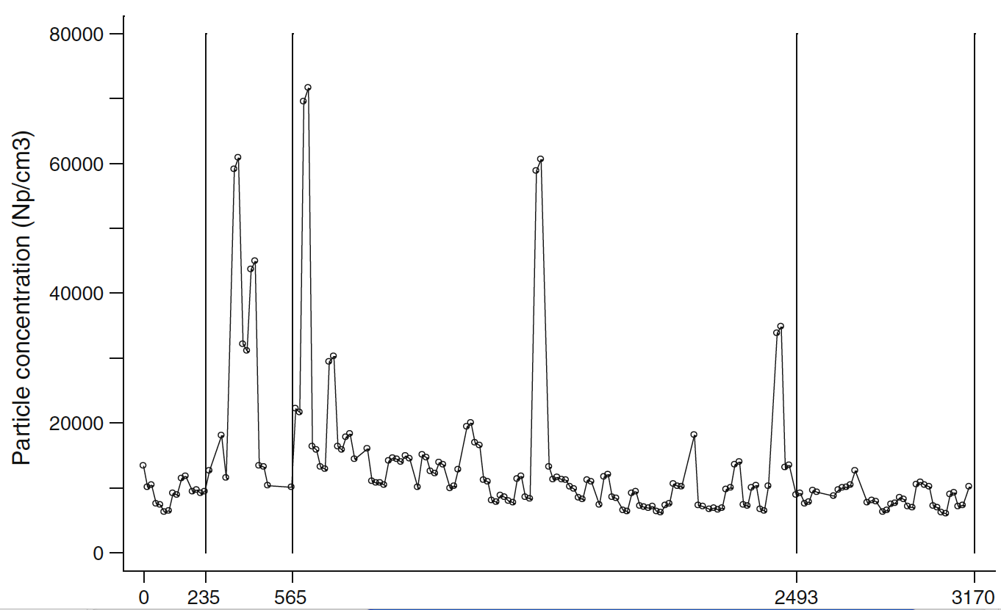
Particle sampling during mixing of 6 bags of Nanocrete mortar (Broekhuizen et al, 2011)
Smoking
Mixing
Time (sec)
“Workplace measurements suggest a modest exposure of construction workers to nanoparticles (NPs) associated with the use of nanoproducts.”

Slide 19

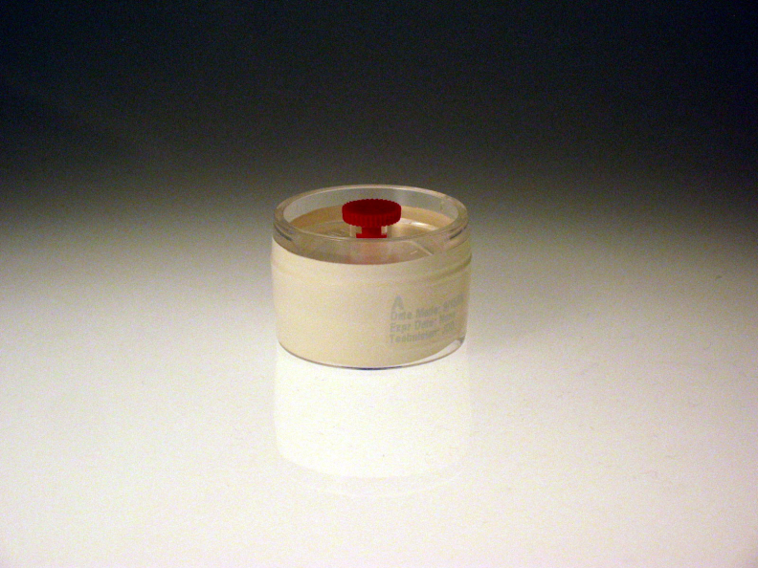
NIOSH chose mass-based REL over counting with electron microscopy
NIOSH Method 5040
Counting protocols haven’t been developed, although ASTM committee is close
REL of 7 µg/m3 elemental carbon (EC) as an 8-hr TWA
37-mm
quartz-fiber filter

Slide 20
Nanoparticles Have Almost No Mass
Edge of a single 10 micron particle
Relative size of 10 nanometer particles for comparison
A 10 μm particle weighs the same as one billion 10 nm particles
Courtesy Larry Gibbs
Notes:
Trainer Notes:
[The entire point of this graphic is to demonstrate that nanoparticles have almost no mass.]
A 10 μm particle weighs the same as one billion 10 nm particles

Slide 21
Large particles bias mass measurements
Standard
37-mm filter cassette
If you’re carrying a grocery bag full of cantaloupes, you’re not going to notice a handful of grapes
Courtesy L. Gibbs
Notes:
Trainer Notes:
Large particles bias mass measurements

Slide 22
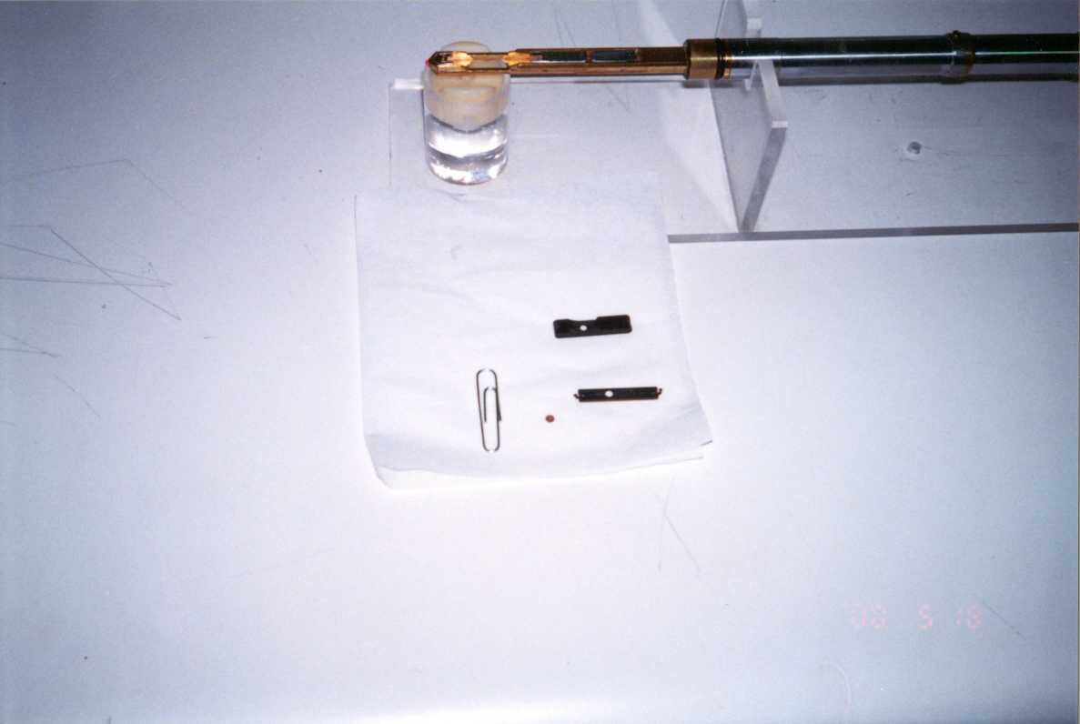
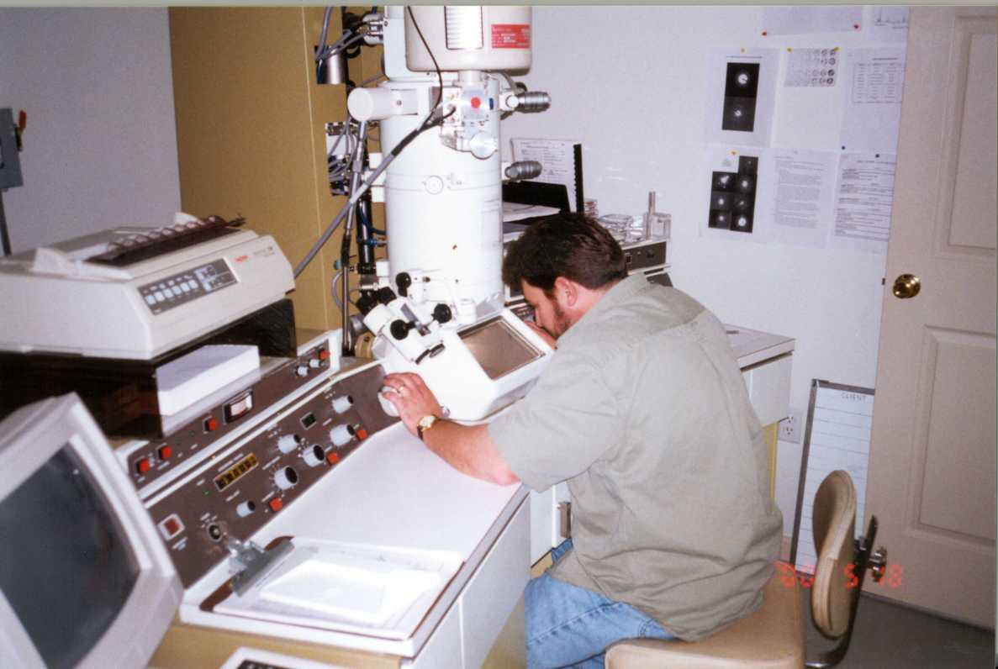
Transmission electron microscopy is the gold standard and will be used in CPWR’s work
Grid inserted into holder
Grid with sample
Notes:
Trainer Notes:
Transmission electron microscopy methods resemble asbestos analysis.
[Make the point of indicating how small the TEM grid that holds the sample. It is helpful for those familiar with phase contrast microscopy to see how much smaller the section of filter is that gets onto the grid compared with the pie wedge that is cut out and mounted on a standard glass slide for PCM.]

Slide 23
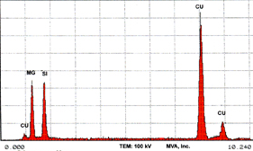
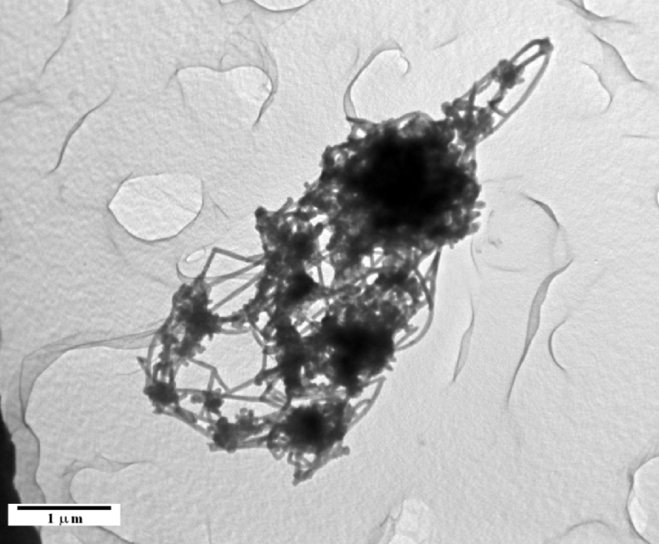
TEM allows several measurements
Shape
Chemical composition
Particle count
Particle length and diameter
EDS
NIOSH image of MWCNT
Notes:
Trainer Notes:
TEM allows several measurements:
Morphology
EDS (EDXA) for chemical composition
Particle count
Particle length and diameter
[Point out that this is the strength of TEM: you can see the shape of the particles to compare to the raw stock, you can use the electron beam to generate x-rays that are characteristic for each element thus identifying the chemical composition, you can count particles (as long as you have counting rules) and you can measure the particles length and diameter. For a tube, with a measured length and diameter, you can determine volume and choose a density to calculate mass.]

Slide 24
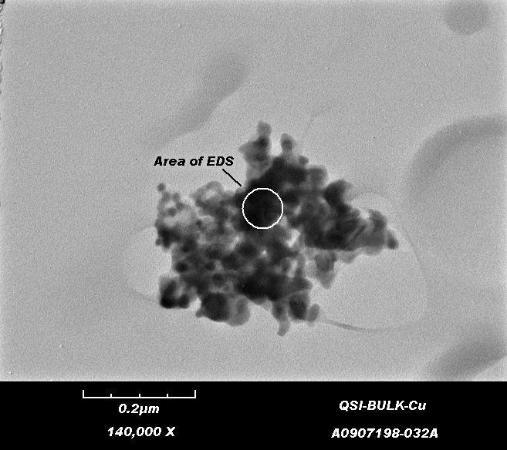
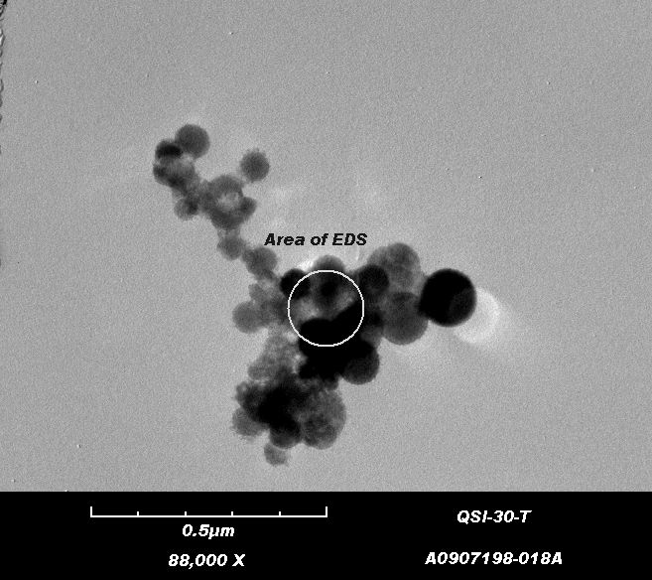
You do the analysis: Do these particles appear similar?
✔
Yes
No
Bulk product sample
Air sample
Notes:
Trainer Notes:
NIOSH analysis of metal reactor cleanout provides good example of EM capabilities
[Use a laser pointer to illustrate how focused the beam of a TEM is to perform Energy Dispersive analysis of the materials to determine its elemental composition. Production of many nanomaterials requires metal catalysts and EDS analysis will show that as a peak.]

Slide 25

How are the hazards being communicated to workers?
Question Three
Photo courtesy eLCOSH
Photo courtesy PNNL/DOE
Notes:
Trainer Notes:

Slide 26
“80% of the workers’ reps and 71% of the employers’ representatives were not aware of the availability of nanomaterials and were ignorant as to whether they actually use nanomaterials at their workplace.”
2009 Survey response from 28 construction workers and employers in Europe (N = 144)
Broekhuizen et al. 2011
Notes:
“80% of the workers’ reps and 71% of the employers’ representatives were not aware of the availability of nanomaterials and were ignorant as to whether they actually use nanomaterials at their workplace.”Part of the inventory was a questionnaire set out by the FIEC and the EFBWW among their members in 24 European countries (hereafter called the 2009-survey). A strategic selection of 144 well-informed FIEC and EFBWW contact persons in the Member States resulted in 28 completed questionnaires from 14 European countries. Completeness was not pursued, as this would require a much more elaborate approach. by in-depth interviewing of construction employers and workers, architects, raw material, and product manufacturers as well as R&D scientists, in total ca 45 interviewees from Western European countries and 5 from the USA and Canada.

Slide 27
We haven’t been doing a great job communicating the hazards of standard industrial chemicals
Hazard Communication: A Review of the Science Underpinning the Art of Communication for Health and Safety
Sattler, Lippy & Jordan, May, 1997

Slide 28
Sattler, Lippy & Jordan1997 review of hazcom literature for OSHA was the only one for a decade
University of Maryland contract with OSHA. Report at: www.osha.gov
Accuracy of technical information was a problem
Most studies were based on reported preferences, not behaviors
Populations studied were students not workers
Notes:
One expert panel review established that only 11% of the MSDSs were found to be accurate in all of the following four areas: health effects, first aid, personal protective equipment, and exposure limits. Further, the health effects data on the MSDSs frequently are incomplete and the chronic data are often incorrect or less complete than the acute data.
Kolp, P.W.; Williams, P.L.; and Burtan, R.C. 1995. Assessment of the Accuracy of Material Safety Data Sheets. Journal of the American Industrial Hygiene Association 56:178-183.

Slide 29
Comprehensibility of MSDSs was not good
Literate workers only understood 60% of the health and safety information on sample MSDSs in three different comprehensibility studies:
  Printing Industries of America, 1990
  Kolp, Sattler, Blayney, Sherwood, 1993. Am. J. Ind. Med
  Phillips, 1998
Notes:
On average, literate workers only understood about 60% of the health and safety information on sample MSDSs in three different comprehensibility studies This percentage was remarkably similar across the studies. study was reported in 1990, by the Printing Industries of America (PIA, 1990). The study involved the comprehensibility of MSDS to Master Printers, who had an average of 13.9 years of formal education, or approximately two years beyond high school. In this study, 27 MSDS were selected and analyzed for reading levels using a software program, finding the average reading grade level of 14. The investigators found that employees with 15 years of education or more understood only 66.2%. Based on these results, it was suggested that years of formal education does not significantly increase comprehension of MSDS.
At the time, the PIA made the suggestion that a standardized format be used for MSDS, as well as standardized color-coded sections for easier access to emergency information, and standardized signs and symbols for vital information. They further suggested that MSDS be produced in other languages (this is not required by OSHA) and be written at a reading level no higher than twelfth grade.
Kolp, P.; Sattler, B.; Blayney, M.; Sherwood, T. 1993. Comprehensibility of Material Safety Data Sheets. American Journal of Industrial Medicine (23)1:135-141. This was based on the doctoral research of Barb Sattler and tested workers ability to find and comprehend information in MSDSs.

Slide 30
Findings from a newer review of the literature did not show improvements
Category | Findings
Accuracy and completeness | “Relatively poor”
Awareness and use | “Suboptimal in workplaces studied”
Comprehensibility | “Poor presentation and complex language…low comprehensibility”
Nicol et al. 2008, Am. J. Ind Medicine
Notes:
Accuracy, comprehensibility, and use of material safety data sheets: A reviewAnne-Marie Nicol, PhD *, A. Christie Hurrell, MA, Desy Wahyuni, MLIS, William McDowall, MSc, Winnie Chu, PhDCentre for Health and Environment Research, University of British Columbia, Vancouver, British Columbia, Canada
email: Anne-Marie Nicol (anicol@interchange.ubc.ca)*Correspondence to Anne-Marie Nicol, 3rd Floor, 2206 East Mall, Vancouver, British Columbia, Canada V6T 1Z3.
This article describes a review of the peer-reviewed scientific literature regarding the accuracy, comprehensibility and use of MSDSs in the workplace.
MethodsArticles were retrieved via a systematic search of indexes and databases, followed by hand searching and citation index searching. Two reviewers independently read and coded the articles using an iterative matrix.
ResultsOf the 280 unique articles retrieved, 24 fit the review criteria. Eligible articles included a range of methodologies: laboratory analyses, site audits, surveys and qualitative inquiry. Articles were grouped into three main topic categories: accuracy and completeness, awareness and use, and comprehensibility. Accuracy and completeness were found to be relatively poor, with the majority of studies presenting evidence that the MSDSs under review did not contain information on all the chemicals present, including those known to be serious sensitizers or carcinogens. Poor presentation and complex language were consistently associated with low comprehensibility among workers. Awareness and use of MSDSs was suboptimal in workplaces where these factors were studied.
ConclusionsDespite the fact that these studies varied in methodology and spanned a period of more than 15 years, a number of common themes emerged regarding inaccuracies, incompleteness, incomprehensibility and overall low use of MSDSs. The results of the literature review suggest that there are serious problems with the use of MSDSs as hazard communication tools. The article concludes with recommendations for governments, regulatory bodies, and occupational health and safety personnel to seriously reassess the ways in which MSDSs are written, monitored, regulated, and used.

Slide 31
Lippy Group reviewed NIOSH collection of nano MSDSs
N = 49 MSDSs
Reviewed all of the MSDSs
33% did NOT identify the nano component
52% did NOT have any cautionary language
  Large surface area in relation to particle size enhance physical and chemical properties (nanosilver)

Slide 32
Most (62%) just referenced PELs and TLVs for the macro size
32% percent indicated nothing
Only 6% used cautionary language about using PELs/TLVs

Slide 33
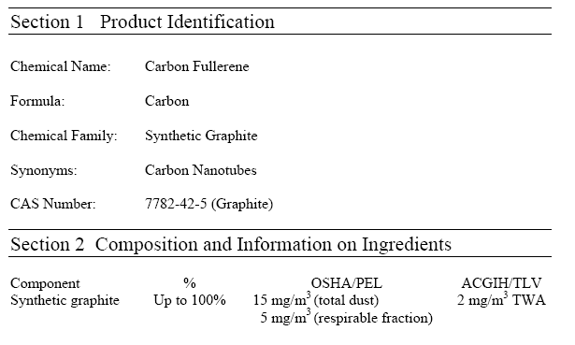
MSDS for Carbon Nanotube
“Nuisance” dust standard for synthetic graphite:
15 mg/m³ total
5 mg/m³ resp

Slide 34
The GHS changes will be a big improvement, but OSHA can do more using the existing SDS format
ANSI Section 16 “Other Information” is the key.
Useful risk information about nanoparticles can be included in Section 16.
OSHA could create an eTool helping SDS developers with the appropriate language

Slide 35

What is CPWR planning to do about nanomaterials as the NIOSH-funded National Construction Center?
Question Four
Photo courtesy PNNL/DOE
Notes:
Trainer Notes:

Slide 36
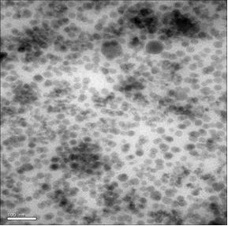
Two CPWR Initiatives
Identify specific construction-related products and create an inventory
Nano-phase silica-filled epoxy adhesive SEM image (scale bar = 100 nm)

Slide 37



Wilson Center has 1317 products, produced by 587 companies located in 30 countries (03-10-11)
Notes:
Trainer Notes:
This is the most complete database of consumer products. The criterion they used:
1) Readily purchased by consumers
2) Identified as nano-based by the manufacturer OR another source, and
3) The nano-based claims for the product appear reasonable.
As of 3-10-11, there were 1,317 products in this database.

Slide 38
The Europeans have created an inventory of construction products
FIEC represents construction employer organizations in 29 countries
EFBWW represents 75 affiliated construction unions in 31 countries and represents a total of 2,350,000 members
Broekhuizen et all. 2011

Slide 39
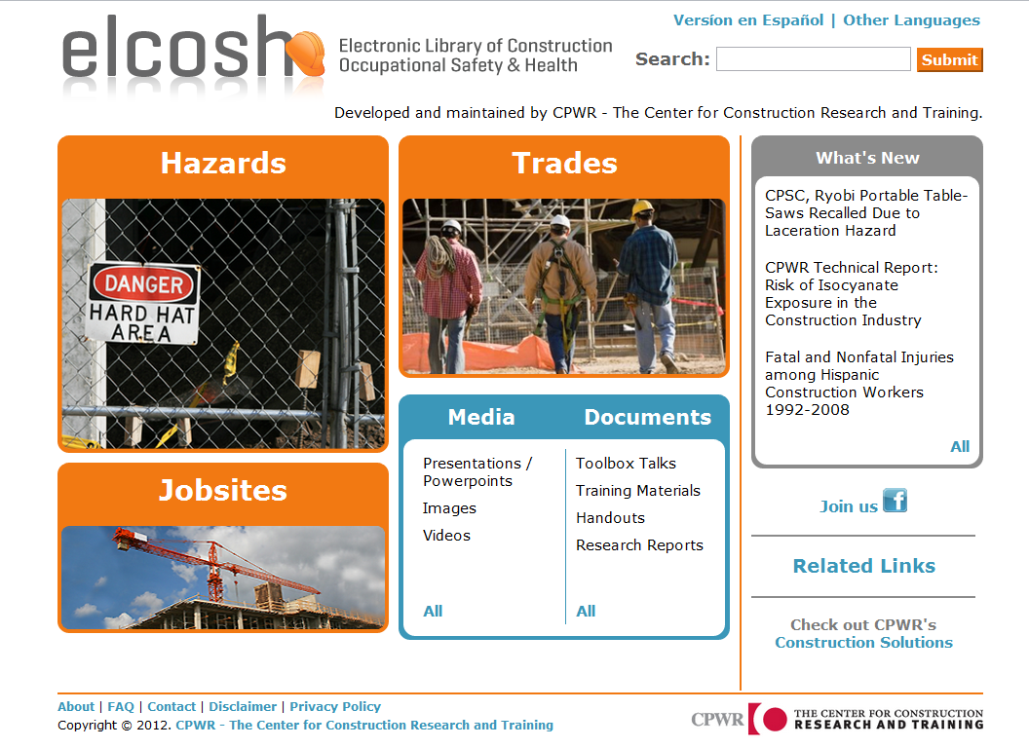
Newly revised site for nano!
Notes:
Trainer Notes:

Slide 40
Second CPWR Initiative
Identify specific construction-related products and create a registry
Identify applicable control technologies currently in the CPWR Construction Solutions database and measure their effectiveness with nanoparticles

Slide 41

Will these control nanoparticles in construction?
Airtec Jet-Rotary Hand-Held Concrete Milling Machines
Pentek Air-Powered COMPACT-VAC High Performance HEPA Vacuum

Slide 42
Conventional controls should work with nano
Courtesy NIOSH
Notes:
Trainer Notes:
This graphic from NIOSH shows that 1 nanometer-sized particles are captured with local exhaust ventilation, primarily through diffusion. Explain that with particles that are in the micro scale, the forces of inertia may keep them from following the air stream as it turns to go towards the hood.

Slide 43
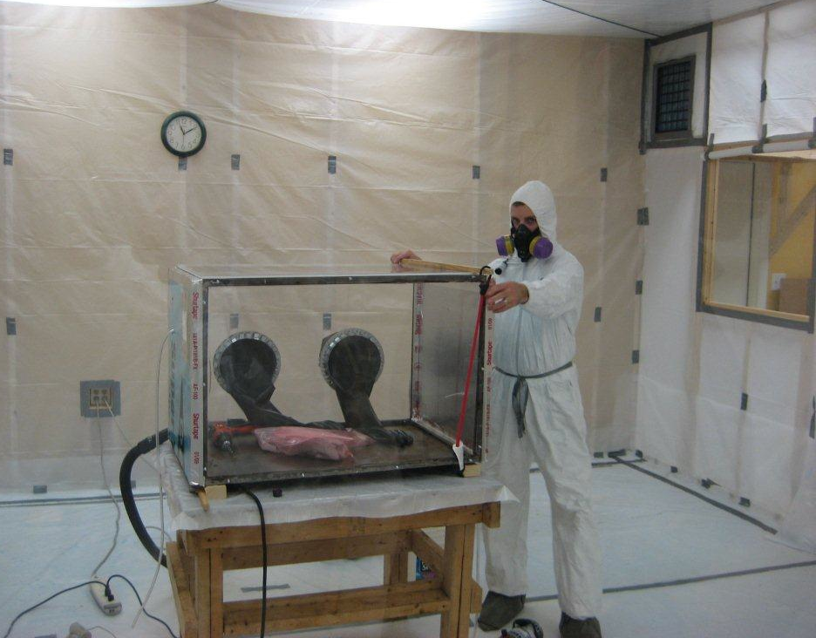
CPWR will be working with a firm called EPI Services that has a test chamber
Controlled area where construction products will be tested. Photo courtesy EPI Services, Inc.
Notes:
Trainer Notes:
Gloveboxes are a type of containment that can contain work with raw nanoparticles. Point out the 25 mm cassette pulling air inside the box to determine how much gets airborne.

Slide 44

Along with its own website and distribution system, CPWR will work with other organizations including yours
http://GoodNanoGuide.org
Notes:
44
Administrator
ICON
Faciltators
Matthew Jaffe (C&M)
Kristen Kulinowski (Rice U)
Chairs
Bruce Stockmeier (Argonne Nat’l Lab)
Michael Riediker (Institute for Work and Health, Switzerland)
Planning Team
Crowell & Moring, LLP
Nanotech BC
NIOSH
U Wisc NSEC
U Mass Amherst NSEC
ILO
IOM (UK)
RTI
Evonik DeGussa
Nanotech Industries Assoc (UK)
Boeing

Slide 45
Questions? for more info contact:
Bruce Lippy, Ph.D., CIH, CSP
Director of Safety Research blippy@cpwr.com
301-578-8500
410-916-0359 cell www.cpwr.com www.elcosh.org
Notes:
Trainer Notes:
Try us out! Go to our site: http://www.elcosh.org or contact our Project Manager, Bruce Lippy:
Office: 301-578-8500
Cell: 410-916-0359

